Slide 1

BLAST Best-Hit Algorithm

Slide 2
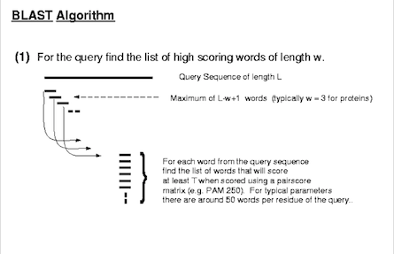
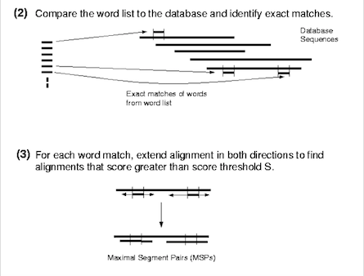
Quick Overview of BLAST

Slide 3
Why use this program?
Customizable Inference – Algorithm tailors to your filtering weights and preferences
Fast - Process thousands of queries in less than a minute
Accurate – All results are generated from BLAST+, a certified NIH tool that guarantees inclusion of all possible matches
Consistent – Use of an algorithm ensures consistent logic is enforced across all query entries
Simple – Once everything is set up, you can run the program on many other datasets with ease

Slide 4
Outline of the Blast Best-Hit algorithm
Usage:
Python BLAST_BestHit.py –i results.txt –s <species>,…
Featured Arguments:
Species Preference – Can select multiple species that would each have a best match
Cutoffs – Identity, coverage, e-value
Filter Weighing – species over score (-c), status over score (-m)
Filter Selection – Ability to skip certain filters
Debug – Thorough, step-by-step description of filtration process for every input query
Species
Identity
+
Coverage
Bit Score
E-value
Review
Status
Ranking
Annotation
Top
Pick

Slide 5
Three Step Pipeline
makeblastdb
Database Creation: Download database online (uniprot recommended), mask with segmasker, and finalize with makeblastdb
BLAST+
Running BLAST+: Select your blast type, your arguments, and our specified output format and run the blast executable
BestHit
Run our algorithm on the .txt file generated above

Slide 6
LIVE DEMO

Slide 7
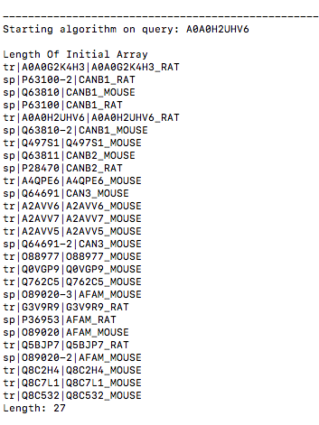
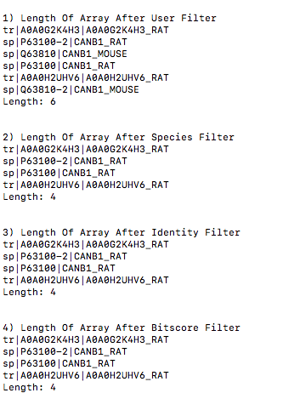
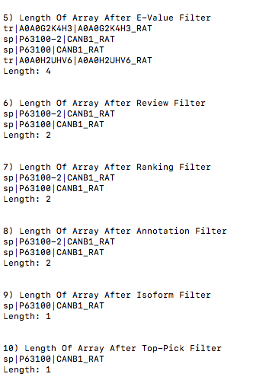
Walkthrough of Logging and Debugging

Slide 8
Example 1: How Blast Best-Hit deals with isoform calls
Input
Result (Isoform cannot be determined)
Input
Result (Isoform is determined)

Slide 9
Example 2: How Blast Best-Hit deals with multi-species choices
Input (with –s RAT,PIG)
Result (Default: Score over Species)
Result (with arg –c: Species over Score)

Slide 10
Example 3: How Blast Best-Hit deals with Review Status input
Input
Result (Default: Score over Status)
Result (with arg -m 1: Status over Score)

Slide 11
Example 4: How Blast Best-Hit deals with Scoring/Annotation
Input
Result
--------------------------------------------------------------------------------------------------------------------------------------------------------------------------------------
Input
Result

Slide 12
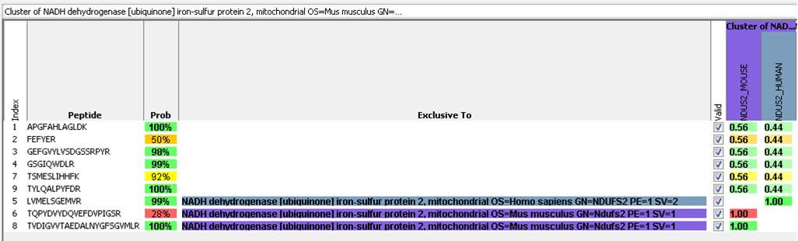
Peptide-Centric vs Protein Centric Grouping

Slide 13
Final Remarks
Applications
Future Directions
Customization allows program to tailor to many different mindsets
Confirming isoforms and peptides unique to a protein/species
Identifying peptides/proteins conserved across species
Allows annotation of unreviewed or uncharacterized proteins
Protein grouping/clustering Analysis
At the least, excellent for double-checking results from other protein identification programs
Add User-Friendly GUI that takes care of database creation and blast+ tools
Interweave into Optra for ease of access
Could be expanded to create characterized proteomes for species such as Pig, Rat etc.
Single-Amino acid polymorphisms between species could be assessed along with MS evidence

