Slide 1

Privacy in data stream
ρ-uncertainty: Transaction Anonymization

Slide 2
El problema *common mistake- writing “La problema”
In data mining, data such as purchased goods, query terms, or individual preferences, is instrumental for some applications. Still, their publication poses privacy threats. A particular threat is posed by an adversary who has partial knowledge about a certain person’s transaction t, and may use it, along with the published data, to derive additional knowledge about the contents of t, thus identifying previously unknown sensitive items in t. Therefore, there is high importance for privacy preservation in data mining.

Slide 3


The $"ρ$-uncertainty” concept
$ρ$-uncertainty is the concept of maintaining the confidence of each SAR lower than a threshold ρ.
*SAR- sensitive assosiation rule

Slide 4
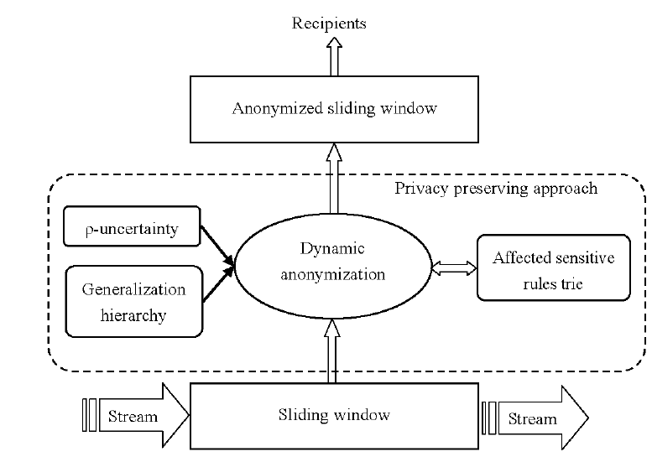
But what does it have to do with data stream?
In our project we will implement an algorithm for data preserving for data streams, meaning a non-static database. We will use a sliding window method. A sliding window is a data structure which has two fields: size and step.

Slide 5




La solución
In our algorithm we will change each window in a manner that will prevent the mining of SARs that violates $ρ$-uncertainty.
We will do so by using suppression- deleting items from the window.
Idealy, in each step of the window we would like to consider Wadd and Wdel so that we wouldn’t check irellevant SARs (SARs that surely won’t violate $ρ$-uncertainty).
Unfortunately, the article was too damn hard to comprehend, so we use the same static algorithm on each window.

Slide 6

Relevant terms
$SR_{i}$ - Set of SARs with |antecedents|= i that violates $ρ$-uncertainty.
C(item, $SR_{i}$) – number of rules in $SR_{i}$ that contain item (either in their antecedents or in their consequents)
PAYOFF($SR_{i}$, item) = $\frac{C(item,SR_{i})}{sup⁡(item)} .$ Expresses the amount of SARs concealed per unit of lost information. Hence, higher payoff is perferable for suppression.

Slide 7

Algorithm psuedo code
Initialize i=1;
Initialize loss=0;
While true do
SR′i ={χ→α| α∈$sensitive_items$,|χ|=i};
if SR′i = ∅ then break;
SRi ={r| r∈SR′I , conf(r)≥ρ};
while SRi $≠$ ∅ do
Find the item b of maximum payoff(i, b);
Suppress b;
Delete all rules in SRi containing b;
loss = loss + sup(b);
i = i + 1;
Return loss;

Slide 8
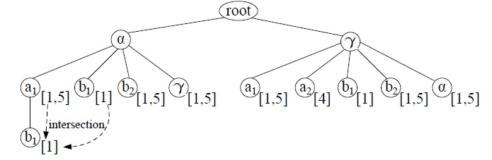

implemantation
Mining potential SARs for $S{R′}_{i}$
Creating the rules tree
Going through all paths of length I
Creating $SR_{i}$ by filtering out the SARs which does not violate $ρ$-uncertainty from $S{R′}_{i}$
Until $SR_{i}$ is empty, supress the item with maximum payoff by deleting it from the current window and deleting all SARs in $SR_{i}$containing it.
Running Apriori algorithm on current window

Slide 9

Los resultados
We ran the algorithm with the following parameters:
Window size: 200
Step: 80
$ρ$: 0.5
Min confidence: 0.5, min support: 0.1
Sensitive fields: ["Income", "Marital_Status", "Education"]
We will see 4 aspects of results:
Associations rules before and after the suppression.
Number of legitimate rules deleted – rules that are not violating $ρ$-uncertainty.
Information loss- we’ll compare between loss while choosing item with MAX payoff, and MIN payoff. The less loss the better.
Windows – the difference between each window.

Slide 10
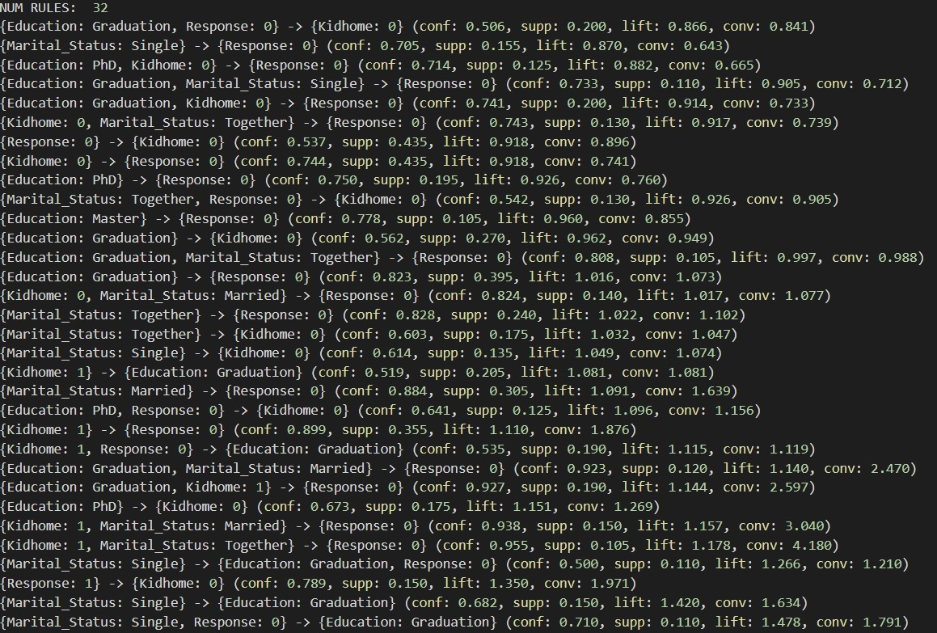
Associations rules before suppression 32 rules

Slide 11
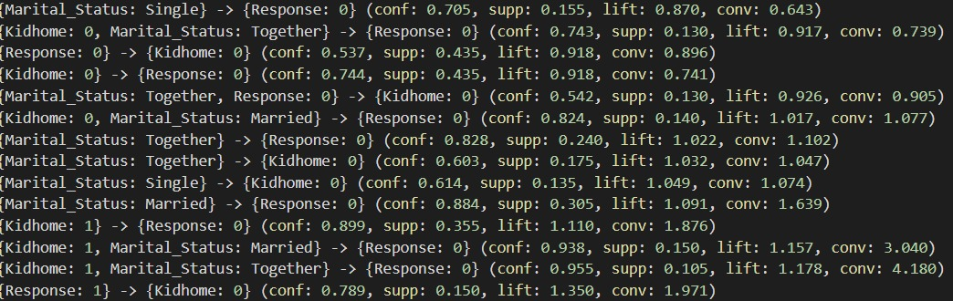
Associations rules after suppression 14 rules

Slide 12
Number of legitimate rules deleted
Regarding the first window, out of 32 association rules, 27 are Non-sensitive, and 5 are Sensitive.
After suppression, out of 14 association rules, all of them are legitimate, meaning we deleted 5 illegitimate rules(Sensitives) and 13 legitimate rules.
This deletion is a necessary loss while suppressing items.

Slide 13
Information loss
On each window we ran the algorithm once while choosing max payoff and once while choosing min payoff. We’ll call the information loss while choosing max payoff max_loss, and the information loss while choosing min payoff min_loss. Here are the results for the first few windows:
Window 1: max_loss=634 , min_loss=1526
Window 2: max_loss=691 , min_loss=1556
Window 3: max_loss=689 , min_loss=1369
Window 4: max_loss=717 , min_loss=1538
Window 5: max_loss=732 , min_loss=1343
As you can see there is a massive deficit between the two losses thus confirming the minimality of information loss whilst choosing max payoff.

Slide 14
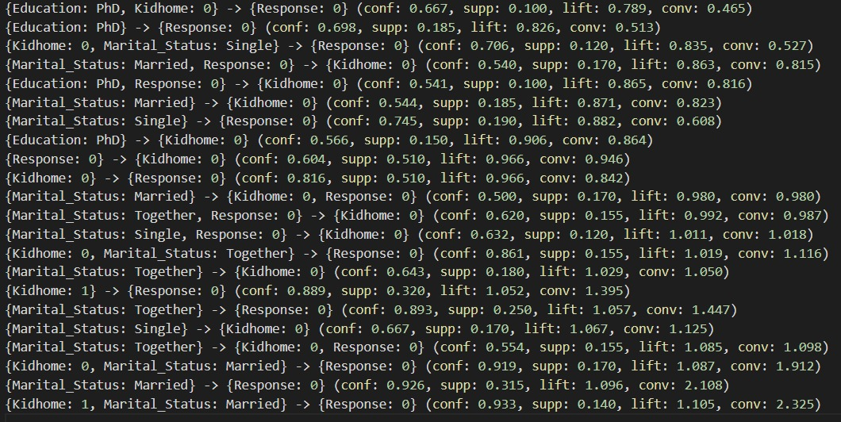
Differences between association rules in deifferent windows- after supression
First window:
14 rules
Second window:
22 rules

