Slide 1

בס"ד
Stop Falling
Start Calling

Slide 2
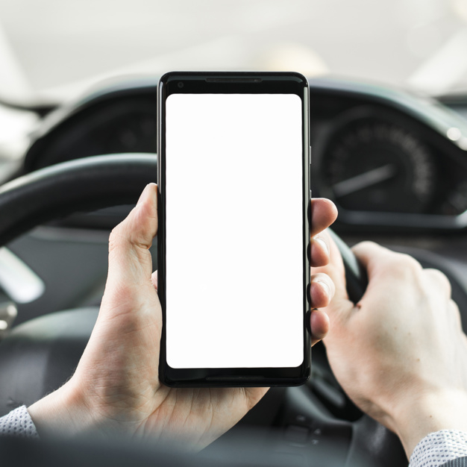
problems
- Driving with phone
- forgetting Grandma
- Call manager

Slide 3
PanCall will give:
Less car accidents
(saves life)
Better grandsons (healthy family)
💑
Calling available friends (saves time)
Social network friendly

Slide 4
Competitor Matrix
Real-Time
Facebook
PanCall
☺
Whatsapp
Callendar
Management

Slide 5
To be implemented
- Waze connectivity
- Smart recommender
- Date notifier
- Gamification

Slide 6
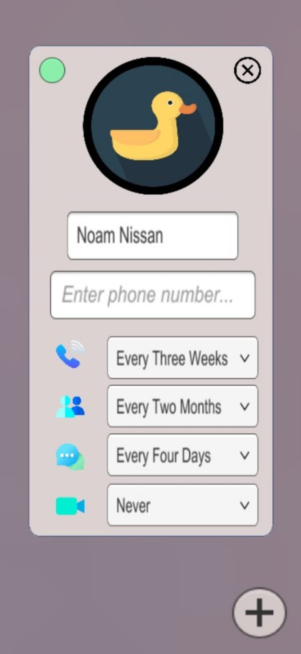
Thanks ☺

