Slide 1
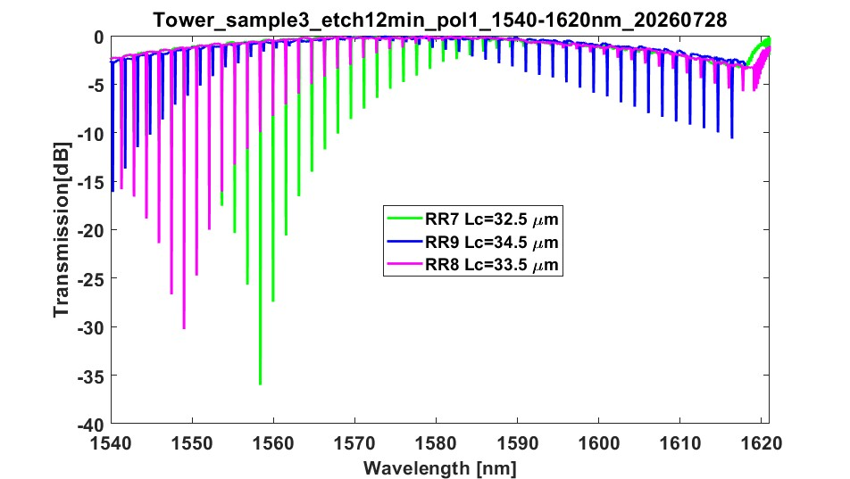

Slide 2
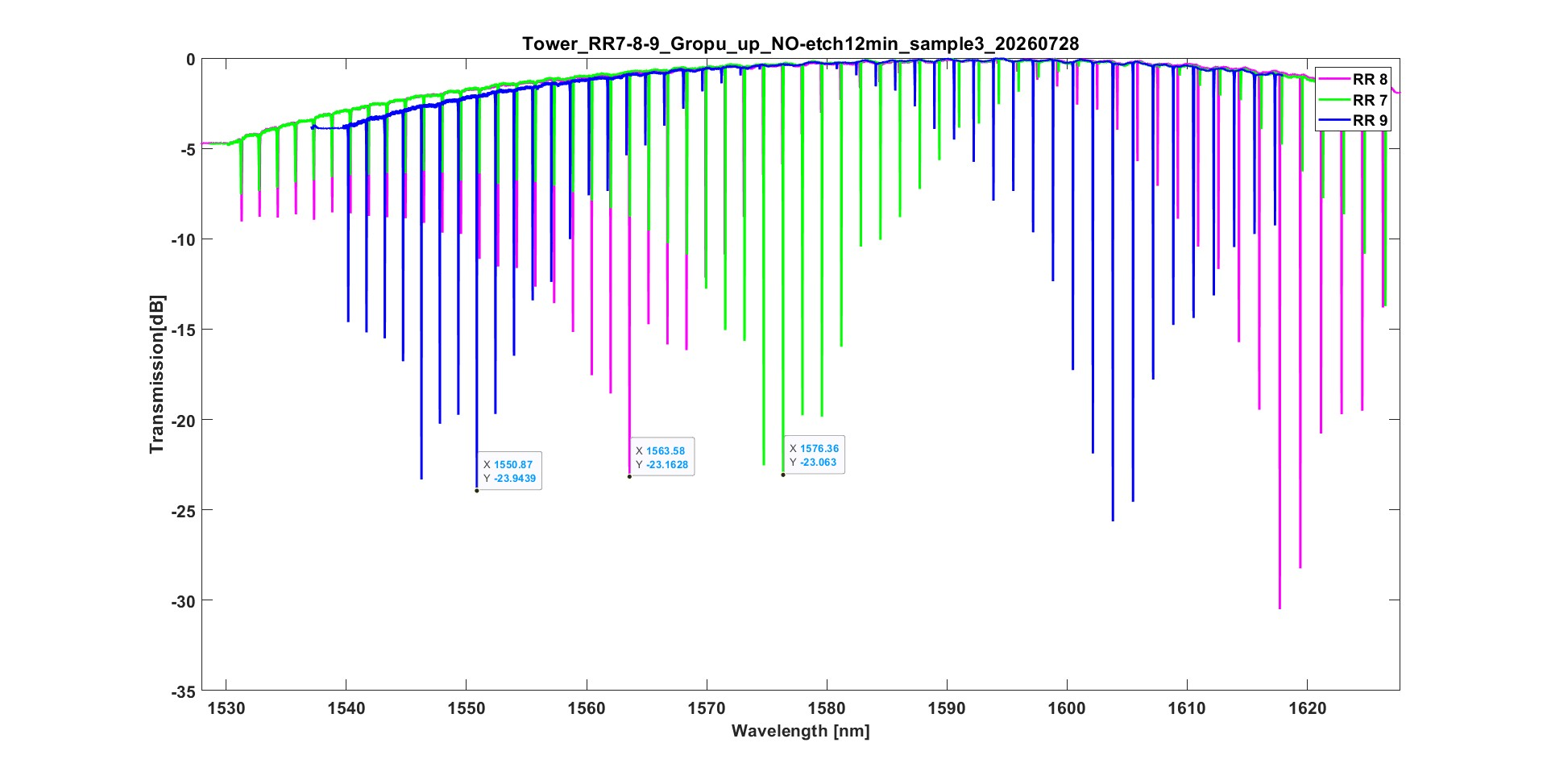

Slide 3
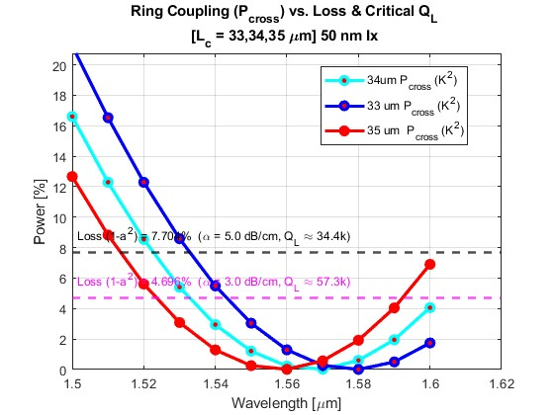
Simulation
V:\Projects\SiN Photonics\Simulation\matlab\Mode solver\Coupler Tower etch\50 nm Ox TE

Slide 4
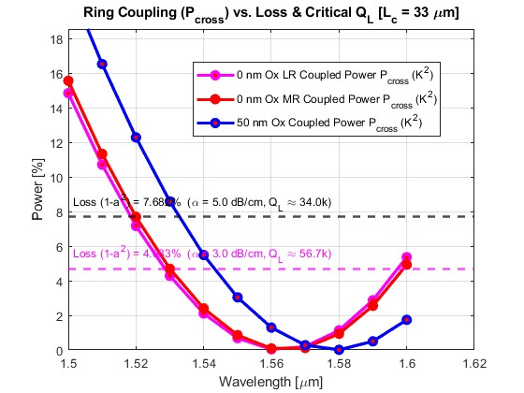
No clad at all vs 50 nm – small difference
Low resolution vs mid-res : similar
I did 50 nm

Slide 5
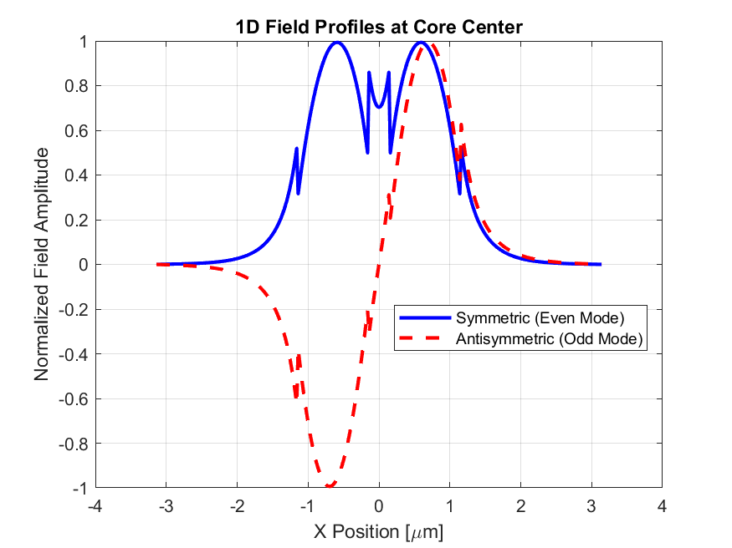
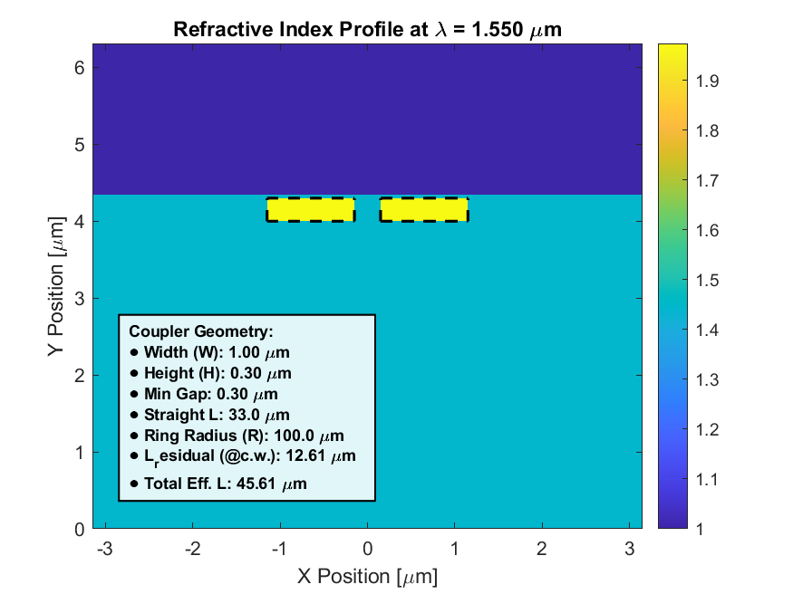
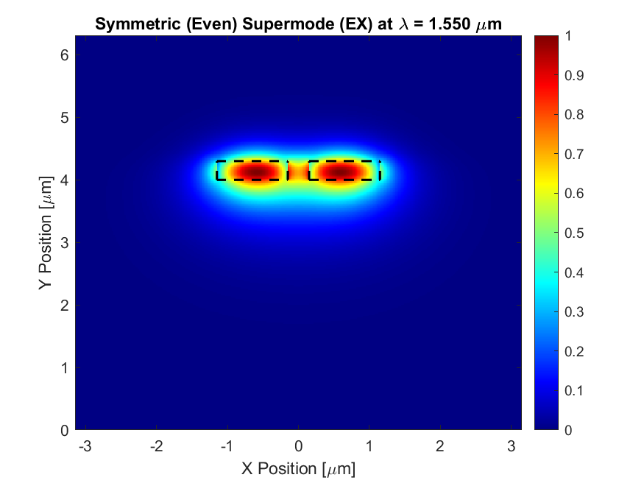
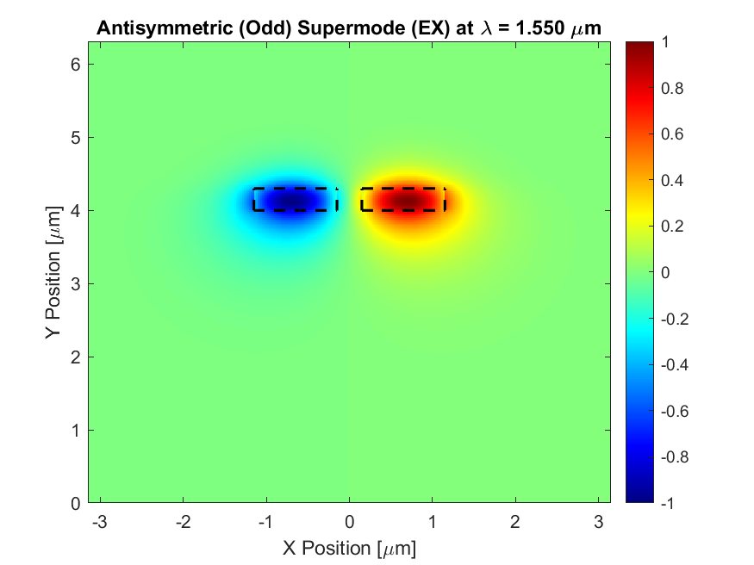
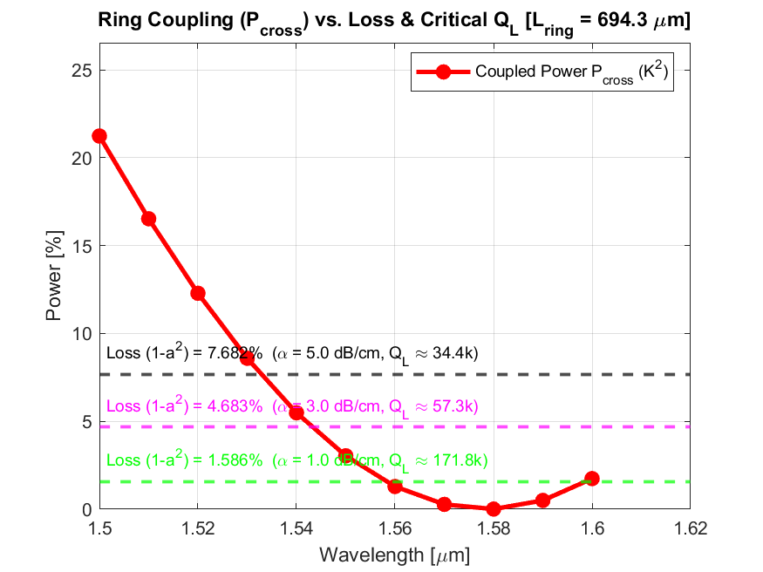
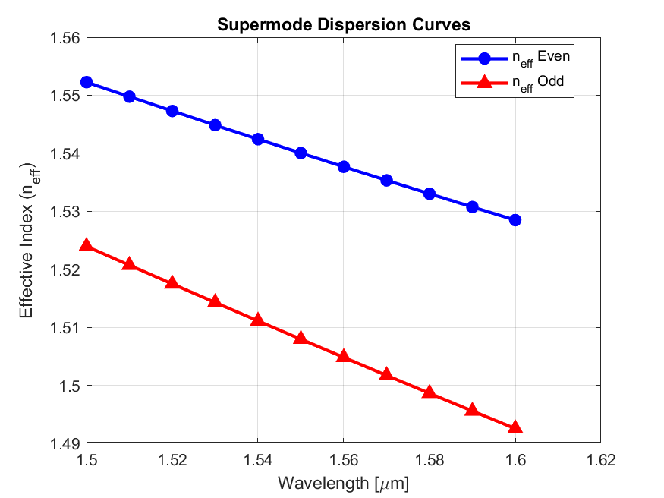
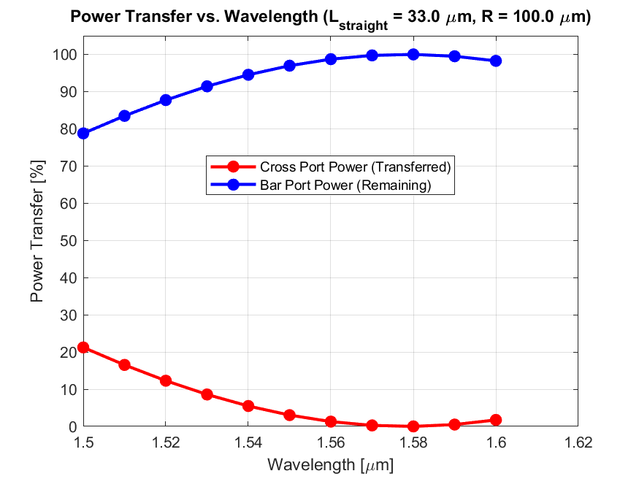
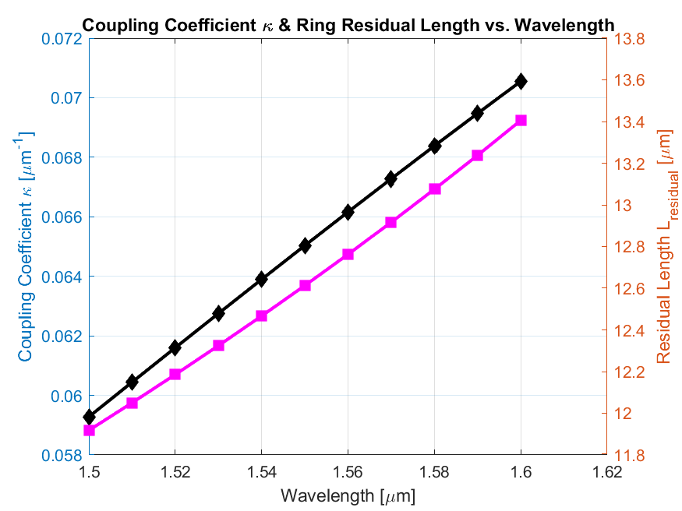
V:\Projects\SiN Photonics\Simulation\matlab\Mode solver\Coupler Tower etch\50 nm Ox TE\33 um

Slide 6
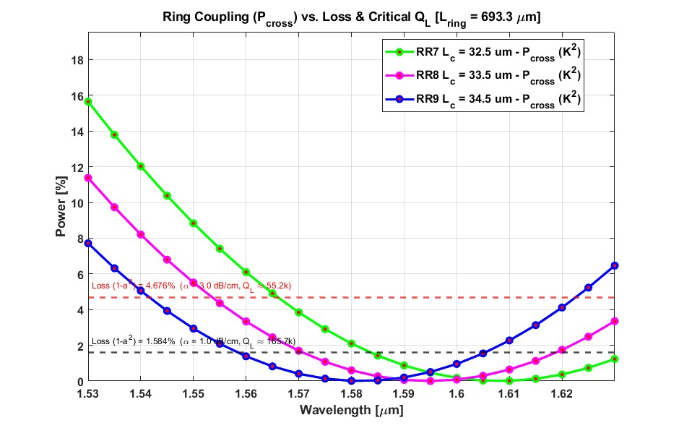
V:\Projects\SiN Photonics\Simulation\matlab\Mode solver\Coupler Tower etch\1000 nm Ox TE

Slide 7
