Slide 1
Lecture 1

Slide 2
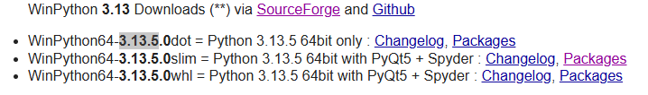
Step 1: Click to download

Slide 3
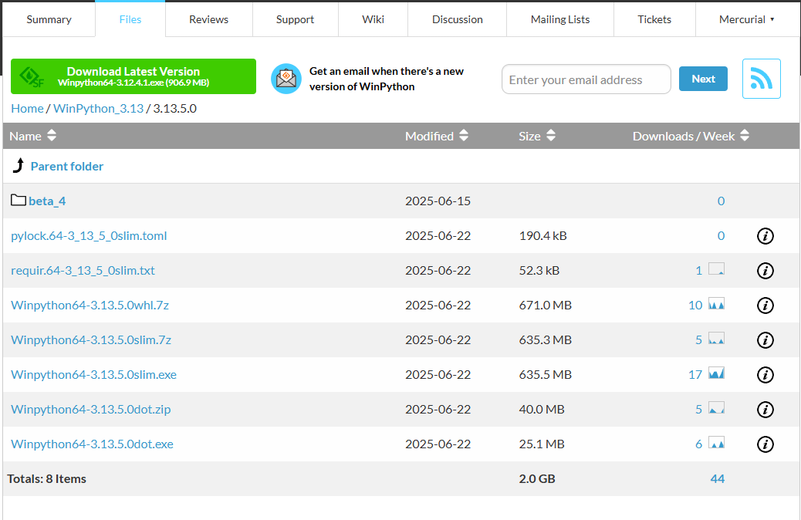
Step 2: Choose one of the followings.

Slide 4
Lecture 2

