Slide 1
Intro to Course
Machine Learning

Slide 2
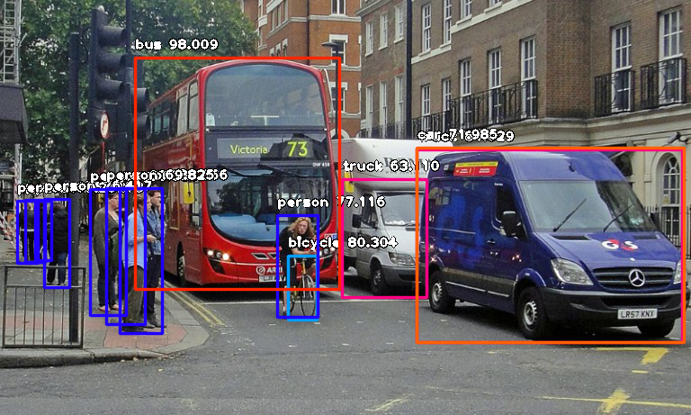
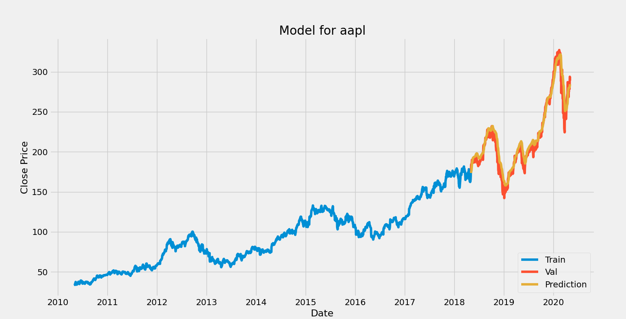

Slide 3
What is Machine Learning?
01
Goal of the Course
02
Table of Contents
04
Course Overview
Kaggle Overview
03
05
Jupyter Notebook & Google Colab Setup

Slide 4
01
What is Machine Learning?

Slide 5
Broad discussion of Machine Learning
Data
Machine Learning
Predictions, Patterns, and Actions

Slide 6
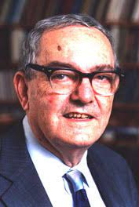
Why is ML Important?
Spreading to Every Industry
Anyone can learn
Fuels life-saving research
“...I don't believe that predicting the future is really what [machine learning is] about. We… are going to be a part of the future. So... our task isn't to predict it. It is to design it...”
Herb Simon
Notes:
"لا أعتقد أن التنبؤ بالمستقبل هو فعلياً ما يدور حول [تعلم الآلة]. نحن… سوف نكون جزءاً من المستقبل. لذلك… مهمتنا ليست التنبؤ به، بل تصميمه."

Slide 7
02
Goals of the course

Slide 8
Course outcomes:
Theory and Fundamentals
Practical Implementation
Build your first ML application/Submit your first competition

Slide 9
03
Kaggle Overview

Slide 10
What is Kaggle?
Most used platform for data scientists and ML enthusiasts
Features
Data Sets
Forums
Code sharing (“Kernels”)
Competitions

Slide 11
Kaggle Competitions
For novices learners or PhD’s alike to work on real world data and improve skills
Types of competitions
Novice Competitions
Prize Competitions
Often award $$$
Awards can be useful for internship / job applications
Competitions can be hard. Most people don’t end up finishing their first submission.

Slide 12
04
Course Overview

Slide 13
Course Overview:
1.1 - Python Review
1.2 - Numpy
1.3 - Pandas
1.4 - Seaborn
2.1 - ML Intro
2.2 - Linear Regression
2.3 - Logistic Regression
2.4 -Naïve Bayes Classifier
2.5 - KNN
2.6 - Decision Trees
3.1 – Ensembling Learning
3.2 - Neural Networks
4.* - Natural Language Processing (NLP)
5.* Competition Tips & Final Thoughts

Slide 14
Course Overview:
1.1 - Python Review
1.2 - Numpy
1.3 - Pandas
1.4 - Seaborn
2.1 - ML Intro
2.2 - Linear Regression
2.3 - Logistic Regression
2.4 - K-NN
2.5 - Decision Trees
2.6 - Neural Networks
3.1 – Ensembling Learning
3.2 Competition Tips & Final Thoughts
4.* - Natural Language Processing (NLP)

Slide 15
05
Jupyter Notebook & Google Colab Setup

Slide 16
05
Installing Jupyter NB @ Local Win Machine
WinPython

Slide 17
Thank you!

