Slide 1

Automatic Image Captioning for Project Documentation at the ITE
Dr. Osama Hamed
Institute of Technology & Engineering (ITE)
Forschungszentrum Jülich
Germany

Slide 2
The Problem: Thousands of Unlabeled Archive Images
The Challenge
Why Image Captioning?
At the ITE, Forschungszentrum Jülich, years of engagement in research projects. This have produced thousands of unlabeled images.
Manually captioning them is time-consuming and resource-intensive for humans — but not for AI.
Image captioning (IC) automatically generates natural language descriptions for images. It combines Computer Vision (CV) and Natural Language Processing (NLP), with applications in accessibility, image search, and institutional documentation workflows.
Our Approach
We leverage small, locally deployed Vision-Language Models (VLMs) — requiring no API key — to automate captioning for historical project images in a secure, cost-aware setting.

Slide 3

Background: From Deep Learning to Vision-Language Models
Classical IC
Template- and retrieval-based approaches, later replaced by CNN + RNN encoder-decoder architectures with attention mechanisms.
Transformer Era
CLIP, BLIP-2, and Flamingo introduced large-scale vision-language pretraining, enabling strong cross-modal alignment and few-shot captioning.
Modern MLLMs
Instruction-tuned models like LLaVA achieve context-aware caption generation, but most remain computationally intensive and cloud-scale.
Local Deployment Gap
Compact models raise concerns about robustness on domain-specific imagery. Systematic benchmarking of lightweight VLMs is needed.

Slide 4
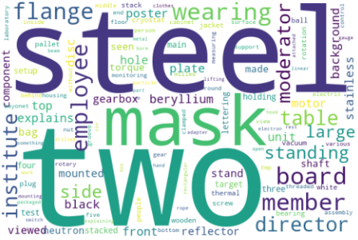
Experimental Setup: Dataset & Models
Dataset
A manually annotated set of 120 images from the Cryogenic Moderator System (CMS) project archive (2017–2020), organized into four categories:
Reflector,
Rotation Unit,
RU Montage,
Visits.
Human annotators wrote 1–2 sentence captions averaging 15.6 words. The dataset was split 67% training / 33% test for BLIP fine-tuning.

Slide 5
Experimental Setup: Dataset & Models
Tested Models
Moondream2 (1.8B)
Qwen2.5VL:3b (3B)
Baseline edge-optimized VLM via Ollama. Tested with short and long prompts.
Mid-size VLM from Alibaba's Qwen family via Ollama. Primary ablation target.
LLaVA:7b (7B)
BLIP-base (Fine-tuned)
Multimodal model combining vision encoder + Vicuna via Ollama.
Salesforce BLIP-base fine-tuned for 10 epochs via Hugging Face.

Slide 6
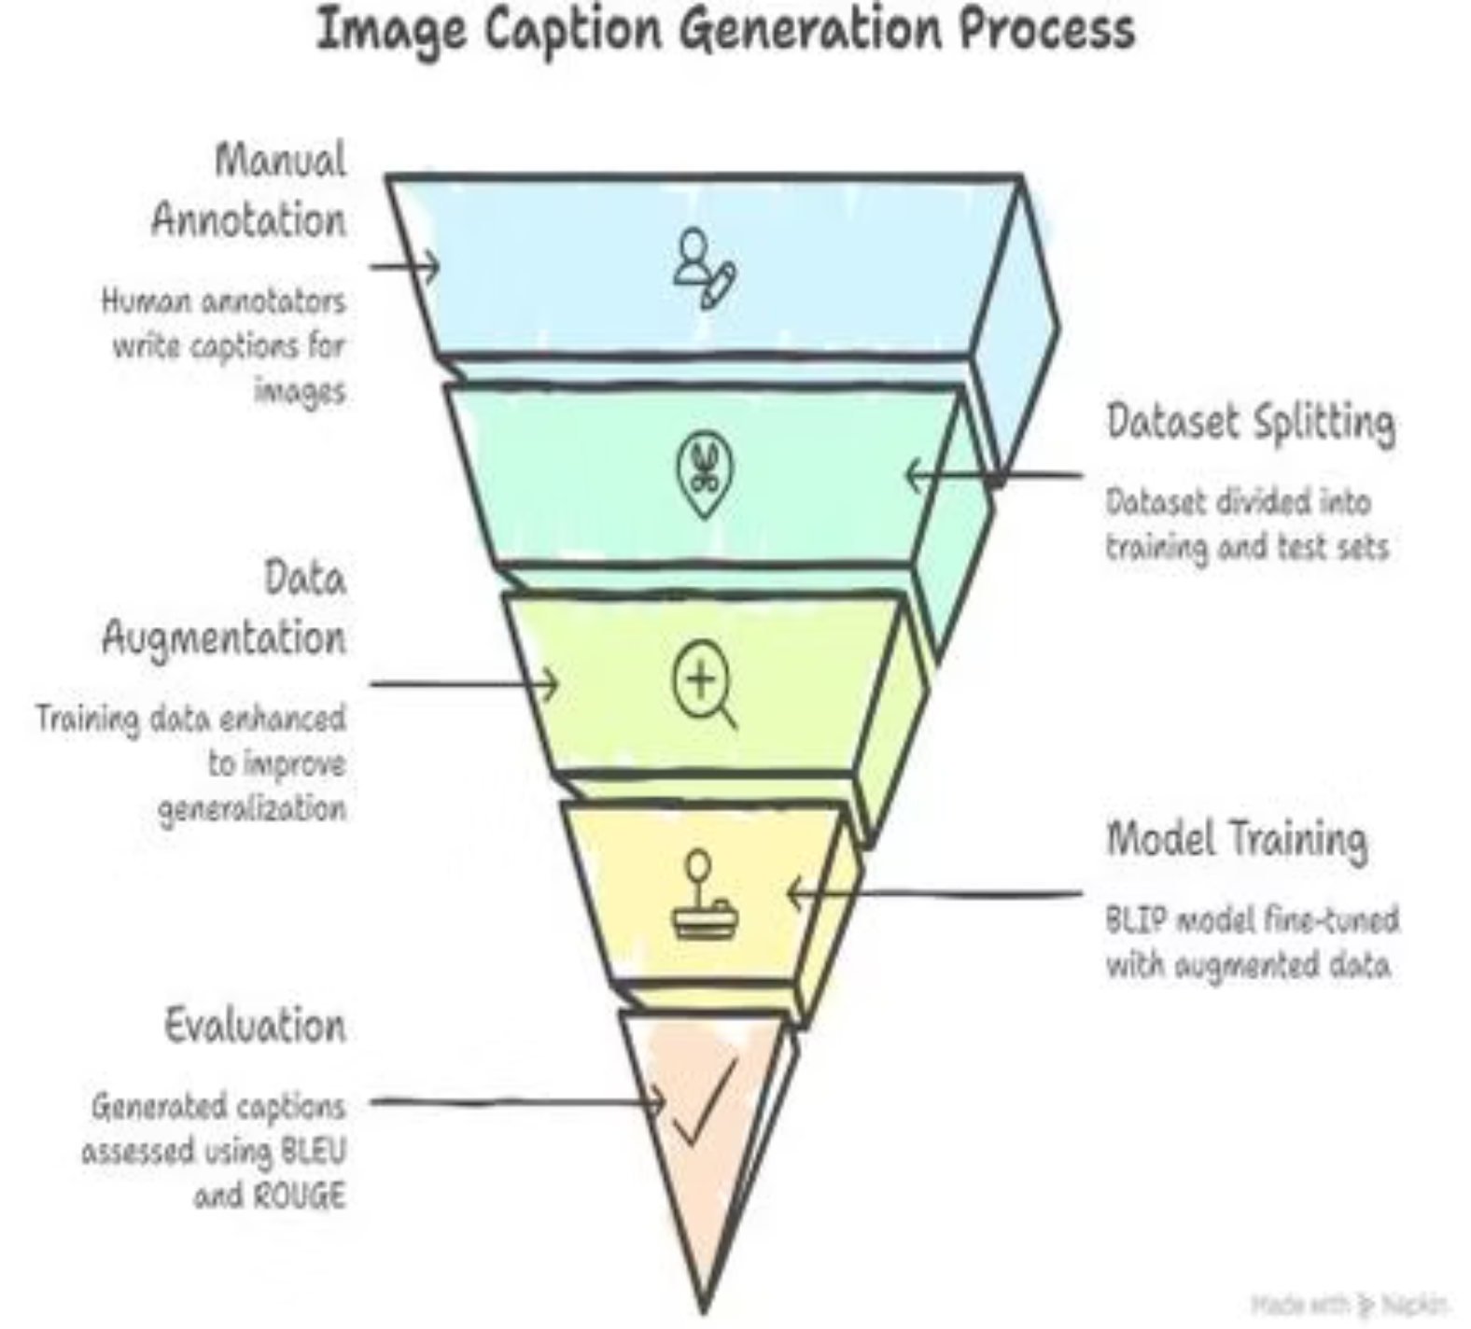
The Image Caption Generation Pipeline
The pipeline flows from Manual Annotation → Dataset Splitting → Data Augmentation (random crops, flips, color jitter, rotations) → Model Training (BLIP fine-tuned with AdamW, 10 epochs on NVIDIA RTX PRO 3000 Blackwell GPU) → Evaluation using BLEU and ROUGE metrics.

Slide 7

Evaluation Metrics: BLEU & ROUGE
BLEU
ROUGE
Bilingual Evaluation Understudy — originally for machine translation. Compares n-gram overlap between generated and reference captions. Precision-oriented. May underestimate performance when domain-specific terminology varies despite correct semantics.
Recall-Oriented Understudy for Gisting Evaluation — designed for summarization evaluation. Measures n-gram overlap between generated and reference text. Recall-oriented. Higher scores indicate greater structural and content overlap with human references.
Both metrics are used together to provide a more complete picture of caption quality across precision and recall dimensions.

Slide 8
Results: Model Comparison Across Prompting Strategies
Model
Prompt
Avg. W. Length
BLEU
ROUGE-1-F1
ROUGE-L-F1
Moondream:1.8b
Short
7.67
0.68
0.14
0.13
Moondream:1.8b
Long
8.13
1.47
0.14
0.12
Qwen2.5VL:3b
Short
17.62
1.66
0.21
0.18
Qwen2.5VL:3b
Long
16.50
1.84
0.21
0.18
LLaVA:7b
Short
54.35
0.83
0.16
0.12
LLaVA:7b
Long
30.78
0.84
0.17
0.13
BLIP-base (fine-tuned)
N/A
15.40
20.53
0.41
0.37
Qwen2.5VL:3b with a long prompt achieved the best zero-shot BLEU (1.84) and consistent ROUGE scores. BLIP-base (fine-tuned) dominated all metrics — BLEU 20.53%, ROUGE-1-F1 0.41 — but this reflects supervised adaptation, not a directly comparable zero-shot setting.

Slide 9

Ablation Study: Sampling Parameters on Qwen2.5VL:3b
Parameters Studied
Key Ablation Results
Temperature (temp)
Configuration
BLEU
ROUGE-1-F1
Controls randomness in word selection during caption generation.
Baseline (default prompt)
1.33
0.20
Top-p (nucleus sampling)
Long-Prompt only
1.84
0.21
Filters word pool by cumulative probability threshold.
temp=0.3, top_p=0.8, top_k=20
0.85
0.21
temp=0.65, top_p=0.85, top_k=30
2.14
0.21
Top-k sampling
Limits selection to a fixed number of most probable next words.
temp=1.0, top_p=0.9, top_k=40
1.29
0.19
Peak BLEU of 2.14 achieved at temp=0.65, top_p=0.85, top_k=30 — a 24.8% improvement over the long-prompt baseline (1.84) and 60.9% over the default (1.33).

Slide 10
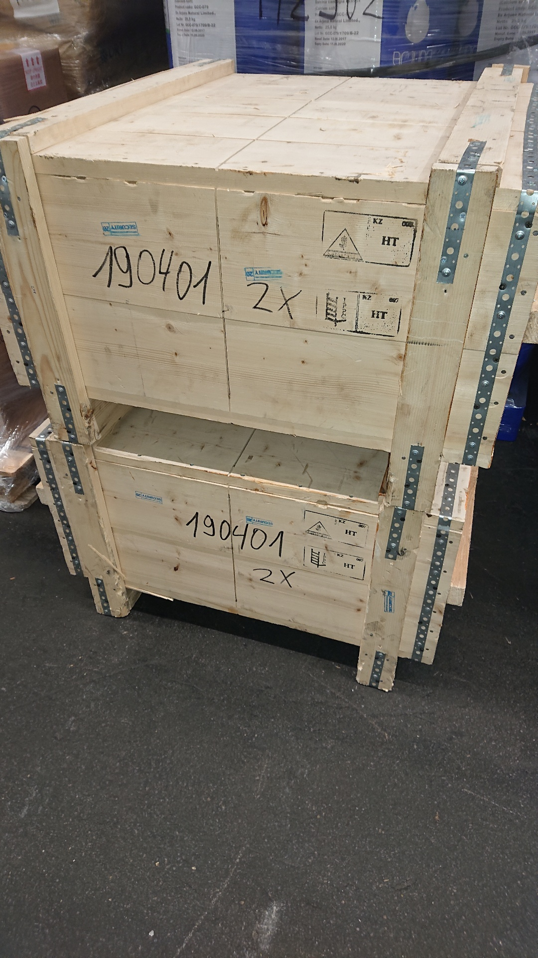
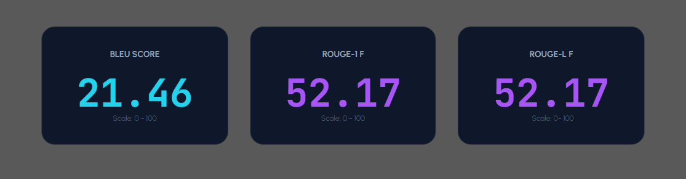
Model Training Examples
Moondream
1.8b
Ground Truth: Two wooden crates stacked on top of each other, each labeled with a number.
AI Captions: Containers on top of each other in a warehouse.

Slide 11
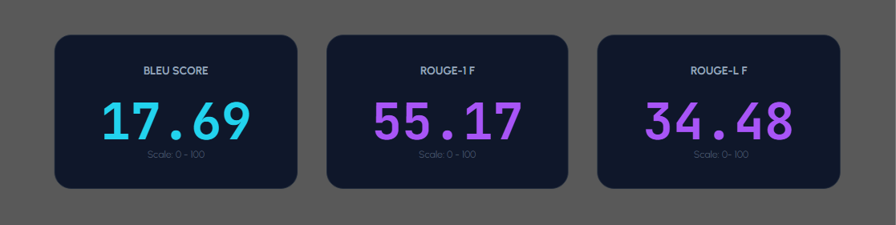
Model Training Examples
Qwen2.5VL
3b
Ground Truth: Two wooden crates stacked on top of each other , each labeled with a number
AI Captions: A stack of wooden crates, each labeled with '190401' and '2X', secured with metal brackets.

Slide 12
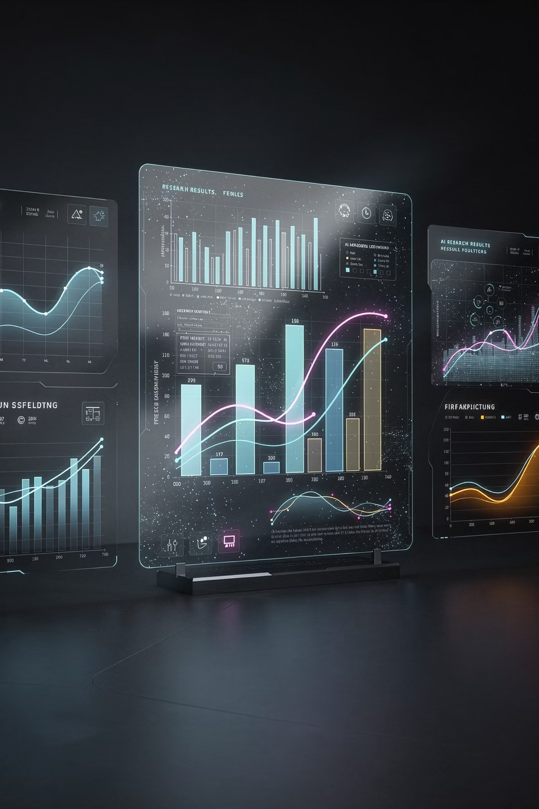
Conclusions
Prompt Design Matters
Prompt engineering and decoding parameters substantially affect corpus-level scores — often more than model size alone.
Lightweight VLMs Are Viable
Optimized Qwen2.5VL:3b performed competitively in ROUGE-based structural alignment, demonstrating practical value for secure, local deployments.
Fine-Tuning Wins on Metrics
BLIP-base fine-tuned achieved BLEU 20.53% and ROUGE-1-F1 0.41, but reflects supervised adaptation — not a zero-shot comparison.
RAG Integration Potential
These models offer a practical path for cost-aware documentation workflows that can integrate with Retrieval-Augmented Generation (RAG) pipelines.

Slide 13

Future Work
Expand Dataset
1
Grow beyond 120 images to improve generalizability of findings across more project categories.
2
More VLM Variants
Include larger Qwen2.5-VL and BLIP-base variants to broaden the model comparison landscape.
Additional Metrics
3
Report CLIPScore and/or BERTScore for richer semantic evaluation beyond n-gram overlap.
4
Qualitative Analysis
Conduct in-depth analysis of prompt templates and length effects on caption quality in LLMs.
This work was supported by the Institute of Technology and Engineering (ITE) at Forschungszentrum Jülich. Contact: o.hamed@fz-juelich.de

