Slide 1
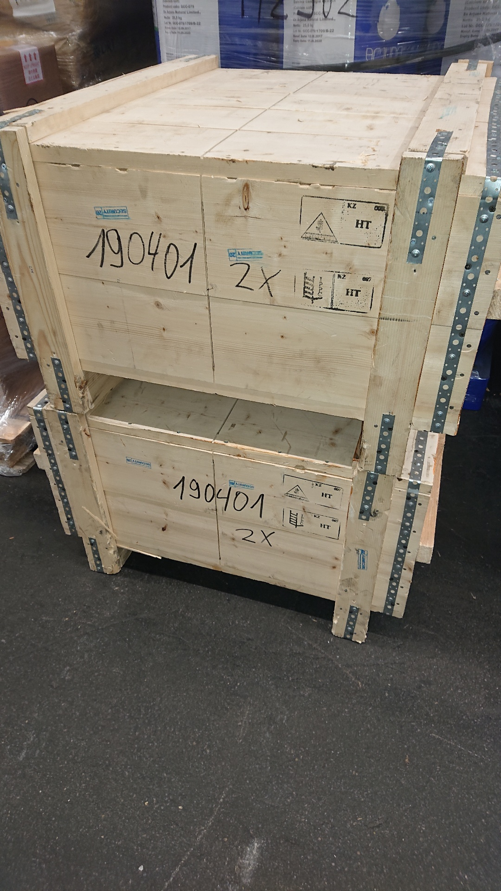
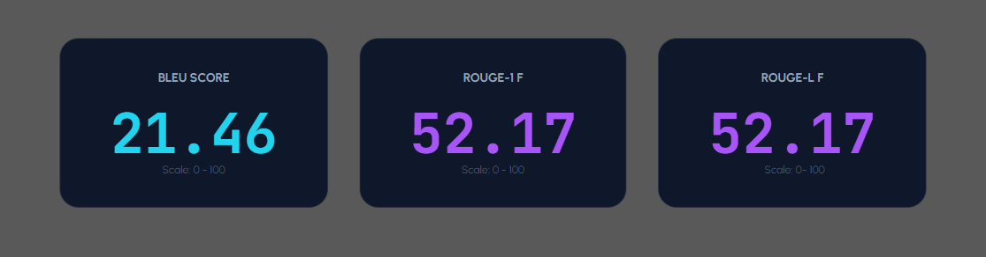
Model Training Examples
Moondream
1.8b
Ground Truth: Two wooden crates stacked on top of each other, each labeled with a number.
AI Captions: Containers on top of each other in a warehouse.

Slide 2
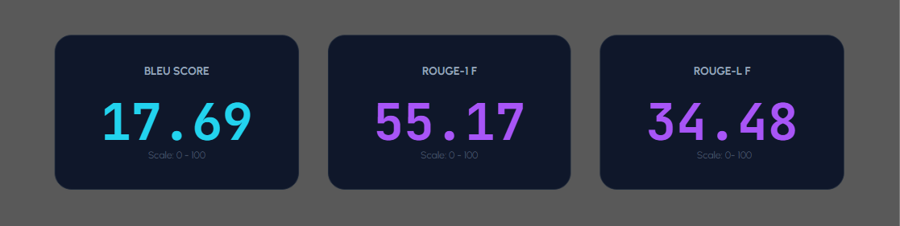
Model Training Examples
Qwen2.5VL
3b
Ground Truth: Two wooden crates stacked on top of each other , each labeled with a number
AI Captions: A stack of wooden crates, each labeled with '190401' and '2X', secured with metal brackets.

