Slide 1

DiverSEA WP3
AI, machine learning, and statistical methods for predictive scenario building

Slide 2
Who We are
Bob O’Hara
Marwah Soliman
Hai Nguyen
VVNOR
Pinar Øztürk
Plus others?

Slide 3
What DiverSEA looks like to us
WP1: create lots of data
WP2: Organise that data so we can get our hands on it
WP3: ????
WP4: Tell WP3 what they want from the data
WP5-7: Errr

Slide 4
Wait for
  WP1 to create lots of data
  WP2 to work out how to organise that data
  WP4 to decide what they want from it
Hired Marwah Soliman

Slide 5
Our Strategy
Need process & observation level models
Combine data types in integrated models
  AI & ML should be able to help
Use AI/ML or ecological models for process level

Slide 6
What we intend to do
Occupancy models for eDNA
  Perhaps other sampling models
Link occupancy models to ML methods
Work on integrated models to combine different data
  Need to talk to WP1 about this!

Slide 7
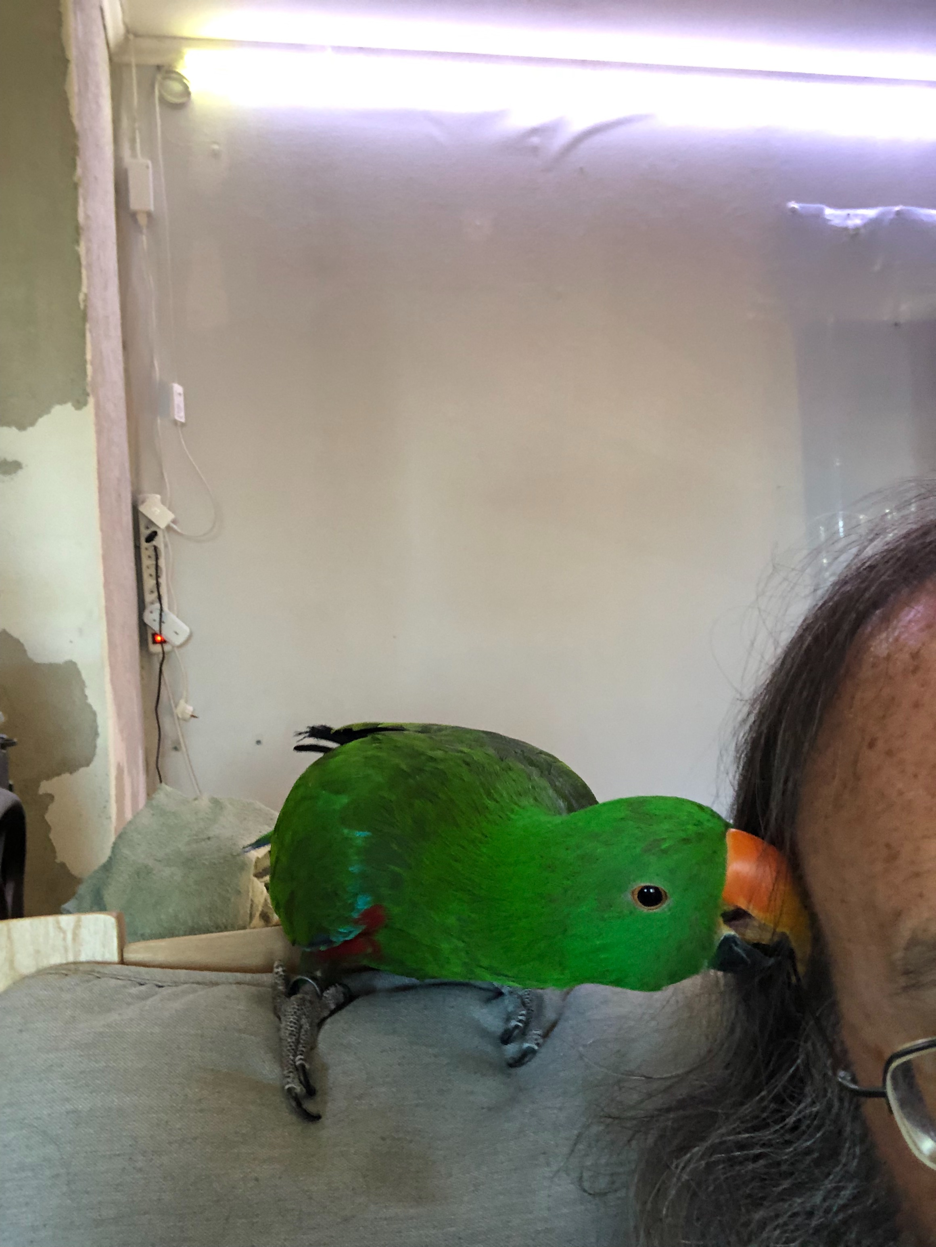
What next?
Need to talk to WP1, 2 & 4

