Slide 1
Private Dropbox
Calum O’Hare
Supervisor: David Eyers

Slide 2

Dropbox
What is dropbox?
What are the downsides to such a service?

Slide 3

Private Dropbox
A file synchronisation tool.
Its main function should be to keep data synchronised between multiple devices.
What makes ‘private’ dropbox?

Slide 4
Important features
Decentralised
File synchronisation
Fine-grained user control
Statistics

Slide 5
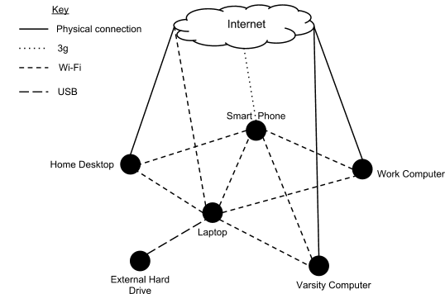
Use case 1

Slide 6
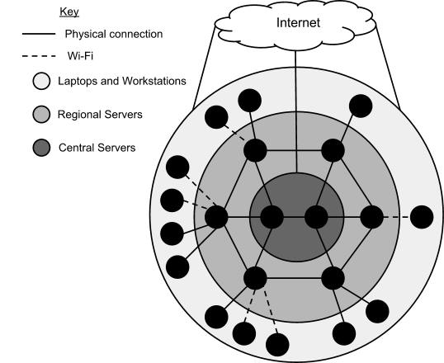
Use case 2

Slide 7
Progress so far
Virtual machines
Network topologys
Performance measures
Point to point synchronisation
Detecting filesystem changes

Slide 8

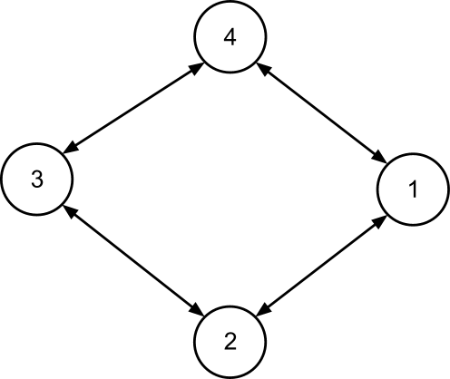
Network topologys
Bus
Ring

Slide 9
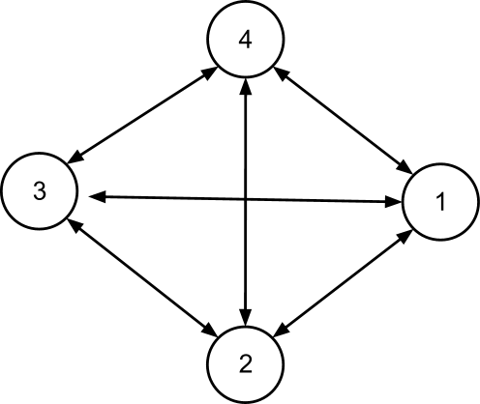
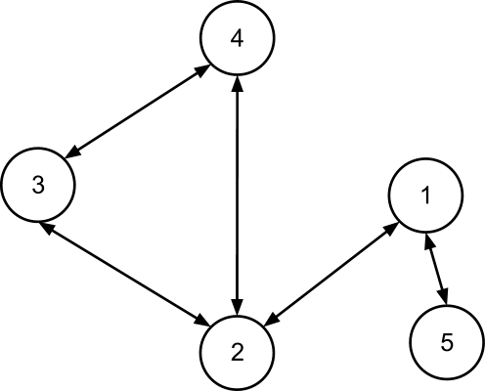
Network topologys
Mesh
Unstructured

Slide 10

Performance measures
Throughput
Latency
Monitoring network interfaces

Slide 11
Point to point synchronisation
Copy
Rsync
Unison
Two way replication tool
Free open source
Runs on many platforms (windows,os x, linux)
Keeps itself in a tidy state incase of failure

Slide 12
File system changes
How does it work?
Python script built on pyinotify
Reads directories and hosts from config file
Inotify (Linux)
Linux kernel subsystem to notices changes to the filesystem
FSEvents, kqueue (OS X)
ReadDirectoryChangesW (Windows)

Slide 13

Next steps
Sub-nodes
Mobile nodes
Statistics
More user control

Slide 14
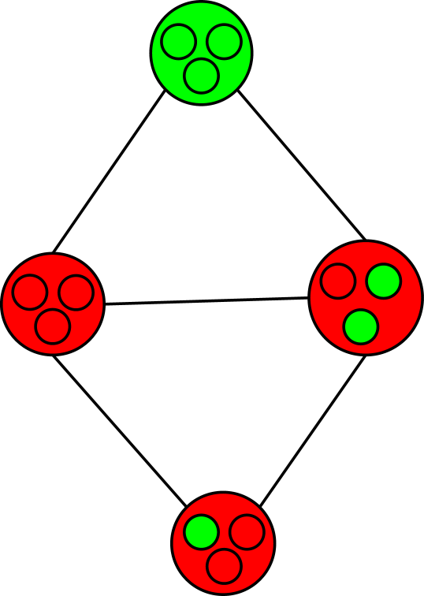
Sub-nodes
How out of date is the graph at any given time?
How long do we expect it to take to become completely up to date?
Can we improve this?

Slide 15
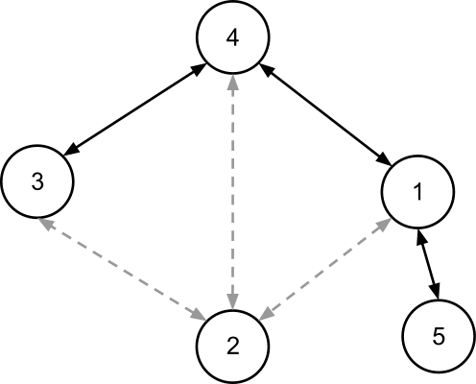
Mobile nodes
Say node two intermittently has a connection to a subset of nodes 1,3 and 4
How does this affect the graph over time?

Slide 16
User control
More user control
How often to replicate a directory
Special conditions i.e. only over wi-fi
Feedback on how changing settings may impact performance

Slide 17
Statistics
What meaningful data can we gather from the program over time?
How is each edge in the graph being used?
How up to date is the graph?
Can we improve the settings from this knowledge?

Slide 18
The end
Thanks for listening

