Slide 1
Private Dropbox
Calum O’Hare
Supervisor: David Eyers

Slide 2
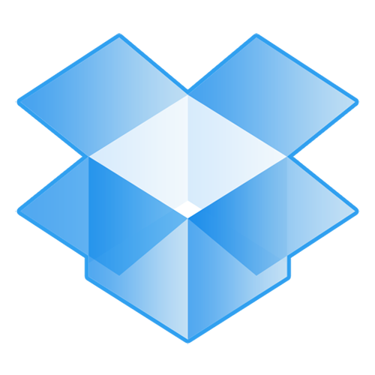
Dropbox
What is dropbox?
What are the downsides to such a service?

Slide 3
Private Dropbox
A file synchronisation tool.
Its main function should be to keep data synchronised between multiple devices.
What makes ‘private’ dropbox?

Slide 4
Important features
Decentralised. It will not necessarily need to be run in “the cloud”, there should be no centralised server, just many cooperating client nodes.
File synchronisation between multiple clients—not just point-to- point between two clients. Clients may be running different operating systems. Clients may run on different networks, with different costs of access (including being disconnected from the Internet at times).
Fine-grained user control for the majority of the program’s functions, e.g., how often, and what, to replicate within different sets of files. ’What’ could be filename, filetype, filesize etc.
Statistics about which files are being replicated, efficiency, cost (bandwidth, disk space). These statistics could also possible lead to a heuristic for when to sync a given file.

Slide 5
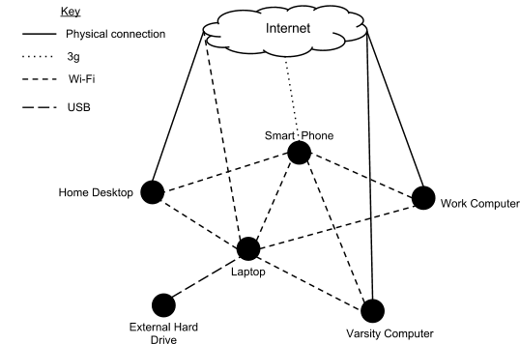
Use case 1

Slide 6
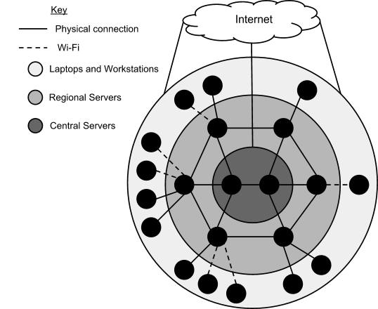
Use case 2

Slide 7
Progress so far
Virtual machines
Network topologys
Performance measures
Point to point synchronisation
Detecting filesystem changes

Slide 8
Virtual machines
Virtualbox
Vboxmanage script

Slide 9
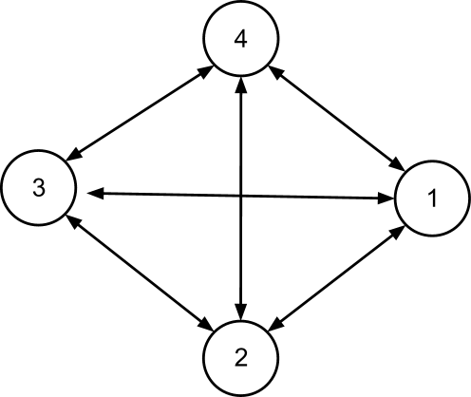
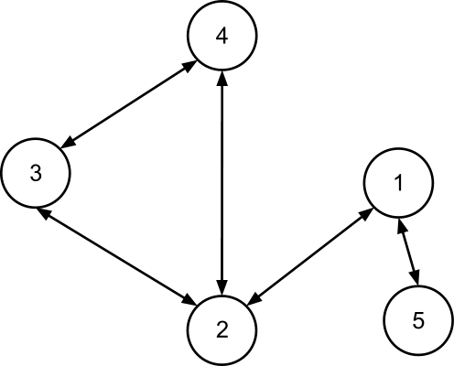
Network topologys
Mesh
Unstructured

Slide 10
Network topologys
Mesh
Unstructured

Slide 11
Performance measures

Slide 12
Point to point synchronisation

