Slide 1


BAYESIAN MODELS FOR DOCKING SCORE PREDICTIONS
DS6040 Bayesian Machine Learning
Thomas Lever, Naomi Ohashi
December 8, 2023

Slide 2
CONTENTS
INTRODUCTION
ABOUT DATA
METHODS
RESULTS
CONCLUSIONS

Slide 3

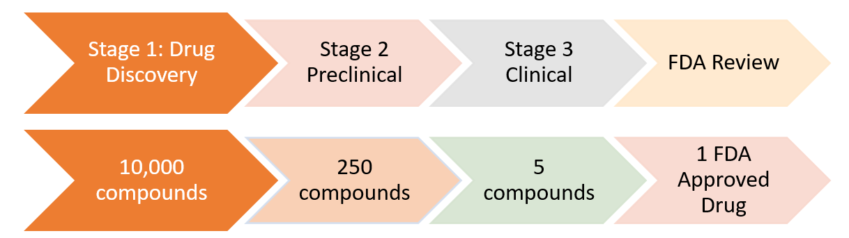
INTRODUCTION
CHALLENGES: Big Data
Drug-like chemical space is huge. Traditional approaches to drug discovery don’t scale.
The largest precalculated chemical database contains > 160 billion chemicals
Drug-like chemical space is >10⁶⁰
Drug development takes many years and expensive with low success rate
Timeline: ~15 years
Cost: over $2.5 billion
Notes:
Costs for bringing a new drug to market was about $1.8 billion in 2010 according to a study (https://en.wikipedia.org/wiki/Cost_of_drug_development)
Chemical space has tens of millions of molecules
Makable chemical space has tens of billions of molecules

Slide 4
CHALLENGES: Big Data
Drug-like chemical space is huge. Traditional approaches to drug discovery don’t scale.
Drug development takes many years and expensive with low success rate
The largest precalculated chemical database contains > 160 billion chemicals
Drug-like chemical space is >10⁶⁰
Bayesian ML models help scale up drug screening process by predicting docking scores efficiently with uncertainty analysis
Saves money and time by accelerating the process, hopefully that leads to cheaper and faster treatment available for patients
This project won’t solve the big problems but could contribute to a small piece in drug screening process.
Timeline: ~15 years
Cost: over $2.5 billion
Notes:
Costs for bringing a new drug to market was about $1.8 billion in 2010 according to a study (https://en.wikipedia.org/wiki/Cost_of_drug_development)
Chemical space has tens of millions of molecules
Makable chemical space has tens of billions of molecules

Slide 5
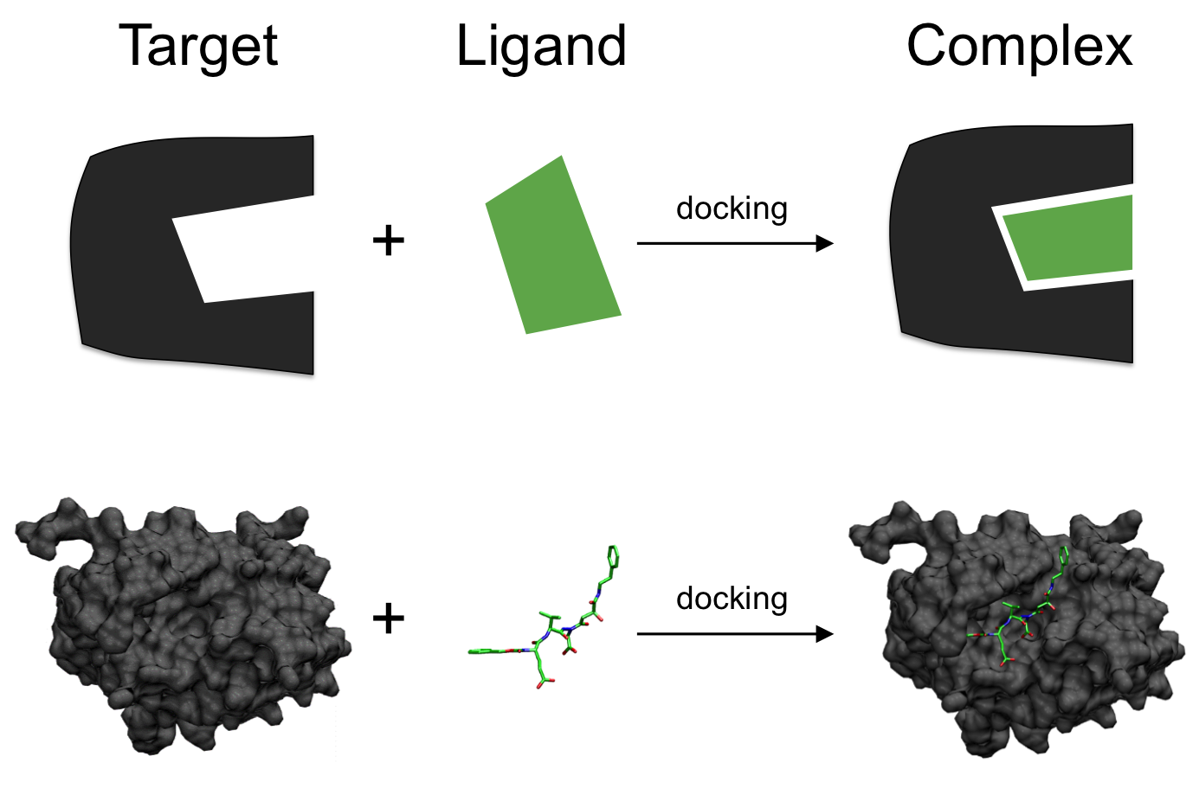
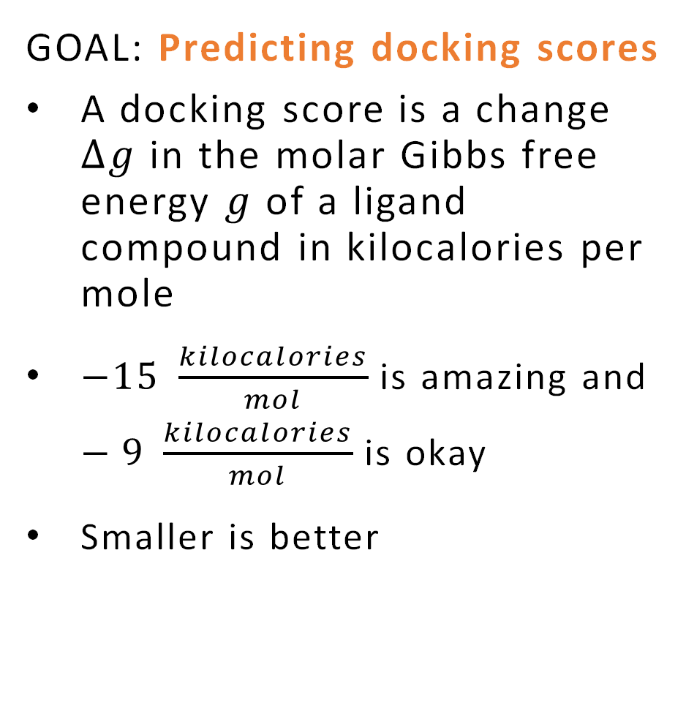
GOAL
GOAL: Predicting docking scores
A docking score is a change $∆g$ in the molar Gibbs free energy $g$ of a ligand compound in kilocalories per mole
$−15 \frac{kilocalories}{mol}$ is amazing and $−9 \frac{kilocalories}{mol}$ is okay
Smaller is better
Source: https://en.wikipedia.org/wiki/Docking_(molecular)
Notes:
[define ligand and target]
Docking is a computational simulation of a candidate ligand binding to a receptor
Scoring is a process of evaluating a pose by counting number of favorable molecular interactions

Slide 6
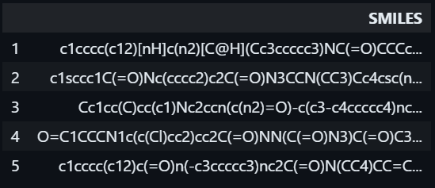
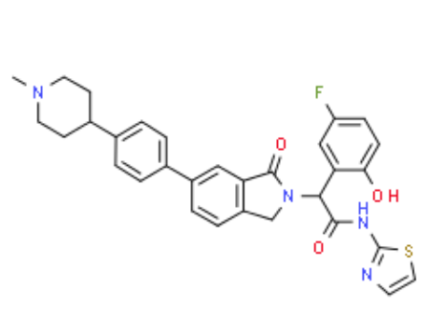
ABOUT DATA
Data set is associated with one site on 7JXQ protein at which ligands bind.
7JXQ protein target may cause lung, breast, or other cancers.
Each row encapsulates data relating to a ligand docking to the protein.
There is one ligand per row, one row per ligand.
The raw data set has 2,121,226 observations and each with a docking score and SMILES
A SMILES (Simplified Molecular-Input Line-Entry System) is a line notation for a chemical structure.
We use SMILES to predict docking scores. Convert into numerical representation.
Source: https://en.wikipedia.org/wiki/Simplified_molecular-input_line-entry_system
Notes:
Each row encapsulates data relating to a ligand docking to the protein:
- Molecular Weight <= 500 Da
- No. Hydrogen Bond Donors <= 10
- No. Hydrogen Bond Acceptors <= 5
- LogP <= 5

Slide 7
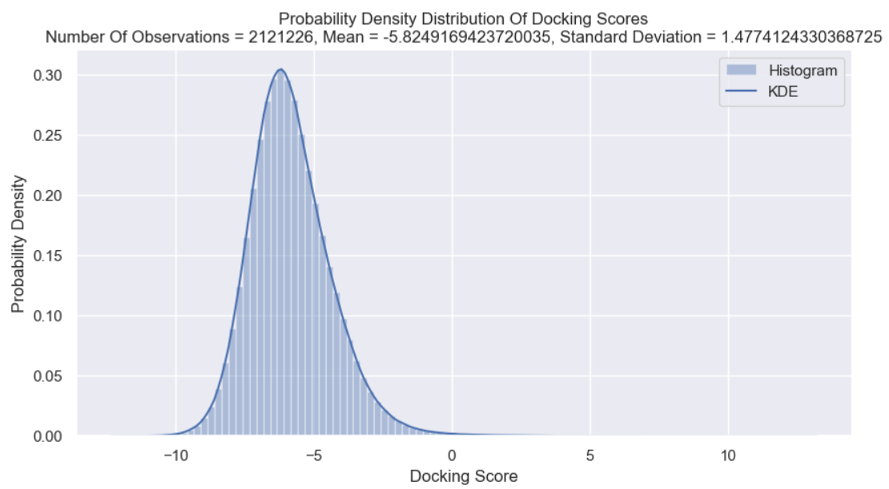
EXPLORATORY DATA ANALYSIS AND DATA WRANGLING
Probability Density Distribution of Docking Score
The histogram of the PDF and kernel density estimation (KDE)
The mean of the docking score is -5.829 and standard deviation of 1.477.
Notes:
Probability density function (PDF) of docking score is shown for the whole dataset.
The histogram of the PDF and kernel density estimation (KDE) which is smoothing for probability density estimation. The mean of the docking score is -5.829 and standard deviation of 1.477.
Each vector of numbers of occurrences of substructures is folded into a vector of 1024 numbers of occurrences of substructures.
We construct a training and testing feature matrix where each row contains a docking score and 1024 numbers of occurrences of substructures. Our feature matrix has up to 2,121,226 observations.
Morgan2 Fingerprints
RDKit descriptor called Morgan Fingerprints generate count vector and using them to calculate molecular similarity.
count vectors : fpgen.GetCountFingerprint
Each vector of numbers of occurrences of substructures is folded into a vector of 1024 numbers of occurrences of substructures.

Slide 8
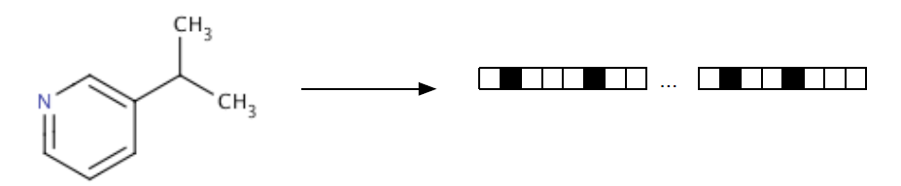
METHODS
Bayesian Docking-Score Predictor
The Bayesian Docking-Score Predictor receives many SMILES of ligands and provides docking scores that approximately predict the binding affinity between two molecules.
We use Python package rdkit to convert over 2 million SMILES's into molecules and molecules into hashed Morgan fingerprints each with 1024 bits
A hashed Morgan fingerprint is a vector of numbers of substructures of molecules
We construct a training and testing feature matrix where each row contains a docking score and 1024 numbers of occurrences of substructures. Our feature matrix has up to 2,121,226 observations.
Predictive models trained with:
- Bayesian Additive Regression Trees (BART)
- Bayesian Neural Network (BNN)
Notes:
The Bayesian Docking-Score Predictor receives SMILES of a ligand and provides a docking score of how well that ligand binds to a protein
Sampling:
- pymc to sample testing values of $\hat{y}$ from the posterior predictive probability density distribution
- No U-Turn Sampling (NUTS) is used to train the predictive models
- Bayesian Additive Regression Trees (BART)
- Linear Regression
- Bayesian Linear Regression
- Bayesian Neural Network (BNN)
- Bayesian Model Using BART Model

Slide 9
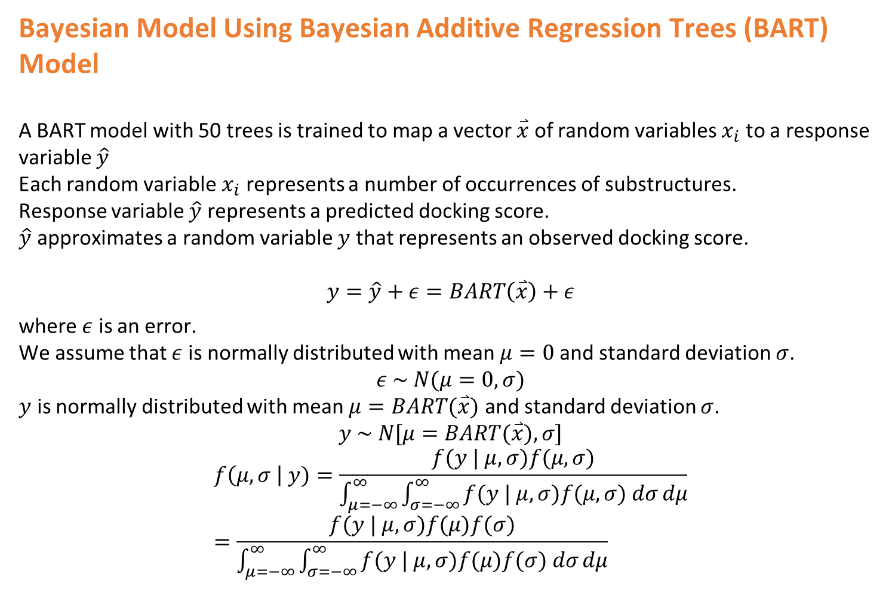
Bayesian Model Using Bayesian Additive Regression Trees (BART) Model
A BART model with 50 trees is trained to map a vector $\overset{⃑}{x}$ of random variables $x_{i}$ to a response variable $\hat{y}$
Each random variable $x_{i}$ represents a number of occurrences of substructures.
Response variable $\hat{y}$ represents a predicted docking score.
$\hat{y}$ approximates a random variable $y$ that represents an observed docking score.
$$y=\hat{y}+ε=BART\left(\overset{⃑}{x}\right)+ε$$
where $ε$ is an error.
We assume that $ε$ is normally distributed with mean $μ=0$ and standard deviation $σ$.
$$ε \sim N(μ=0,σ)$$
$y$ is normally distributed with mean $μ=BART(\overset{⃑}{x})$ and standard deviation $σ$.
$$y \sim N[μ=BART(\overset{⃑}{x}),σ]$$
$$f\left(μ, σ \right| y)=\frac{f(y | μ, σ)f(μ, σ)}{\int_{μ=−∞}^{∞}{\int_{σ=−∞}^{∞}{f(y | μ, σ)f(μ, σ) dσ}dμ}}=\frac{f(y | μ, σ)f(μ)f(σ)}{\int_{μ=−∞}^{∞}{\int_{σ=−∞}^{∞}{f(y | μ, σ)f(μ)f(σ) dσ}dμ}}$$
Notes:
Bayesian Additive Regression Trees (BART) is a sum-of-trees model for approximating an unknown function f.
The decision tree is prone to overfitting. To avoid overfitting, BART uses a regularization prior that forces each tree to be able to explain only a limited subset of the relationships between the covariates and the predictor variable.

Slide 10

PREDICTIVE MODEL(BNN)
Bayesian Neural Network (BNN) Model
A neural network is trained to map a vector $\overset{⃑}{x}$ of random variables $x_{i}$ to a response variable $\hat{y}$.
$\hat{y}$ is multiplied by the range of observed response values $y$.
An input layer through which the BNN receives an input matrix $X∈R^{m×1024}$
A first hidden layer
A second hidden layer
An output layer

Slide 11
Visualization
Trace plots
Plots Of Posterior Predictive Check
Data Frames
Gains curves
Decile-Wise Lift Charts
Density Plots

Slide 12
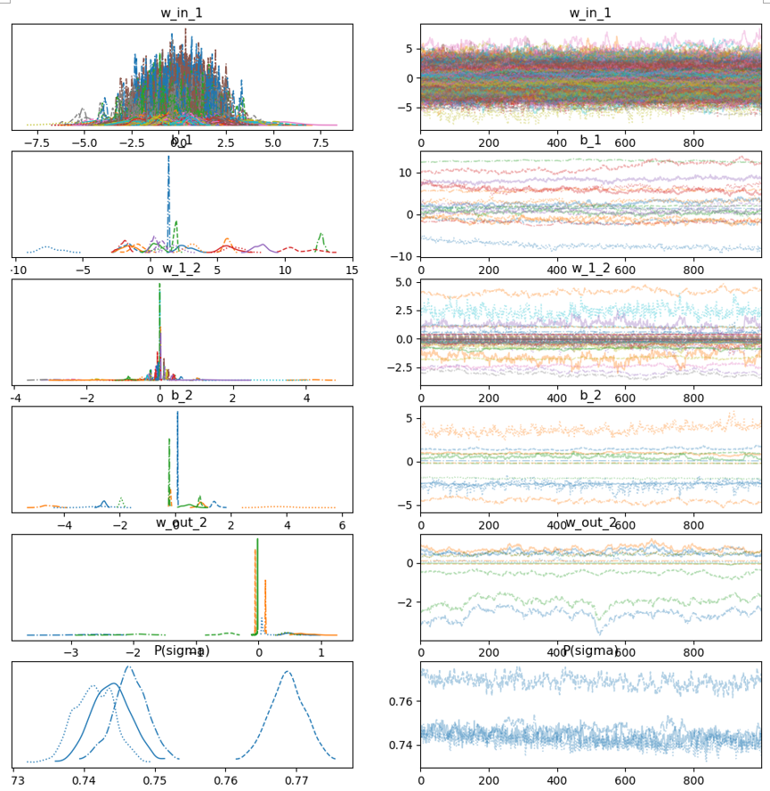
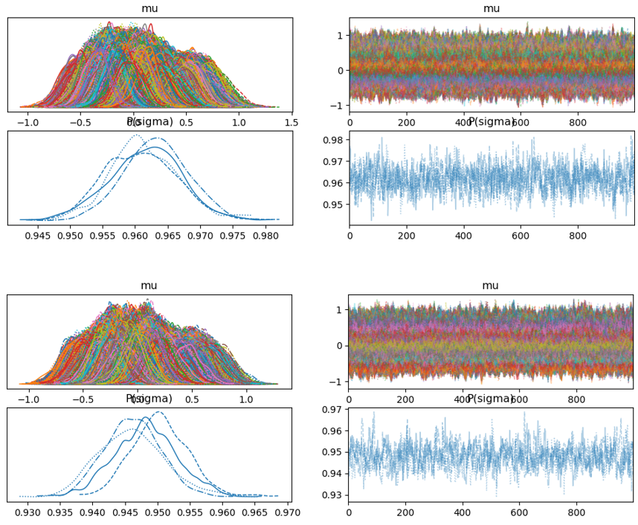
RESULTS: Trace Plots
Bayesian Model using BART Model
(33,145 and 66,289 observations)
BNN Model (66,289 observations)
Notes:
BART model
Trace Plot of distributions each of values of a parameter in a parameter vector estimated as No U-Turn Sampling (NUTS) progresses
The BART model is trained with 33,145, and 66,289 observations
The Trace Plot is least noisy when our model is trained with 66,289 observations
BNN model
The BNN model is trained with 33,145, 66,289, and 132,577 observations.
There is one distribution for each parameter and 4 chains (default).
The Trace Plot is least noisy when our BNN is trained with 66,289 observations.

Slide 13
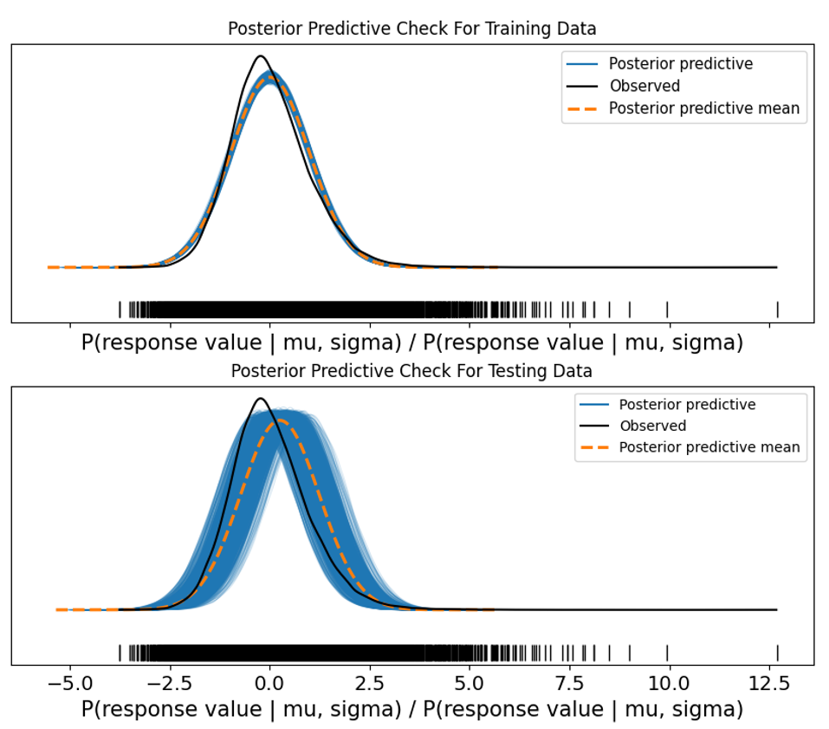
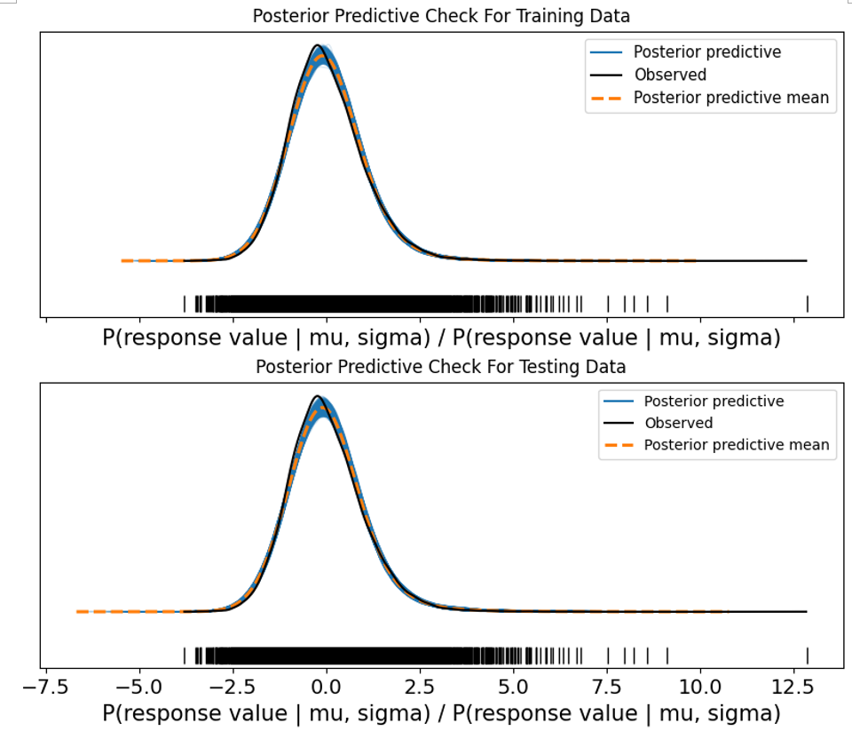
Posterior predictive checks (PPC’s) are a great way to validate a model. PPC’s can analyze the degree to which data generated from the model deviate from data generated from the true distribution.
Bayesian Model using BART Best Model (66,289 obs)
BNN Best Model (33,145 obs)
RESULTS: Posterior Predictive Check
Source: https://www.pymc.io/projects/docs/en/stable/learn/core_notebooks/posterior_predictive.html
Notes:
A Plot Of Posterior Predictive Check consists of a Rug Plot of observed docking scores along the horizontal axis, a black probability density distribution of observed docking scores, one blue probability density distribution of predicted docking scores for each chain, and an orange average probability density distribution of predicted docking scores.
Our BART Model performs better when the model is trained and tested on 66,289 observations than when the model is trained on 33,145 observations
Our BNN performs best when the BNN is trained and tested on 33,145 observations, when our BNN is trained and tested on 33,145, 66,289, and 135,577 observations.

Slide 14
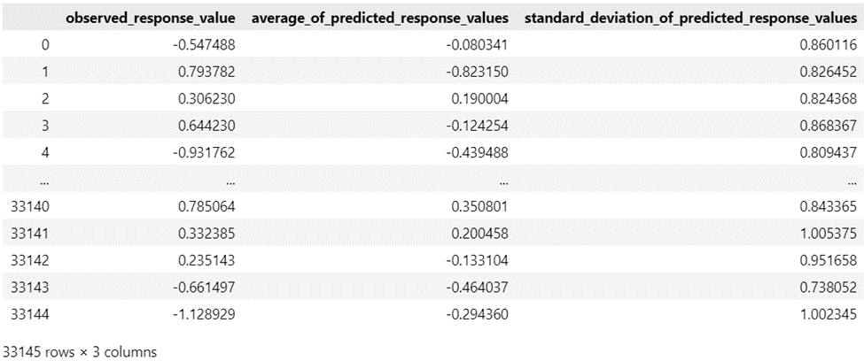
Data Frames Of Observed Docking Scores And Averages And Standard Deviations Of Predicted Docking Scores

Slide 15
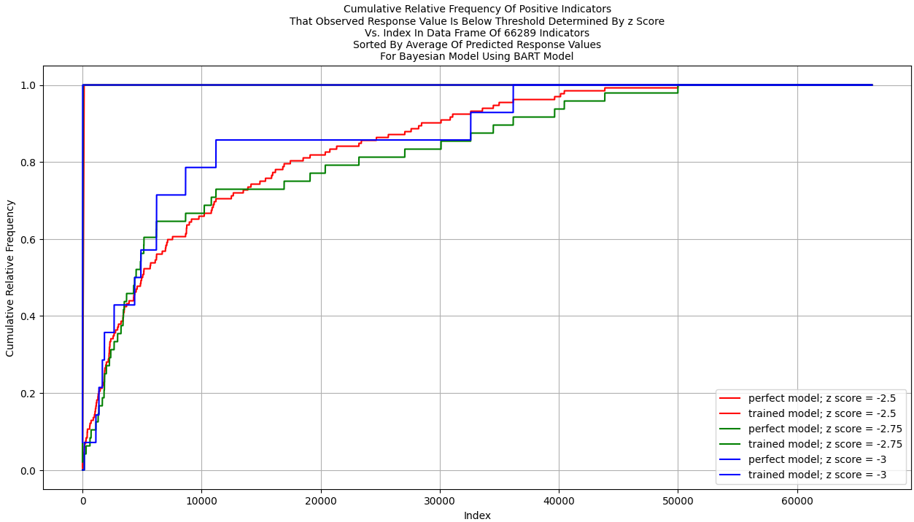
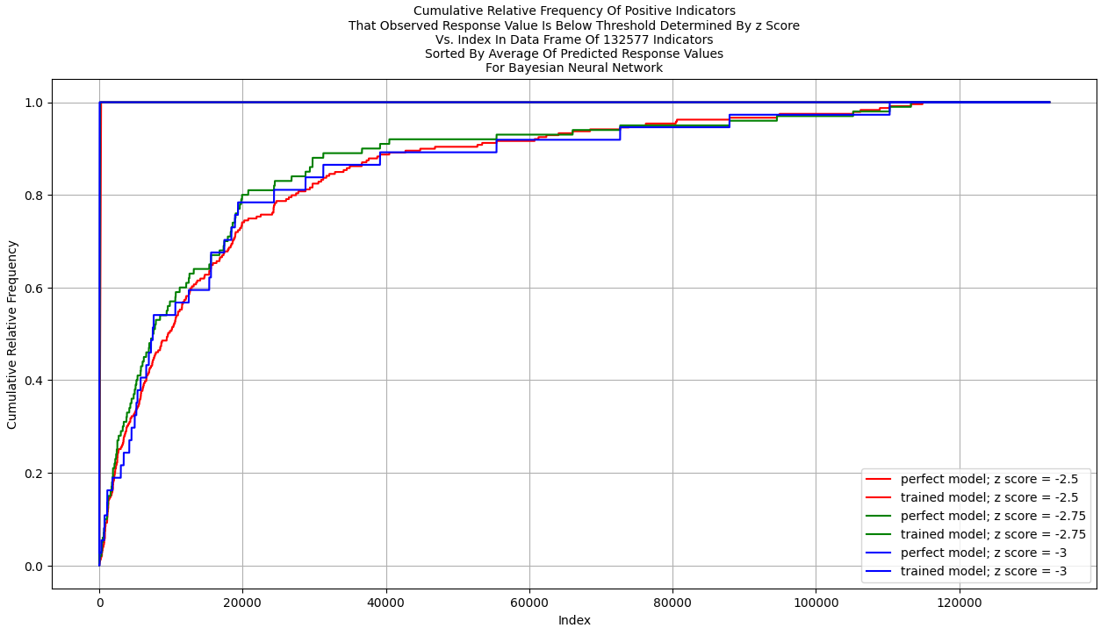
After we generate a data frame of observed docking scores and averages of docking scores predicted by our BNN based on numbers of occurrences of substructures, we may generate a Plot Of Gains Curves / Enrichment-Factor Plot.
Bayesian Model using BART (66,289 obs)
BNN Best Model (132,577 obs)
RESULTS: Gains Curves
Notes:
The Gains Curves for 33,145, 66,289, and 132,577 observations and our BART Model are presented below.
Our Bayesian Model Using BART Model with 66,289 observations performs best.
The Gains Curves for 33,145, 66,289, and 132,577 observations and our BNN are presented below.
For a user-defined z score of $−2.75$, our BNN performs best when trained and tested on 132,577 observations.
It seems our BNN performs better than BART Model most of the time
BNN model performs better most of the time when trained on more observations, while BART model does not improve as increase the number of observations.

Slide 16
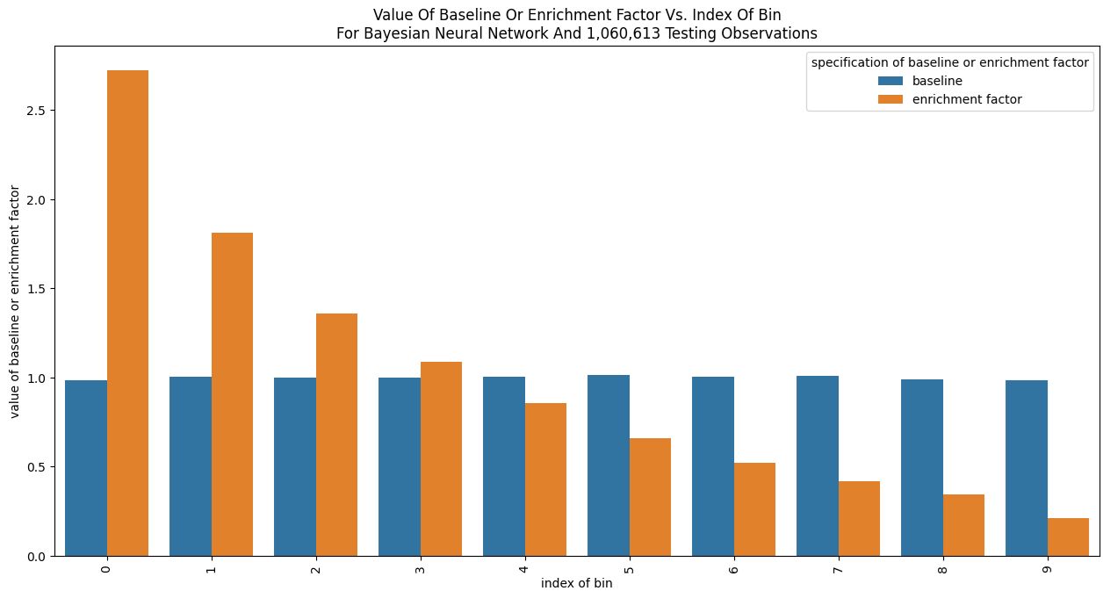

Slide 17
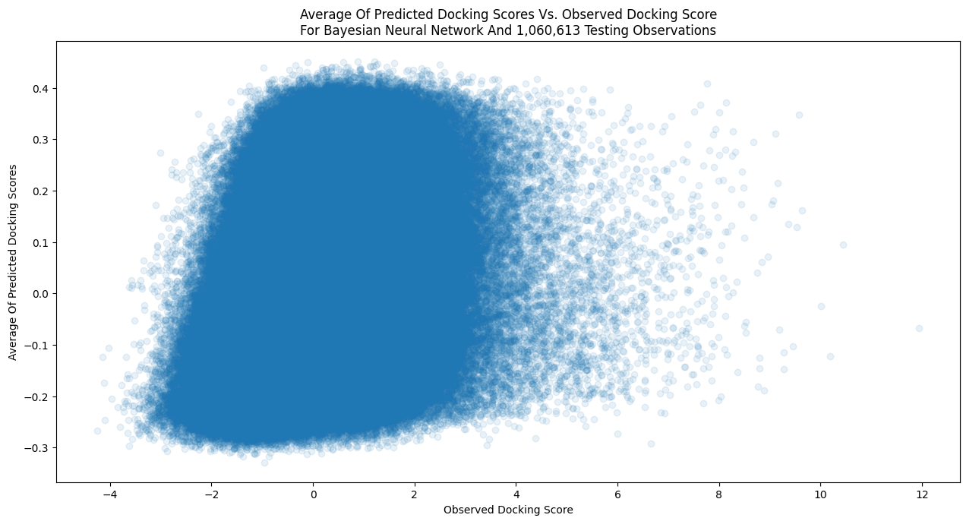
There is a low correlation between average of predicted docking scores and observed docking score.
RESULTS: Density Plots

Slide 18
CONCLUSIONS
Key Findings
Our models are useful in predicting docking scores based on numbers of occurrences of substructures
Our BNN may perform best with more observations.
Both our BART and BNN models may be expanded and tuned.
They may improve more with a uniform distribution of docking scores in a data set. It seems that there is a low correlation between average of predicted docking scores and observed docking score, and that the range of averages is small compared with the range of observed docking scores.

Slide 19

CONCLUSIONS
Future Improvements
Bayesian Docking-Score Predictor could be trained on $n$ (e.g., $100,000$) pairs of SMILES and docking score and used to predict docking scores of ligands based on many (e.g., $1,900,000$) other SMILES’s.
Rows of data representing docking of ligands could be sorted in ascending order by predicted docking score. The first $n$ rows of data corresponding to the lowest predicted docking scores could be added to the training data set.
Applications
Bayesian Docking-Score Predictor may be used to predict, to estimate uncertainty, or in optimization of hyperparameters of other models.
A trained Bayesian Docking-Score Predictor could be used for developing a training data set of SMILES’s and docking scores of ligands for another predictor.

Slide 20
ACKNOWLEDGEMENTS
Special thanks to:
Dr. Peter Gedeck
Lecturer at the School of Data Science, University of Virginia
Research Informatics Senior Scientist, Collaborative Drug Discovery
Dr. Ryan Weil
Frederick National Laboratory for Cancer Research

