Slide 1

Ice Cream Server
Tom Lever
February 20, 2021

Slide 2
Ice Cream Server
System
Tom Lever
February 20, 2021

Slide 3

System Description Context: DataBridge
Tom’s Understanding of Functionality

Slide 4
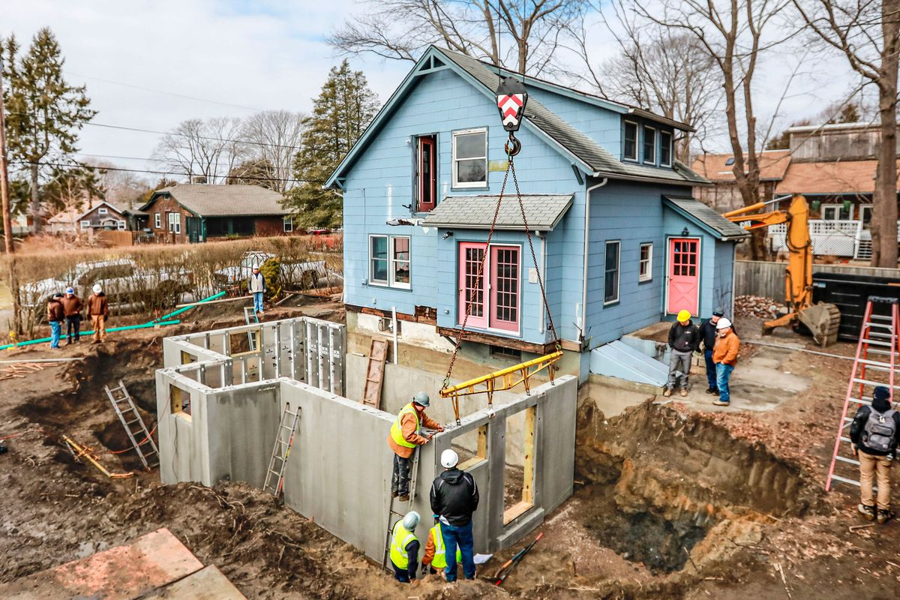
System Description Opportunity Ice Cream System will Address
Foundation

Slide 5


Team

Slide 6
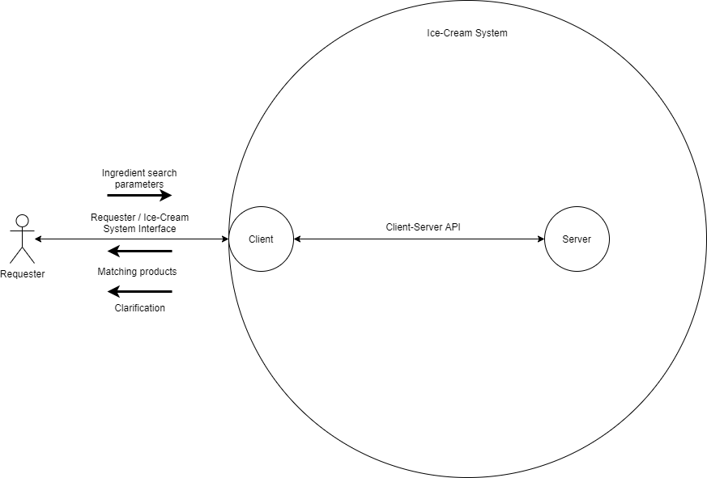
System Description What Ice Cream System will Do

Slide 7
System Description Iterations of Development
Providing products or clarifications, based on ingredient search parameters
↑, based on non-ingredient search parameters
Create, Update, and Delete

Slide 8
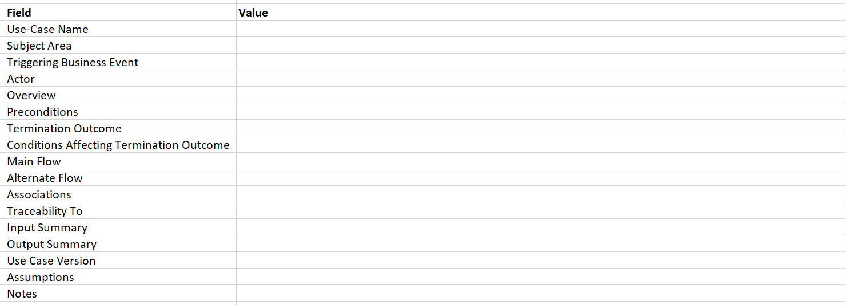
Requirements Use-Case Description Request Products by Ingredients

Slide 9
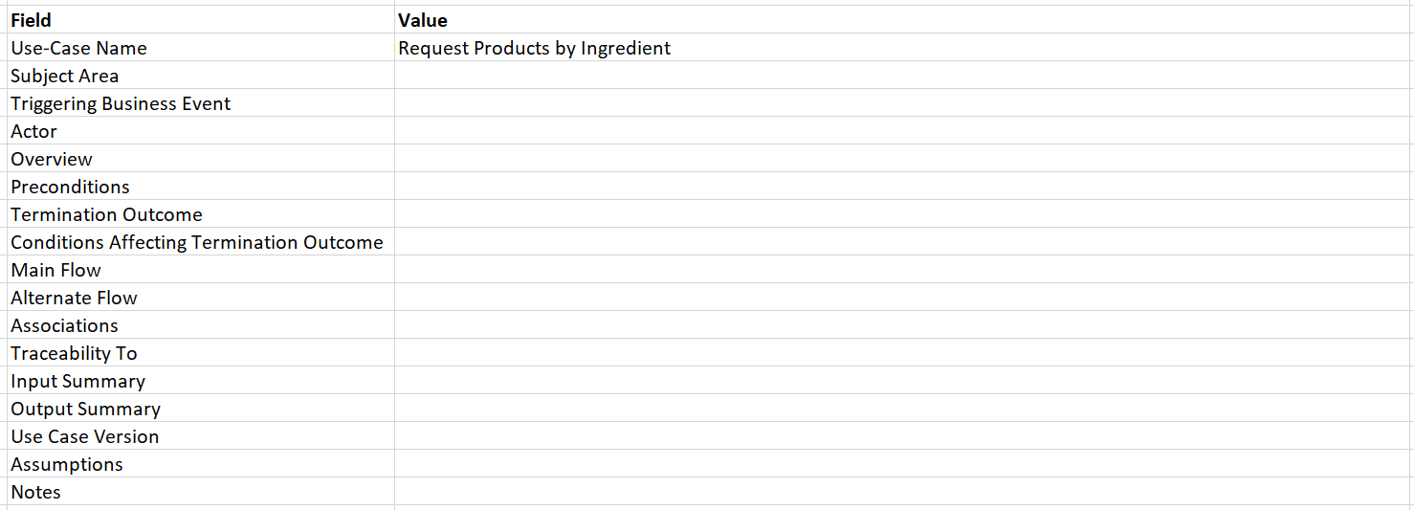
Requirements Use-Case Description Request Products by Ingredients

Slide 10
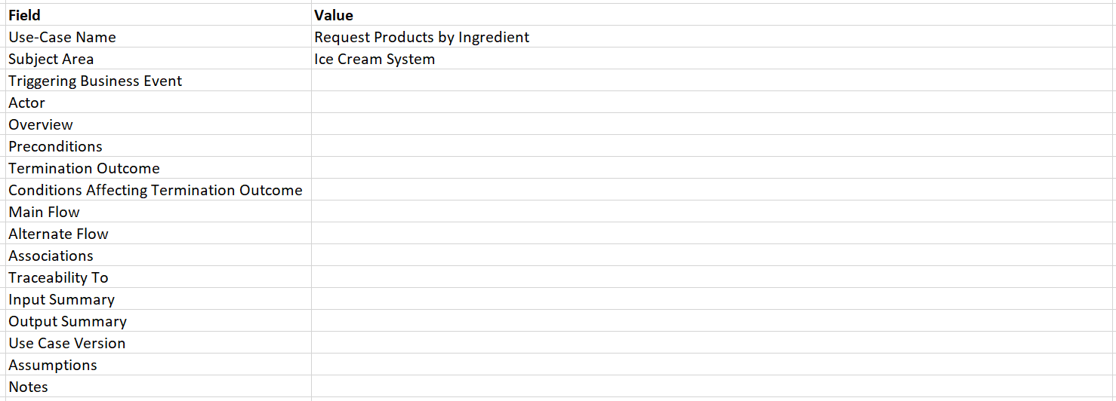
Requirements Use-Case Description Request Products by Ingredients

Slide 11
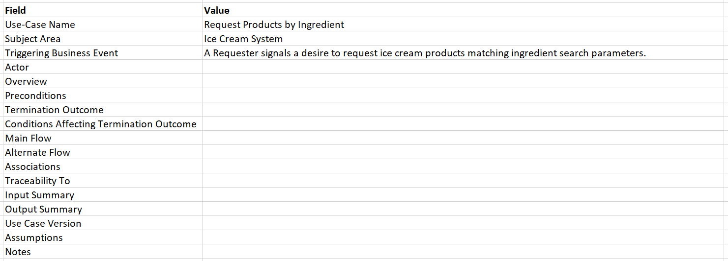
Requirements Use-Case Description Request Products by Ingredients

Slide 12
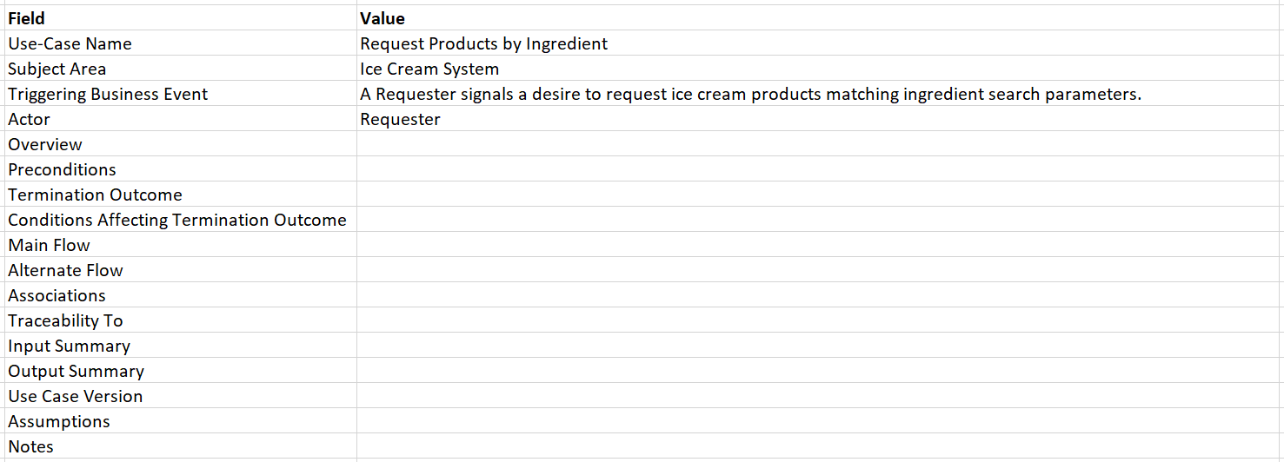
Requirements Use-Case Description Request Products by Ingredients

Slide 13
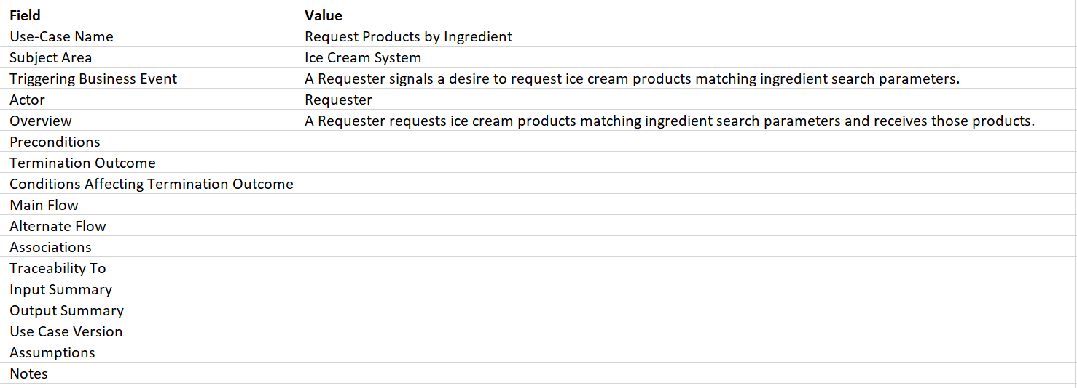
Requirements Use-Case Description Request Products by Ingredients

Slide 14
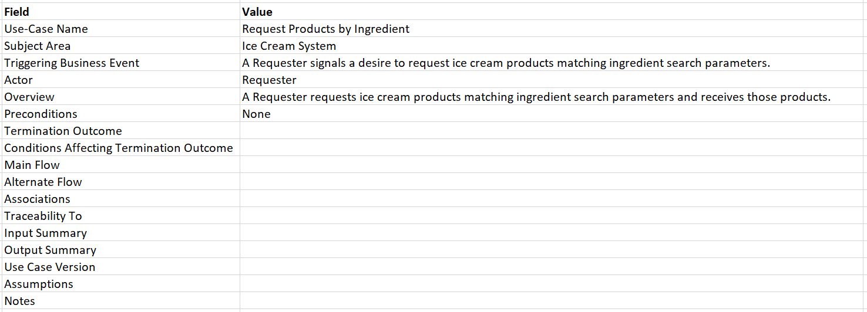
Requirements Use-Case Description Request Products by Ingredients

Slide 15
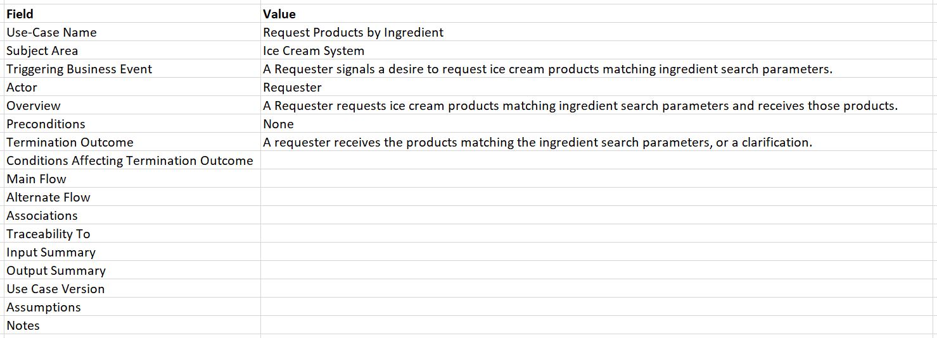
Requirements Use-Case Description Request Products by Ingredients

Slide 16
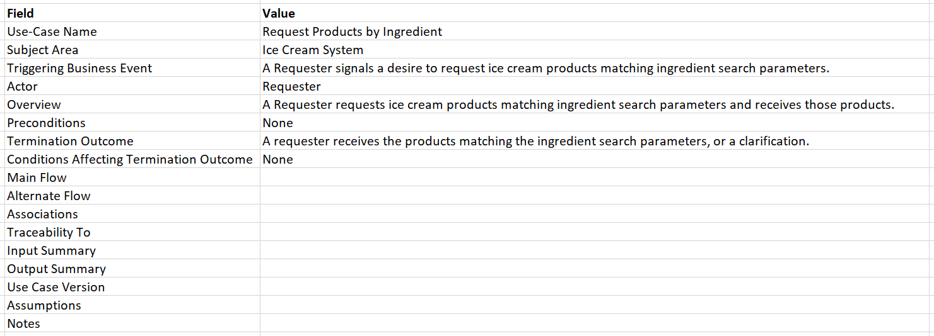
Requirements Use-Case Description Request Products by Ingredients

Slide 17
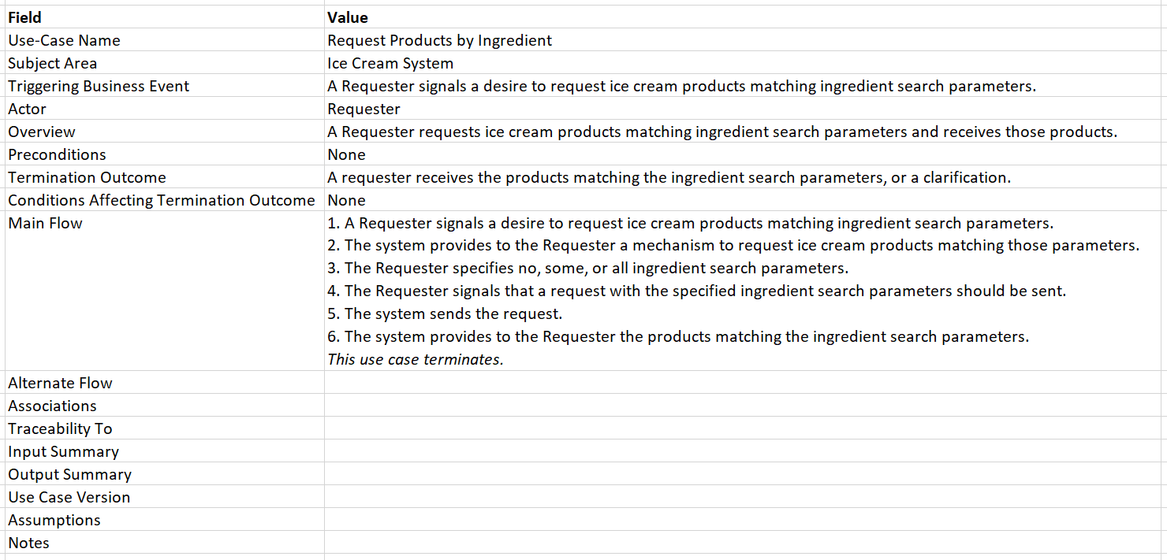
Requirements Use-Case Description Request Products by Ingredients

Slide 18
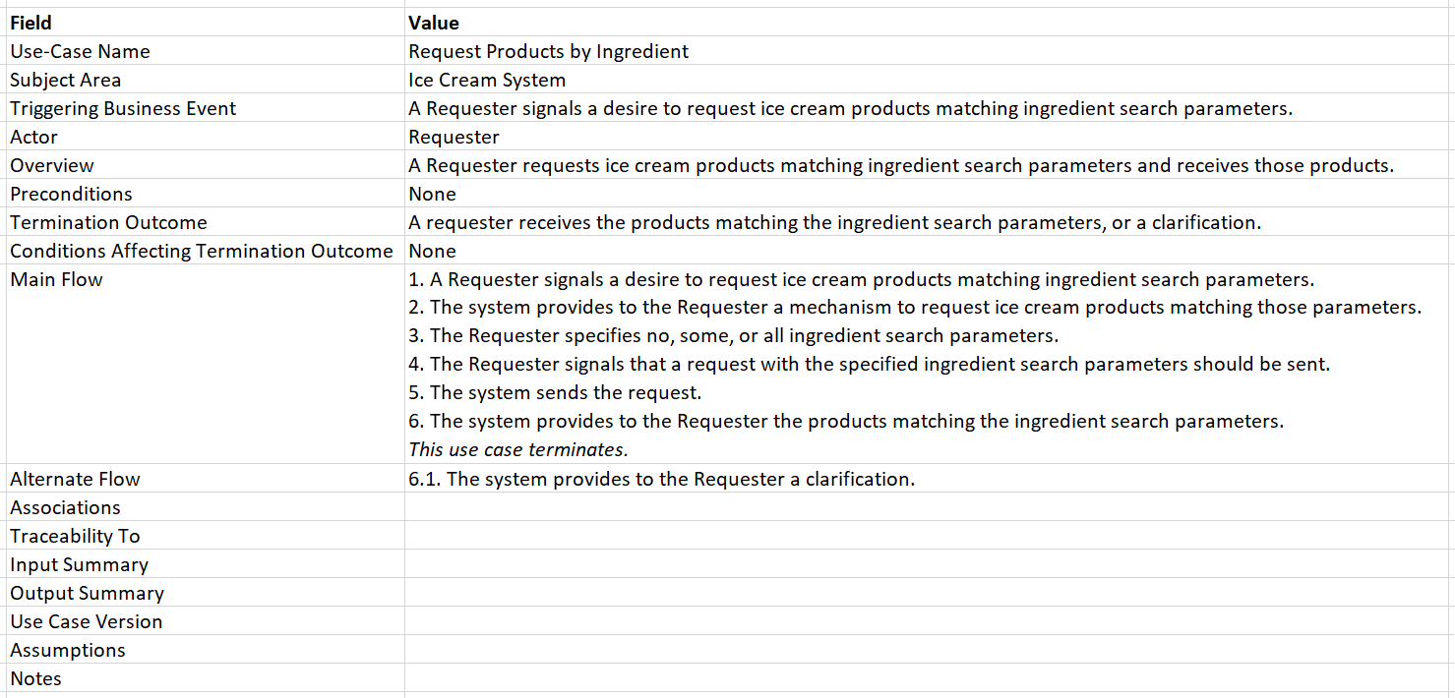
Requirements Use-Case Description Request Products by Ingredients

Slide 19
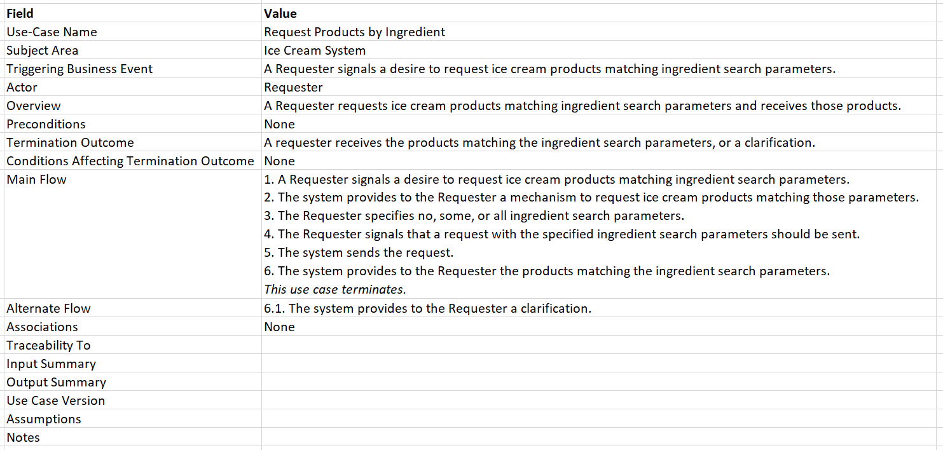
Requirements Use-Case Description Request Products by Ingredients

Slide 20
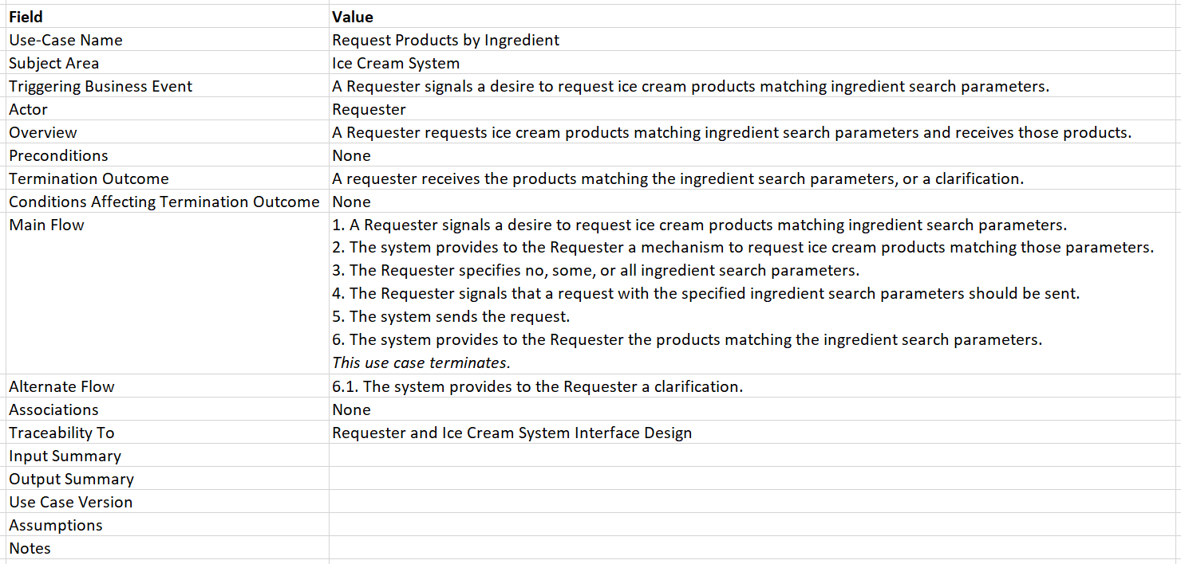
Requirements Use-Case Description Request Products by Ingredients

Slide 21
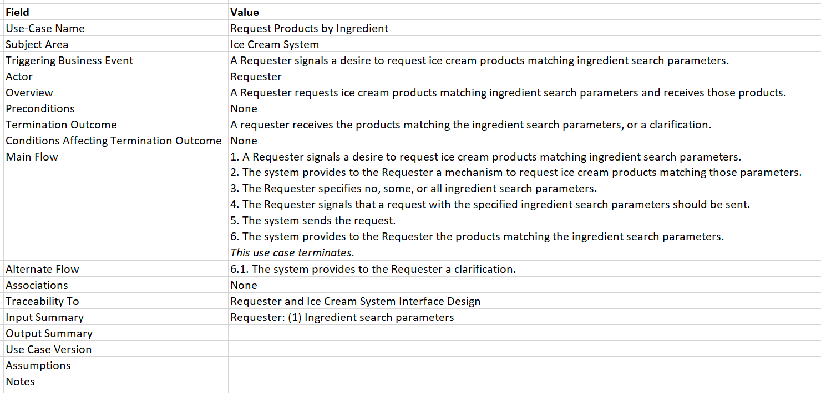
Requirements Use-Case Description Request Products by Ingredients

Slide 22
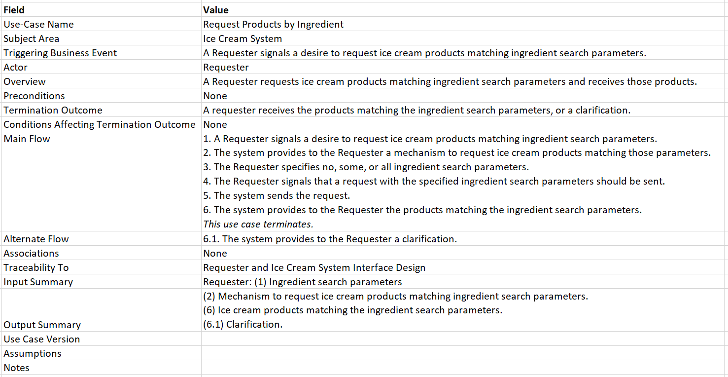
Requirements Use-Case Description Request Products by Ingredients

Slide 23

Requirements Use-Case Description Request Products by Ingredients

Slide 24

Requirements Use-Case Description Request Products by Ingredients

Slide 25
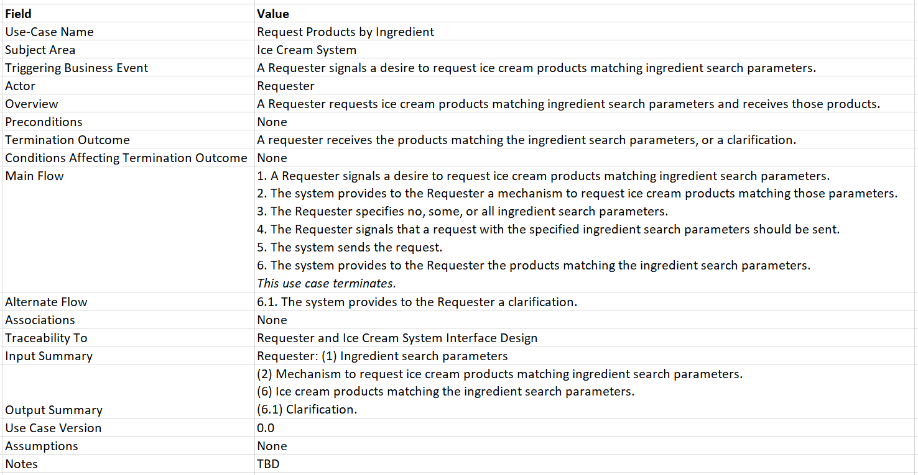
Requirements Use-Case Description Request Products by Ingredients

Slide 26
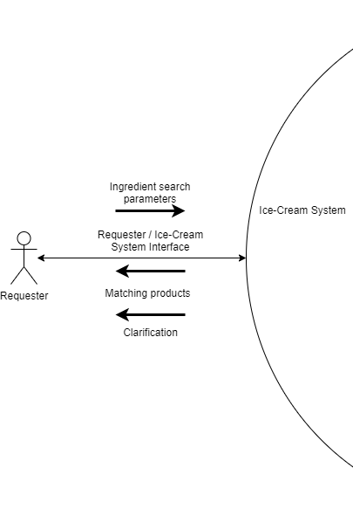
Requirements Requester and Ice Cream System Interface Design
Inputs from Requester
Ingredient search parameters
Outputs to Requester
Matching products
Clarification

Slide 27
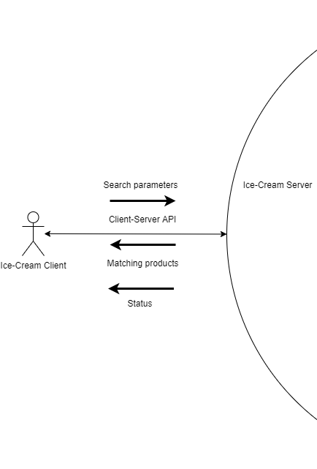
Client-Server Interface Requirements Server Half

Slide 28
Client-Server Interface Design Server Perspective
Endpoint
/search-by-ingredients
Incoming Message
Search parameters
Outgoing Messages
Matching products
Status

Slide 29
Client-Server API Design Incoming Message
search-parameters =
{“ingredients”: [
*<ingredient w/ comma>
<ingredient w/o comma>
]}
What you see is Backus-Naur Form.
Actual format is“x-www-form-urlencoded”.

Slide 30
Client-Server API Design Outgoing Messages
Matching products
{“products”: [
*<product w/ comma>
<product w/o comma>
]}
Status
{“status”: <status>}

Slide 31
Client-Server API Design Product
{
“name”: <catchy name>
“image_closed”: <path to image of closed product>
“image_open”: <path to image of open product>
“description”: <phrase to get customers salivating>
“story”: <sales-pitch>
“sourcing_values”: [*<sourcing value>]
“ingredients”: [*<ingredient>]
“allergy_info”: [*<allergen>]
“dietary_certifications”: [*<dietary certification>]
“productId”: <productid>
}

Slide 32
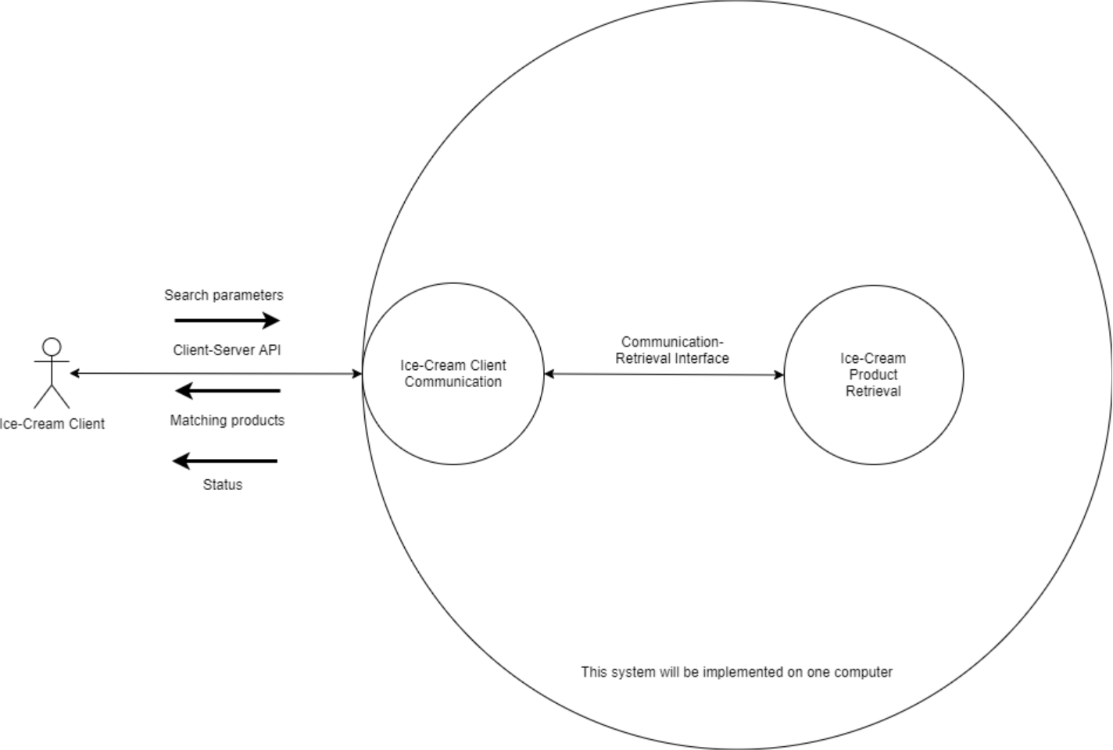
Ice Cream Server Decomposition

Slide 33
Design Classes
IceCreamClientCommunication
IceCreamProductRetrieval
SearchParameters
Products
Status

Slide 34
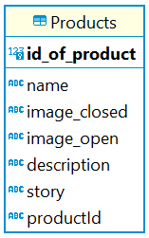
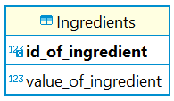
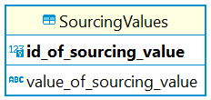
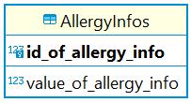
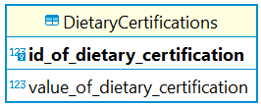
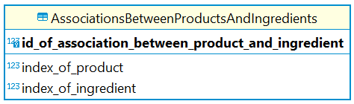
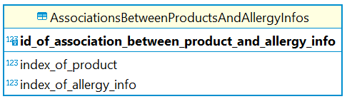
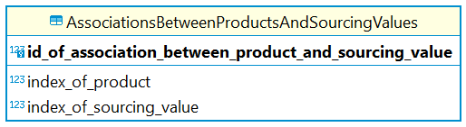
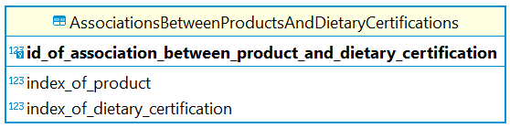
Ice Cream Database Design

Slide 35


















Development Tools
Apache Maven
Shade Plugin

Slide 36
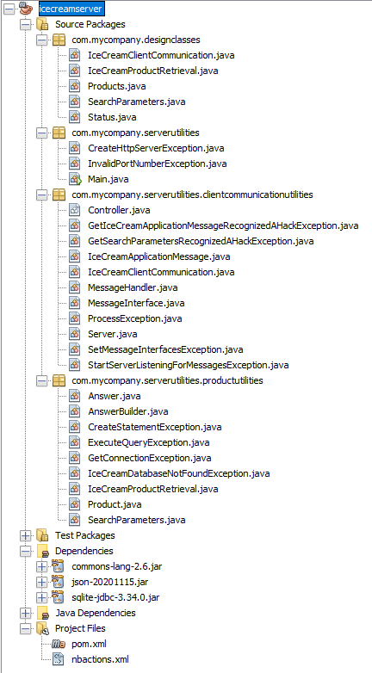
Java Project Structure as of 02/21/21

Slide 37
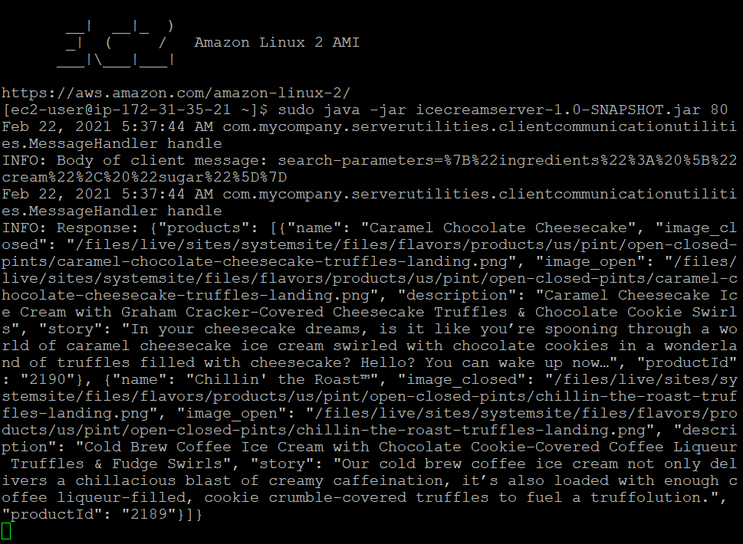
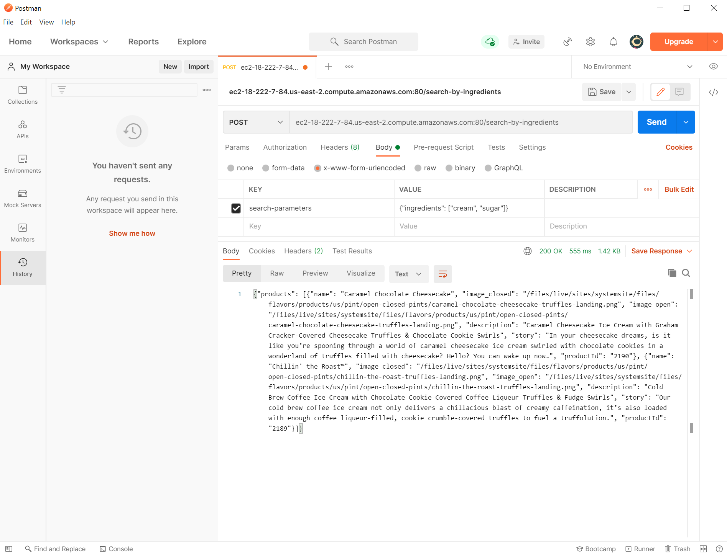
Execution

