Slide 1

HR Attrition
Predicting Employees in risk of leaving the company

Slide 2

Problem of Attrition
695 Employees left the company within the last year
16.65% Of the employees left the company within the last year
126 New hires within the last year
81,87% Of leaving employees were not replaced
This highlights the importance of maintaining the employees within the company
Notes:
#Number of current employees and number of attained employees
data_hr['Attrition'].value_counts()
#Percent who left of all people being employeed
attrition_yes = (data_hr['Attrition'] == 'Yes').sum()
attrition_no = (data_hr['Attrition'] == 'No').sum()
attrition_per = (attrition_yes/(attrition_no+attrition_yes-new_hires))*100
print(attrition_per)
# New people within the last year
new_hires = (data_hr['YearsAtCompany'] == 0).sum()
new_hires

Slide 3

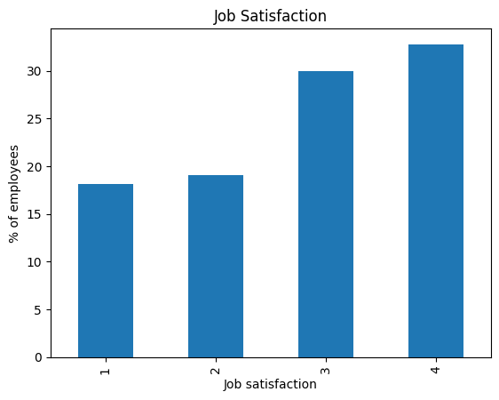
Data Analysis
The app allows the user to get an overview of the three departments within the company
Information on 11 different variables for every department
This page allows the user to investigate the profile of the current employees.

Slide 4

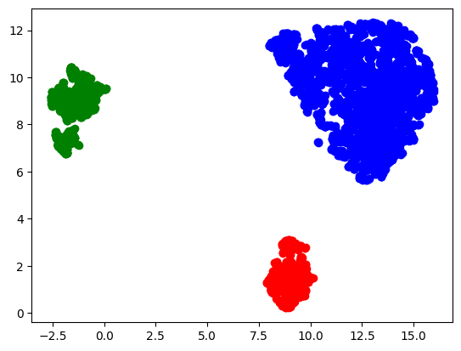
Employee Clustering
We have identified three different clusters of employees
Cluster 1 (Blue) has a mean monthly income of 67,098.55
Cluster 2 (Red) has a mean monthly income of 65,164.68
Cluster 3 (Green) has a mean monthly income of 65,123.59

Slide 5

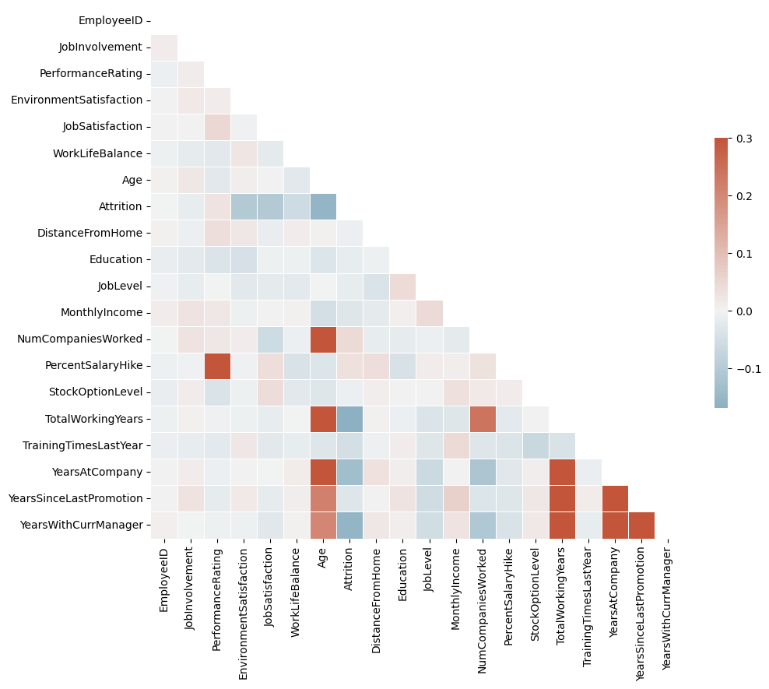
SML – Attrition Prediction
Based on the characteristics of the employees who left the company the SML will predict if a current employee is in risk of leaving as well.
The model is based on the features with the highest impact on (correlation with) attrition.
The aim of the model is to help HR and the managers of other departments to evaluate whether a specific employee is likely to leave the company based on filling in some information about the employee.

