Slide 1



Table Talks

Slide 2


Open Mics

Slide 3
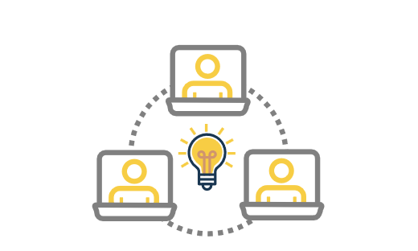
Emergent sessions

Slide 4

Panel
Sessions

