Slide 1
Solar Energy Management System with IoT
텍스트를 입력하십시오
Ways to interact and maintain solar energy sources from many miles away…
Preject #4
Jiacheng Wang, Bumjun Oh, Hanbyeol Lee, Hyeongyu Lee, Sangje Jeong

Slide 2



What we have done so far
Basic Setup : Server,AWS instance,public IP, DB,Front-End
Changed our goal:
Analysis with Tensorflow →
Fundamental Network Setup for data transfers
"Solar Energy Perspectives: Executive Summary" (PDF). International Energy Agency. 2011.

Slide 3
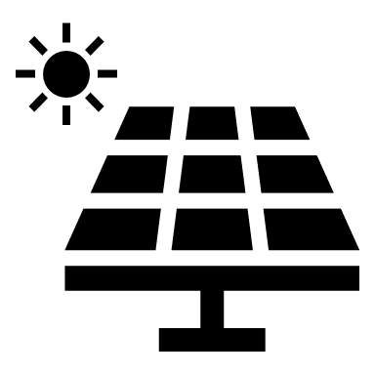
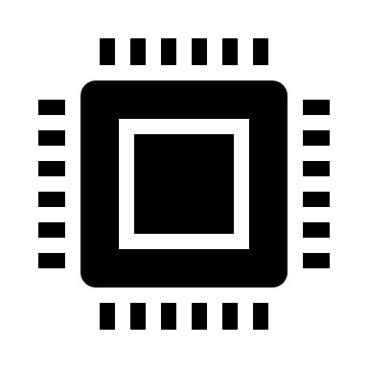
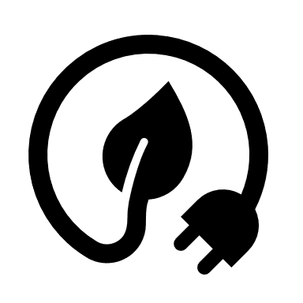
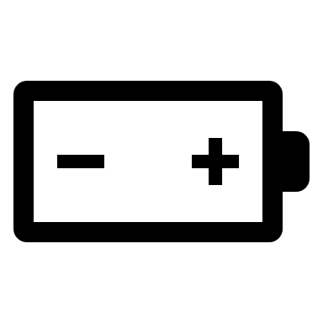

What we have done so far
Equipment purchase
Solar Panel (10W, 18V)
PWM Solar Charge Controller (12V/24V, 10A)
Lead Acid Battery (12V, 2A)
Raspberry Pi (may differ by teammates)
Sensors(Ammeter, Voltmeter, etc.)
Electric cables, resistors etc.
→This implies that the experiment will be held in a small scale.
Notes:
All bought by Hyeongyu Lee in advance before the request to our advisor Prof. Kim

Slide 4
CONTENTS
Basic Setup
Short term goals
Solar controller & Raspberry Pi

Slide 5
Basic Set up

Slide 6


Basic Set up
Basic set-up for project
AWS : http://3.140.217.19/
Server : Flask
DB : MongoDB

Slide 7
Short Term Goals

Slide 8
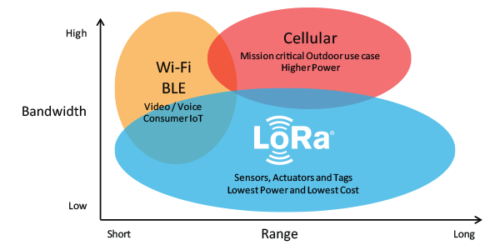
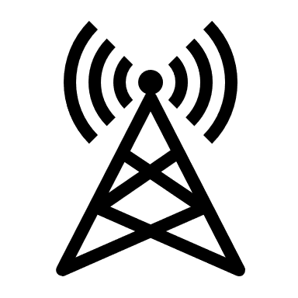
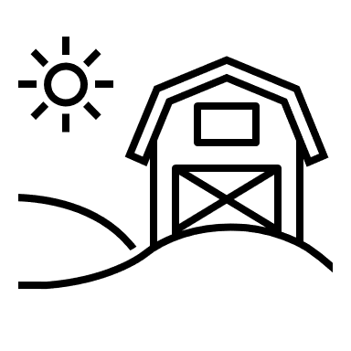

Communication between remote Places
Making our own LoRa gateway and LoRa devices connected to solar panels
Notes:
LoRa covers long range up to 450km theoretically with low bandwidth.
This technology is suitable for our project since our devices only need to send small size of data containing
Measurements of voltage, current, humidity etc.

Slide 9
Solar Controller - Raspberry pi

Slide 10
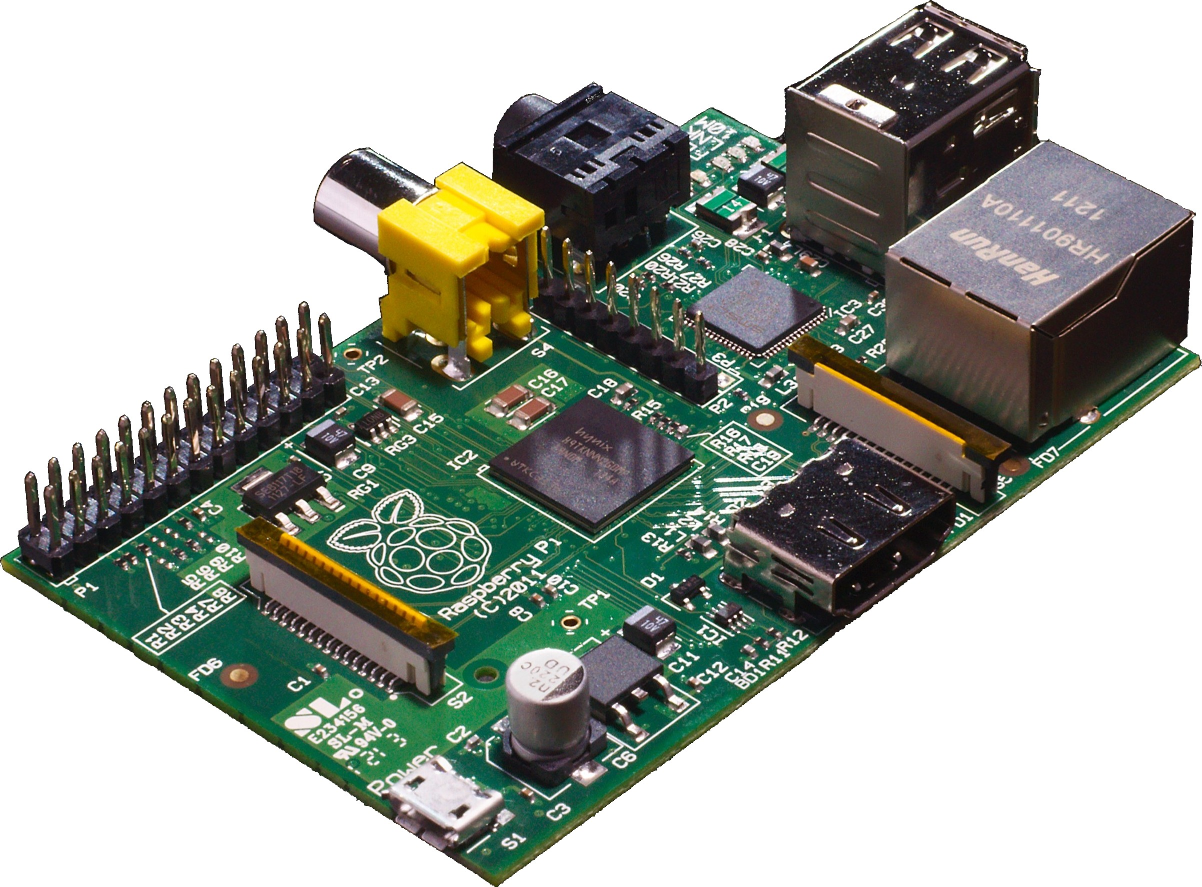
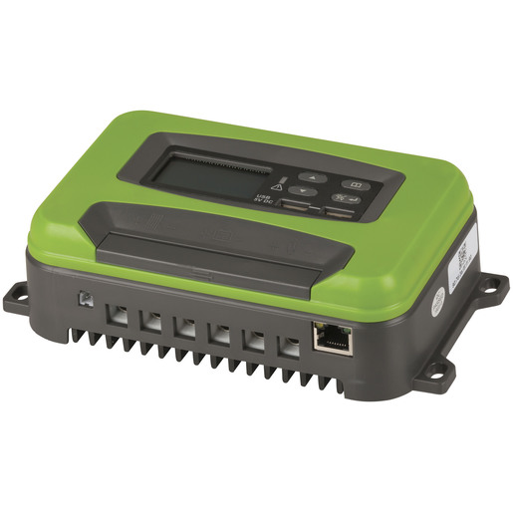
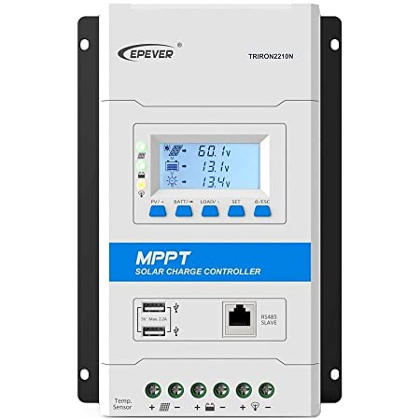

Hardships to face
How to connect Raspberry Pi to the solar charge controller?
Although solar charge controllers have numerous sensors that measure electricity flow by itself, not all of them have expansion ports like Ethernet or screw terminals to send out data
(Here are some examples)
Notes:
The solar charge controllers above are expensive items.
So Hyeongyu decided to purchase a cheap alternative that seems to work fine with the customers.
The type is PWM and it costed about $10

Slide 11
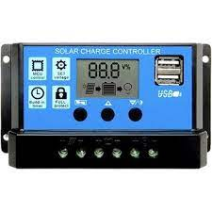
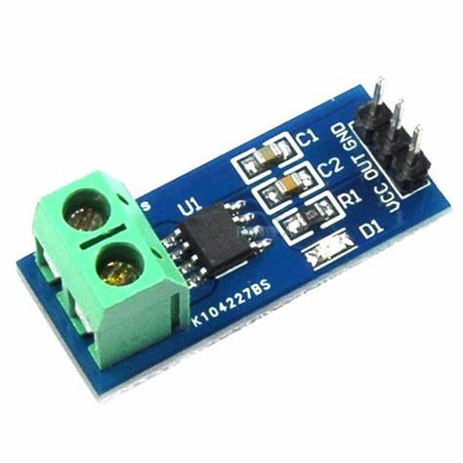
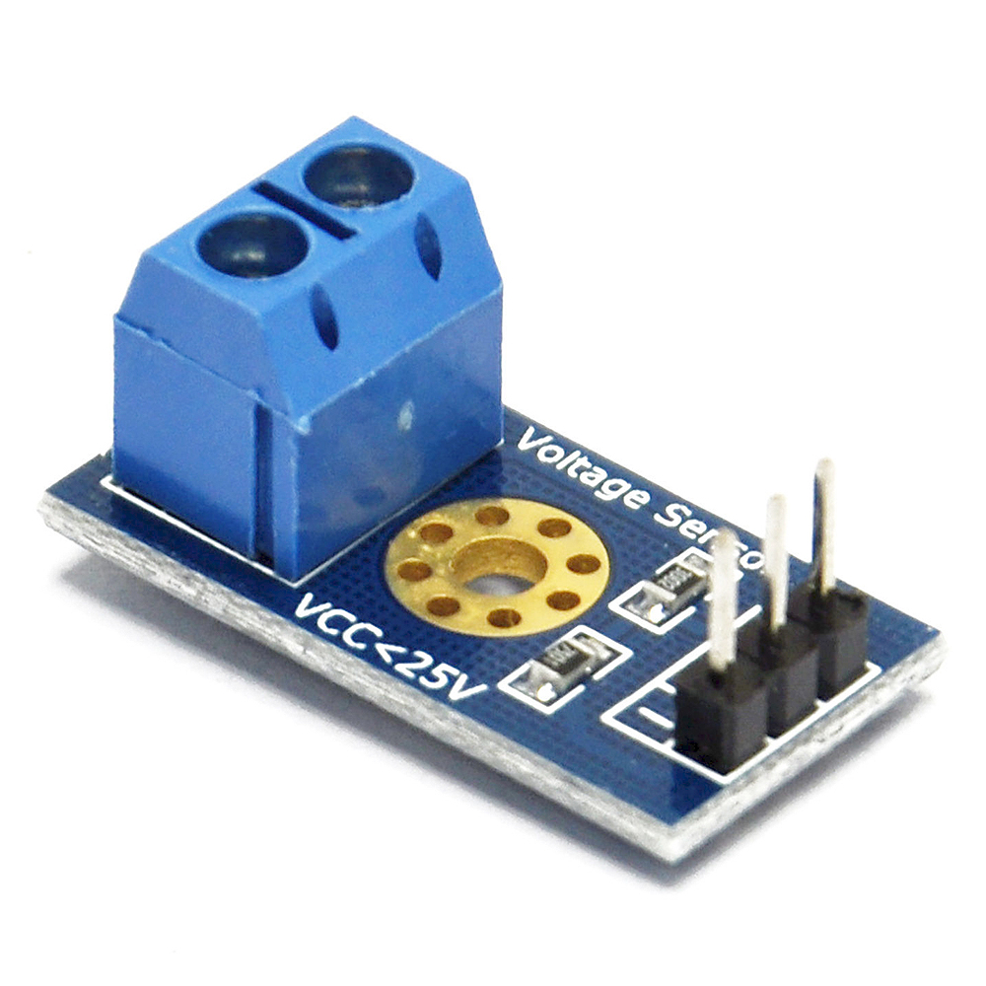
Alternative Way
Utilize additional sensors to measure current and voltage
Notes:
With Raspberry Pi, I(Hyeongyu) have an idea to utilize ammeter and voltmeter sensor to externally measure electricity flow.
However, this is just a draft before I get into the components of the actual solar charge controller
If I don’t find a way to hook up with the internal sensors, I might have to gather up various equipment to measure on my own in a small scale
But of course, it would be redundant to measure twice, once in the controller and other with raspberry pi

Slide 12
Hyeongyu Lee
Student of
Chung-Ang University
snicket@cau.ac.kr

