Slide 1
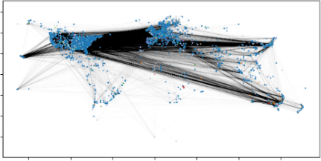
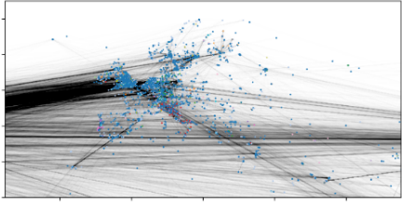
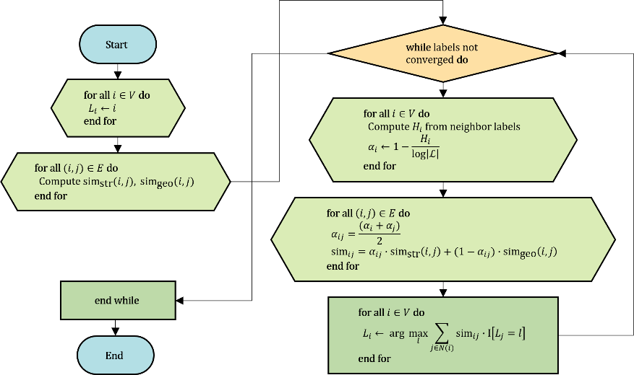


Adaptive Label Propagation with Entropy-Guided Weighting
for Location-Aware Graph Clustering
UNIST CSE, Doyeol Oh (20211187)
https://github.com/ohdoyoel/unist_cse304_term_project
Introduction
Problem Statement
Traditional graph clustering (e.g., LP, Louvain) uses only structure, often ignoring spatial coherence.
Location-based networks provide rich spatial signals via check-ins, but prior methods rely on heavy models.
We propose a lightweight, training-free method that adaptively fuses structure and location using entropy-based weighting.
Local label uncertainty guides dynamic adjustment between topological and spatial similarity.
Given a social graph $G=(V,E)$ and each user’s most recent check-in location $l_{i}$, the goal is to cluster users by combining structural proximity and spatial locality, without only relying on node features or labels.
⚖️ Hybrid Similarity Function
To fuse structure and location, we define:
$${\text{sim}}_{ij}=α_{ij}∙{\text{sim}}_{\text{str}}\left(i,j\right)+{(1−α}_{ij})∙{\text{sim}}_{\text{geo}}\left(i,j\right)$$
${\text{sim}}_{\text{str}}\left(i,j\right)$: Jaccard similarity between neighbors
${\text{sim}}_{\text{geo}}\left(i,j\right)$: Cosine similarity of location vectors
$α_{ij}=\frac{(α_{i}+α_{j})}{2}$: Weight based on entropy
🌡️ Entropy-Guided Weight
Each node $i$ calculates local label entropy at each iter:
$$H_{i}=−\sum_{l∈ℒ}{p_{i}\left(l\right)\log{p_{i}\left(l\right)}}, α_{i}=1−\frac{H_{i}}{\log\left|ℒ\right|}$$
Low entropy → Clear structural signal
→ Higher reliance on graph topology
High entropy → Ambiguous structural signal
→ Shift focus to spatial similarity
Worldwide
Europe
Limitation: Structure-only methods link distant users,
ignoring local community boundaries.
Main Contributions
🧭 Entropy-guided Weighting
: Balances structure and location using local label entropy.
📍 Recent Check-in Only
: Uses latest location to avoid trajectory modeling.
📊 Coherent Clustering
: Quantitative and visual gains on Brightkite dataset.
⚙️ Training-free & Scalable
: No learning phase; fits low-resource settings.
Algorithm Steps
Initialize: Assign a unique label to each node
Precompute: Calculate pairwise structural similarity ${\text{sim}}_{\text{str}}\left(i,j\right)$ and spatial similarity ${\text{sim}}_{\text{geo}}\left(i,j\right)$
For each node at every iteration:
Compute entropy $H_{i}$ over neighbor labels
Derive adaptive weight $α_{i}$ and hybrid similarity ${\text{sim}}_{ij}$
Update label by weighted majority vote
Repeat until label assignments converge
$$L_{i}^{(t+1)}=\text{arg} \max_{l∈ℒ}{\sum_{j∈N(i)}{{\text{sim}}_{ij}∙}Ι\left[L_{i}^{(t)}=l\right]}$$
Related Work
🧱 Key Limitations in Prior Work
Structure-only: LP, Louvain ignore node context
GNN-based: Require features, labels, and training
Location-aware: Often need trajectories and end-to-end models
🌈 In contrast, our approach:
Adaptive LP: Training-free, unsupervised, entropy-based fusion without labels
Method | Structure | Location | Training | Scalability
LP | ✅ | ❌ | ❌ | ✅
Louvain | ✅ | ❌ | ❌ | ✅
GNN | ✅ | ✅ | ✅ | ❌
Adaptive LP | ✅ | ✅ | ❌ | ✅
Adaptive Label Propagation Algorithm Flow

Slide 2

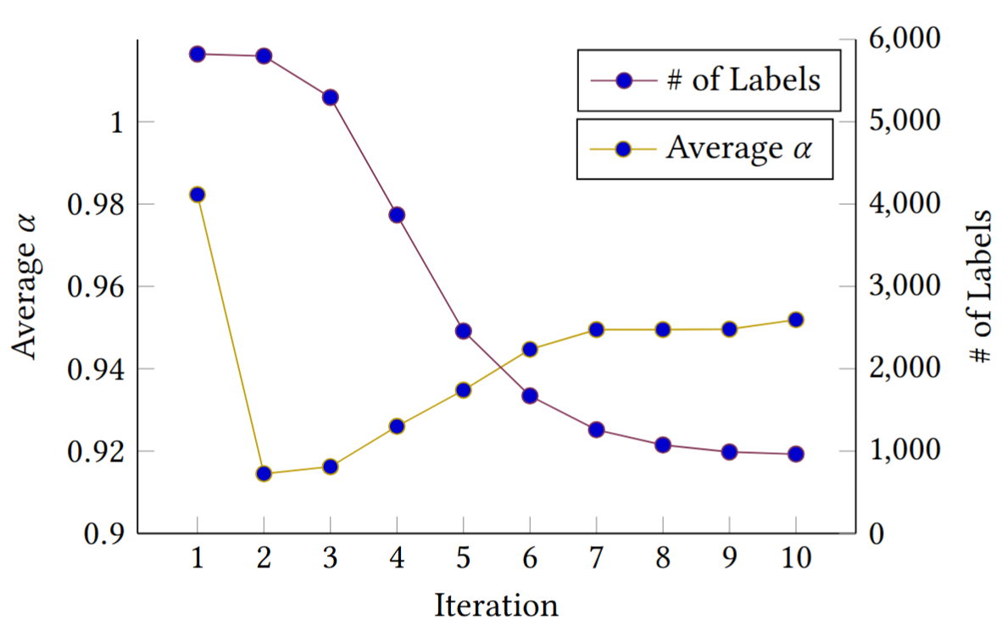
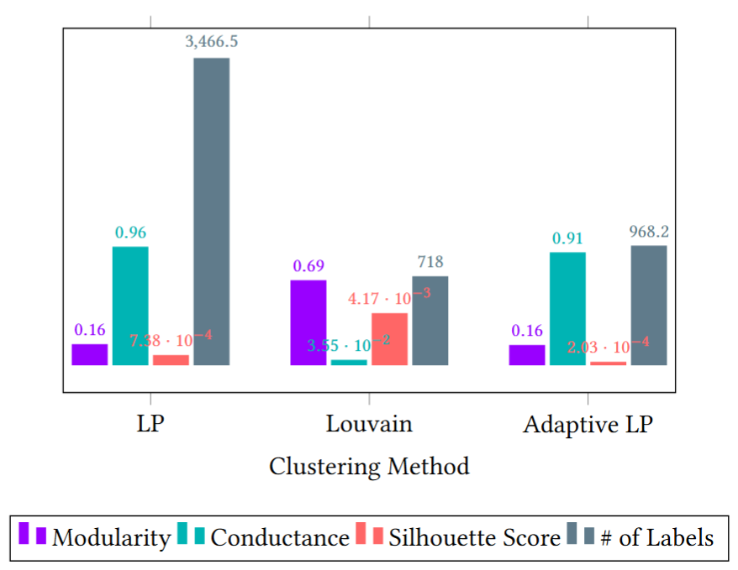


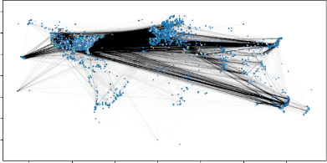

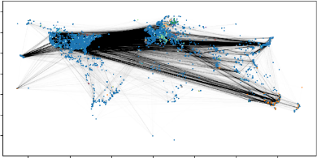

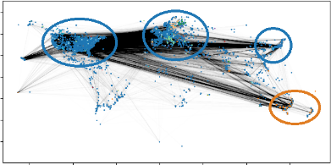
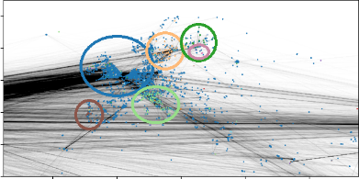
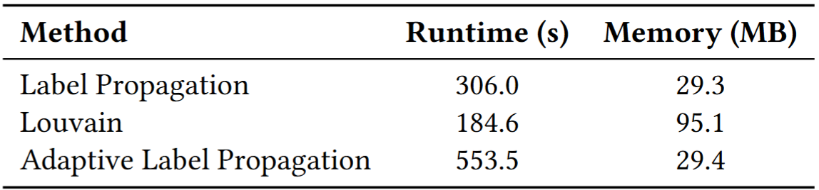
Experiment
Adaptive Weighting Behavior
📂 Dataset: Brightkite
58K users, 214K mutual edges
4.5M check-ins → only most recent used
No trajectory modeling, but preserves spatial context
🧪 Baselines
Label Propagation (LP): Structure-only label diffusion
Louvain: Hierarchical modularity optimization
🎯 Metrics
Modularity: Intra-cluster density vs. random chance
Conductance: Sharpness of cluster boundaries
Silhouette Score: Spatial compactness and separation
# of Labels: Cluster granularity (over-/under-segmentation)
📊 Result
All metrics are averaged over 10 independent runs to ensure consistency and reduce variance across methods.
Modularity & Conductance
: ALP matches LP in modularity and conductance,
but offers stronger inter-cluster connectivity with fewer
isolated groups.
Spatial Coherence vs. Silhouette
: Though ALP records a lower silhouette score, it excels in
producing geographically aligned clusters—showing its
strength in balancing spatial and structural signals.
Cluster Granularity
: ALP finds a middle ground in cluster count, mitigating
LP’s excessive fragmentation (~3466 clusters) and
Louvain’s over-merging (~718 clusters) by maintaining
moderate granularity (~968 clusters).
Evolution of # of Labels and Average $α$ over 10 Runs
🏷️ # of Labels
Drops rapidly from 5822 to 963, showing fast convergence.
📈 Average 𝛼
Decreases early (favoring spatial similarity),
then rises as structural confidence grows.
💡 Insight
Confirms ALP’s adaptive fusion of structure and
location over time.
Spatial Coherence Visualization
Comparison of Averaged Clustering Metrics over 10 Runs
LP (Worldwide)
LP (Europe)
Louvain (Worldwide)
Louvain (Europe)
LP / Louvain: Structure-only methods group distant users, producing fragmented clusters.
ALP: Leverages recent check-ins + entropy-guided weighting to form compact, localized communities.
Marked clusters:
Show ALP captures regional structures (cities) more accurately.
Adaptive LP (Worldwide)
Adaptive LP (Europe)
Computational Efficiency
Adaptive LP (Worldwide), Marked
Adaptive LP (Europe), Marked
Averaged Runtime and Memory Usage over 10 Runs
⏱️ Runtime
ALP requires more time (553.5s) due to iterative entropy
and similarity computations.
💾 Memory
Remains lightweight (29.4MB), comparable to LP and
significantly more efficient than Louvain (95.1MB).
💡 Insight
Suitable for large-scale or resource-constrained
environments where memory and responsiveness matter.
Conclusion
Proposed a lightweight, unsupervised method that fuses structure and location via entropy-guided weighting.
🏆 Strengths: Interpretable, scalable, and spatially coherent without training.
🚀 Future work: ¹ Use full trajectory data for spatiotemporal clustering ² Incorporate uncertainty metrics beyond entropy ³ Extend to streaming/dynamic social graphs

