Slide 2
Relevant
Notes:
C:\code\FluencyPowerPoint\PowerPointGeneration\PowerPointGeneration.Tests\CodeSmells-Clutter\Relevant 01.png

Slide 3
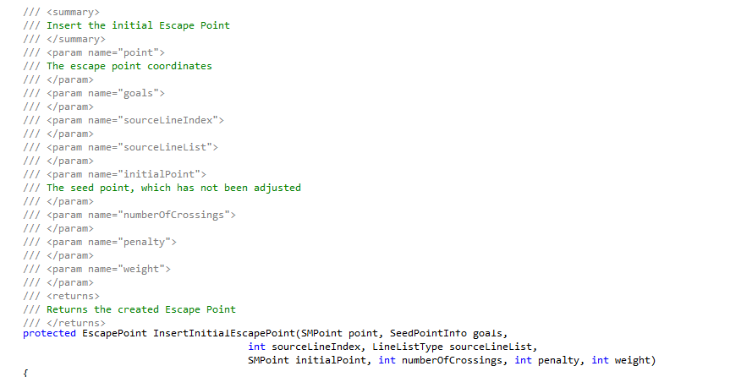

Slide 4
Clutter
Notes:
C:\code\FluencyPowerPoint\PowerPointGeneration\PowerPointGeneration.Tests\CodeSmells-Clutter\Clutter 01.png

Slide 5
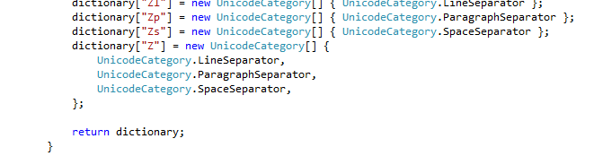

Slide 6
Relevant
Notes:
C:\code\FluencyPowerPoint\PowerPointGeneration\PowerPointGeneration.Tests\CodeSmells-Clutter\Relevant 02.png

Slide 7
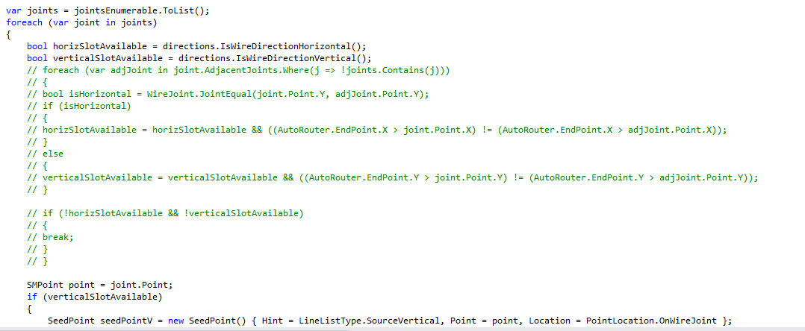

Slide 8
Clutter
Notes:
C:\code\FluencyPowerPoint\PowerPointGeneration\PowerPointGeneration.Tests\CodeSmells-Clutter\Clutter 02.png

Slide 9
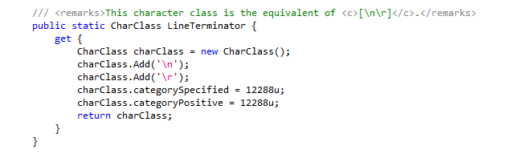

Slide 10
Relevant
Notes:
C:\code\FluencyPowerPoint\PowerPointGeneration\PowerPointGeneration.Tests\CodeSmells-Clutter\Relevant 03.png

Slide 11


Slide 12
Relevant
Notes:
C:\code\FluencyPowerPoint\PowerPointGeneration\PowerPointGeneration.Tests\CodeSmells-Clutter\Relevant 04.png

Slide 13
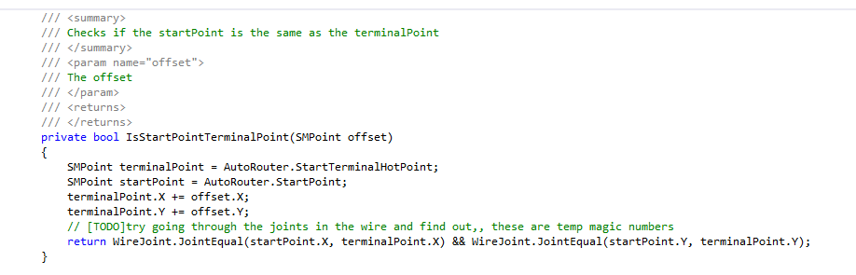

Slide 14
Clutter
Notes:
C:\code\FluencyPowerPoint\PowerPointGeneration\PowerPointGeneration.Tests\CodeSmells-Clutter\Clutter 03.png

Slide 15
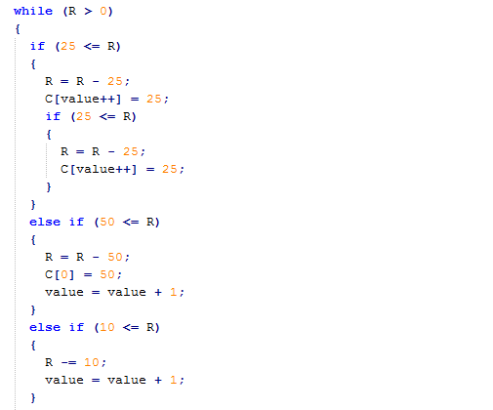

Slide 16
Relevant
Notes:
C:\code\FluencyPowerPoint\PowerPointGeneration\PowerPointGeneration.Tests\CodeSmells-Clutter\Relevant 05.png

Slide 17
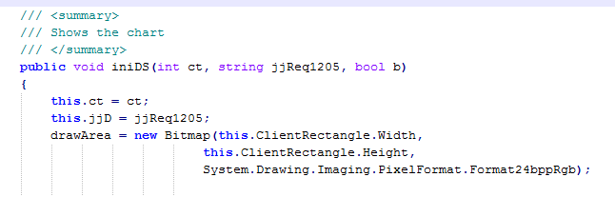

Slide 18
Relevant
Notes:
C:\code\FluencyPowerPoint\PowerPointGeneration\PowerPointGeneration.Tests\CodeSmells-Clutter\Relevant 06.png

Slide 19
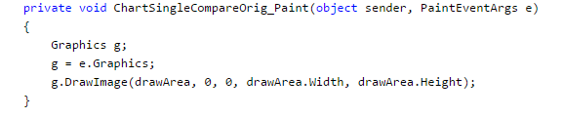

Slide 20
Relevant
Notes:
C:\code\FluencyPowerPoint\PowerPointGeneration\PowerPointGeneration.Tests\CodeSmells-Clutter\Relevant 07.png

Slide 21
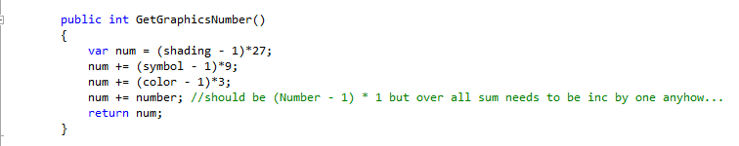

Slide 22
Relevant
Notes:
C:\code\FluencyPowerPoint\PowerPointGeneration\PowerPointGeneration.Tests\CodeSmells-Clutter\Relevant 08.png

Slide 23
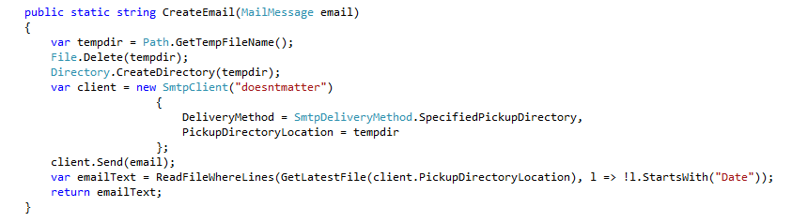

Slide 24
Relevant
Notes:
C:\code\FluencyPowerPoint\PowerPointGeneration\PowerPointGeneration.Tests\CodeSmells-Clutter\Relevant 09.png

Slide 25
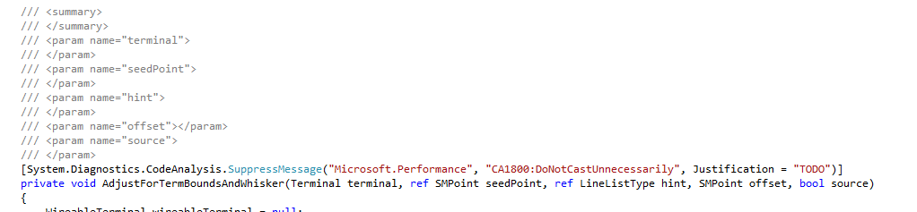

Slide 26
Clutter
Notes:
C:\code\FluencyPowerPoint\PowerPointGeneration\PowerPointGeneration.Tests\CodeSmells-Clutter\Clutter 04.png

Slide 27
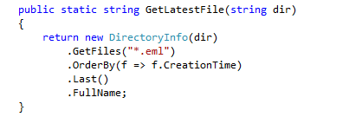

Slide 28
Relevant
Notes:
C:\code\FluencyPowerPoint\PowerPointGeneration\PowerPointGeneration.Tests\CodeSmells-Clutter\Relevant 10.png

Slide 29
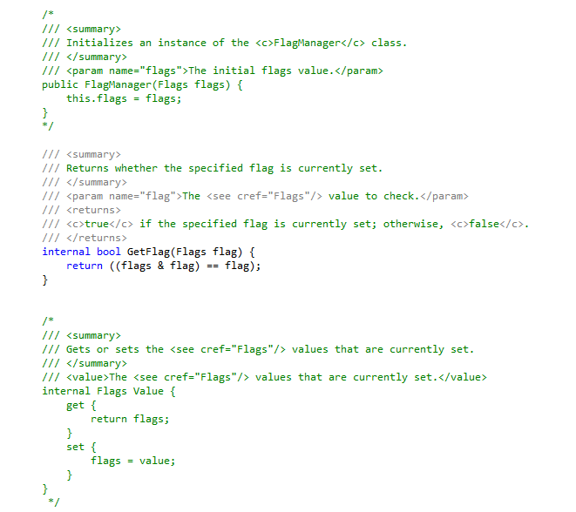

Slide 30
Clutter
Notes:
C:\code\FluencyPowerPoint\PowerPointGeneration\PowerPointGeneration.Tests\CodeSmells-Clutter\Clutter 05.png

Slide 31
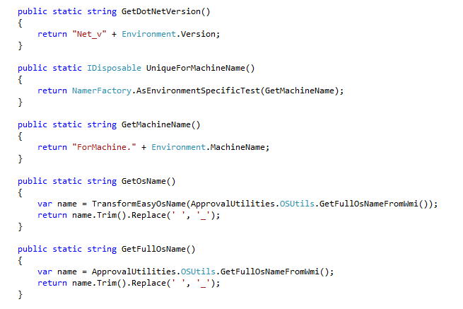

Slide 32
Relevant
Notes:
C:\code\FluencyPowerPoint\PowerPointGeneration\PowerPointGeneration.Tests\CodeSmells-Clutter\Relevant 11.png

Slide 33
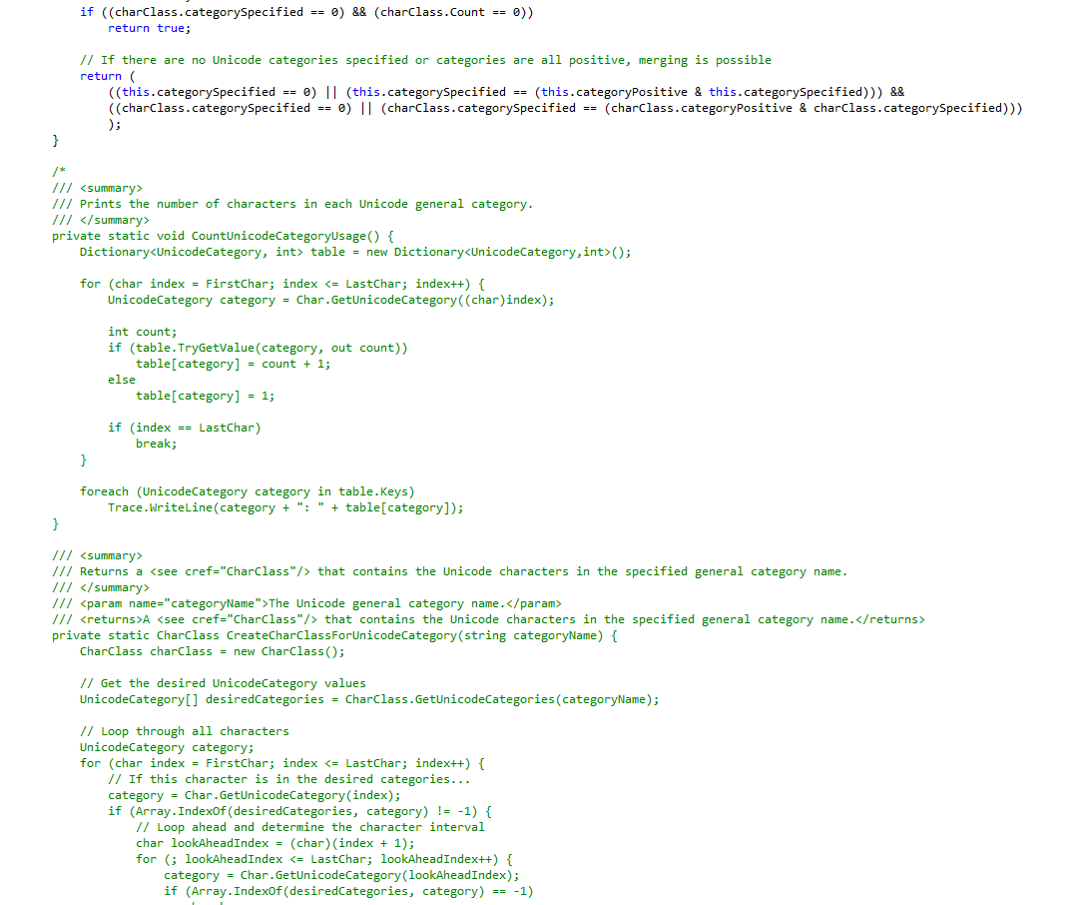

Slide 34
Clutter
Notes:
C:\code\FluencyPowerPoint\PowerPointGeneration\PowerPointGeneration.Tests\CodeSmells-Clutter\Clutter 06.png

Slide 35
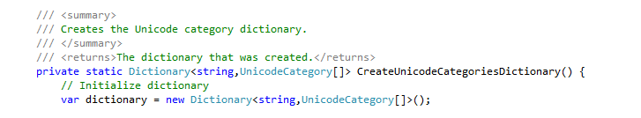

Slide 36
Clutter
Notes:
C:\code\FluencyPowerPoint\PowerPointGeneration\PowerPointGeneration.Tests\CodeSmells-Clutter\Clutter 07.png

Slide 37
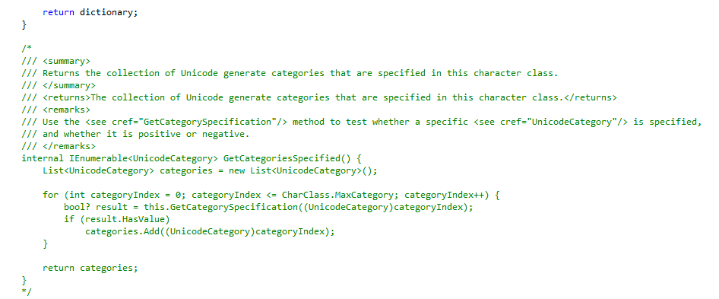

Slide 38
Clutter
Notes:
C:\code\FluencyPowerPoint\PowerPointGeneration\PowerPointGeneration.Tests\CodeSmells-Clutter\Clutter 08.png

Slide 39
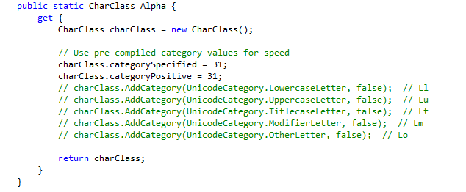

Slide 40
Clutter
Notes:
C:\code\FluencyPowerPoint\PowerPointGeneration\PowerPointGeneration.Tests\CodeSmells-Clutter\Clutter 09.png

Slide 41
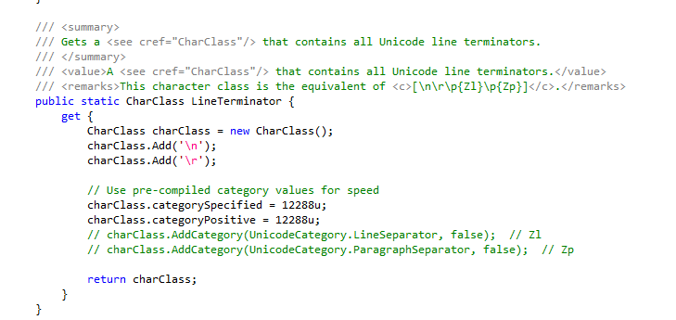

Slide 42
Clutter
Notes:
C:\code\FluencyPowerPoint\PowerPointGeneration\PowerPointGeneration.Tests\CodeSmells-Clutter\Clutter 10.png

Slide 43
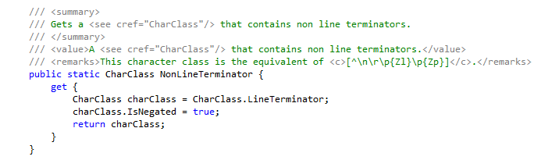

Slide 44
Clutter
Notes:
C:\code\FluencyPowerPoint\PowerPointGeneration\PowerPointGeneration.Tests\CodeSmells-Clutter\Clutter 11.png

Slide 45
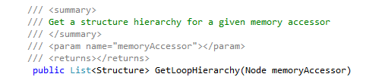

Slide 46
Clutter
Notes:
C:\code\FluencyPowerPoint\PowerPointGeneration\PowerPointGeneration.Tests\CodeSmells-Clutter\Clutter 12.png

Slide 47
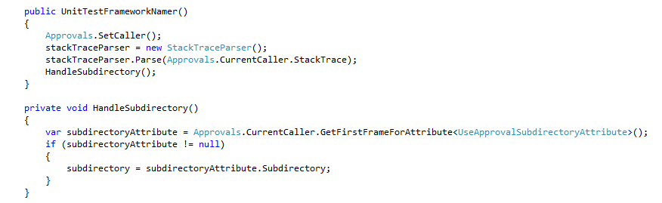

Slide 48
Relevant
Notes:
C:\code\FluencyPowerPoint\PowerPointGeneration\PowerPointGeneration.Tests\CodeSmells-Clutter\Relevant 12.png

Slide 49
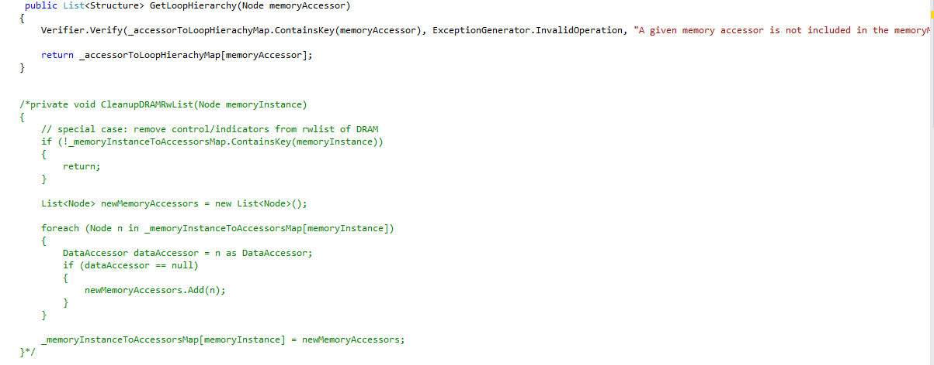

Slide 50
Clutter
Notes:
C:\code\FluencyPowerPoint\PowerPointGeneration\PowerPointGeneration.Tests\CodeSmells-Clutter\Clutter 13.png

Slide 51
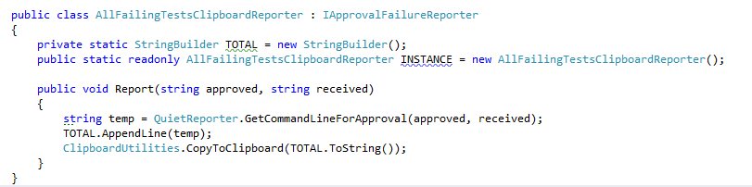

Slide 52
Relevant
Notes:
C:\code\FluencyPowerPoint\PowerPointGeneration\PowerPointGeneration.Tests\CodeSmells-Clutter\Relevant 13.png

Slide 53
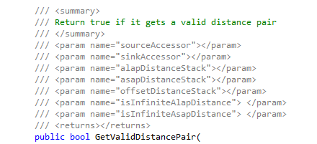

Slide 54
Clutter
Notes:
C:\code\FluencyPowerPoint\PowerPointGeneration\PowerPointGeneration.Tests\CodeSmells-Clutter\Clutter 14.png

Slide 55
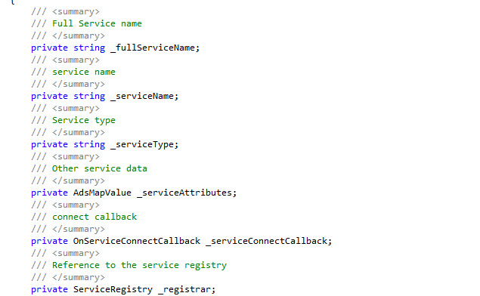

Slide 56
Clutter
Notes:
C:\code\FluencyPowerPoint\PowerPointGeneration\PowerPointGeneration.Tests\CodeSmells-Clutter\Clutter 15.png

Slide 57


Slide 58
Clutter
Notes:
C:\code\FluencyPowerPoint\PowerPointGeneration\PowerPointGeneration.Tests\CodeSmells-Clutter\Clutter 16.png

Slide 59
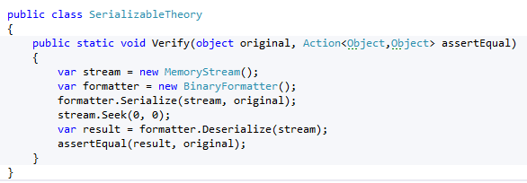

Slide 60
Relevant
Notes:
C:\code\FluencyPowerPoint\PowerPointGeneration\PowerPointGeneration.Tests\CodeSmells-Clutter\Relevant 14.png

Slide 61
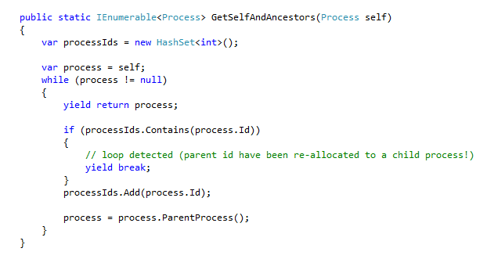

Slide 62
Relevant
Notes:
C:\code\FluencyPowerPoint\PowerPointGeneration\PowerPointGeneration.Tests\CodeSmells-Clutter\Relevant 15.png

Slide 63
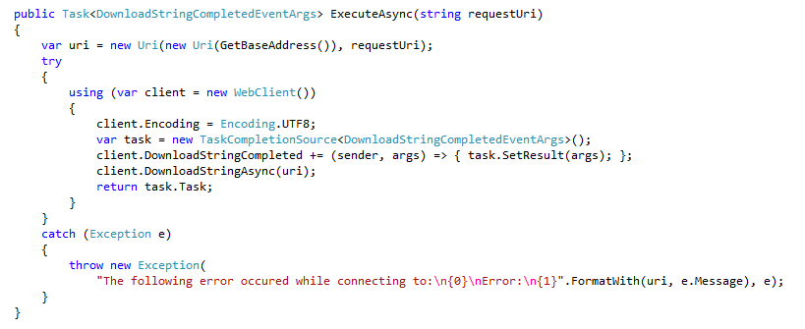

Slide 64
Relevant
Notes:
C:\code\FluencyPowerPoint\PowerPointGeneration\PowerPointGeneration.Tests\CodeSmells-Clutter\Relevant 16.png

Slide 65
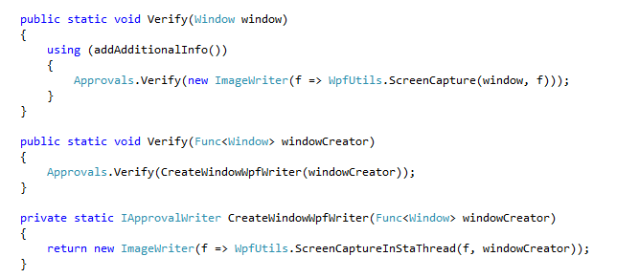

Slide 66
Relevant
Notes:
C:\code\FluencyPowerPoint\PowerPointGeneration\PowerPointGeneration.Tests\CodeSmells-Clutter\Relevant 17.png

Slide 67


Slide 68
Clutter
Notes:
C:\code\FluencyPowerPoint\PowerPointGeneration\PowerPointGeneration.Tests\CodeSmells-Clutter\Clutter 17.png

Slide 69


Slide 70
Clutter
Notes:
C:\code\FluencyPowerPoint\PowerPointGeneration\PowerPointGeneration.Tests\CodeSmells-Clutter\Clutter 18.png

Slide 71
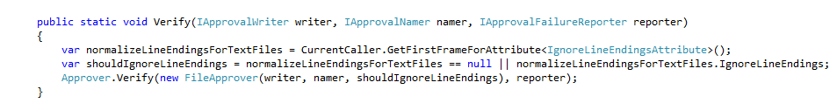

Slide 72
Relevant
Notes:
C:\code\FluencyPowerPoint\PowerPointGeneration\PowerPointGeneration.Tests\CodeSmells-Clutter\Relevant 18.png

Slide 73
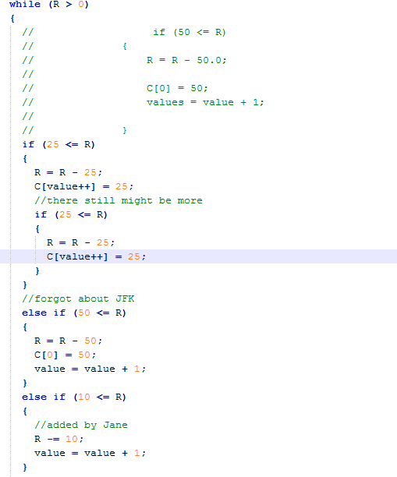

Slide 74
Clutter
Notes:
C:\code\FluencyPowerPoint\PowerPointGeneration\PowerPointGeneration.Tests\CodeSmells-Clutter\Clutter 19.png

Slide 75
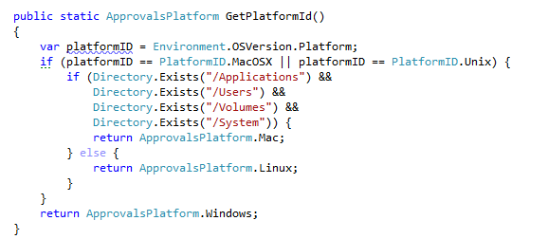

Slide 76
Relevant
Notes:
C:\code\FluencyPowerPoint\PowerPointGeneration\PowerPointGeneration.Tests\CodeSmells-Clutter\Relevant 19.png

Slide 77
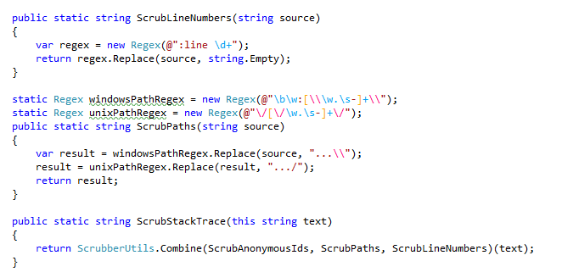

Slide 78
Relevant
Notes:
C:\code\FluencyPowerPoint\PowerPointGeneration\PowerPointGeneration.Tests\CodeSmells-Clutter\Relevant 20.png

Slide 79
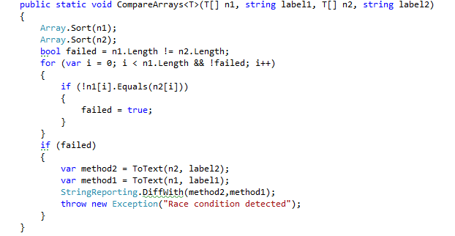

Slide 80
Relevant
Notes:
C:\code\FluencyPowerPoint\PowerPointGeneration\PowerPointGeneration.Tests\CodeSmells-Clutter\Relevant 21.png

Slide 81


Slide 82
Clutter
Notes:
C:\code\FluencyPowerPoint\PowerPointGeneration\PowerPointGeneration.Tests\CodeSmells-Clutter\Clutter 20.png

Slide 83
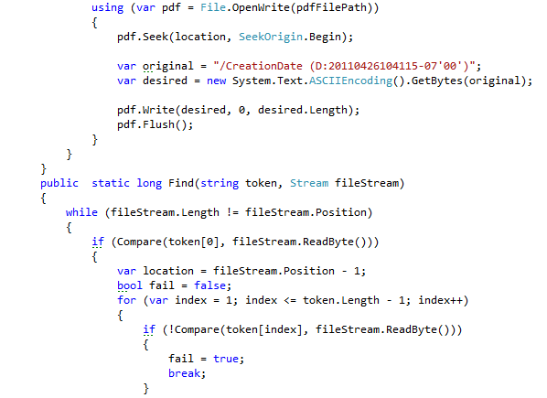

Slide 84
Relevant
Notes:
C:\code\FluencyPowerPoint\PowerPointGeneration\PowerPointGeneration.Tests\CodeSmells-Clutter\Relevant 22.png

Slide 85
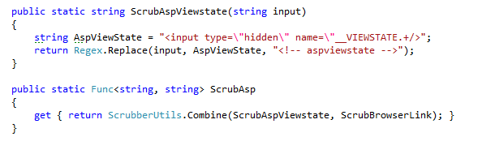

Slide 86
Relevant
Notes:
C:\code\FluencyPowerPoint\PowerPointGeneration\PowerPointGeneration.Tests\CodeSmells-Clutter\Relevant 23.png

Slide 87
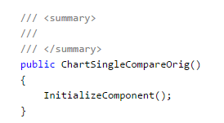

Slide 88
Clutter
Notes:
C:\code\FluencyPowerPoint\PowerPointGeneration\PowerPointGeneration.Tests\CodeSmells-Clutter\Clutter 21.png

Slide 89
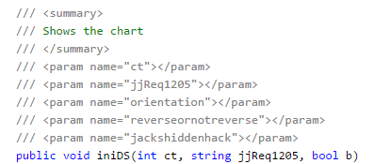

Slide 90
Clutter
Notes:
C:\code\FluencyPowerPoint\PowerPointGeneration\PowerPointGeneration.Tests\CodeSmells-Clutter\Clutter 22.png

Slide 91
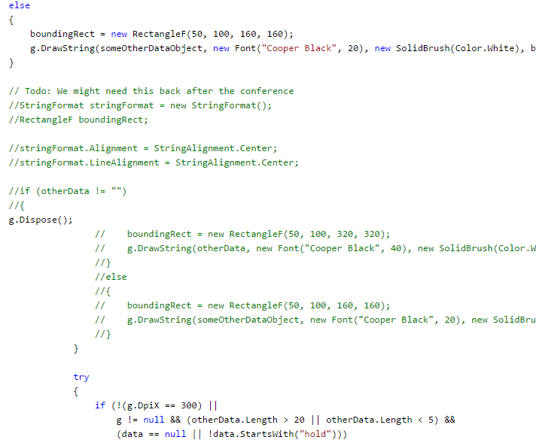

Slide 92
Clutter
Notes:
C:\code\FluencyPowerPoint\PowerPointGeneration\PowerPointGeneration.Tests\CodeSmells-Clutter\Clutter 23.png

Slide 93
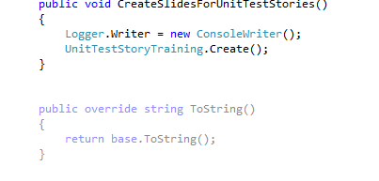

Slide 94
Clutter
Notes:
C:\code\FluencyPowerPoint\PowerPointGeneration\PowerPointGeneration.Tests\CodeSmells-Clutter\Clutter 24.png

Slide 95
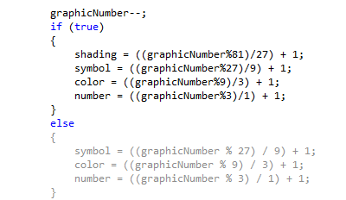

Slide 96
Clutter
Notes:
C:\code\FluencyPowerPoint\PowerPointGeneration\PowerPointGeneration.Tests\CodeSmells-Clutter\Clutter 25.png

Slide 97
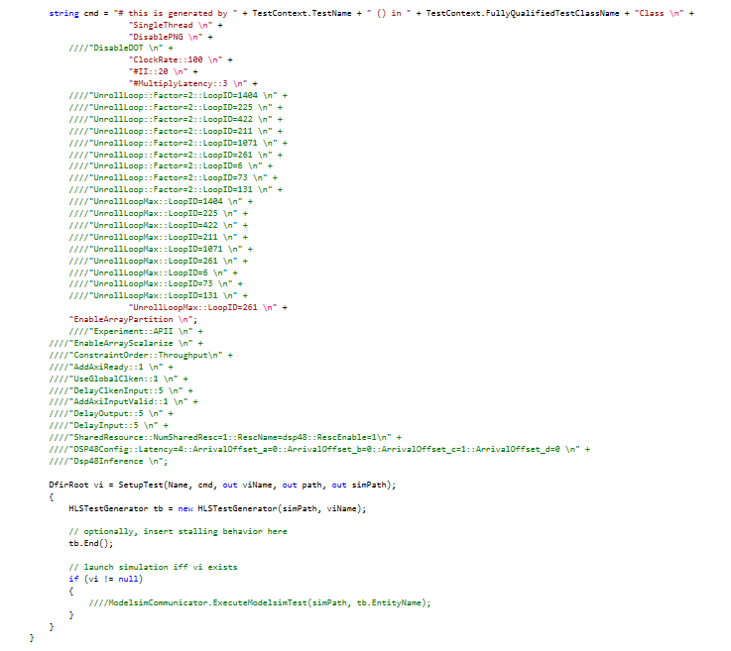

Slide 98
Clutter
Notes:
C:\code\FluencyPowerPoint\PowerPointGeneration\PowerPointGeneration.Tests\CodeSmells-Clutter\Clutter 26.png

Slide 99


Slide 100
Clutter
Notes:
C:\code\FluencyPowerPoint\PowerPointGeneration\PowerPointGeneration.Tests\CodeSmells-Clutter\Clutter 27.png

Slide 101


Slide 102
Relevant
Notes:
C:\code\FluencyPowerPoint\PowerPointGeneration\PowerPointGeneration.Tests\CodeSmells-Clutter\Relevant 24.png

Slide 103
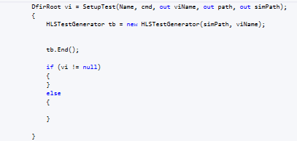

Slide 104
Clutter
Notes:
C:\code\FluencyPowerPoint\PowerPointGeneration\PowerPointGeneration.Tests\CodeSmells-Clutter\Clutter 28.png

Slide 105
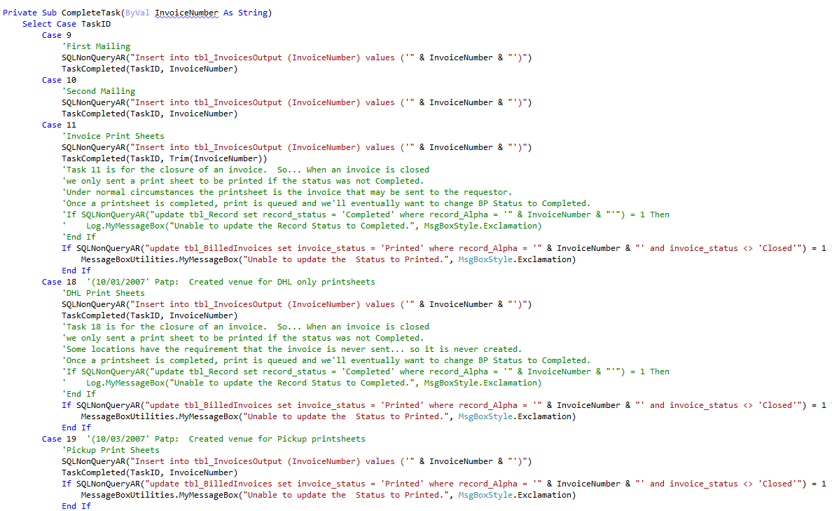

Slide 106
Clutter
Notes:
C:\code\FluencyPowerPoint\PowerPointGeneration\PowerPointGeneration.Tests\CodeSmells-Clutter\Clutter 29.png

Slide 107
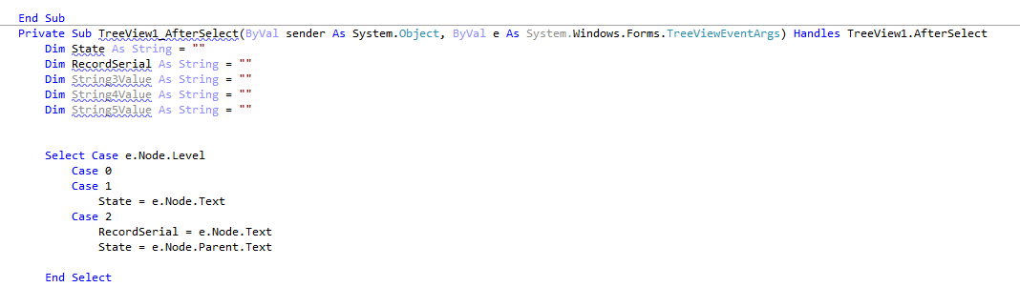

Slide 108
Clutter
Notes:
C:\code\FluencyPowerPoint\PowerPointGeneration\PowerPointGeneration.Tests\CodeSmells-Clutter\Clutter 30.png

Slide 109
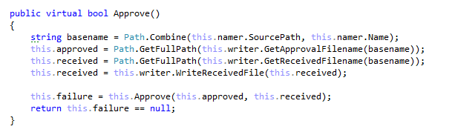

Slide 110
Relevant
Notes:
C:\code\FluencyPowerPoint\PowerPointGeneration\PowerPointGeneration.Tests\CodeSmells-Clutter\Relevant 25.png

Slide 112
Clutter
Notes:
C:\code\FluencyPowerPoint\PowerPointGeneration\PowerPointGeneration.Tests\CodeSmells-Clutter\Clutter 31.png

Slide 113
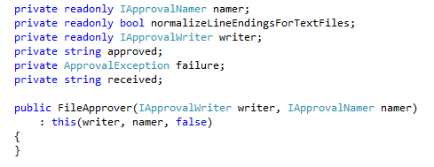

Slide 114
Relevant
Notes:
C:\code\FluencyPowerPoint\PowerPointGeneration\PowerPointGeneration.Tests\CodeSmells-Clutter\Relevant 26.png

Slide 115


Slide 116
Clutter
Notes:
C:\code\FluencyPowerPoint\PowerPointGeneration\PowerPointGeneration.Tests\CodeSmells-Clutter\Clutter 32.png

Slide 117
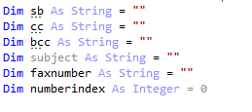

Slide 118
Clutter
Notes:
C:\code\FluencyPowerPoint\PowerPointGeneration\PowerPointGeneration.Tests\CodeSmells-Clutter\Clutter 33.png

Slide 119
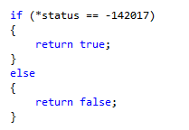

Slide 120
Clutter
Notes:
C:\code\FluencyPowerPoint\PowerPointGeneration\PowerPointGeneration.Tests\CodeSmells-Clutter\Clutter 34.png

Slide 121


Slide 122
Relevant
Notes:
C:\code\FluencyPowerPoint\PowerPointGeneration\PowerPointGeneration.Tests\CodeSmells-Clutter\Relevant 27.png

Slide 123


Slide 124
Relevant
Notes:
C:\code\FluencyPowerPoint\PowerPointGeneration\PowerPointGeneration.Tests\CodeSmells-Clutter\Relevant 28.png

Slide 125


Slide 126
Clutter
Notes:
C:\code\FluencyPowerPoint\PowerPointGeneration\PowerPointGeneration.Tests\CodeSmells-Clutter\Clutter 35.png

Slide 127


Slide 128
Clutter
Notes:
C:\code\FluencyPowerPoint\PowerPointGeneration\PowerPointGeneration.Tests\CodeSmells-Clutter\Clutter 36.png

Slide 129


Slide 130
Clutter
Notes:
C:\code\FluencyPowerPoint\PowerPointGeneration\PowerPointGeneration.Tests\CodeSmells-Clutter\Clutter 37.png

Slide 131


Slide 132
Relevant
Notes:
C:\code\FluencyPowerPoint\PowerPointGeneration\PowerPointGeneration.Tests\CodeSmells-Clutter\Relevant 29.png

Slide 133


Slide 134
Clutter
Notes:
C:\code\FluencyPowerPoint\PowerPointGeneration\PowerPointGeneration.Tests\CodeSmells-Clutter\Clutter 38.png

Slide 135


Slide 136
Clutter
Notes:
C:\code\FluencyPowerPoint\PowerPointGeneration\PowerPointGeneration.Tests\CodeSmells-Clutter\Clutter 39.png

Slide 137


Slide 138
Relevant
Notes:
C:\code\FluencyPowerPoint\PowerPointGeneration\PowerPointGeneration.Tests\CodeSmells-Clutter\Relevant 30.png

Slide 139


Slide 140
Clutter
Notes:
C:\code\FluencyPowerPoint\PowerPointGeneration\PowerPointGeneration.Tests\CodeSmells-Clutter\Clutter 40.png

Slide 141


Slide 142
Clutter
Notes:
C:\code\FluencyPowerPoint\PowerPointGeneration\PowerPointGeneration.Tests\CodeSmells-Clutter\Clutter 41.png

Slide 143


Slide 144
Clutter
Notes:
C:\code\FluencyPowerPoint\PowerPointGeneration\PowerPointGeneration.Tests\CodeSmells-Clutter\Clutter 42.png

Slide 145


Slide 146
Clutter
Notes:
C:\code\FluencyPowerPoint\PowerPointGeneration\PowerPointGeneration.Tests\CodeSmells-Clutter\Clutter 43.png

Slide 147


Slide 148
Clutter
Notes:
C:\code\FluencyPowerPoint\PowerPointGeneration\PowerPointGeneration.Tests\CodeSmells-Clutter\Clutter 44.png

Slide 149


Slide 150
Clutter
Notes:
C:\code\FluencyPowerPoint\PowerPointGeneration\PowerPointGeneration.Tests\CodeSmells-Clutter\Clutter 45.png

Slide 151


Slide 152
Clutter
Notes:
C:\code\FluencyPowerPoint\PowerPointGeneration\PowerPointGeneration.Tests\CodeSmells-Clutter\Clutter 46.png

Slide 153


Slide 154
Clutter
Notes:
C:\code\FluencyPowerPoint\PowerPointGeneration\PowerPointGeneration.Tests\CodeSmells-Clutter\Clutter 47.png

Slide 155


Slide 156
Clutter
Notes:
C:\code\FluencyPowerPoint\PowerPointGeneration\PowerPointGeneration.Tests\CodeSmells-Clutter\Clutter 48.png

Slide 157


Slide 158
Clutter
Notes:
C:\code\FluencyPowerPoint\PowerPointGeneration\PowerPointGeneration.Tests\CodeSmells-Clutter\Clutter 49.png

Slide 159


Slide 160
Clutter
Notes:
C:\code\FluencyPowerPoint\PowerPointGeneration\PowerPointGeneration.Tests\CodeSmells-Clutter\Clutter 50.png

Slide 161


Slide 162
Clutter
Notes:
C:\code\FluencyPowerPoint\PowerPointGeneration\PowerPointGeneration.Tests\CodeSmells-Clutter\Clutter 51.png

Slide 164
Clutter
Notes:
C:\code\FluencyPowerPoint\PowerPointGeneration\PowerPointGeneration.Tests\CodeSmells-Clutter\Clutter 52.png

Slide 165


Slide 166
Clutter
Notes:
C:\code\FluencyPowerPoint\PowerPointGeneration\PowerPointGeneration.Tests\CodeSmells-Clutter\Clutter 53.png

Slide 167


Slide 168
Clutter
Notes:
C:\code\FluencyPowerPoint\PowerPointGeneration\PowerPointGeneration.Tests\CodeSmells-Clutter\Clutter 54.png

Slide 169


Slide 170
Clutter
Notes:
C:\code\FluencyPowerPoint\PowerPointGeneration\PowerPointGeneration.Tests\CodeSmells-Clutter\Clutter 55.png

Slide 171


Slide 172
Clutter
Notes:
C:\code\FluencyPowerPoint\PowerPointGeneration\PowerPointGeneration.Tests\CodeSmells-Clutter\Clutter 56.png

