Slide 2
Short Enough
Notes:
C:\code\FluencyPowerPoint\PowerPointGeneration\PowerPointGeneration.Tests\CodeSmells-LongLines\Short Enough 01.png

Slide 3
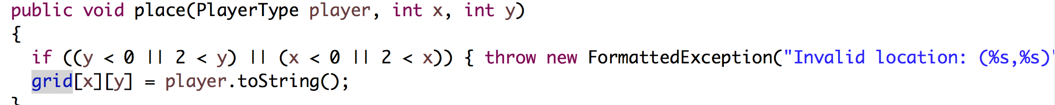

Slide 4
Too Long
Notes:
C:\code\FluencyPowerPoint\PowerPointGeneration\PowerPointGeneration.Tests\CodeSmells-LongLines\Too Long 01.png

Slide 6
Short Enough
Notes:
C:\code\FluencyPowerPoint\PowerPointGeneration\PowerPointGeneration.Tests\CodeSmells-LongLines\Short Enough 02.png

Slide 7
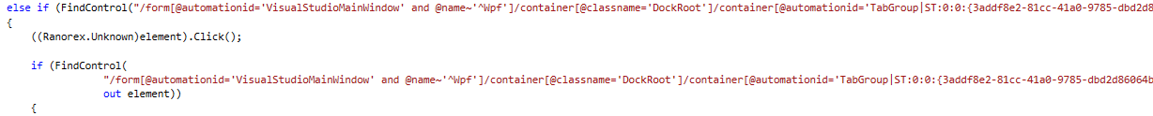

Slide 8
Too Long
Notes:
C:\code\FluencyPowerPoint\PowerPointGeneration\PowerPointGeneration.Tests\CodeSmells-LongLines\Too Long 02.png

Slide 10
Too Long
Notes:
C:\code\FluencyPowerPoint\PowerPointGeneration\PowerPointGeneration.Tests\CodeSmells-LongLines\Too Long 03.png

Slide 12
Short Enough
Notes:
C:\code\FluencyPowerPoint\PowerPointGeneration\PowerPointGeneration.Tests\CodeSmells-LongLines\Short Enough 03.png

Slide 13
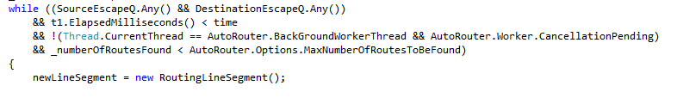

Slide 14
Too Long
Notes:
C:\code\FluencyPowerPoint\PowerPointGeneration\PowerPointGeneration.Tests\CodeSmells-LongLines\Too Long 04.png

Slide 15


Slide 16
Short Enough
Notes:
C:\code\FluencyPowerPoint\PowerPointGeneration\PowerPointGeneration.Tests\CodeSmells-LongLines\Short Enough 04.png

Slide 18
Too Long
Notes:
C:\code\FluencyPowerPoint\PowerPointGeneration\PowerPointGeneration.Tests\CodeSmells-LongLines\Too Long 05.png

Slide 20
Too Long
Notes:
C:\code\FluencyPowerPoint\PowerPointGeneration\PowerPointGeneration.Tests\CodeSmells-LongLines\Too Long 06.png

Slide 22
Too Long
Notes:
C:\code\FluencyPowerPoint\PowerPointGeneration\PowerPointGeneration.Tests\CodeSmells-LongLines\Too Long 07.png

Slide 24
Too Long
Notes:
C:\code\FluencyPowerPoint\PowerPointGeneration\PowerPointGeneration.Tests\CodeSmells-LongLines\Too Long 08.png

Slide 26
Too Long
Notes:
C:\code\FluencyPowerPoint\PowerPointGeneration\PowerPointGeneration.Tests\CodeSmells-LongLines\Too Long 09.png

Slide 28
Too Long
Notes:
C:\code\FluencyPowerPoint\PowerPointGeneration\PowerPointGeneration.Tests\CodeSmells-LongLines\Too Long 10.png

Slide 30
Too Long
Notes:
C:\code\FluencyPowerPoint\PowerPointGeneration\PowerPointGeneration.Tests\CodeSmells-LongLines\Too Long 11.png

Slide 31


Slide 32
Short Enough
Notes:
C:\code\FluencyPowerPoint\PowerPointGeneration\PowerPointGeneration.Tests\CodeSmells-LongLines\Short Enough 05.png

Slide 33
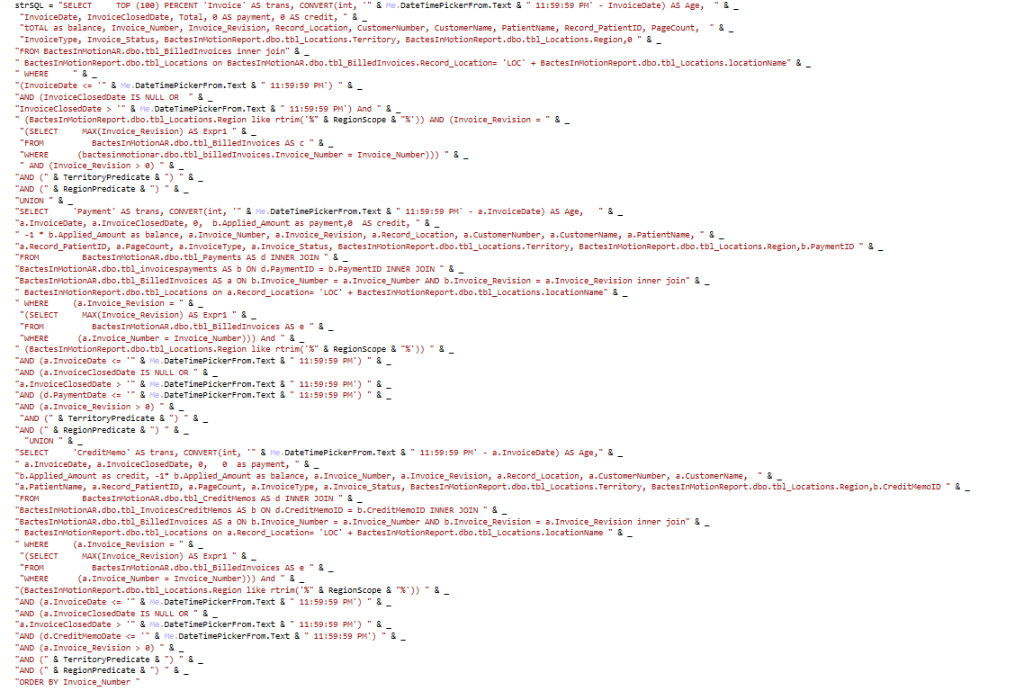

Slide 34
Too Long
Notes:
C:\code\FluencyPowerPoint\PowerPointGeneration\PowerPointGeneration.Tests\CodeSmells-LongLines\Too Long 12.png

Slide 36
Short Enough
Notes:
C:\code\FluencyPowerPoint\PowerPointGeneration\PowerPointGeneration.Tests\CodeSmells-LongLines\Short Enough 06.png

Slide 38
Short Enough
Notes:
C:\code\FluencyPowerPoint\PowerPointGeneration\PowerPointGeneration.Tests\CodeSmells-LongLines\Short Enough 07.png

Slide 40
Short Enough
Notes:
C:\code\FluencyPowerPoint\PowerPointGeneration\PowerPointGeneration.Tests\CodeSmells-LongLines\Short Enough 08.png

Slide 42
Short Enough
Notes:
C:\code\FluencyPowerPoint\PowerPointGeneration\PowerPointGeneration.Tests\CodeSmells-LongLines\Short Enough 09.png

Slide 44
Too Long
Notes:
C:\code\FluencyPowerPoint\PowerPointGeneration\PowerPointGeneration.Tests\CodeSmells-LongLines\Too Long 13.png

Slide 46
Too Long
Notes:
C:\code\FluencyPowerPoint\PowerPointGeneration\PowerPointGeneration.Tests\CodeSmells-LongLines\Too Long 14.png

Slide 48
Too Long
Notes:
C:\code\FluencyPowerPoint\PowerPointGeneration\PowerPointGeneration.Tests\CodeSmells-LongLines\Too Long 15.png

Slide 50
Too Long
Notes:
C:\code\FluencyPowerPoint\PowerPointGeneration\PowerPointGeneration.Tests\CodeSmells-LongLines\Too Long 16.png

Slide 51
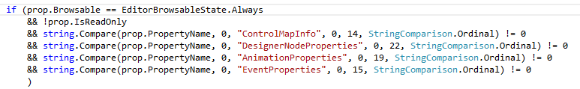

Slide 52
Too Long
Notes:
C:\code\FluencyPowerPoint\PowerPointGeneration\PowerPointGeneration.Tests\CodeSmells-LongLines\Too Long 17.png

Slide 54
Short Enough
Notes:
C:\code\FluencyPowerPoint\PowerPointGeneration\PowerPointGeneration.Tests\CodeSmells-LongLines\Short Enough 10.png

Slide 56
Short Enough
Notes:
C:\code\FluencyPowerPoint\PowerPointGeneration\PowerPointGeneration.Tests\CodeSmells-LongLines\Short Enough 11.png

Slide 57
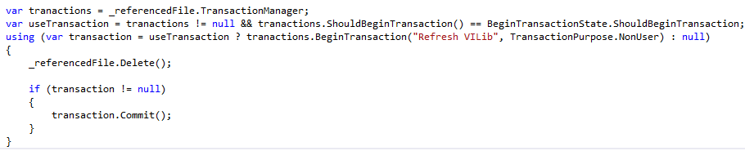

Slide 58
Short Enough
Notes:
C:\code\FluencyPowerPoint\PowerPointGeneration\PowerPointGeneration.Tests\CodeSmells-LongLines\Short Enough 12.png

Slide 60
Too Long
Notes:
C:\code\FluencyPowerPoint\PowerPointGeneration\PowerPointGeneration.Tests\CodeSmells-LongLines\Too Long 18.png

Slide 62
Too Long
Notes:
C:\code\FluencyPowerPoint\PowerPointGeneration\PowerPointGeneration.Tests\CodeSmells-LongLines\Too Long 19.png

Slide 63
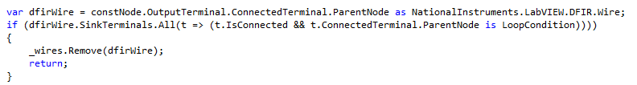

Slide 64
Short Enough
Notes:
C:\code\FluencyPowerPoint\PowerPointGeneration\PowerPointGeneration.Tests\CodeSmells-LongLines\Short Enough 13.png

Slide 65


Slide 66
Short Enough
Notes:
C:\code\FluencyPowerPoint\PowerPointGeneration\PowerPointGeneration.Tests\CodeSmells-LongLines\Short Enough 14.png

Slide 68
Too Long
Notes:
C:\code\FluencyPowerPoint\PowerPointGeneration\PowerPointGeneration.Tests\CodeSmells-LongLines\Too Long 20.png

Slide 70
Short Enough
Notes:
C:\code\FluencyPowerPoint\PowerPointGeneration\PowerPointGeneration.Tests\CodeSmells-LongLines\Short Enough 15.png

Slide 72
Too Long
Notes:
C:\code\FluencyPowerPoint\PowerPointGeneration\PowerPointGeneration.Tests\CodeSmells-LongLines\Too Long 21.png

Slide 74
Too Long
Notes:
C:\code\FluencyPowerPoint\PowerPointGeneration\PowerPointGeneration.Tests\CodeSmells-LongLines\Too Long 22.png

Slide 76
Too Long
Notes:
C:\code\FluencyPowerPoint\PowerPointGeneration\PowerPointGeneration.Tests\CodeSmells-LongLines\Too Long 23.png

Slide 78
Too Long
Notes:
C:\code\FluencyPowerPoint\PowerPointGeneration\PowerPointGeneration.Tests\CodeSmells-LongLines\Too Long 24.png

Slide 80
Too Long
Notes:
C:\code\FluencyPowerPoint\PowerPointGeneration\PowerPointGeneration.Tests\CodeSmells-LongLines\Too Long 25.png

Slide 82
Too Long
Notes:
C:\code\FluencyPowerPoint\PowerPointGeneration\PowerPointGeneration.Tests\CodeSmells-LongLines\Too Long 26.png

