Slide 1
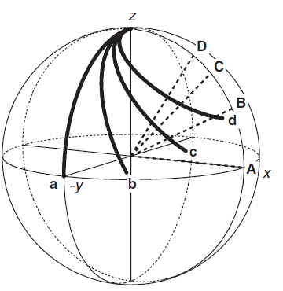
4.11 Off-resonance effects and soft pulses
Fig.4.27
a, A: k = 0, i.e. on-resonance
b, B: k = 0.5
c, C: k = 1.0
d, D: k = 1.5
offset: +/- 2500 Hz @ 500 MHz spectrometer
90º pulse width: 12 μs => ω₁/2π = 20 833 Hz
Ω/ω₁ = k = 2500 / 20 833 = 0.12
k = 0.12
z
z
z
y
y
x
y
x
x

Slide 2
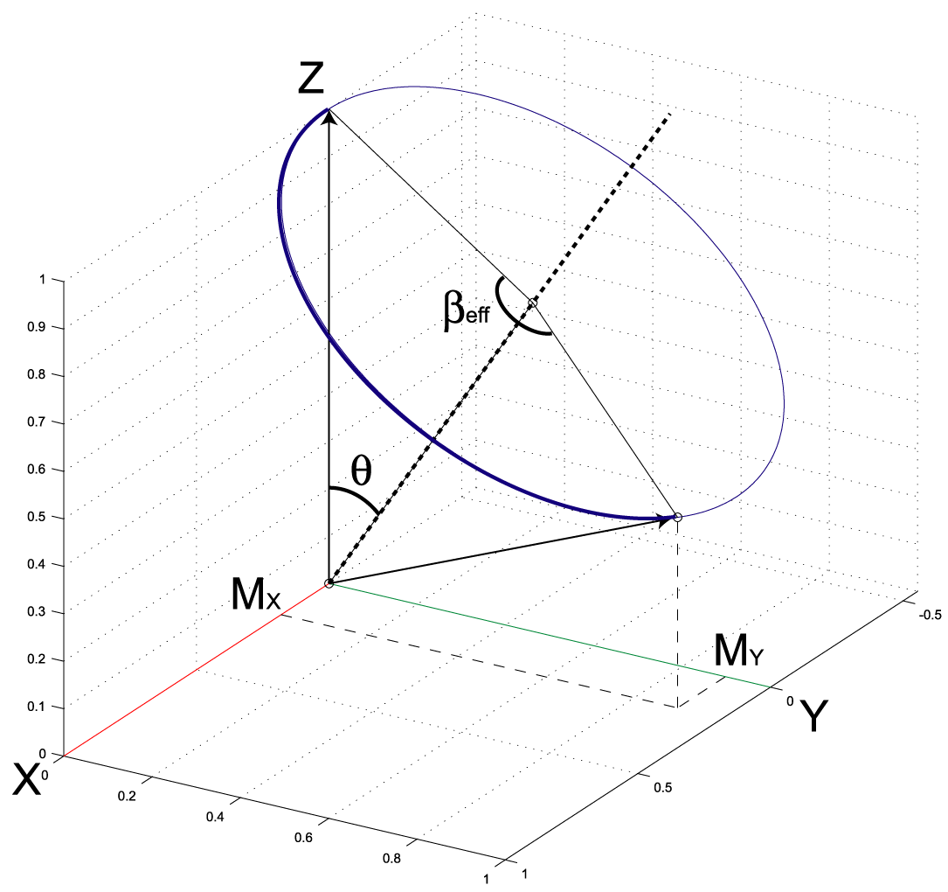
4.11 Off-resonance effects and soft pulses
Figs.4.13 & 14
Ω/ω₁ = ΔB/B₁ = k = 1.5 (case d in the previous slide)
θ = atan(1/k) ~ 33º
β_{eff} = π/2*sqrt(1+k²) ~ 162º
during t_{p},
ω₁ * t_{p} = π/2
ω_{eff} * t_{p} = π/2*ω_{eff} /ω₁
M_{x}, M_{y}: functions of k

Slide 3
3D trace of M_{x}, M_{y} and M_{z} (k = [-20 20])
Ch4_11_OffsetEffect.m
M_{x}, M_{y} (and M_{z}): functions of k
Z
k : negative
Y
k : positive
X
k = 0

Slide 4
4.11 Off-resonance effects and soft pulses
Ch4_11_OffsetEffect.m

Slide 5
3.11 Off-resonance effects and soft pulses
Ch4_11_OffsetEffect.m
M_{x}
M_{y}
M_{z}
M_{abs} = sqrt(M_{x}² + M_{y}²)
Fig. 4.28

Slide 6
3.11 Off-resonance effects and soft pulses
k
M_{abs} = sqrt(M_{x}² + M_{y}²)
p. 73 “If we want at least 90% of the full intensity the offset must be
less than about 1.6 times the RF field strength.”

Slide 7
Related Topic in Chapter 5, Phase Correction
Ch4_11_OffsetEffect.m
k = [-1.6:0.2:1.6]
k = [-1.6:0.2:1.6]
Necessity of the first-order phase correction (Fig. 5.11)

Slide 8
Simple Representation of Fourier Transform
Fig5_3.m

Slide 9
Simple Representation of Fourier Transform
Fig5_3_ver2.m

Slide 10
Simple Representation of Fourier Transform
Fig5_3_ver3.m

Slide 11
Representations of an FID and a spectrum using complex numbers
Fig5_9.m
The users can check how the zeroth order phase works by moving the slider.

Slide 12
Representations of an FID and a spectrum using complex numbers
Fig5_9_ver2.m
The users can check how
- the zeroth order phase works on both the FID and spectrum,
- the offset frequency affects the oscillation of the FID, and
- the weighting function (exponential) affects the spectrum.

Slide 13
Zero-filling and Weighting Functions
Fig5_18.m
FID
Spectrum
Raw
Zero-filling
Weighting functions
Zero-filled and Weighted

Slide 14
Phase Correction of a Spectrum using complex numbers
Phase_correction.m
NMR beginners have hard time to understand how to correct the phase of a spectrum. That is due to the lack of understanding how the 0th- and 1st- order phases works.
In this program, the process of the phase correction is visualized in a 3D space.
The 0th-order phase rotates the object (the spectrum described in complex numbers).
The 1st-order phase twists the object, but the degree of the twisting is frequency-dependent.

Slide 15
Phase Correction of a Spectrum using complex numbers
Phase_correction.m

