Slide 1
Displaying the energy levels between |α> and |β> states of ¹H and their populations
C10Boltzman

Slide 2
How to compare NMR spectra of a sample measured under different magnetic fields: introduction of chemical shift
C20ppm

Slide 3
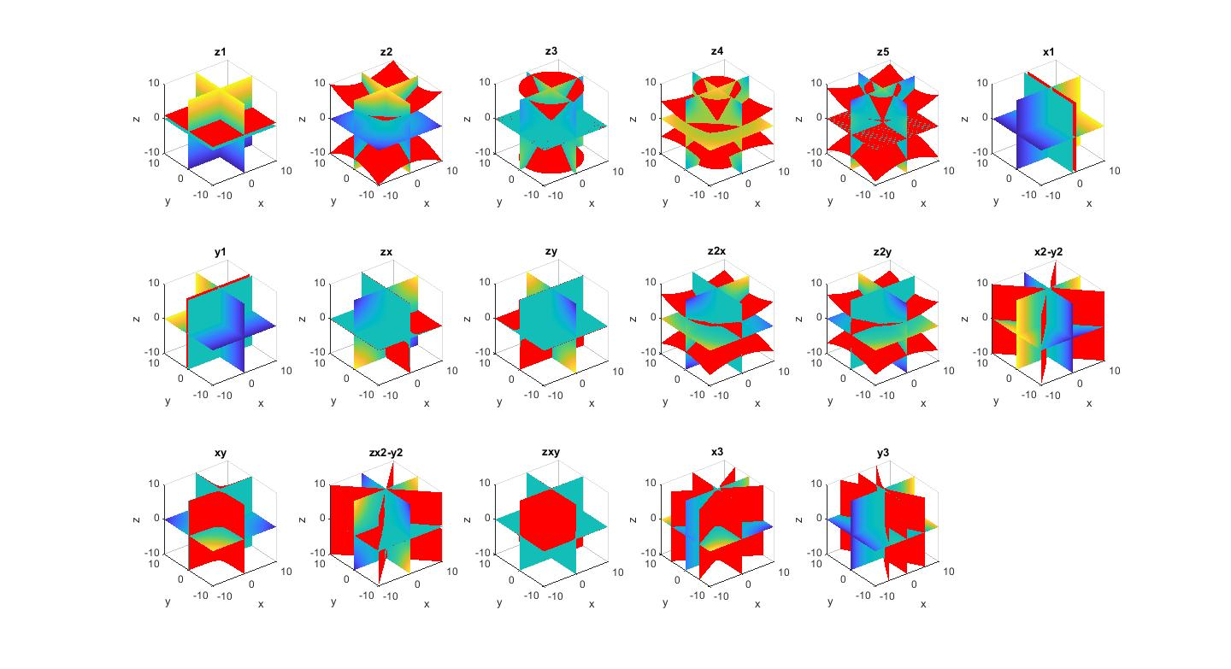
Shape of magnetic fields created by shim coils
C25PlotShim

Slide 4
Visualization of Solution of Bloch Equation
C50BlochEquations('Relaxation_on’)
This program shows an animation.
M vector

Slide 5
Visualization of Rotating Frame
C80RotatingFrame([1 1],0.3,'Relaxation_on’)
This program shows an animation.
M_{lab} vector
M_{rot} vector
Vector rotating with transmitter frequency
Projection of M_{lab}
on X_{lab}-Y_{lab} plane
Projection of M_{rot}
on X_{rot}-Y_{rot} plane

Slide 6
Visualization of Effect of RF Phase
C100rf_LF_RF_motion
This program shows an animation.
Oscillating RF field
Resonant component
Non-resonant component

Slide 7
How can a pulse rotate the magnetization?
C120RF_Irradiation
This program shows an animation.
M_{lab} vector
M_{rot} vector
B₁ field
B₁ field

Slide 8
FID in Laboratory and Rotating Frames
C140FID
This program shows an animation.

Slide 9
FID in Laboratory and Rotating Frames
C150FID_TwoFreq
This program shows an animation.

