Slide 1
Distributed messages by gen_tcp with Elixir
Tam Ly (On behalf of Ohhi.vn team )

Slide 2
Agenda
Introduction Ohhi team and me.
Why gen_tcp ?
Advantage and disadvantage of gen_tcp.
Demo.
Q & A.

Slide 3
Ohhi team (https://ohhi.vn)
Started from January 2023.
Came from Erlang’s world.
Focus to Elixir ecosystem.
Have some open source projects (https://github.com/ohhi-vn).
Try to make new funny thing for people.
Contact: info@ohhi.vn

Slide 4
About me
Software Engineer with 5+ years experience working with Erlang ecosystem.
1+ year with Elixir.
Current company and position: Cisco Consultant at Adabeat company.
My linkedIn: Tam Nhat Ly (http://linkedin.com/in/tam-nhat-ly)

Slide 5
Why gen_tcp ?
asd
Service B (Using C language)
Service A (Using elixir)
Service C
(Using Python language)
CLIENT SIDE
Service D
(Using C# language)

Slide 6
gen_tcp ?
Interface to TCP/IP sockets.
This module provides functions for communicating with sockets using the TCP/IP protocol.
Suitable for sending message over system despite of different language.

Slide 7
Advantage & Disadvantage
Advantage | Disadvantage
Efficiency. Integration. Binary Data Handling. Reliability. | Complexity. Error Handling (closed, timeout, eaddrinuse, etc.). Potential for Blocking.

Slide 8
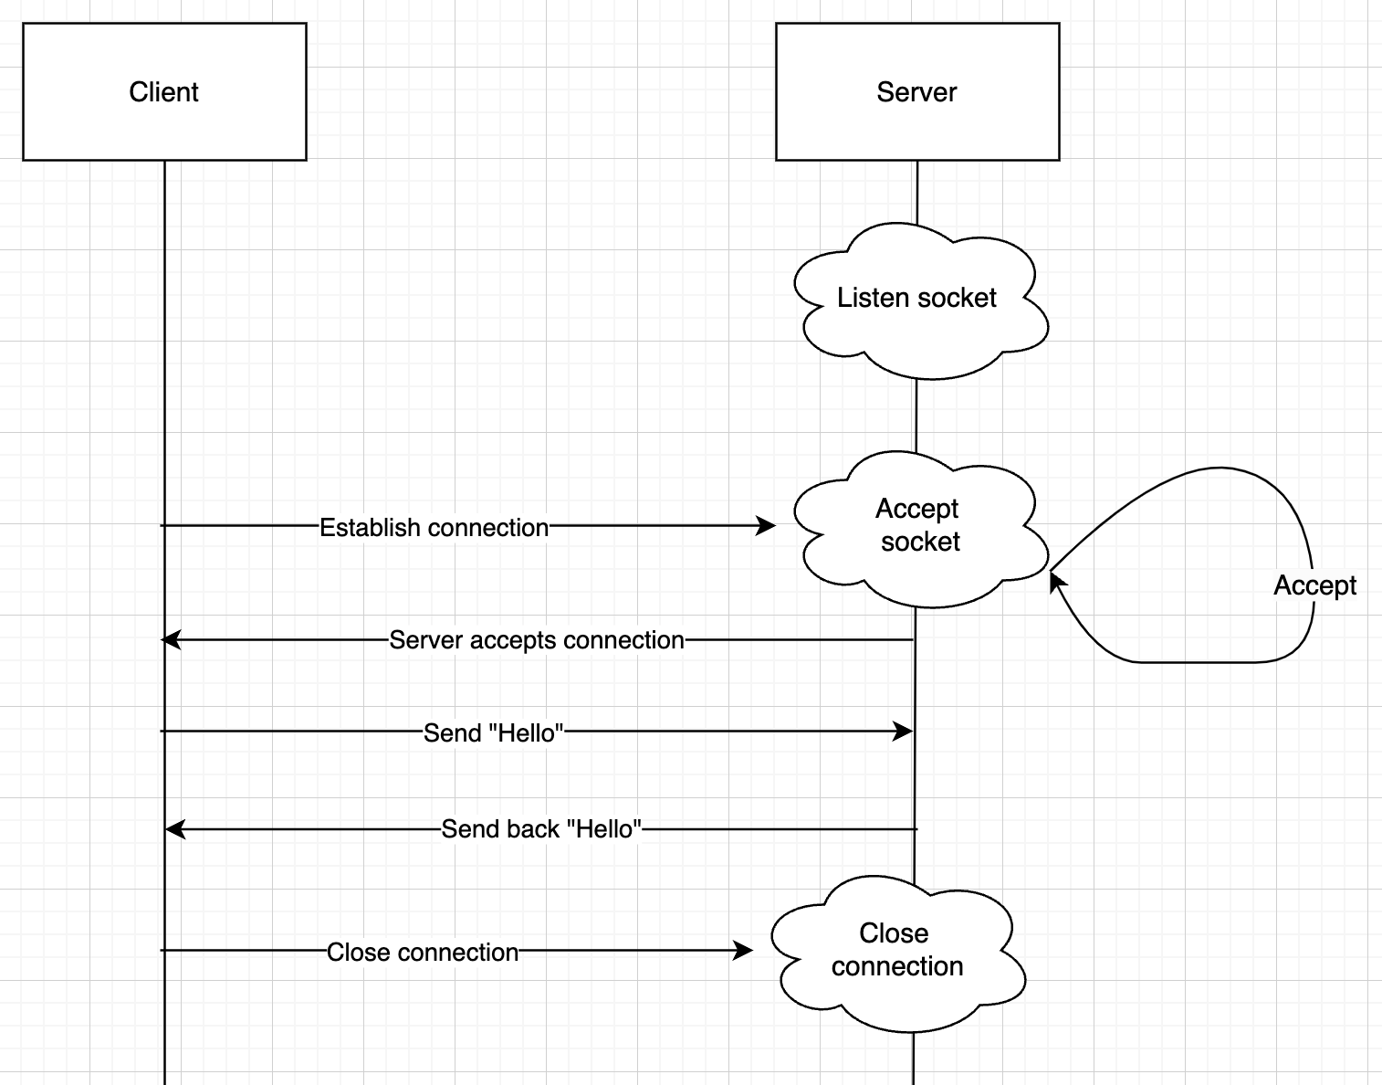
Demo

Slide 9
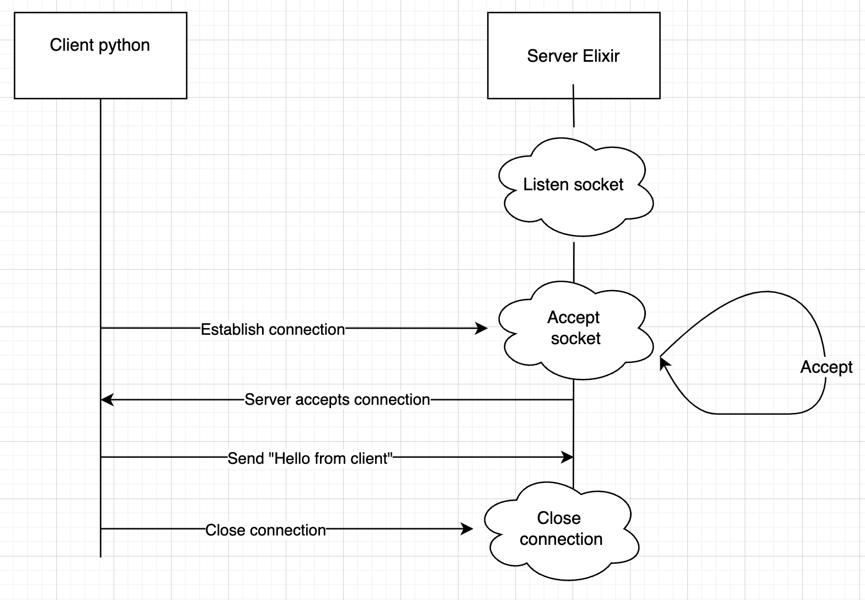
Demo

Slide 10
References
https://www.erlang.org/doc/man/gen_tcp
https://learnyousomeerlang.com/buckets-of-sockets#sockserv-revisited
https://docs.python.org/3/library/socket.html#module-socket
https://www.openmymind.net/Elegant-TCP-with-Elixir-Part-1-TCP-as-Messages/
https://www.openmymind.net/Elegant-TCP-with-Elixir-Part-2-Message-Boundaries/
https://hexdocs.pm/elixir/task-and-gen-tcp.html
https://stackoverflow.com/questions/72384327/how-to-send-a-message-through-tcp-protocol-to-a-tcp-server-using-gen-tcp-in-elix
https://www.erlang.org/doc/man/rpc
Designing scalability erlang otp book

Slide 11
Repo
https://github.com/ohhi-vn/gen_tcp

Slide 12


Slide 13


