Slide 1

CPU PIPELINE DATAPATH
By: Sungho oh & kevin roxas
ECE 524

Slide 2
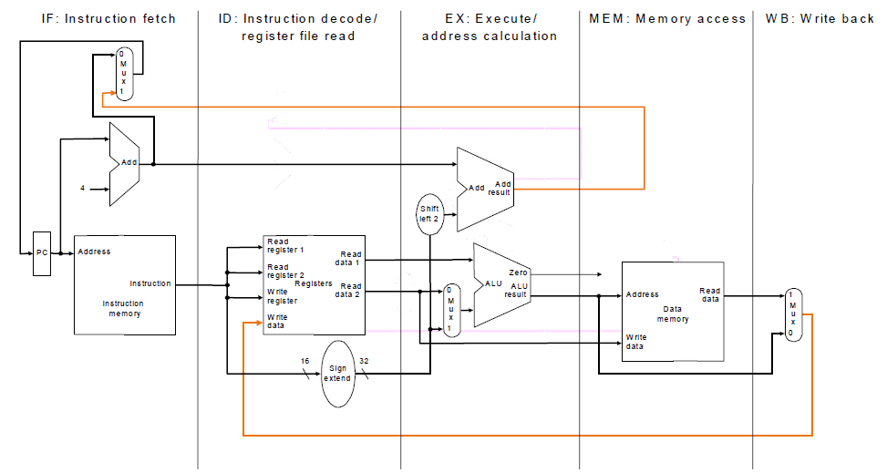
What is cpu pipeline datapath
Allows multiple instructions to be executed at once
Performs 5 stages which are
Fetch, Decode, Execute, Memory, Write-back
But since we are college students and about to be in debt
Cheap
Performing only 3 stage
Why? More complex more expensive build

Slide 3
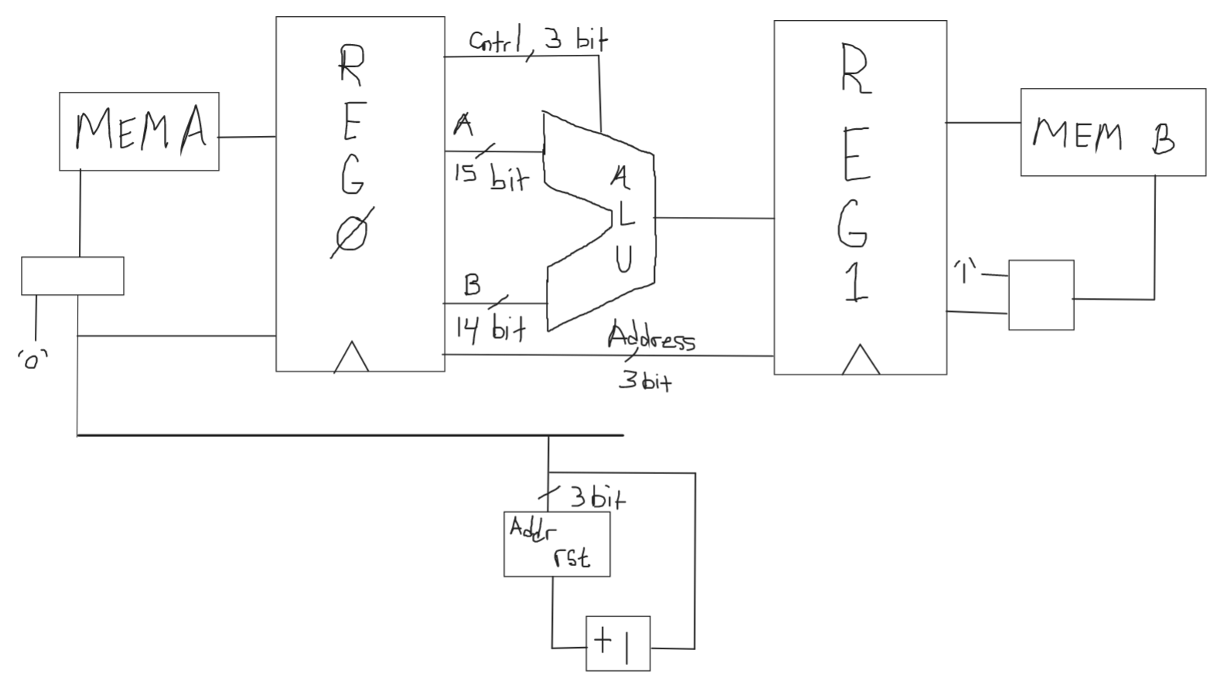
What are the 3 stages?
Get the Data from the Memory(Decode)
Execute the instruction(Execute)
Save the Data into the “Memory”(Memory)

Slide 4
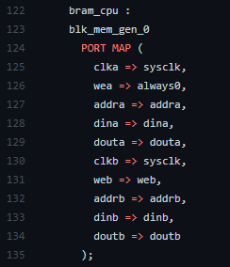
Get the data from memory
First stage of the CPU DATAPATH is the Decode stage
Acts as Brain on the CPU
Access into the RAM/Memory to fetch the source ‘operands’
BRAM
The user setting constants or the logical values are being held inside the RAM
Which all it has to do in order to receive data is by sending an address to access the instruction in the memory
When BRAM is ‘0’ it will read the data from the memory
Acts like a data storage space that holds information data, or instructions to be used.

Slide 5
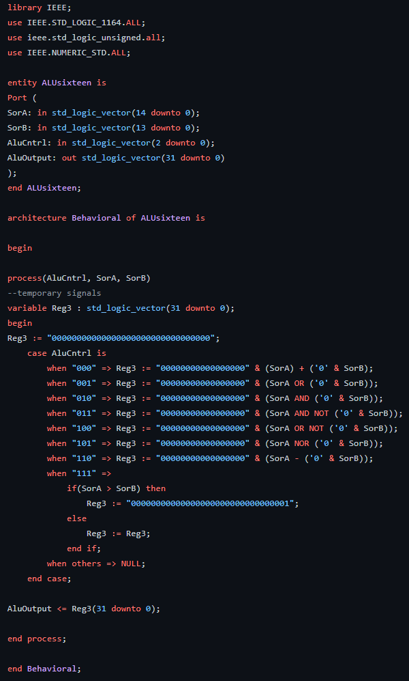
Execute
Arithmetic-Logical Unit
CPU’s calculator
Gives two operands and one logical operation for it to compute
Receives information on the BRAM and performs certain logical operation
Logical Operations
Addition, Subtraction, AND, OR, AND NOT, OR NOT, NOR
32 Bits of data and we split it into 3 parts
15 bits for input A
14 bits for input B
3 bits for Control(Opcode)

Slide 6
Save to data
Where do we save the data to?
Back to the BRAM
RAM can be both read and write
Acts as write back into the BRAM but it overwrites the current constant we are on

Slide 7
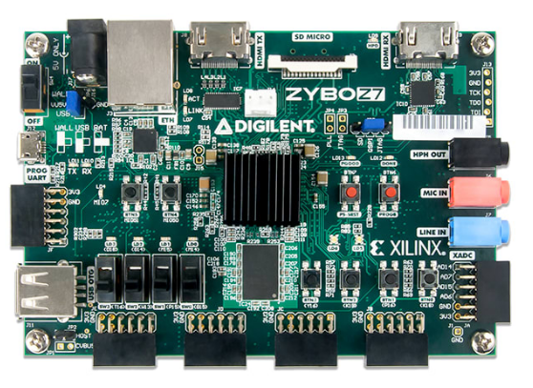
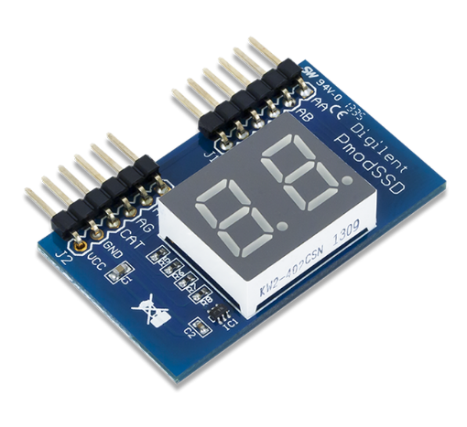
DeMO equipments
Zybo Z7-20
PMOD Seven Segment Display (SSD)

Slide 8
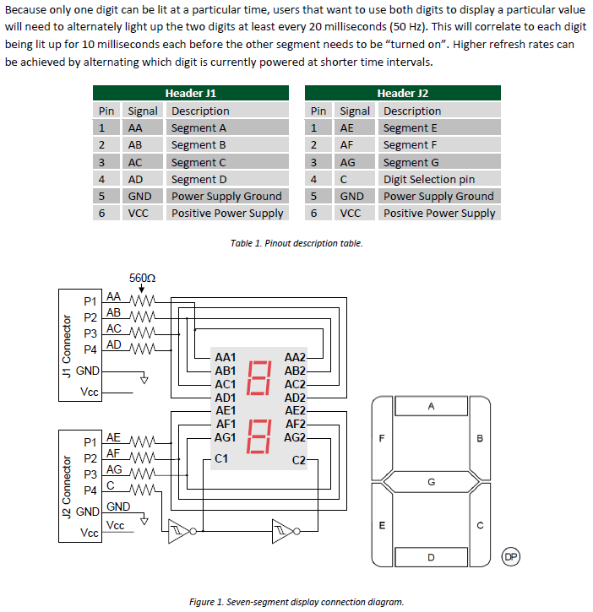
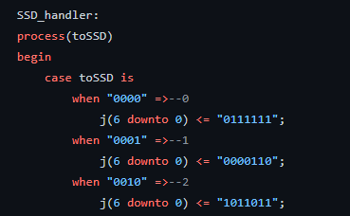
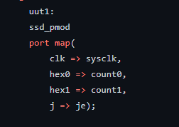
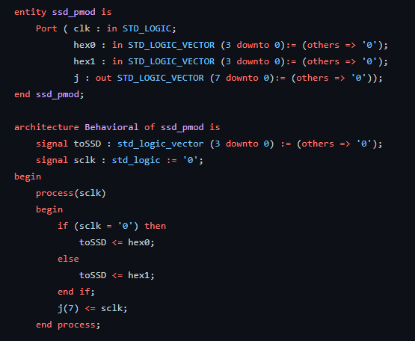
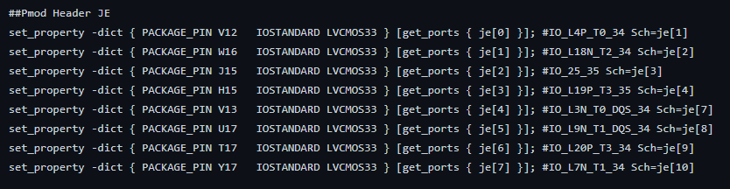
PMOD Seven segment display
Can display only one digit, but in order to display two
Must set the “light up” by 20 milliseconds alternating between the two digit lights
Depending on which signal we send, it corresponds on the Seven Segment Display as displayed on the diagram on the right
The signals it receives comes from the code shown below and turns from Binary(input) to Hex then it sends towards the Seven Segment Display

Slide 9
How this work?
switch(3) is for reset and start
switch(2) for slow and normal clk speed
switch(1) is to show address or value
switch(0) is to show input or output
there is 3 bit program counter in VHDL code is connected to address
to Block memory and to the ALU designed
while counter is < "111" SSD will show what is happening board
which is showing value outside of memory
soon as counter became "111", done flag will raise
SSD start showing data inside memory

Slide 10
now we will demonstrate

Slide 11
References
https://www.fpga4student.com/2017/07/16-bit-alu-design-in-vhdl.html
https://vhdlguru.blogspot.com/2011/06/vhdl-code-for-simple-alu.html#:~:text=ALU(Arithmetic%20Logic%20Unit)%20is,basic%20block%20in%20any%20processor.&text=The%20input%20signal%20'Op'%20is,be%20performed%20by%20the%20ALU.
https://courses.cs.washington.edu/courses/cse378/10sp/lectures/lec11.pdf
https://digilent.com/reference/pmod/pmodssd/reference-manual
Our codes:
https://github.com/ohho96/csun_ece524_pipelined_cpu

