Slide 1
EASY LIFE
by bug hunter squad

Slide 2
TEAM: BUG HUNTER SQUAD
NAME | ID NO
Imdadul Haque Ohi | 2122020034
Abida Sultana Nowshin | 2122020013
Numan Ahmed Rony | 2122020045
Md.Mahin Usman | 2122020012

Slide 3
Supervised By
Md Saidur Rahman Kohinoor
Designation
Department of CSE
Leading University

Slide 4
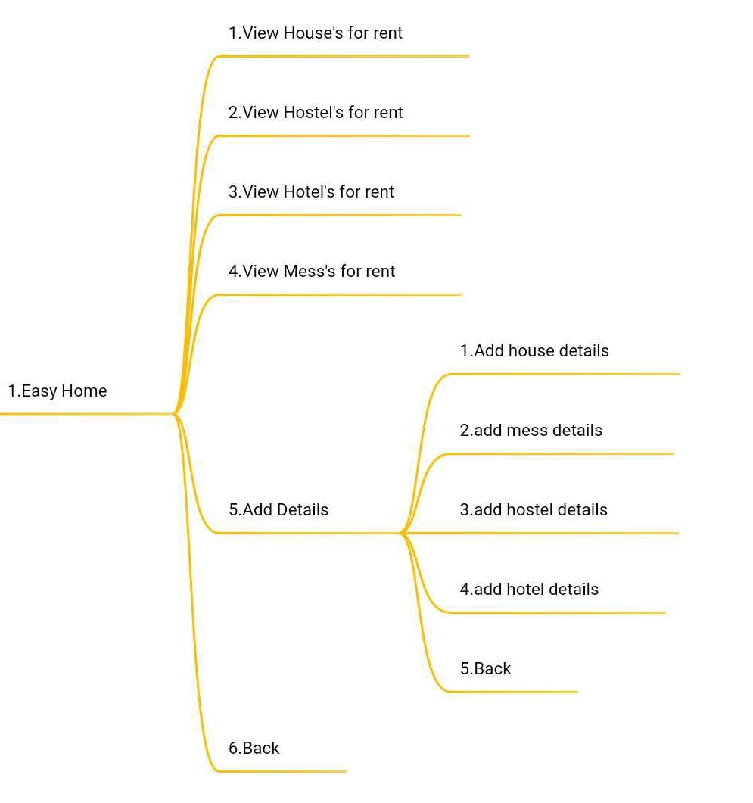
Project diagram
Part 1

Slide 5
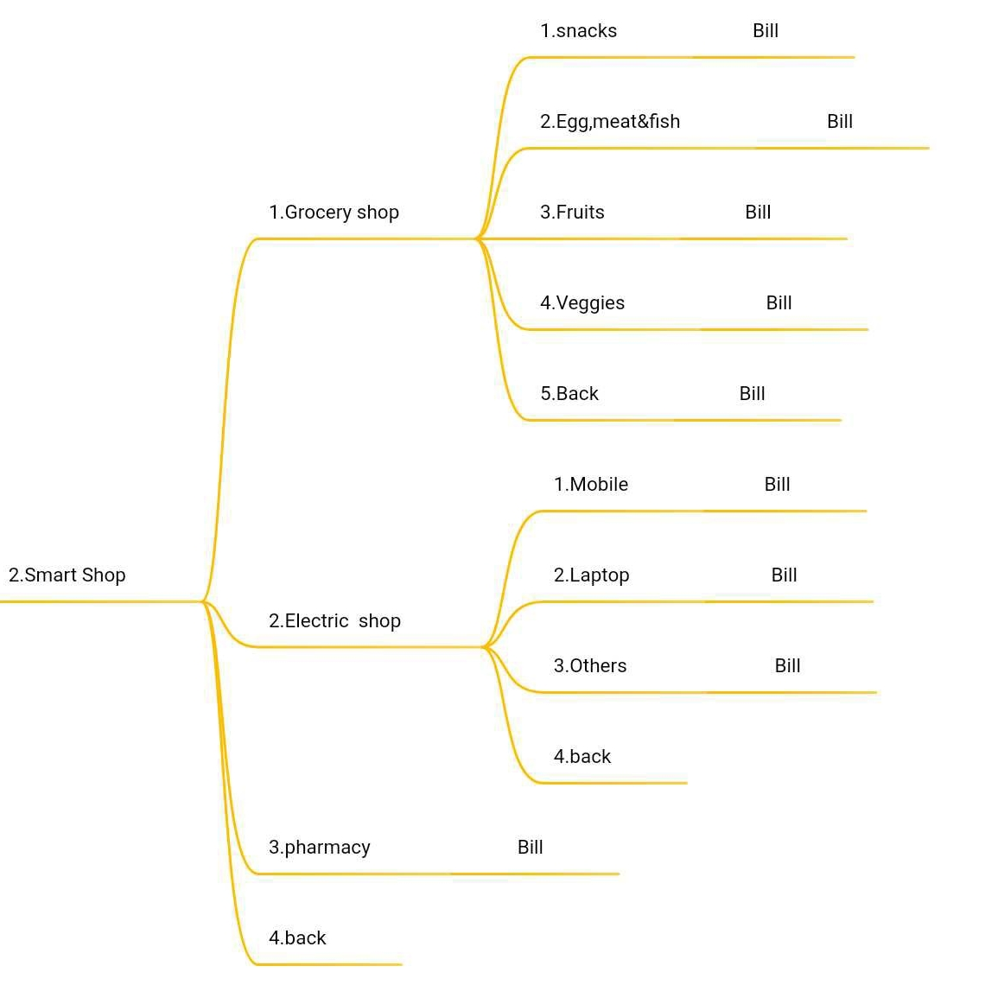
Project diagram
Part 2

Slide 6
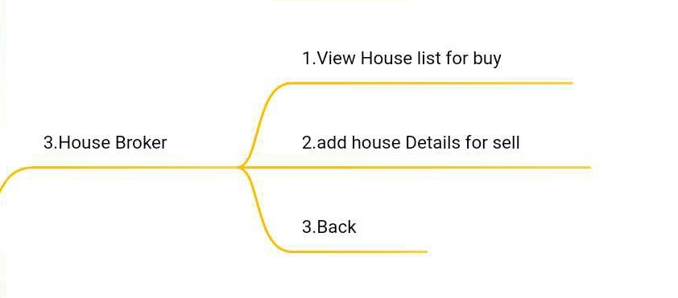
Project diagram
Part 3

Slide 7
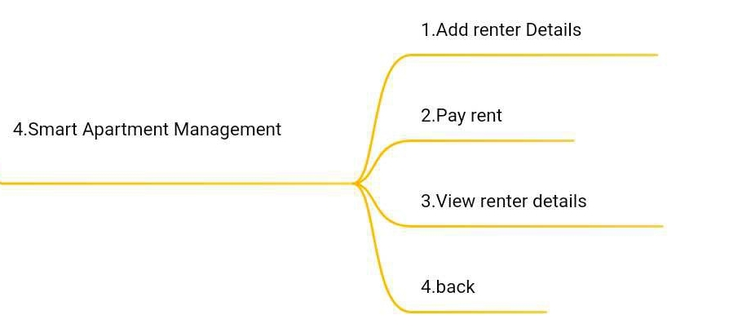
Project diagram
Part 4

Slide 8
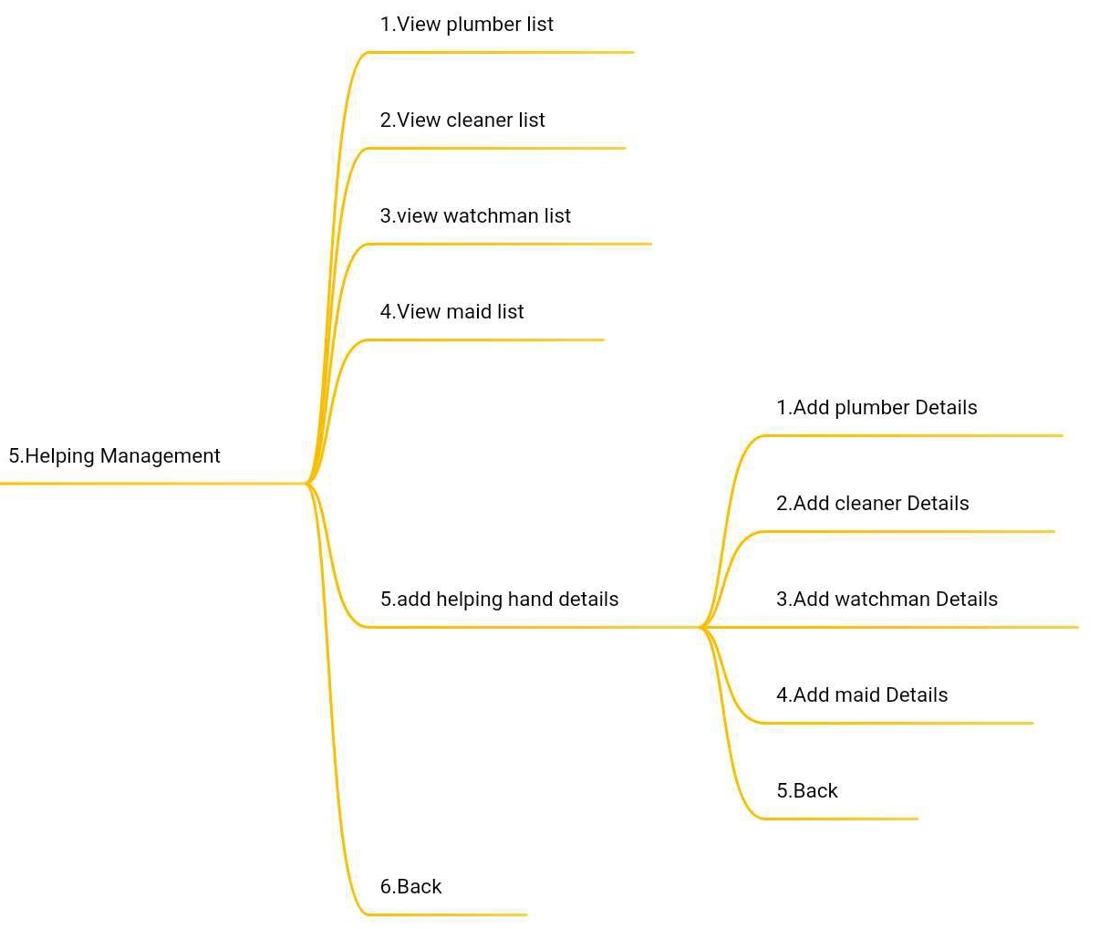
Project diagram
Part 5

Slide 9
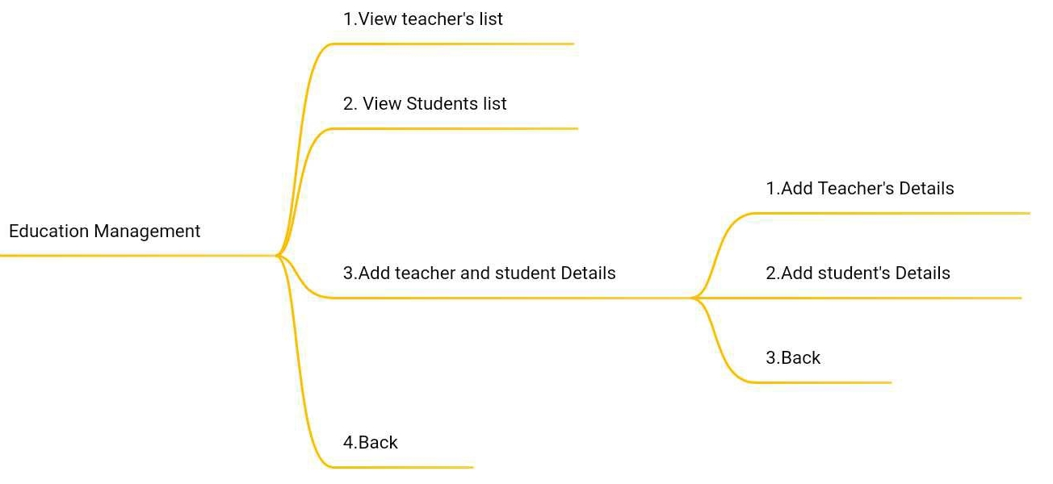
Project diagram
Part 6

Slide 10
Purpose
Makes life easier
Developing a technology which is a one-step solution
Reducing difficulties in city life
Save time and cost

Slide 11
Tools
Programming language
 | - C
IDE / Editor
 | - Codeblocks
Topics | - Function - FILE -Conditional statement - Structure

Slide 12
Problem
Lack of time
Lack of experience
Lack of Idea
Some error in shopping feature

Slide 13
OVERVIEW
1 | Viewing list of house,hostel,mess for rent or add details of house,hostel,mess
2 | Online shop
3 | Details for buy and sell any house
4 | Billing system
5 | Renter details
6 | Add payment for renter

Slide 14
Reference:
https://www.tutorialspoint.com/cprogramming/index.htm
https://www.cplusplus.com/
https://www.geeksforgeeks.org/c-programming-language/

Slide 15
Any question?
☺☹
Thank You!

