Slide 1




Investigating Social Interaction Patterns with Depression Severity across Different Personality Traits Using Digital Phenotyping
Ohida Binte Amin^{1, 2}, Varun Mishra^{1, 2}, Aarti Sathyanarayana^{1, 2, 3}
Contact Information:
THE
¹Khoury College of Computer Sciences, Northeastern University, Boston, MA, ​
²Bouve College of Health Sciences, Northeastern University, Boston, MA,​
³Department of Biostatistics, Harvard T.H. Chan School of Public Health, Boston, MA
{amin.o, v.mishra, a.sathyanarayana}@northeastern.edu
LAB

Slide 2
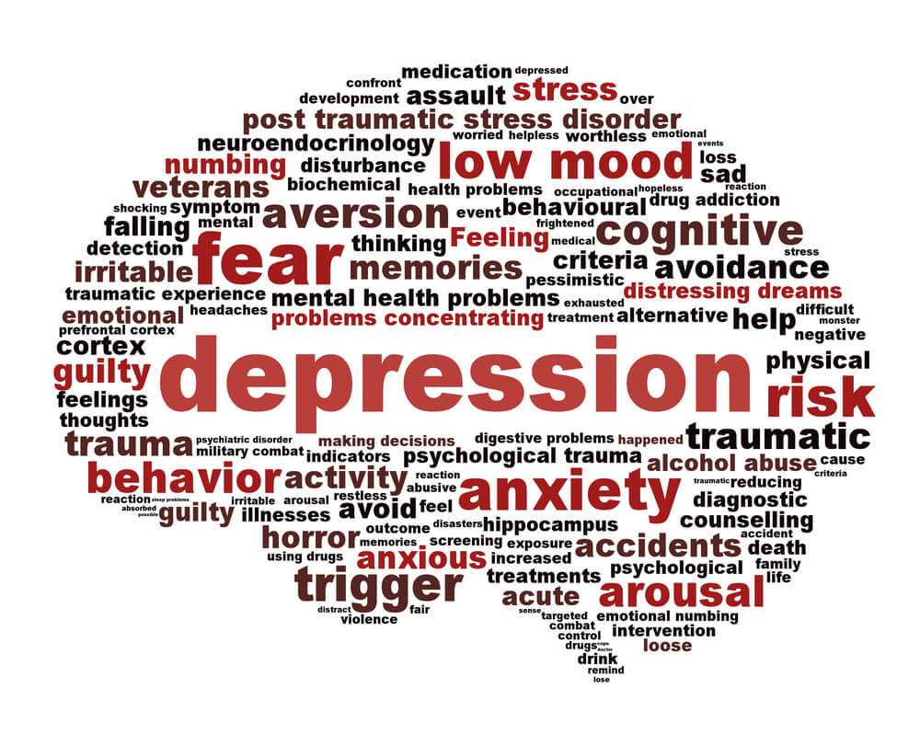
33% of college students experience mental health disorders, mostly depression and this issue is getting worse…

Slide 3
Highly neurotic students with increased depression had more variation in the number of social contacts.​

Slide 4

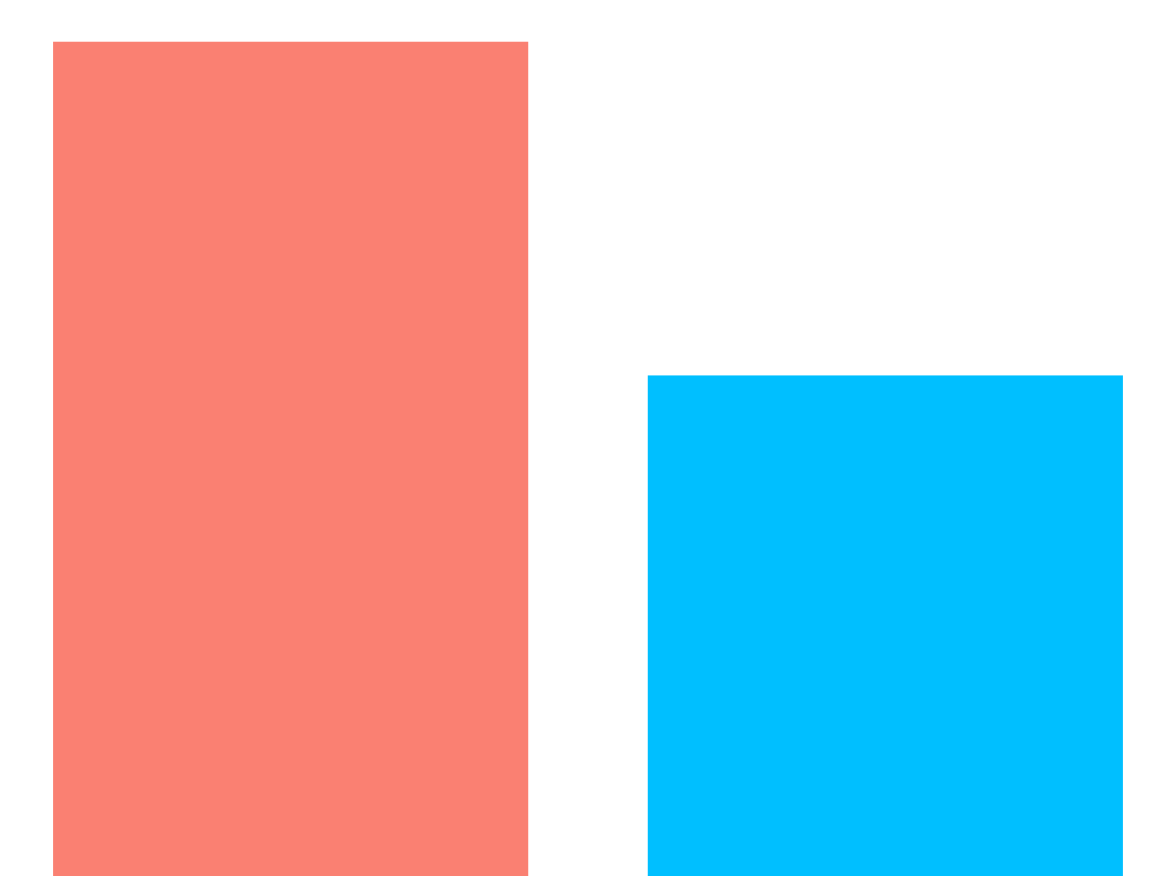
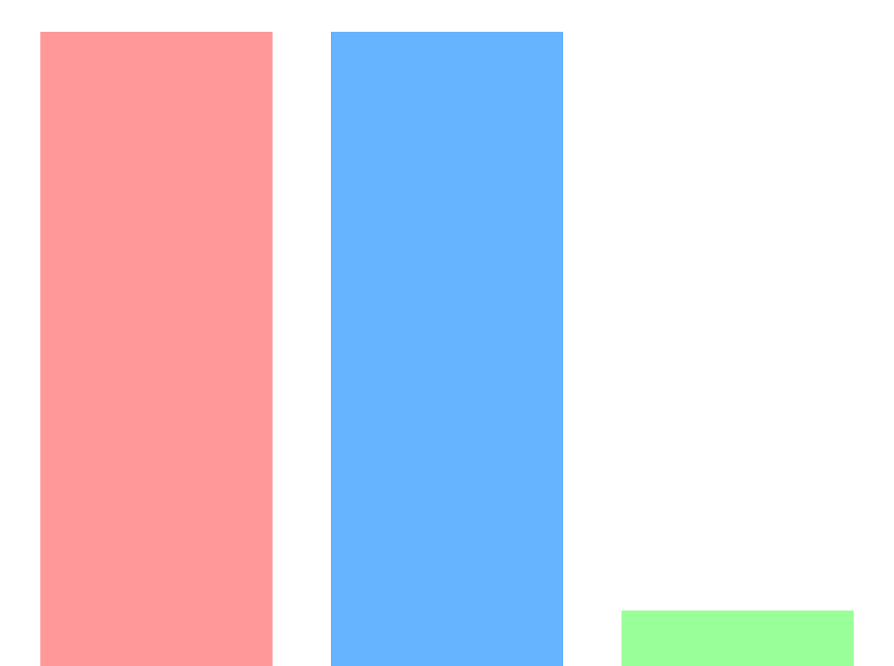
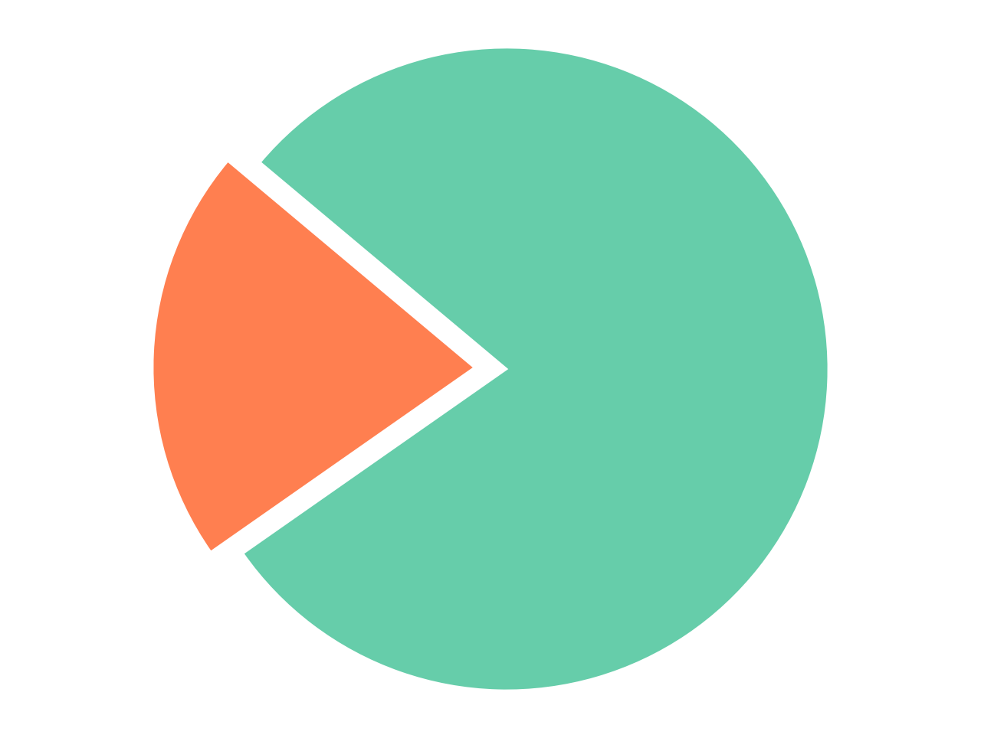

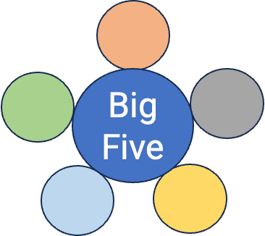
Socio Demographics of Participants
Education Level
Gender
Race & Ethnicity
30
Male: 38
StudentLife Dataset
18
23
23
2
Undergrads
Graduates
Female: 10
Caucasian​ Asian Black
Active & Passive Sensing Data from 48 Students
PHQ-9
EMA
Big Five

Slide 5
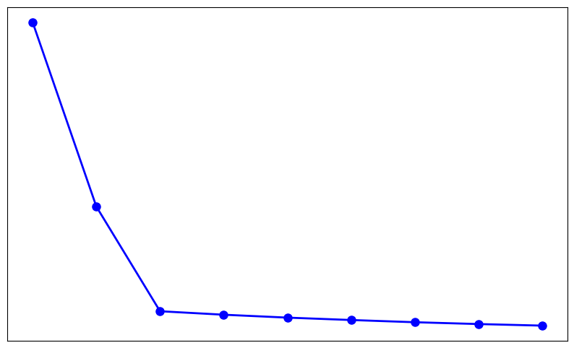
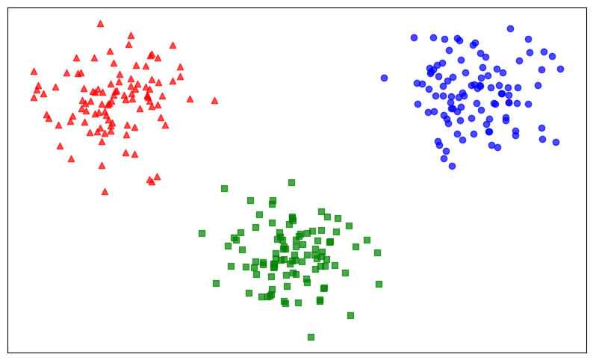
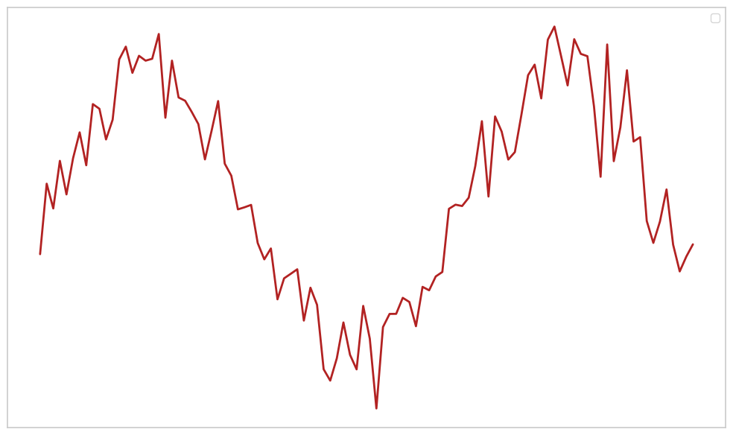
Digital Phenotyping
Preprocessing Data and Coding Big Five Personality Scores
Centroid Analysis from Constrained K-means Clustering
Trajectory Modeling on Subgroups of Clusters

Slide 6
Clustering Analysis Identifies Three Distinct Personality Traits
Cluster 1 (16) students with high neuroticism​
Survey Type | Variance in PHQ-9 Scores
pre-survey post-survey | 17.0625 27.9743
Cluster 2 (13) students with high conscientiousness & low neuroticism​
pre-survey post-survey | 43.2424 61.4285
pre-survey post-survey | 7.1838 9.3166
Cluster 3 - (17) students with low conscientiousness​

Slide 7
16 students of cluster 1 with high neuroticism​
12 students with increased depression with high neuroticism​
4 students with decreased depression with high neuroticism​
Cluster 1 Students Subgroups | Depression Difference | Pre PHQ-9 Score Range | Post PHQ-9 Score Range | Mean PHQ-9 Difference
12 Students 4 Students | Increased Decreased | 0-11 3-15 | 3-21 1-12 | +3.69 -3.50

Slide 8
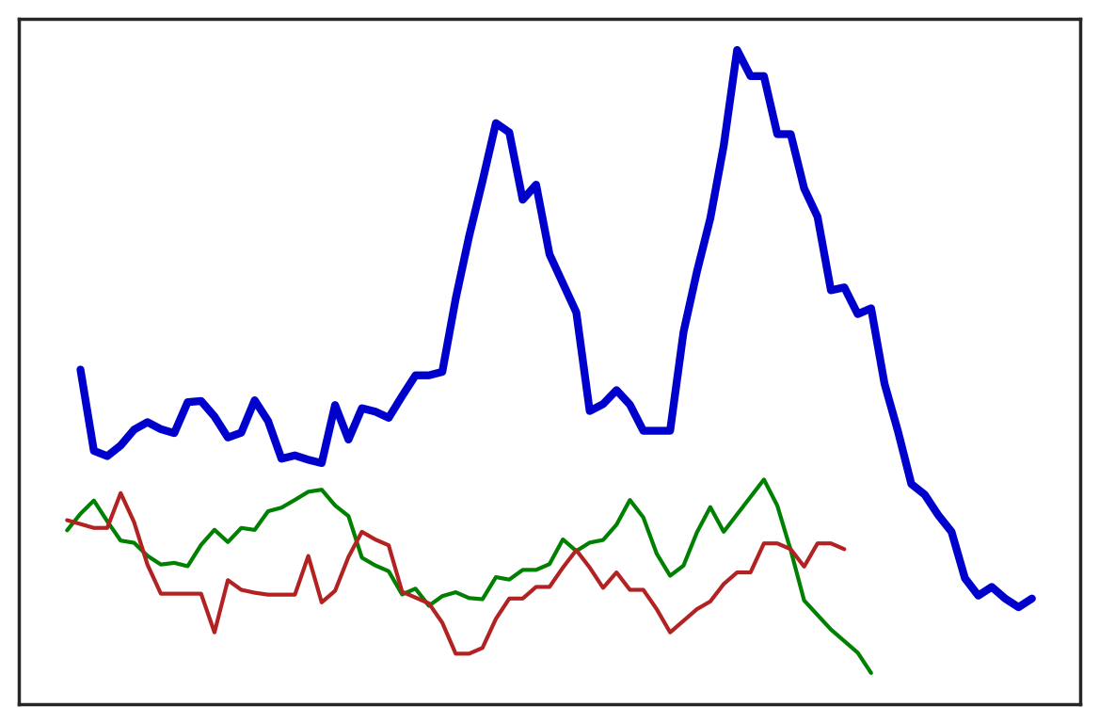
Cluster 1 with depression
Significant social contact fluctuations, peaking during midterm and final exams
Cluster 2 with depression
Cluster 3 with depression
Number of Social Contacts
Number of Days

Slide 9
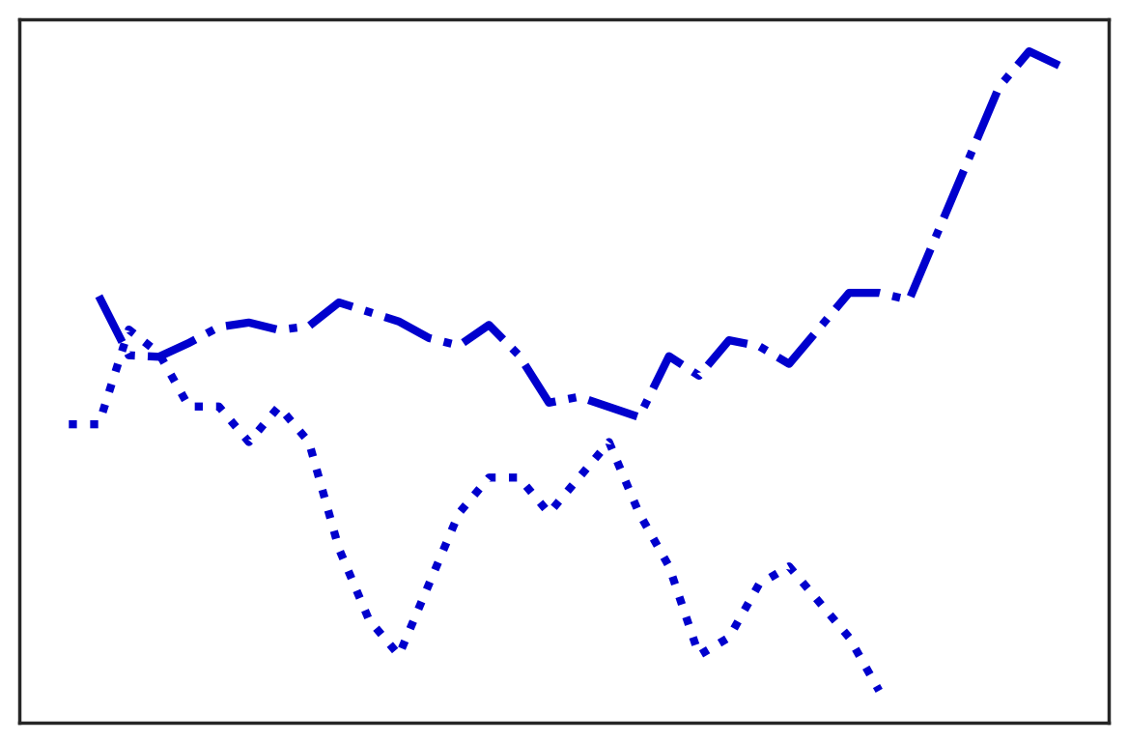
Cluster 1 with depression
Cluster 1 students with lower depression had fewer social contacts compared to higher depression
Number of Social Contacts
Cluster 1 with depression
Number of Days

Slide 10
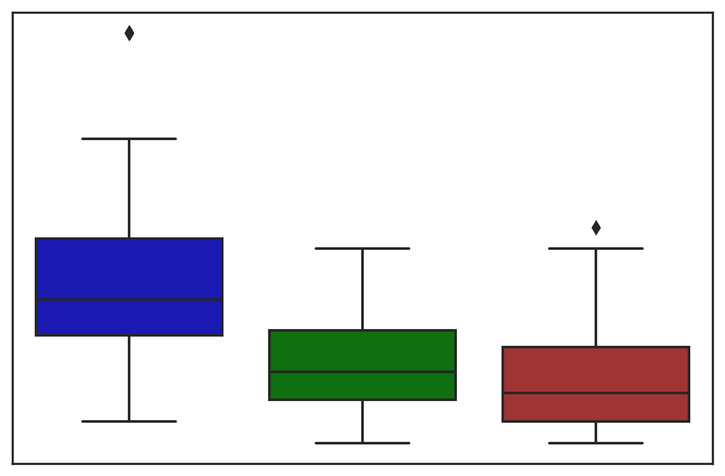
Highest variation and range in the number of social contacts
Personality Trait | Variance | SD
Cluster 1 Students Cluster 2 Students Cluster 3 Students | 0.685 0.405 0.441 | 0.828 0.636 0.664
Range: 90
Number of Social Contacts
Range: 50
Range: 45
Cluster 1 Cluster 2 Cluster 3

Slide 11
Our findings indicate that students with neurotic personality traits who experience depression exacerbation show more variation in their number of social contacts POSSIBLY due to low self esteem and negative self-perception.

Slide 12
Thank
You…
THE
Ohida Binte Amin
Email ID: amin.o@northeastern.edu
LAB

