Slide 1
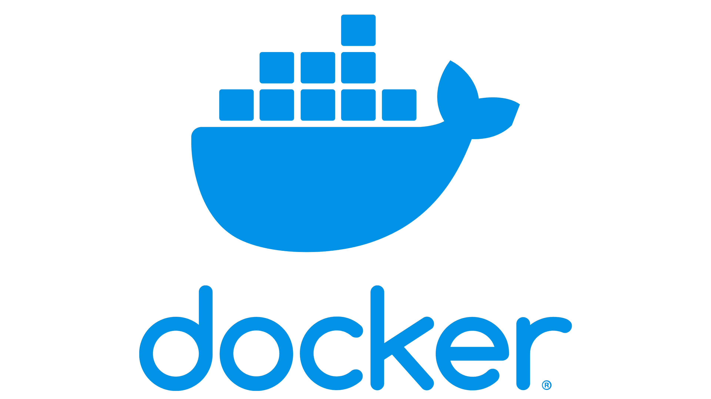

Intro to Docker
Brendan Smyers

Slide 2
What is Docker?
Docker is a tool that packages your code, operating system, dependencies, and settings into an image that can run anywhere.

Slide 3
Why use Docker?
No more “it works on my machine”
Easy scalability, just spin up another container!
Abstract away complex setup instructions
It’s the industry standard!

Slide 4
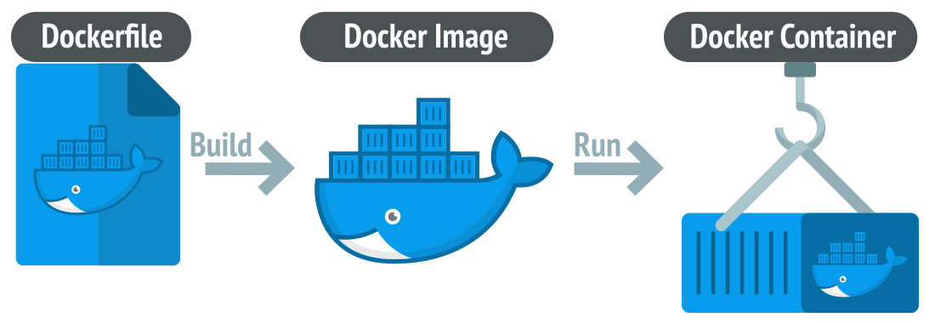
Dockerfile
Defines and builds an image
Image
Blueprint for creating containers
Container
Running instance of an image
Key terms

Slide 5
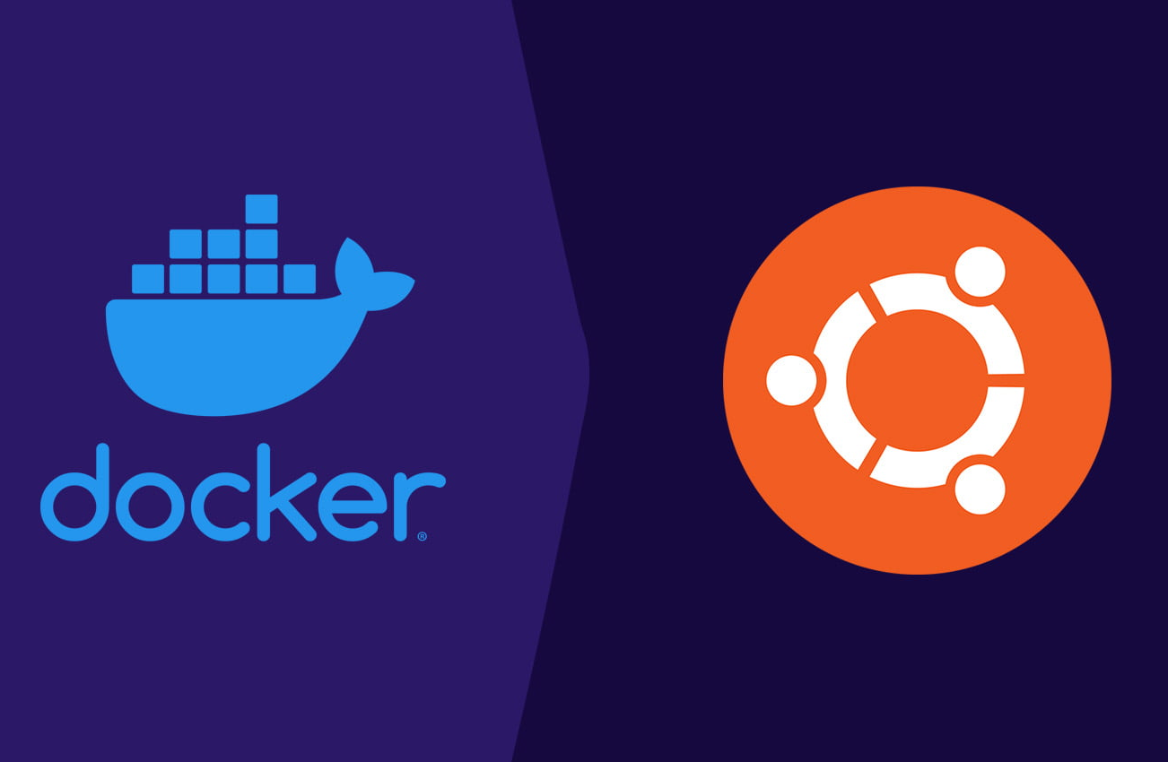
Setup
Docker
From
Scratch

Slide 6
Clone the sample project
Repo URL: https://github.com/ohio-software-development/docker-example/tree/main

Slide 7
Install Docker Compose
sudo apt install docker-compose
sudo apt install docker-buildx

Slide 8
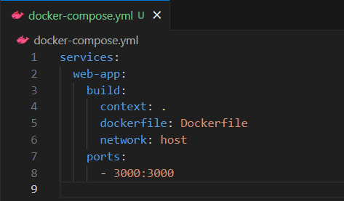
Docker Compose
Create ‘docker-compose.yml’

Slide 9
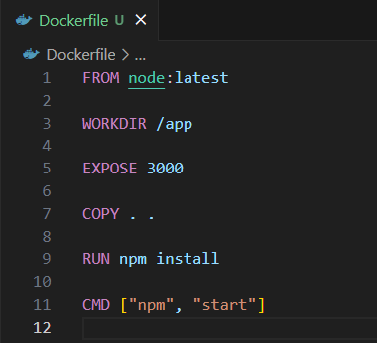
Dockerfile
Create ‘Dockerfile’

Slide 10
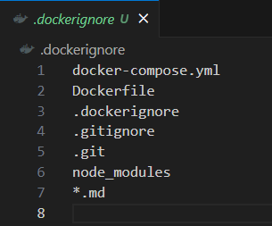
Docker
Ignore
Create ‘.dockerignore’

Slide 11
Build & Run
Build the image
sudo docker-compose build
Might take a minute
Run the image
sudo docker-compose up
You can use the ‘-d’ flag to put the running service in the background

Slide 12
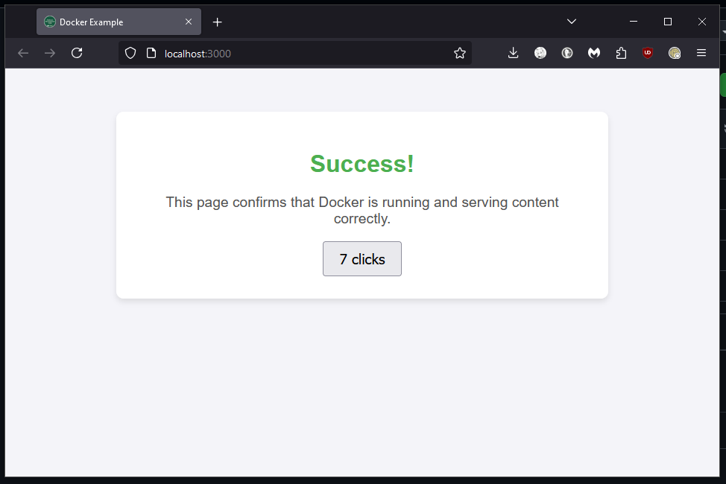
Visit http://localhost:3000
To see the website

Slide 13
Thank you!

