Slide 1

Jest + Continuous Integration
Brendan Smyers

Slide 2
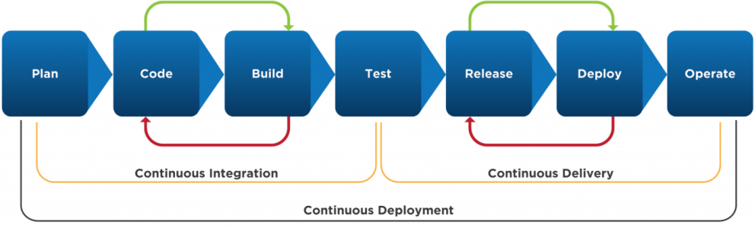
What is Continuous integration (CI)?
Notes:
Continuous integration is a practice used by large professional codebases that focuses on integrating new code changes into a shared repository.
New changes are automatically built and tested before being deployed further in the Continuous Delivery pipeline.
We are only going to get into the continuous integration side of the pipeline.
I already said large professional codebases use the CI/CD pipeline, but there are many other reasons why you should know about continuous integration.

Slide 3
Why you should care
Catch errors early
Automates tedious tasks
Reduces code regression
Companies expect you to know CI/CD
Faster and more stable releases
Notes:
Continuous integration helps you catch errors early and can prevent buggy code from being deployed.
It automates tasks like unit testing. This guarantees every commit is tested.
With proper unit tests you can reduce the chance that your code regresses, and behaves correctly after bug fixes.
Large companies and technical interviewers are going to expect you to know what CI and CD mean. If you don't learn about it now, you will learn about it eventually.
If you have the whole CI/CD pipeline setup it can automate deployment and creating new releases of your code for just about any platform.

Slide 4
Testing Tools
Testing Framework | Target Language
JUnit | Java
Jest | JS/TS
Catch2 | C++
Pytest | Python
PHPUnit | PHP
Selenium | Websites
Notes:
Testing tools are usually language specific.
Here are a few I know about and a few that google says are popular.
We are going to be using the Jest framework for our example

Slide 5
Continuous Integration Tools
Jenkins
Travis CI
GitLab
Docker
Microsoft Azure
Circle CI
GitHub Workflows
Notes:
Here are some of the more popular CI tools available. We are going to use GitHub Workflows to automate testing using Jest.

Slide 6
Let's automate!

Slide 7
Getting started
Prerequisites
Node.js >=14
npm
Next steps...
Clone the repo
Create your branch with git branch first-last
Switch to your branch git checkout first-last
Run npm install
Try it out with npm start

Slide 8
Jest Testcases

Slide 9
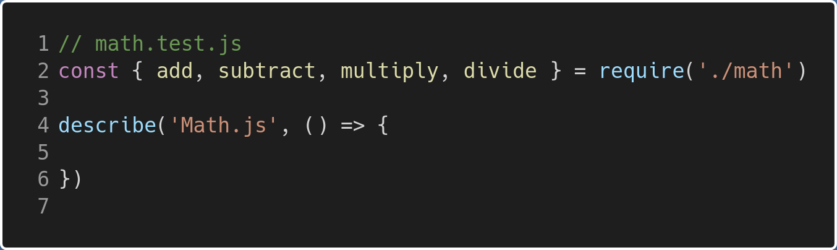
Create Tests - Base
Notes:
Here are some of the more popular CI tools available. We are going to use GitHub Workflows to automate testing using Jest.

Slide 10
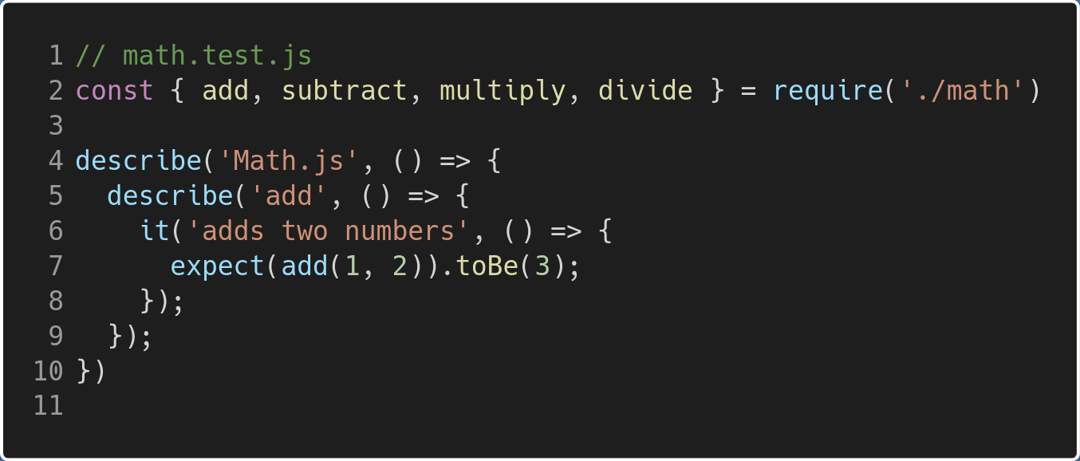
Create Tests - Add
Notes:
Here are some of the more popular CI tools available. We are going to use GitHub Workflows to automate testing using Jest.

Slide 11
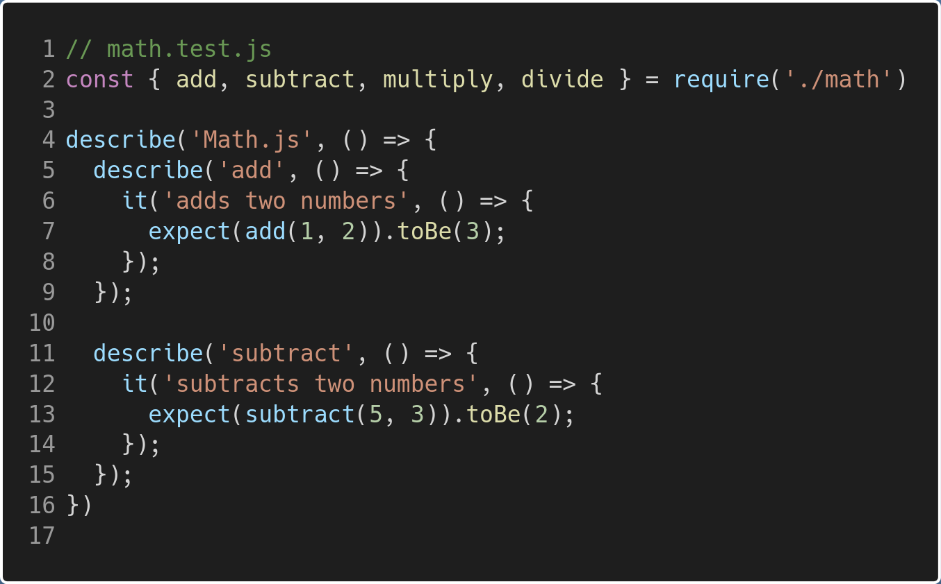
Create Tests - Subtract
Notes:
Here are some of the more popular CI tools available. We are going to use GitHub Workflows to automate testing using Jest.

Slide 12
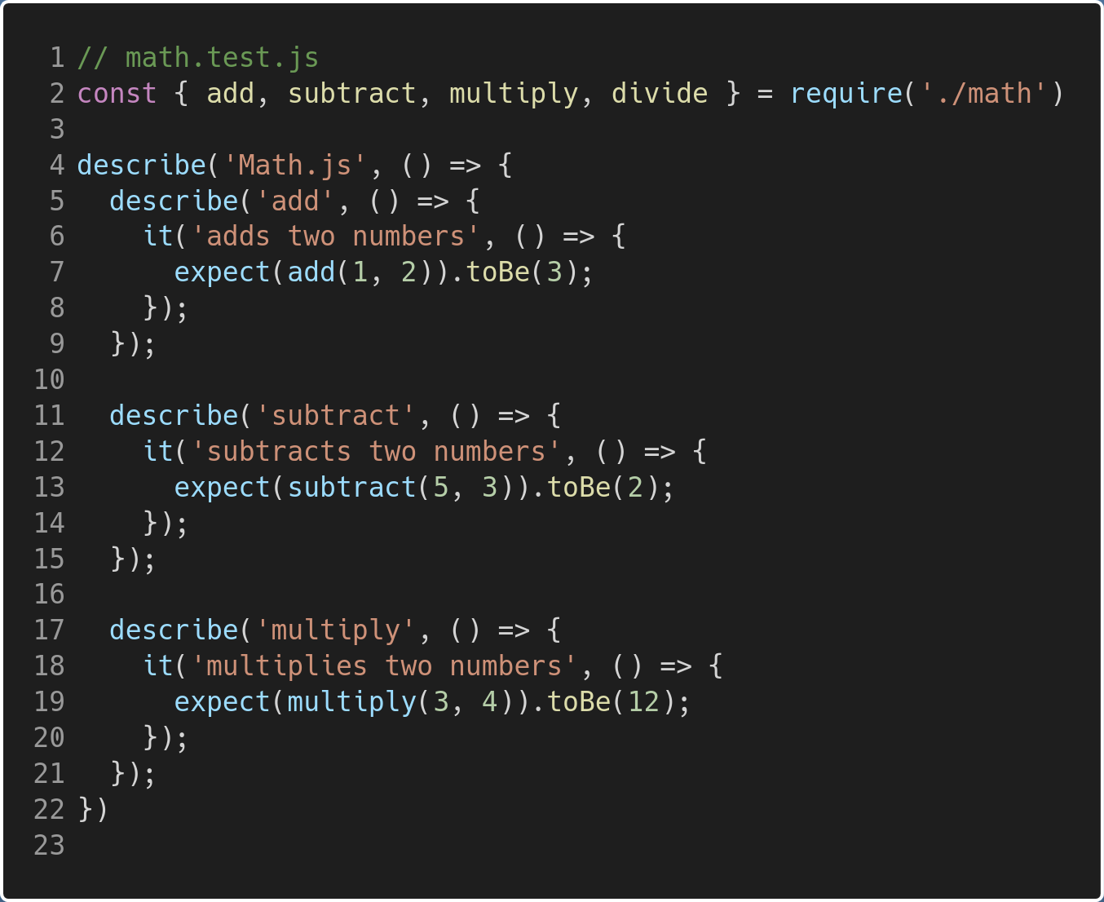
Create Tests - Multiply
Notes:
Here are some of the more popular CI tools available. We are going to use GitHub Workflows to automate testing using Jest.

Slide 13
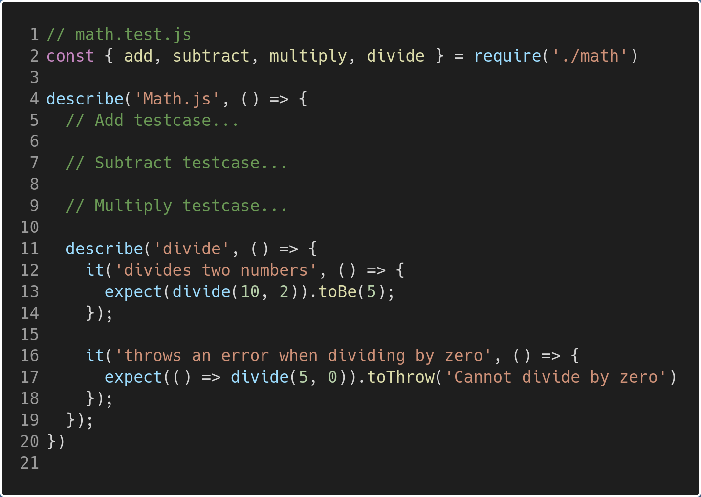
Create Tests - Divide
Notes:
Here are some of the more popular CI tools available. We are going to use GitHub Workflows to automate testing using Jest.

Slide 14
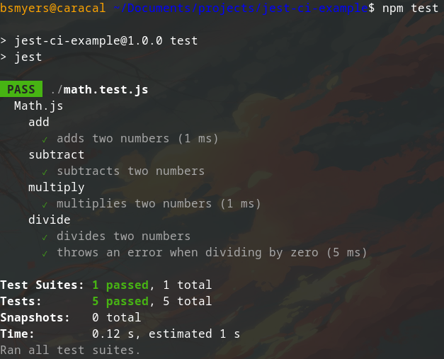
Run Your Tests!
Run your tests with: npm test

Slide 15
GitHub Workflow

Slide 16
GitHub Workflow - Creating The Workflow
Create a ./.github/workflows directory if it doesn't exist
Create a new workflow test.yml in the directory

Slide 17
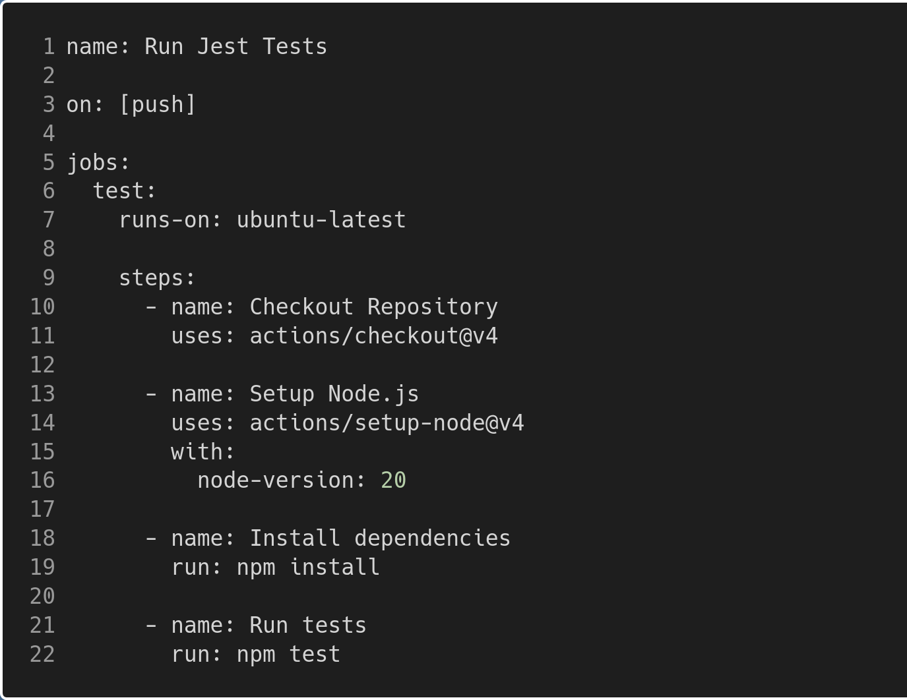
GitHub Workflow - Creating The Workflow
<- Name of workflow on GitHub <- When to trigger the workflow <- Create a 'test' job <- Tell's GitHub the OS to run on <- GitHub Action that clones the repository <- GitHub Action that Installs Node.js to the workflow OS <- Installs the project dependencies <- Run the tests! - If the tests fail, it will throw an error and the workflow will fail and show a red X on GitHub

Slide 18
Test Your Automated Testing
You can now push your changes to your branch and test out the automated test cases!
Make sure you are on your branch! git checkout first-last
git add .
git commit –m "My first CI pipeline!"
git push

Slide 19
Thank You
Brendan Smyers

