Slide 1

Pygame Track
Host: Brendan Smyers

Slide 2
What is Python?
# Print to console
print("Hello, World!")
# Functions
def add_three(v):
return v + 3
# Variables and lists
x = [1, 2, 3]
x[0] = add_three(x[0]) # 1 + 3 = 4
# Loops
for num in x:
print(num) # 4 2 3
# If statements
if x[2] == 3:
print(“Yay!”) # Yay!
Python is a simple and versatile programming language that’s easy to read and write. It’s popular for web development, data analysis, and automation, making it a great choice for beginners.

Slide 3
What is Pygame?
Pygame is a Python library that helps you create 2D games by handling graphics, sound, and user input easily. It’s great for beginners to learn game development basics without complex coding.
Who has used Pygame before?
Who has used Python before?

Slide 4
Cookie Clicker
The Goal?

Slide 5
Setup
Make sure Python and pip is installed
Install Pygame
  python3 -m pip install -U pygame --user
Fork and clone the starting code
  https://github.com/ohio-software-development/software-speedrun-game-dev-track
  git clone git@github.com:ohio-software-development/software-speedrun-game-dev-track.git

Slide 6
Useful Pygame Functions
pygame.draw.rect() and pygame.draw.circle()
  Draw a square or circle to the screen
pygame.font.Font(), font.render() and screen.blit()
  Draw text to the screen
pygame.mouse.get_pos()
  Helpful when checking if the mouse is on a button when the user clicks

Slide 7
Resources
Pygame Documentation:
  https://www.pygame.org/docs/
Stack Overflow
W3 Schools
No LLMs Please!
  We are here to learn Python and Pygame!

Slide 8
Ready to Code?

Slide 9
Project Requirements
Setup a basic Pygame window with a custom title
Display a large circle to represent the cookie on the left half of the screen
Add a counter above the cookie that increments by one when you click the cookie
Make the right half of the screen a different color. This area will be used for upgrades
Create a new upgrade button that is a different color from the background
  The upgrade must show the count, name, and cost of the upgrade
When the upgrade is clicked, add 1 to the count, remove cookies from total and increase the cost of the upgrade. (You can use a math function for the new price)
Make the upgrade give the player cookies over time based on how many upgrades they have
Add at least 2 more different upgrades

Slide 10
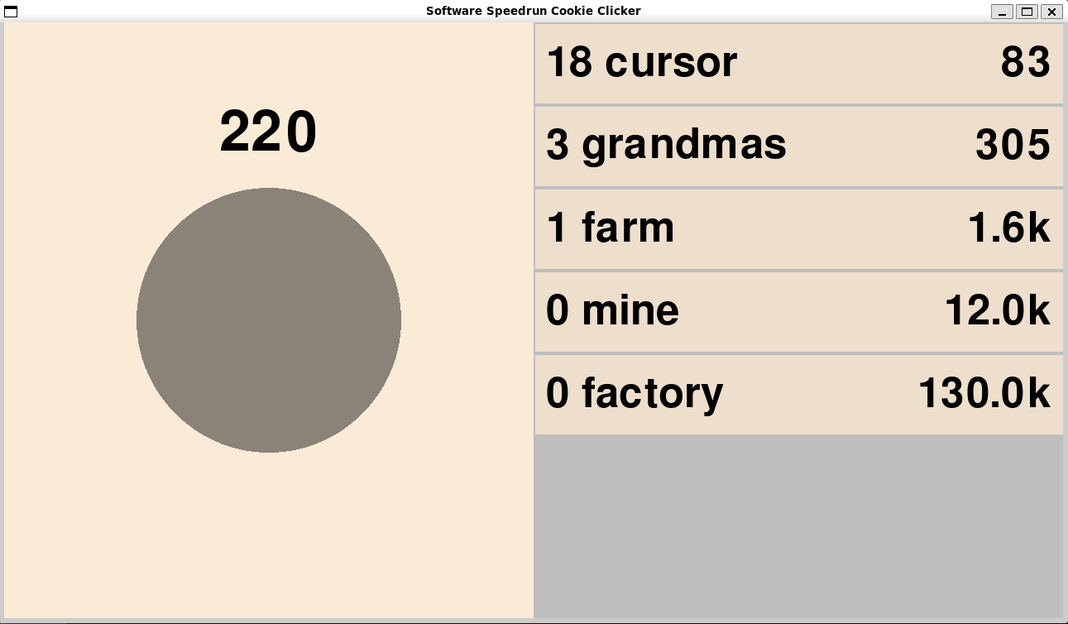
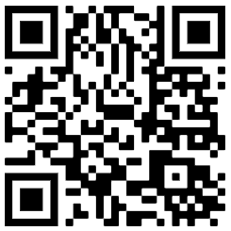
Thank you for competing!
Please give us feedback!
We would like to host this in the future and want to hear your thoughts!

