Slide 1
We're Watching You: An analysis of IP cameras through their firmware
Charles Monett
OISF - November 2016

Slide 2
Warning/Disclaimers
Please use this knowledge only for good and for your own devices.
Disclaimers:
All trademarks/etc. used in this presentation are property of their respective owners.
All testing performed in a controlled environment.

Slide 3
Outline
Introduction/Key Points/Takeaways
Example 1: Conference Camera + demos
Example 2: Security Camera + demos
Some good news
Usage/Research
Wrap-up/Q&A

Slide 4
Introduction
Did product research for IP cameras
Was looking at more upmarket cameras (above Foscam)
Part of it involved looking at firmware updates
Was expecting a bit more resistance to modification
Not just tearing apart firmware
Putting the knowledge to good use

Slide 5
Key Points & Takeaways
Key points
Network appliance design is hard to get right
Sometimes we can use it for our advantage
Takeaways
Introduction to tools/methods/processes
Relevant applications that highlight security issues
A greater understanding of IP cameras

Slide 6
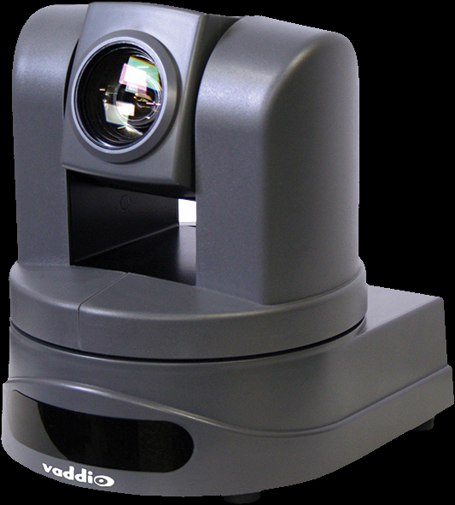
Example 1: Conference Camera
Vaddio ClearVIEW HD-USB Slotcard
Early-generation HD conference camera
Runs Ångström distribution of Linux
Powered by TI DaVinci DM368 platform
(ARM926EJ-S CPU)
Provides HTTP/telnet/network streaming services

Slide 7
Issues:
Network:
Cleartext administration interfaces (HTTP/telnet), no alternatives
Firmware:
Can be modified (in entirety) while running
Firmware obfuscation is minimal (byte-reversal)
Can be updated with modified firmware

Slide 8
The update process
At System part of Administration menu:
User uploads firmware
Package is decoded and unpacked to scratch space.
Bootloader update script is executed
System update script is executed
System verifies functionality, and:
If good, commits update.
If not good, reverts to existing firmware.

Slide 9
The firmware package
Relatively trivial unpacking. No binwalk needed.
A byte-reversed, base64 encoded zipfile containing:
Bootloader
Updated environment
Support scripts
Python Interpreter
Other goodies

Slide 10
Extracting & re-packing firmware
Extracting:
Undo byte-reversal
Uudecode file
Extract resulting zip into a directory
Re-packing:
Create zip archive
Uuencode file
Redo byte-reversal
If all goes well, it will accept your changes.

Slide 11
Demonstration

Slide 12
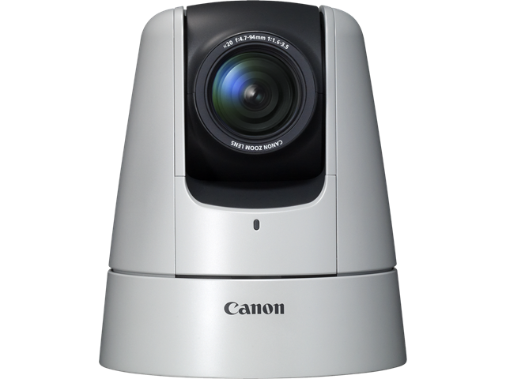
Example 2: Security Camera
Canon VB-H41
Pan/Tilt/Zoom IP camera
Proprietary OS (Linux-based)
Powered by DIGIC DV III Platform
(ARMV6TEJ-based CPU)
SD slot for event recording

Slide 13
Issues:
Network:
None (if running as intended)
Firmware:
Default administrative account is root
Running software can be easily updated
Arbitrary tasks can be invoked with cron job
Easily unpacked, no apparent signature check in bootloader (?)
Enough space available to run Debian in a chroot.
Remember that SD card slot?
Applications only limited by binutils

Slide 14
The firmware package
Courtesy of binwalk, we get the following:
128 bytes: Header (for this series)
Remainder is a tarred CPIO archive containing:
Canon DryOS Bootloader (boot.bin)
Data (cmr.dat)
SquashFS filesystem (mtd4fs, ro) – core OS
JFFS2 ‘appfs’ filesystem (main, mtd9fs, rw) – external apps
Linux Kernel (zImage)
MD5 sum of above items

Slide 15
Extracting firmware
Extracting:
Remove header
Extract gunzip archive
Extract resulting cpio archive in a directory
Extract other filesystems
SquashFS (core OS):
unsquashfs mtd4fs.squashfs
JFFS2:
Extract/unpack to a loopback device
Use Jefferson (jffs2 extraction tool)

Slide 16
Demonstration

Slide 17
Good News
VB-H41:
SSL is available (which raises the bar)
Some parts of firmware resist modification.
Some sanitization is performed (such as system logs)
HD-USB Slotcard:
Obtaining root is not straightforward
Outbound network traffic is restricted by default
Subsequent generation products more protected from altered firmware

Slide 18
Usage
For good/neutral:
Fix features (e.g. stepped Pan/Tilt)
Extend functionality to cross-platform clients
Ansible integration (depending on security model)
For [not good]:
Unwanted surveillance
Redirect/Copy streams to external sources
Jumping-off point to other devices
Other accounts (crafted alert e-mail)?
Compromise other devices with the camera

Slide 19
Further research
Obtain access without having to look over the wire
Extract keys from other devices (via JTAG, TTL serial, etc.)
Other firmware (Canon, AXIS, others)
Addressing issues with Canon firmware:
Properly extracting squashfs
Building firmware package (squashfs/jffs2-appfs)
NFS volume mounting off a camera (TI SDK kernel modules, perhaps?)
Stream straight to networked storage.

Slide 20
Questions?

Slide 21
Resources:
Angstrom Distribution: http://www.angstrom-distribution.org/
Binwalk: http://www.binwalk.org/
SquashFS:
http://tldp.org/HOWTO/SquashFS-HOWTO/mksqoverview.html
JFFS2 extraction:
https://github.com/sviehb/jefferson
http://linux-7110.sourceforge.net/howtos/netbook_new/x1125.htm
Multistrap: https://wiki.debian.org/Multistrap
TI DM365/368 SDK: http://www.ti.com/tool/linuxdvsdk-dm36x
Unpacking scripts: http://github.com/cm-code/firmware-scripts

Slide 22
Thank you.

