Slide 1
An Introduction to Bitcoin & Cryptocurrency
Josh Muller
January 8, 2015
Ohio Information Security Forum

Slide 2
My Bitcoin Background
Heard about it from a friend in college in early 2011 (BTC/USD ~75 cents each)
Began mining with graphics cards in March 2011, made several bitcoins a week
Bought bitcoins with CoinPal via PayPal
Traded on Mt. Gox & other exchanges & analyzed charts
In October 2011, bought from fellow early adopter who owned a coffee shop, paid ~8 BTC for ~$24 gift card when price was ~$3
Biggest regret: selling over 1,000 BTC < $10 to help pay for college at parent’s advice, although deep down I wanted to keep accumulating BTC
Continued trading & supporting cryptocurrency ever since

Slide 3
The Need for Bitcoin
Satoshi Nakamoto. “Bitcoin: A Peer-to-Peer Electronic Cash System.” http://bitcoin.org/bitcoin.pdf
Internet commerce relies on trusted financial institutions for payment processing (i.e., trust is required)
Non-reversible transactions are not really possible (financial institutions must mediate disputes)
Cost of mediation increases transaction costs, resulting in minimum transaction sizes
Since transactions can be reversed, need for trust spreads
Thus, merchants must be wary of customers & obtain more personal information than otherwise needed
Cash is used in person, but we lack a digital equivalent without trusting a 3rd party (i.e., a centralized business entity or trusted currency issuer)

Slide 4
The Need for Bitcoin (continued)
Bitcoin solves these problems
Electronic payment system based on cryptographic proof instead of 3rd party trust
Purely peer-to-peer distributed timestamp server – secure as long as honest nodes collectively control more hashing power than cooperating attacker nodes
Transactions are computationally impractical to reverse
Protects sellers from fraud (i.e., chargebacks)
Escrow can be implemented to protect buyers
Currency issued by the p2p network to its voluntary participants in return for securing it, not issued by a government entity

Slide 5
The Need for Bitcoin (continued)
Nikolei M. Kaplanov, Temple Law Review. “Nerdy Money: Bitcoin, the Private Digital Currency, and the Case Against Its Regulation” (March 31, 2012). Temple University Beasley School of Law Legal Studies Research Paper Series. Available at SSRN: http://ssrn.com/abstract=2115203
Historically, currencies are under centralized government control
E.g., Queen Elizabeth I & her government devalued Irish coin from nine ounces fine to three ounce fine of silver to finance the Nine Years War in Ireland
Private currencies nearly gone from U.S.; task delegated to Federal Reserve System

Slide 6
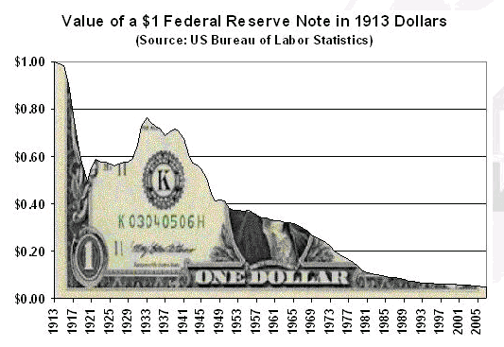
The Need for Bitcoin (continued)
Bitcoin prevents monetary tyranny
Deliberate inflation by central bank policies
Federal Reserve’s devaluation of U.S. dollar by over 97% since 1913:
Blatant sovereign confiscation (e.g., Cyprus bail-ins, money effectively stolen from savings accounts)
PayPal blocks payments in 60 countries, but Bitcoin lacks this censorship

Slide 7

How did Bitcoin begin?
Satoshi Nakamoto posted the Bitcoin whitepaper on 2008-10-31 to cryptography mailing list
Satoshi mined the genesis block on 2009-01-03
Solves “Byzantine General’s Problem” (computer science)
Notes:
Post on Bitcoin forums from Satoshi Nakamoto’s account explaining Byzantine General’s Problem as solved by Bitcoin implementation:
“A number of Byzantine Generals each have a computer and want to attack the King's wi-fi by brute forcing the password, which they've learned is a certain number of characters in length. Once they stimulate the network to generate a packet, they must crack the password within a limited time to break in and erase the logs, lest they be discovered. They only have enough CPU power to crack it fast enough if a majority of them attack at the same time. They don't particularly care when the attack will be, just that they agree. It has been decided that anyone who feels like it will announce an attack time, which we'll call the "plan", and whatever plan is heard first will be the official plan. The problem is that the network is not instantaneous, and if two generals announce different plans at close to the same time, some may hear one first and others hear the other first. They use a proof-of-work chain to solve the problem. Once each general receives whatever plan he hears first, he sets his computer to solve a difficult hash-based proof-of-work problem that includes the plan in its hash. The proof-of-work is difficult enough that with all of them working at once, it's expected to take 10 minutes before one of them finds a solution and broadcasts it to the network. Once received, everyone adjusts the hash in their proof-of-work computation to include the first solution, so that when they find the next proof-of-work, it chains after the first one. If anyone was working on a different plan, they switch to this one, because its proof-of-work chain is now longer. After about two hours, the plan should be hashed by a chain of 12 proofs-of-work. Every general, just by verifying the difficulty of the proof-of-work chain, can estimate how much parallel CPU power per hour was expended on it and see that it must have required the majority of the computers to produce in the allotted time. At the least, most of them had to have seen the plan, since the proof-of-work is proof that they worked on it. If the CPU power exhibited by the proof-of-work is sufficient to crack the password, they can safely attack at the agreed time.”
[EARLY HISTORY OF BITCOIN – “The Rise & Rise of Bitcoin” 8:05-10:16]

Slide 8
What is Bitcoin?
Open-source, decentralized, p2p, pseudonymous cryptographic currency protocol
“Bitcoin” = payment network
“bitcoins” = unit of cryptocurrency (abbreviated as BTC or XBT)
Doesn’t require any personal information, minimal trust required
Not regulated by any central institution, but by mathematical algorithms
Supply is limited & bitcoins cannot be forged or double spent
Transactions are irreversible
Fees are very low, if any at all
Notes:
[Brief overview of Bitcoin network – “The Rise & Rise of Bitcoin” 5:35-7:16]

Slide 9
What is Bitcoin? (continued)
Utilizes public key cryptography, timestamps, p2p, Merkle trees, & proof-of-work to process & verify transactions
The public key is the bitcoin address, and knowledge of the private key allows one to spend bitcoins located at that bitcoin address
Cryptography includes ECDSA (Elliptic Curve Digital Signature Algorithm) & SHA-256

Slide 10
The Bitcoin Network
Contains nodes possessing copies of a public ledger called the block chain
Block chain contains chronological record of bitcoin transactions between bitcoin addresses to prevent double spending
Transactions are broadcast throughout nodes in the network, recorded in the distributed block chain, and confirmed by mining nodes every ten minutes (avg. 6 blocks/hour)
Mining nodes that solve blocks are rewarded with certain number of bitcoins (currently 25 BTC/block, decreases over time)
Bitcoin network is the largest distributed supercomputer in existence & growing (@4,040,406 petaFLOPS in the first week of 2015, exponentially beating world’s fastest supercomputer, Tianhe-2 @ 33.86 petaFLOPS)
Hash rate on 2014-12-30 was 290,919 terahashes/second (that’s 290,919 trillion calculations per second)
Notes:
Bitcoin transactions occur when an individual, Alice, decides to send bitcoins located at her Bitcoin address to another individual, Bob. Alice’s wallet file contains the private keys for any/all Bitcoin addresses that she controls, which allow her to “spend” BTC by signing the transaction request with the private key(s) associated with her Bitcoin address. Her Bitcoin client broadcasts the transaction to other nodes in the network, which can verify that this request is actually sent from the account owner (due to the relationship between private and public keys). To verify the transaction and prevent double-spending, the bitcoin miners calculate complex hashing functions as proof-of-work to secure the blockchain, and are rewarded for securing the network. As long as one entity does not control more than 51% of the hashing power of the network, the blockchain is secure from being forked, and all nodes accept and propagate the longest blockchain.

Slide 11
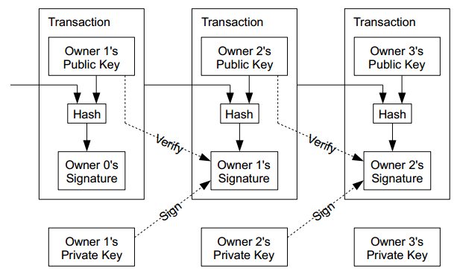
Blockchain Transactions
Notes:
Illustrates how owners of bitcoin addresses (public keys) can spend their bitcoins by signing transaction requests with their private keys

Slide 12
Bitcoin Currency
Finite supply of 21,000,000 BTC (logarithmic supply curve approaches 21 million around 2140 A.D.)
Units are divisible to 8 decimal places (smallest unit = 0.00000001 BTC), thus 2,099,999,997,690,000 (over 2 quadrillion) maximum possible atomic units
Transferable quickly & globally without any middleman
Counterfeit-proof (all currency units can be traced from inception)
Fungible (for now, but some are trying to push “colored coins”)
Decay-proof (if wallets are backed up properly)
Forgotten wallet passwords or lost/destroyed private keys’ BTC is gone forever, decreasing the money supply, which makes all other bitcoins more valuable (naturally deflationary)
Deflationary properties can encourage responsible saving rather than reckless spending

Slide 13
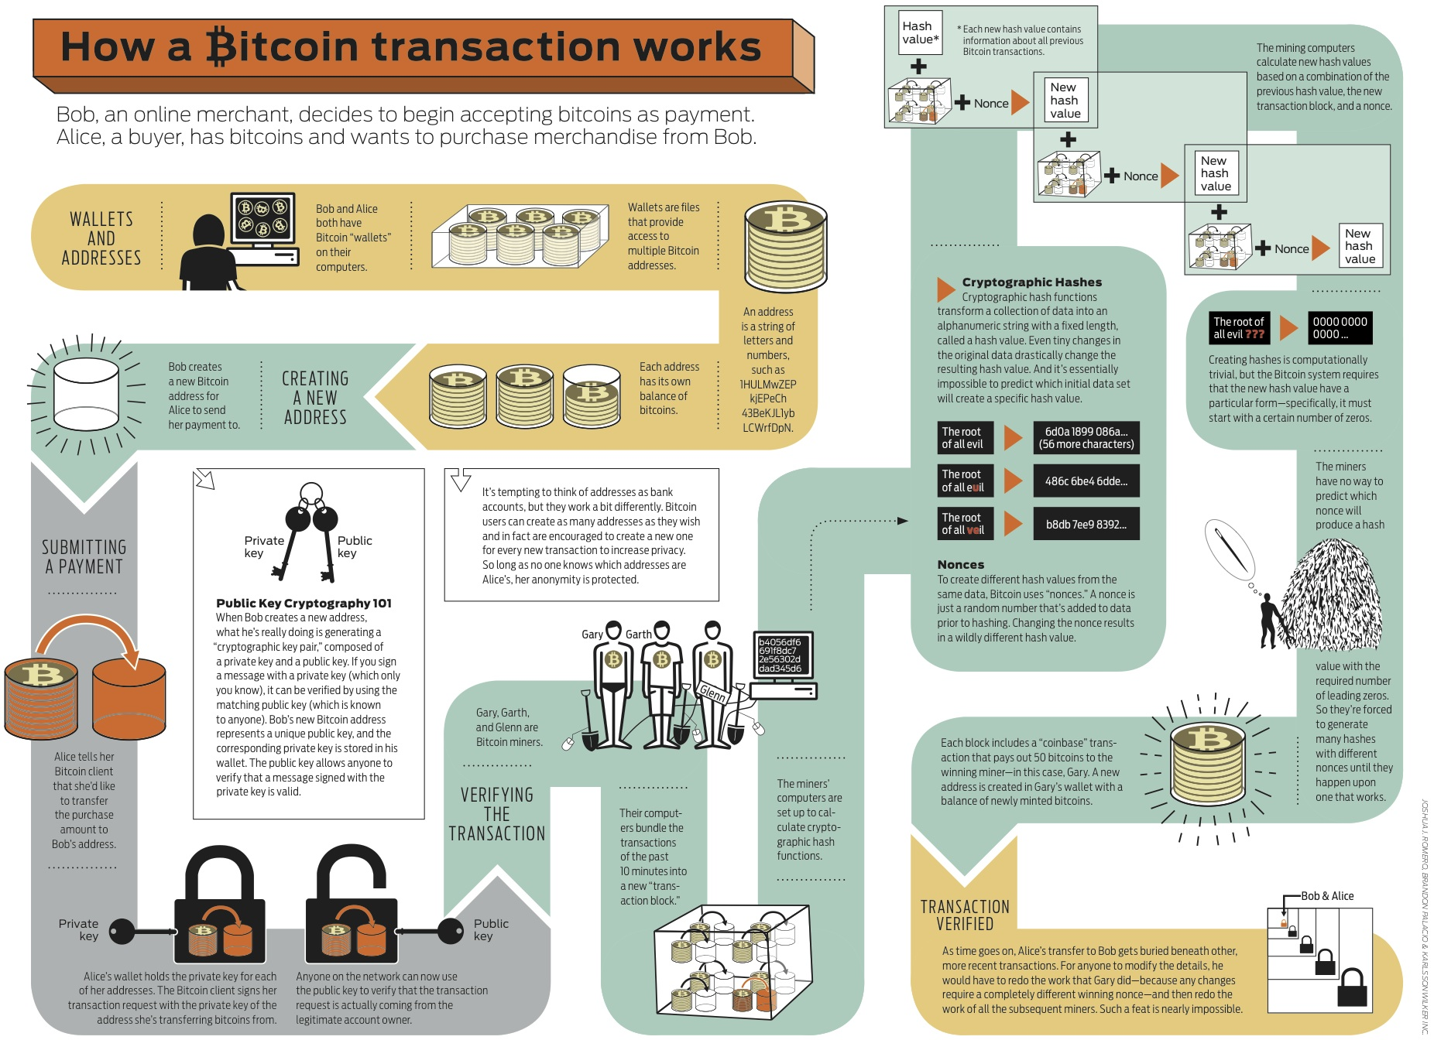
Notes:
Show YouTube - “How Bitcoin Works in 5 Minutes (Technical)”

Slide 14
Bitcoin Economy
Accepted as payment by growing number of businesses including:
Dell
Newegg
TigerDirect
Expedia
DISH Network
Overstock
Virgin Galactic
Wordpress
Reddit
Zynga
On Monday, January 5, 2015, bitcoins were worth $266 each, with a total of 13,688,900 BTC in the economy
Total market capitalization = $3,650,720,118.80 ($3.65 billion)
Notes:
Show charts from Blockchain.info

Slide 15
How do I secure my Bitcoin wallet?
Too many horror stories of web wallet hacks (e.g., $5 million stolen in BitStamp.net exchange hack last week, MtGox, MyBitcoin)
If you don’t exclusively control your private keys, you don’t truly own/control your bitcoins

Slide 16
How do I secure my Bitcoin wallet? (continued)
If storing backups online, encrypt them!
Use strong password & don’t forget it
Store backups in many locations
Long term savings offline wallet (aka “cold storage”)
Generate paper wallets offline (private can be printed as QR codes or text, & locked in a safe) – see BitAddress.org & download from GitHub (DEMO)
Boot into network-disabled live Linux DVD, run Bitcoin client, generate BTC address (write it down), encrypt wallet.dat & backup to USB drive, shut down Linux, and send BTC to that address
Use the “Armory” Bitcoin client: multiple encrypted wallets, import private keys, sign transactions offline, use BTC address to sign message (proof of ownership)
Backup wallet often as new keypairs are generated/added (unless using new HD wallet)

Slide 17
New Hierarchical Deterministic (HD) Wallets
Can be shared partially or entirely with different systems, each with or without the ability to spend coins
Use elliptic curve mathematics to calculate public keys without revealing private keys (e.g., webserver generates fresh public key addresses for each customer order without exposing/accessing corresponding private keys)

Slide 18
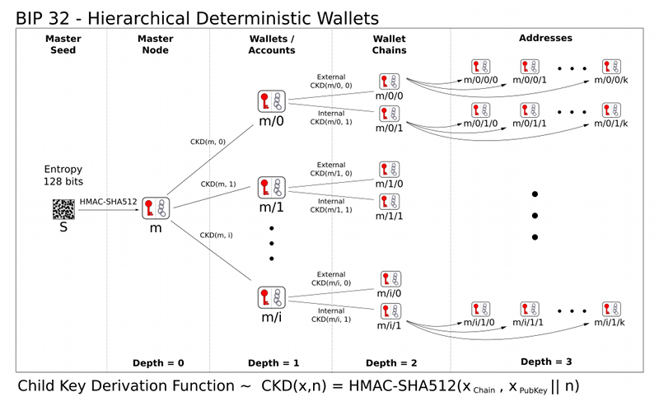
HD Wallets (deriving tree of keypairs from single master seed)

Slide 19
Brain Wallets
If generated with high degree of entropy, offers high degree of security
Nothing physical to be stolen
Requires minimal trust
Downside – if you forget it, it’s gone
Bitcoin addresses (public keys) are 160-bit numbers expressed in base 58 (33-34 characters starting with a “1”)
E.g., 1JwSSubhmg6iPtRjtyqhUYYH7bZg3Lfy1T
Private keys are 256-bit numbers expressed in base 58 (51 characters, starting with a “5”)
E.g., 5KJvsngHeMpm884wtkJNzQGaCErckhHJBGFsvd3VyK5qMZXj3hS
Hard way: memorize BTC address (160-bit number) & private key (256-bit number)
Easy way: generate a 12-word base 1600 mnemonic code for a wallet generation seed using Electrum client & memorize it
Used to generate 5 keypairs (public addresses & corresponding private keys)
E.g., pain apologize tired bar change think off outside clear fear hit stir resolves to 521566b6ebfe0ab8ff7b8110b92c57d4

Slide 20
How do I buy/sell bitcoins?
Services (Coinbase.com, Circle.com, GoCelery.com, etc.)
Exchanges (BitFinex.com, BTC-E.com, BitStamp.net, etc.)
Individually (LocalBitcoins.com)

Slide 21
Bitcoin Wallets
Windows, Mac, & Linux
Bitcoin Core (full node, stores full blockchain)
Electrum
Armory (advanced security)
mSIGNA
MultiBit
Green Address
Android
KnC Wallet
Bitcoin Wallet
Hive
Mycelium
Green Address
iOS
Breadwallet
Hive
Green Address

Slide 22
Bitcoin Wallets (continued)
Hardware
TREZOR
HW.1
Web
Xapo
Coinbase
Coinkite
Hive
BitGo
Green Address

Slide 23
Some other cryptocurrencies (altcoins)
See http://coinmarketcap.com/ for larger list
Litecoin (scrypt instead of SHA-256, 2.5 min. block times)
Namecoin (decentralized DNS)
BitShares
Stellar
Nxt
Dogecoin
Peercoin
Darkcoin
BitcoinDark
Monero
Feathercoin
Primecoin
Quark

Slide 24
Useful Links
https://bitcoin.org/
http://coindesk.com
https://blockchain.info/
https://zeroblock.com/
http://bitcoincharts.com/
http://www.bitcoinx.com/
https://bitcoinwisdom.com/
https://bitcoin.org/en/developer-guide
https://bitcoin.org/en/developer-documentation
https://bitcoin.org/en/faq
https://en.bitcoin.it/wiki/FAQ
http://bitcoin.stackexchange.com/
http://www.michaelnielsen.org/ddi/how-the-bitcoin-protocol-actually-works/
http://evoorhees.blogspot.com/2012/04/bitcoin-libertarian-introduction.html
http://dealbook.nytimes.com//2014/01/21/why-bitcoin-matters/?_r=0

Slide 25
Informative Videos
“The Rise & Rise of Bitcoin” documentary: http://bitcoindoc.com/
“How Bitcoin Works in 5 Minutes (Technical): https://www.youtube.com/watch?v=l9jOJk30eQs
“How Bitcoin Works Under the Hood: https://www.youtube.com/watch?v=Lx9zgZCMqXE

