Slide 1
Kali PI RECON
John Carls

Slide 2
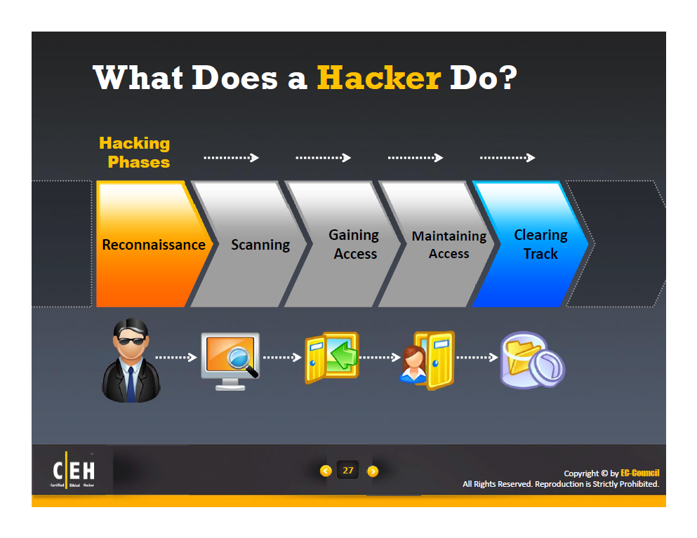

Slide 3
C|EH’s Information Gathering Methodology
Footprinting
Unearth Initial Information
Locate the Network Range
Ascertain Active Machines
Discover Open Ports/Access Points
Detect Operating Systems
Uncover Services on Ports
Map the Network

Slide 4
Basic Structure of a PenTest
Planning
NDA, Timeframe, Tools, Permissions, Disclosure, Internal/External
Enumeration (Discovery & OSINT)
Public Info, Passive Discovery
Attack (Gain Access & Maintain Access)
Root Access, Active Discovery
Report
What was discovered, accessed

Slide 5
Information Gathering
Determining everything you can about a target
Company, network, system, person, etc., through technical and/or non-technical means
Bits and pieces collected from multiple sources to create a larger picture
“Footprinting” and “Reconnaissance” often mentioned in the same context

Slide 6
Footprinting
The process of gathering all available information about an organization or target network
Passive, non-obtrusive method (e.g., Google)
Security Professionals Footprint to:
Determine what information the organization is giving away and what weaknesses are apparent
Hacker’s Footprint to:
Identify potential targets
Identify types of attacks that may be successful against the targets

Slide 7
Reconnaissance
Information gathering, exploration
Etymology
Military term about looking for an adversary’s intentions, plans, capabilities, and environment
Network reconnaissance
Overlaps with scanning, but can be considered the necessary research before launching a scan

Slide 8
Goals of Reconnaissance
Locate major assets and their IP addresses
Identify system owners
Acquire requisite knowledge to efficiently and effectively configure scans
Identify types of systems and software running
Gain knowledge on non-technical aspects of the system of interest
Effective reconnaissance positions the tester to do less work with more success later

Slide 9
Acquiring Target Information
Passive Reconnaissance
As little contact as possible with target
No direct scanning, no intrusion
No logging and no alarm triggering
Active Reconnaissance
Requires “touching” the device or network by sending packets to the target

Slide 10
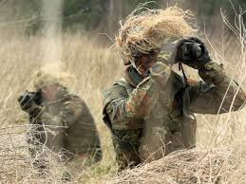
Passive Recon
Passive Reconnaissance
The term reconnaissance comes from its military use to describe an information-gathering mission.
Passive reconnaissance is an attempt to gain information about targeted computers and networks without actively engaging with the systems.
Notes:
“Footprinting” and “reconnaissance” are both related to each other in one way or another.

Slide 11
Intelligence Gathering
By using open source material, gather substantial information on the target
Organizational web sites
Google
Job postings
Business connections
This phase can uncover as many security holes as actually scanning for vulnerabilities on the network

Slide 12
External Footprinting > Defined
This is a phase of information gathering that consists of interaction with the target in order to gain information from a perspective external to the organization
Why is this done?
Much information can be gathered by interacting with targets
By probing a service or device, you can often create scenarios in which it can be fingerprinted
This step is necessary to gather more information about your targets
Notes:
Reference:
Penetration testing execution standard. (2012, October 31). Retrieved February 19, 2014, from http://www.pentest-standard.org/index.php/ Intelligence_Gathering#External_Footprinting GNU Free Documentation License Version 1.2, November 2002 Copyright (C) 2000,2001,2002 Free Software Foundation, Inc. 51 Franklin St, Fifth Floor, Boston, MA 02110-1301 USA Everyone is permitted to copy and distribute verbatim copies of this license document, but changing it is not allowed.

Slide 13

Internal Footprinting > Defined
The Internal Footprinting phase of Intelligence Gathering involves gathering response results from a target based upon direct interaction from an internal perspective. The goal is to gather as much information about the target as possible.
Internal footprinting begins with the identification of live systems
Notes:
Reference:
Penetration testing execution standard. (2012, October 31). Retrieved February 19, 2014, from http://www.pentest-standard.org/index.php/ Intelligence_Gathering#External_Footprinting GNU Free Documentation License Version 1.2, November 2002 Copyright (C) 2000,2001,2002 Free Software Foundation, Inc. 51 Franklin St, Fifth Floor, Boston, MA 02110-1301 USA Everyone is permitted to copy and distribute verbatim copies of this license document, but changing it is not allowed.

Slide 14
Passive Footprinting
Passive footprinting is a method in which the attacker never makes contact with the target systems
This is a hands off approach
Passively gather intelligence about web, mail, DNS, directory servers and look for IP addresses, domain names, network protocols, active services, operating systems, software and users
Notes:
Reference:
Tutorial footprinting. (2010, March 20). Retrieved February 20, 2014, from http://www.infond.fr/2010/05/toturial-footprinting.html

Slide 15
Passive Footprinting (Cont’d)
Packet Sniffing
Program that can see all of the information passing over the network it is connected to
Packet sniffing is used within a network in order to capture and register data flows
Allows you to discern each individual packet and analyze its content based on predefined parameters
Allows for very detailed network monitoring and bandwidth usage analysis
Notes:
Reference:
Packet sniffing. (n.d.). Retrieved February 20, 2014, from http://www.paessler.com/packet_sniffing

Slide 16
Scanning and Enumeration
Scanning is the process of detecting live or responding systems on the network
Scanning is conducted after the information gathering, footprinting, and reconnaissance stages
Enumeration occurs next and is the process of gathering user names, host or device names, and applications. It involves actively querying or connecting to a system to acquire these pieces of information.

Slide 17
Types of Scanning
Port Scanning: Determines open TCP/IP ports and services running on a system
Network Scanning: Identifies IPs on a given network or subnet
Vulnerability Scanning: Discovers presence of known weaknesses on a system

Slide 18

Port Numbers and Ranges
System (Well-know) ports: 0 to 1023
Registered (User) ports: 1024 to 49,151
Registered with IANA for Specific Service
Dynamic, private, or ephemeral (unassigned) ports:
Range: 49,152 to 65,535
Used for custom or temporary purposes
Cannot be registered with IANA
Recommend Scanning ALL Ports
Most tools don’t scan ephemeral ports
Scan UPD and TCP separately
Notes:
For port/service/protocol scans, discuss the value in scanning all 65535 TCP/UDP scans. In most cases scanners are not set to scan all ports. It's best to scan TCP and UDP separate as UDP will take a good bit of time.
http://www.trekearth.com/gallery/Europe/Portugal/North/Porto/Porto/photo1127847.htm

Slide 19
Ports, Protocols, and Services
Port: logical representation used by computers to establish a connection (e.g. Port 80).
Protocol: agreed upon method of communication (e.g. HTTP).
Service: function that is offered to a higher layer in the OSI model (e.g. Web Service).
Windows 7
w/IE
Apache Web Server
Port: 80
Notes:
The Web Server is a Linux OS that is providing service to a Windows OS. The ability for different operating system types to communicate is handled through the protocol (i.e. HTTP).

Slide 20
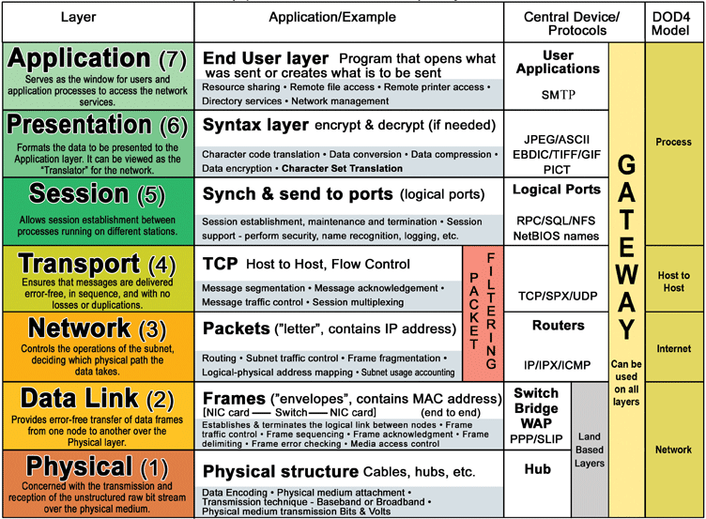
OSI (Open Systems Interconnection) Model: (ISO/IEC 7498-1): 7 Layers
All People Seem To Need Data Processing
Notes:
http://www.escotal.com/Images/Network%20parts/osi.gif

Slide 21
Traceroute
Traceroute is a commonly included tool that allows users to discover all of the hops taken between a host and target machine.
*nix Command: traceroute www.example.com
Windows Command: tracert www.example.com

Slide 22
Traceroute Example
C:\>tracert www.google.com
Tracing route to www.google.com [173.194.75.104]
over a maximum of 30 hops:
1 4 ms 1 ms 2 ms ■.■.■.■
2 7 ms 14 ms 11 ms ■.■.■.■
3 7 ms 5 ms 6 ms ■.■.■.■
4 7 ms 8 ms 6 ms 208.89.202.146
5 6 ms 6 ms 6 ms ge-9-39.car3.washington1.level3.net [4.79.169.221]
6 6 ms 7 ms 6 ms google-inc.car3.washington1.level3.net [4.79.168.210]
7 7 ms 7 ms 6 ms 209.85.252.80
8 7 ms 7 ms 7 ms 72.14.236.152
9 20 ms 60 ms 19 ms 209.85.243.114
10 19 ms 18 ms 18 ms 216.239.48.159
11 * * * Request timed out.
12 31 ms 19 ms 19 ms ve-in-f104.1e100.net [173.194.75.104]
Trace complete.

Slide 23
Google Hacking
Johnny Long
“Google Hacking for Penetration Testers”
https://www.blackhat.com/presentations/bh-europe-05/BH_EU_05-Long.pdf
Google Hacking Database
http://www.exploit-db.com/google-dorks/
Power searching using advanced operators
Syntax: operator:search_term
No spaces are required when using advanced operators or special characters
Notes:
https://support.google.com/websearch/bin/answer.py?hl=en&answer=2466433

Slide 24
Google: Advanced Operators
Operator | Effect | Mixes with Other Operators | For Use Alone
site | Useful for website mapping/crawling | Yes | Yes
link | Finds sites that link to the given URL | No | Yes
inurl, allinurl | Search within a URL | Yes, No | Yes, Yes
intext, allintext | Search text of page only | Not really | Yes
intitle, allintitle | Seach page title | Yes, No | Yes, Yes
filetype | Search for specific file types | Yes | No
inanchor | Search link anchor text | Yes | Yes
numrange | Locate number | Yes | Yes
daterange | Search in date range | Yes | No
author | Group author search | Yes | Yes
group | Group name search | Not really | Yes
insubject | Group subject search | Yes | Yes
msgid, as_msgid | Group msgid search | No | Yes
Google Operators: https://support.google.com/websearch/bin/answer.py?hl=en&answer=136861
https://en.wikipedia.org/wiki/Google_hacking

Slide 25
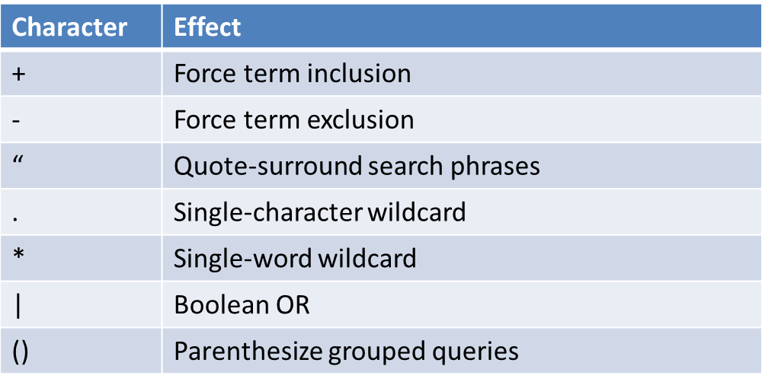
Google Special Characters
More details at:
https://support.google.com/websearch/bin/answer.py?hl=en&answer=2466433

Slide 26
DNS Lookups
DNS = Domain Name Service
DNS is the utility within the Internet that maps human-readable website names to IP addresses.
Looking at DNS records can tell you about where servers are located, who runs them, and footprint information on the servers
DNS is considered to be at either the Application or Network layer.
Since the Internet is huge, its governance and mapping occurs on an international scale.
DNS can be thought of as a “structured hierarchy” (Shuler, 2002, “How Does the Internet Work?” http://www.stanford.edu/class/msande91si/www-spr04/readings/week1/InternetWhitepaper.htm)

Slide 27
Whois Protocol
Whois is a protocol that maps domains to IP addresses and their owners
Historically, Unix systems come with the whois command line capability built-in.
Systems by Microsoft and Apple originally did not have whois built-in, so users had to rely on web-based clients.
The whois protocol stems from the NAME/FINGER protocols (RFC 742, 1977).
Whois is defined in RFC 3912 (2004, current)
RFC 954, 1985, obsolete
RFC 812, 1982, obsolete

Slide 28
Using Whois
Today, many web services provide whois lookups for different sections and levels of the Internet.
Depending on which region a site is in and where it falls in the DNS hierarchy, different whois providers need to be used.
For websites in the USA, query ARIN (the RIR) to find the local ISP responsible for that website.
Most RIRs can provide cross-references to the other RIRs to look at when they do not contain a particular site reference.
For international targets, the IANA Whois Service (https://www.iana.org/cgi-bin/whois) will return the relevant registrar database.
Registry data on TLDs can be found at:
http://www.internic.net
http://www.networksolutions.com/whois/
Whois works using TCP over port # 43
Whois can be queried using Telnet
Whois Query argument types: domain names, IP addresses, and AS numbers
Notes:
Look up: Referral Whois (RWhois)

Slide 29
DiG: Domain Information Groper
DiG is used to look up the DNS name servers of a domain.
Previous utilities that have been deprecated: nslookup and host
Dig is a part of the BIND DNS suite for *nix
Dig for Windows: http://members.shaw.ca/nicholas.fong/dig/
Syntax: dig @server name type
Unless specified otherwise, dig will try each server listed in /etc/resolv.conf
When no options are given, dig performs an NS query for “.” (root)
Dig defaults to IPv4 lookups.
More info on the dig utility can be found in the dig man pages and http://www.madboa.com/geek/dig/
Notes:
http://www.domainmonster.com/glossary/dns/arecord/
A-Record
An A-record is an entry in your DNS zone file that maps each domain name (e.g. yourdomain.com) or subdomain(e.g. subdomain.yourdomain.com) to an IP address. In other words, the A-record specifies the IP address to which the user would be sent for each domain or subdomain. This means that you can have different subdomains of your website resolving to different IP addresses, which could be useful if they are hosted on different servers.
Example A-record for yourdomain.com:
Host Name: www - IP Address: 217.22.89.217
This would cause www.yourdomain.com to resolve to the IP address 217.22.89.217.

Slide 30
Nmap Syntax: Scan Types
-sS: TCP SYN scan
-sT: Connect() scan
-sA: ACK scan
-sW: Window scan
-sM: Maimon scan
-sU: UDP scan
-sN: TCP Null scan
-sF: FIN scan
-sX: Xmas scan
-sI <zombie host{:probeport]>: Idle scan
-sY: SCTP INIT scan
-sZ: COOKIE-ECHO scan
-s0: IP protocol scan
-b <FTP relay host>: FTP bounce scan
--scanflags <flags>: Customize TCP scan flags

Slide 31

Wireshark
Wireshark is the top network protocol analyzer.
Called Ethereal until May 2006
Free under the GNU General Public License
Provides deep packet inspection across virtually all major protocols
Can be used for live capture or offline for analysis
http://www.wireshark.org/

Slide 32
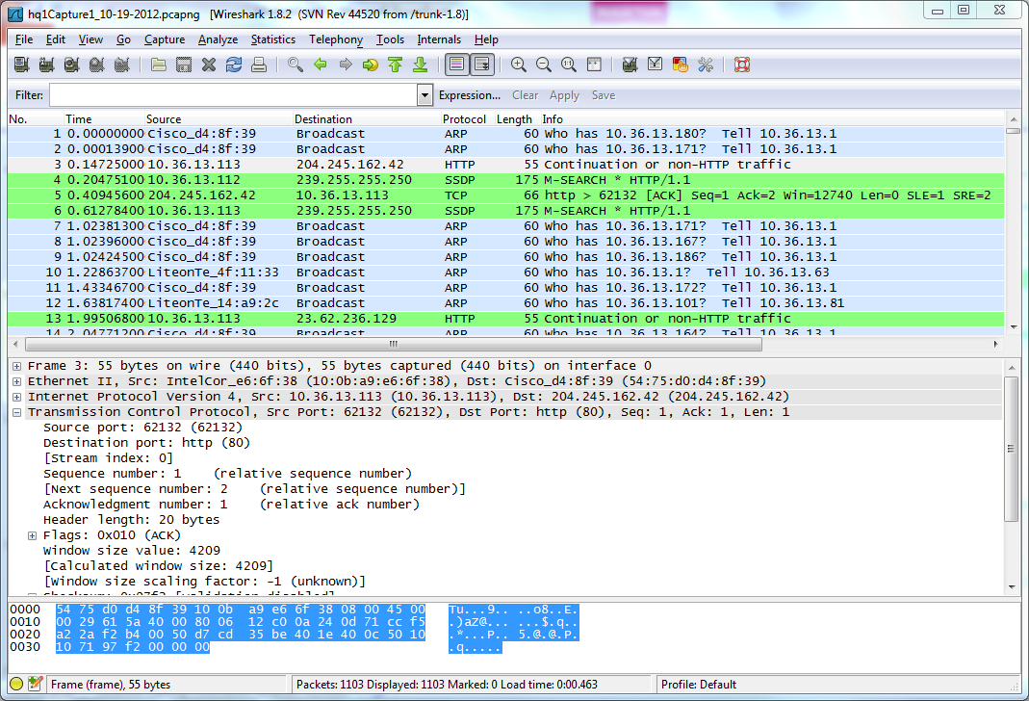
Wireshark

Slide 33

Aircrack-ng (suite)
Network software suite with a detector, packet sniffer, and WPA/WPA2-PSK cracker and analysis tool for 802.11 wireless LANs
Replaced original suite (Aircrack)
Main use: [quickly] cracking WEP and WPA-PSK keys through the use of captured wireless packets
Sniffs: 802.11a, 802.11b, 802.11g
Compatibility: Windows (minimal to no support), Linux, mobile
The chipset and wireless card (hardware) matters when running Aircrack-ng (not all wireless chipsets are supported—ability to inject packets)
Official website: http://www.aircrack-ng.org/
Notes:
http://en.wikipedia.org/wiki/Aircrack-ng

Slide 34


BurpSuite & Nikto
Burp Suite is an integrated platform for attacking web applications
Nikto is a web server scanner that looks for malicious files/CGIs, outdated server software, HTTP server options, cookies, and a variety of other web server weaknesses
http://cirt.net/nikto2 by Chris Sullo and David Lodge
Not a stealthy too, but has optional anti-IDS support
Logs to Metasploit
http://starwars.wikia.com/wiki/Nikto
Notes:
Wookieepedia says that Nikto are a reptilian humanoid species from the planet Kintan in the Si'Klaata Cluster and have many subspecies.
http://starwars.wikia.com/wiki/Nikto
http://hackertarget.com/nikto-tutorial/
http://blog.tenablesecurity.com/2008/09/using-nessus-to.html

