Slide 1
Making Kali PI
John Carls

Slide 2
Lab Equipment and Environment
Desktop / Laptop Computer
Windows 7
SysAdmin privilege
Internet connectivity to download tools / images
Ability to Install Programs
Knowledge of Windows command line
Knowledge of Linux command line

Slide 3


Kali Linux
Kali Linux 2018.1 (Current Release) (DEC ‘12 - First Release) (https://www.kali.org)
Debian Linux (http://www.debian.org)
Digital Forensics
Penetration Testing
Includes many well-know Security Tools (12 Categories)
12 MetaPackages
subsets of tools based on your particular needs
Replaced BackTrack 5 R3 (Final Release) (FEB 06 was First Release)
Ubuntu Linux (http://www.ubuntu.com)
Developed by Offensive Security

Slide 4

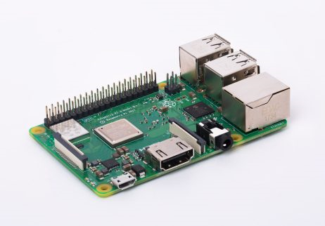
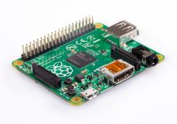
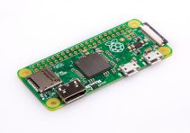
Raspberry Pi - Raspberry Pi Foundation (https://www.raspberrypi.org/)
Raspberry Pi 3 Model B+
Broadcom BCM2837B0 64-bit SoC
Quad-core ARM Cortex-A53 1.4 GHz processor
Dual Core VideoCore IV GPU (1 Gpixels/s ~ 2001 Xbox)
1 GB LPDDR2 + microSD
10/100/1000 Mbps Ethernet
4 USB Ports
Wireless ac/n + Bluetooth LE
HDMI
Raspberry Pi 3 Model B
Broadcom BCM2837 64-bit SoC
Quad-core ARM Cortex-A53 1.2 GHz processor
1 GB LPDDR2 + microSD
10/100 Mbps Ethernet
4 USB Ports
Wireless n + Bluetooth LE
HDMI
Raspberry Pi 2 Model B
Broadcom BCM2836 32-bit SoC
Quad-core ARM Cortex-A7 900 MHz processor
1 GB + microSD
10/100 Mbps Ethernet
4 USB Ports
Wireless
HDMI
Raspberry Pi 1 Model B+
Raspberry Pi 1 Model A+
Raspberry Pi Zero W
Wireless & Bluetooth
Raspberry Pi Zero

Slide 5



What is Kali Pi?
Combining Kali and Raspberry Pi
Kali Pi
Kali Linux 2018.1
Penetration Testing
MetaPackages
Raspberry Pi
Linux OS – Raspbian Linux (variant of Debian)

Slide 6
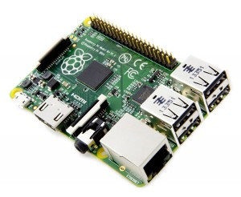
Download Kali
Download ARM Image
Kali Linux 2018.1a (Current Release)
https://www.offensive-security.com/kali-linux-arm-images/
Kali Linux RaspberryPi 2 and 3
https://images.offensive-security.com/arm-images/kali-linux-2018.1a-rpi3-nexmon.img.xz

Slide 7

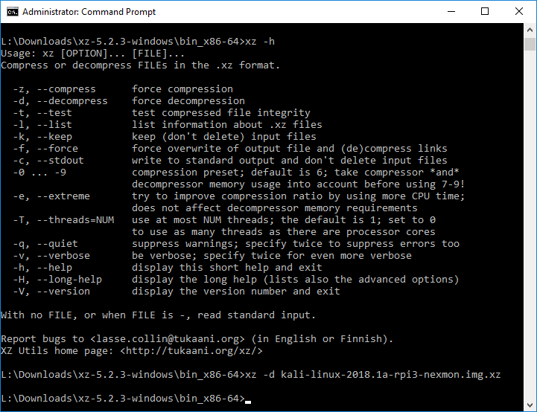
extract Kali
Use XZ Utils to extract Kali Image
https://tukaani.org/xz/
xz –d kali-linux-2018.1a-rpi3-nexmon.img.xz

Slide 8

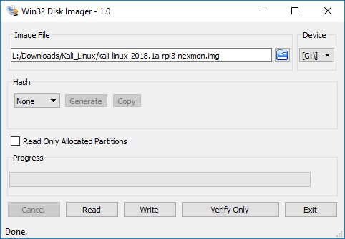
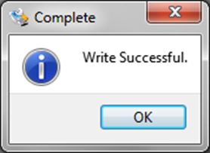
Write ImG
Use Win32 Disk Imager to write image to microSD card
https://sourceforge.net/projects/win32diskimager/files/latest/download/
Power on Raspberry Pi

Slide 9
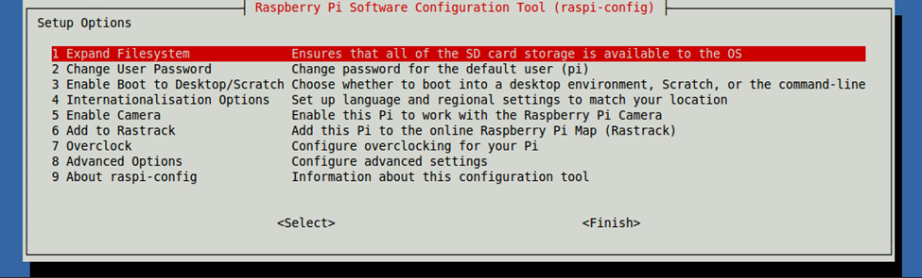
Configuring Kali Pi
Kali Pi image is smaller than microSD card capacity
Latest image expands to ~7 GB
Raspberry Pi Configuration
http://archive.raspberrypi.org/debian/pool/main/r/raspi-config/
wget http://archive.raspberrypi.org/debian/pool/main/r/raspi-config/raspi-config_20171127_all.deb
wget http://http.us.debian.org/debian/pool/main/l/lua5.1/lua5.1_5.1.5-8.1+b2_armhf.deb
wget http://http.us.debian.org/debian/pool/main/t/triggerhappy/triggerhappy_0.3.4-2_armhf.deb
dpkg -i triggerhappy_0.3.4-2_armhf.deb
dpkg -i lua5.1_5.1.5-8.1+b2_armhf.deb
dpkg -i raspi-config_20171127_all.deb
raspi-config
DEMO

Slide 10
Updating Kali OS
Ensure latest updates are installed
apt-get update
apt-get upgrade
apt-get dist-upgrade

Slide 11
Installing Kali MetaPackageS
Decide on Kali Metapackage to install
Easily install subsets of tools based on their particular needs
Metapackages allow for easy installation of certain tools in a specific field
https://www.kali.org/news/kali-linux-metapackages/
Example Metapackages that are available:
apt-get install kali-linux-top10
apt-get install kali-linux-wireless
apt-get install kali-linux-all
apt-get install armitage
Includes Metasploit

Slide 12
Updating SSH KEYs
Remove bad / old SSH keys
rm /etc/ssh/ssh_host_*
dpkg-reconfigure openssh-server

Slide 13
Updating User
Add a New User and Set Password
useradd -m muts -G sudo -s /bin/bash
passwd muts
Enter new UNIX password:
Retype new UNIX password:
passwd: password updated successfully
Prevents from having only one account – ROOT
Should perform functions as STD USER and only SU / SUDO when necessary

Slide 14
Questions?

