Slide 1


Slide 2

Hacking with Critters
https://shop.hak5.org/
Dr. John W. Carls, CISSP, C|EH

Slide 3
Bash Bunny
Packet Squirrel
LAN Turtle
Rubber Ducky
Signal Owl
Screen Crab
https://shop.hak5.org/
https://docs.hak5.org/hc/en-us

Slide 4
Bash Bunny

Slide 5

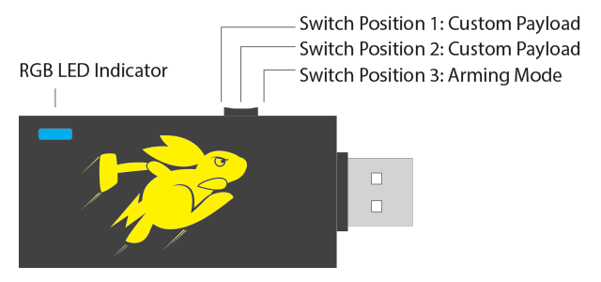
Bash Bunny
The Bash Bunny by Hak5 is the world’s most advanced USB attack platform. It delivers penetration testing attacks and IT automation tasks in seconds by emulating combinations of trusted USB devices – like gigabit Ethernet, serial, flash storage and keyboards.
With it, computers are tricked into divulging data, exfiltrating documents, installing backdoors and many more exploits.
Specifications#
•Quad-core ARM Cortex A7
•32 K L1/512 K L2 Cache
•512 MB DDR3 Memory
•8 GB SLC NAND Disk
Power Requirements
•USB 5V ~1.5A
LED Status
Green (blinking) Booting up
Blue (blinking) Arming Mode
Red (blinking) Recovery Mode or Firmware Flashing from v1.0 DO NOT UNPLUG
Red/Blue Alternating Recovery Mode or Firmware Flashing from v1.1+ DO NOT UNPLUG
Notes:
http://lanturtle.com/wiki/#!index.md

Slide 6

Bash Bunny
Mass Storage Directory Structure
•/docs – home to documentation.
•/languages – install additional HID Keyboard layouts/languages.
•/loot – used by payloads to store logs and other data
•/tools – used to install additional deb packages and other tools.
•/payloads – home to active payloads, library and extensions
•/payloads/switch1 and /payloads/switch2 – home to payload.txt and accompanying files which will be executed on boot when the bash bunny switch is in the corresponding position.
•/payloads/library – home to the payloads library which can be downloaded from the Bash Bunny Payload git repository
•/payloads/library/extensions – home to Bunny Script extensions
Default Settings#
•Username: root
•Password: hak5bunny
•IP Address: 172.16.64.1
•DHCP Range: 172.16.64.10-12
Notes:
http://lanturtle.com/wiki/#!index.md

Slide 7
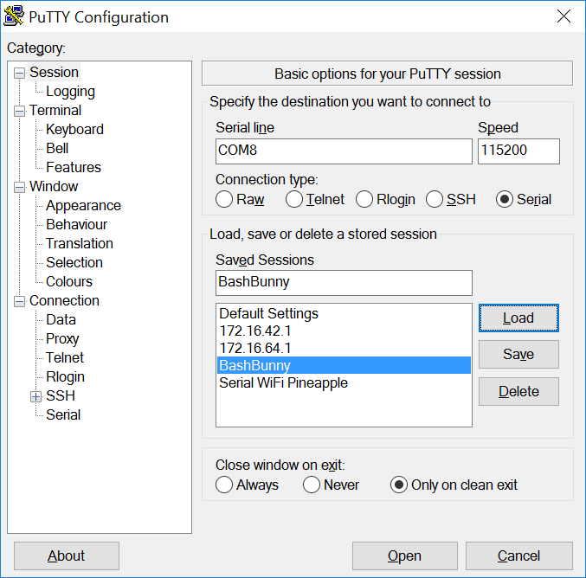
Bash Bunny
Connecting to to the Bash Bunny Serial Console from Windows
Find the COM# from Device Manager > Ports (COM & LPT) and look for USB Serial Device (COM#). Example: COM3
Alternatively, run the following powershell command to list ports:
[System.IO.Ports.SerialPort]::getportnames()
Open PuTTY and select Serial. Enter COM# for serial line and 115200 for Speed. Click Open.
Notes:
http://lanturtle.com/wiki/#!index.md

Slide 8
Bash Bunny
Connecting to the Linux Bash Bunny Console from Linux
1.Find the Bash Bunny device from the terminal
ls /dev/tty*" or "dmesg | grep tty
Usually on a Linux host, the Bash Bunny will register as either /dev/ttyUSB0 or /dev/ttyACM0. On an OSX/macOS host, the Bash Bunny will register as /dev/tty.usbmodemch000001.
2.Next, connect to the serial device using screen, minicom or your terminal emulator of choice.
If screen is not installed it can usually be found from your distributions package manager.
sudo apt-get install screen
Connecting with screen
sudo screen /dev/ttyACM0 115200
Disconnect with keyboard combo: CTRL+a followed by CTRL+\
https://docs.hak5.org/hc/en-us/categories/360000982534-Bash-Bunny
Notes:
http://lanturtle.com/wiki/#!index.md

Slide 9
Packet Squirrel

Slide 10
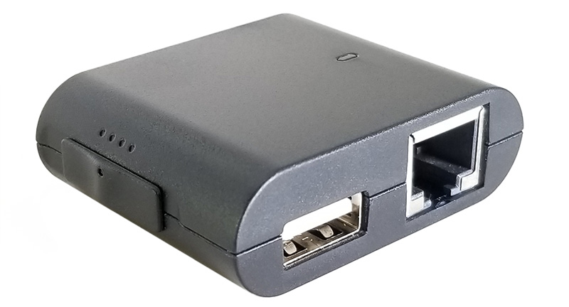
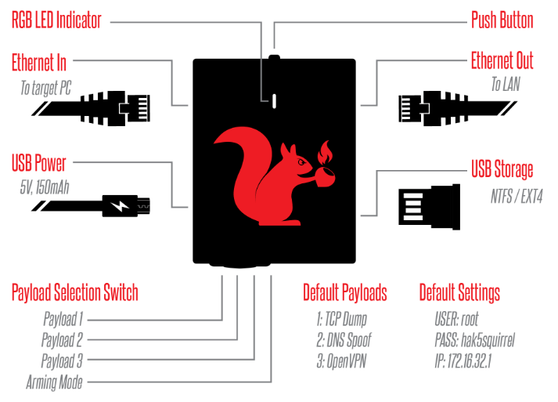
Packet Squirrel
Covert PenTesting Tool
Provides stealthy Remote Access, Man-in-the-Middle (MitM) (Ethernet Pass-thru), and Network Intel Gathering
Specifications
Atheros AR9331 SoC at 400 MHz MIPS
16 MB Onboard Flash / 64 MB DDR2
2x 10/100 Ethernet Port
USB Ethernet Port
Payload Selector (4 options)
Scriptable
Notes:
http://lanturtle.com/wiki/#!index.md

Slide 11
Packet Squirrel
RGB LED Indicator
This status LED will light to indicate various states such as boot-up, errors and payload execution.
Push Button
The push button may be used by various payloads to perform functions using the BUTTON command. The push button has two default actions.
Arming Mode
In Switch Position 4 (closest to the USB host port) the Packet Squirrel will boot into arming mode, enabling SSH access. From this dedicated mode, Packet Squirrel payloads may be managed via SCP or the Linux shell. This mode is indicated by a slow blinking blue LED.
Notes:
http://lanturtle.com/wiki/#!index.md

Slide 12
Packet Squirrel
To get into the device flip the switch to arming mode (far right position):
Plug an Ethernet cable from your computer into the Ethernet In port (left side, above the micro USB port)
Power on the Packet Squirrel with any ordinary Micro USB cable and USB power supply (phone charger, computer’s USB port, battery bank)
It takes 30-40 seconds to boot, indicated by a blinking green LED. Once it’s booted it’ll be in arming mode, indicated by a blinking blue LED.
From here your computer will receive an IP address from the Packet Squirrel in the 172.16.32.x range, and you’ll be able to ssh in as root to 172.16.32.1. The default password is hak5squirrel
You’ll find the default payloads from /root/payloads in their corresponding switch folders.
https://docs.hak5.org/hc/en-us/categories/360000982574-Packet-Squirrel
Notes:
http://lanturtle.com/wiki/#!index.md

Slide 13
Packet Squirrel
Tools on the Packet Squirrel include:
•openvpn
•autossh
•tcpdump
•ngrep
•urlsnarf
•meterpreter-php
•meterpreter-https
•cron
•nmap
•dsniff
•ncat-ssl
•ncat
•sshfs
•tcpdump
•wget
Additionally a utility to reformat a USB flash disk is included:
•reformat_usb
Notes:
http://lanturtle.com/wiki/#!index.md

Slide 14
LAN Turtle

Slide 15

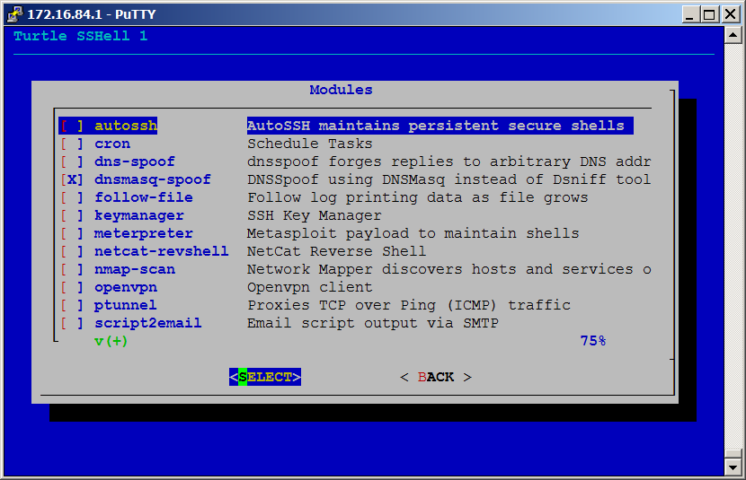
LAN Turtle
Covert PenTesting Tool using Generic USB Ethernet Adapter
Masquerade as legit USB Ethernet Adapter
Plugs in USB Port on Host
Offers host an IP address, bridges connection
Provides stealthy Remote Access, Man-in-the-Middle (MitM) (Ethernet Pass-thru), and Network Intel Gathering
Specifications
Atheros AR9331 SoC at 400 MHz MIPS
16 MB Onboard Flash / 64 MB DDR2
10/100 Ethernet Port
USB Ethernet Port - Realtek RTL8152
https://docs.hak5.org/hc/en-us/categories/360000979313-LAN-Turtle
http://hakshop.myshopify.com
Notes:
http://lanturtle.com/wiki/#!index.md

Slide 16
Rubber Ducky

Slide 17
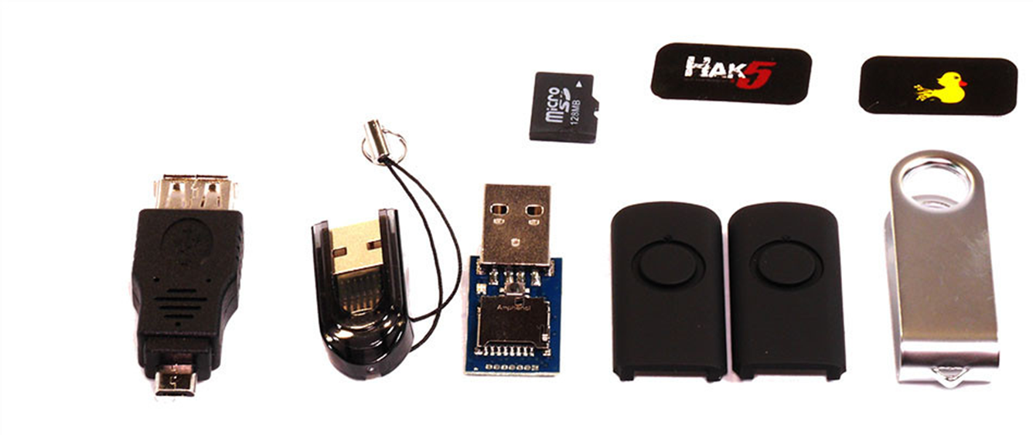
USB Rubber Ducky
Keystroke Injection Attack Platform
Simple scripting language and covert design
USB standard known as HID - or Human Interface Device
Any USB device claiming to be a Keyboard HID will be automatically detected and accepted by most modern operating systems
Takes advantage of the inherent trust with scripted keystrokes
May Include Payload(s)
https://docs.hak5.org/hc/en-us/categories/360000982554-USB-Rubber-Ducky
http://hakshop.myshopify.com/

Slide 18
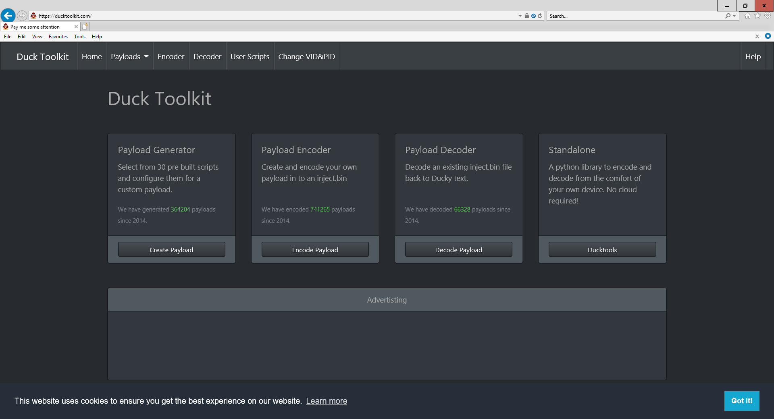

Slide 19
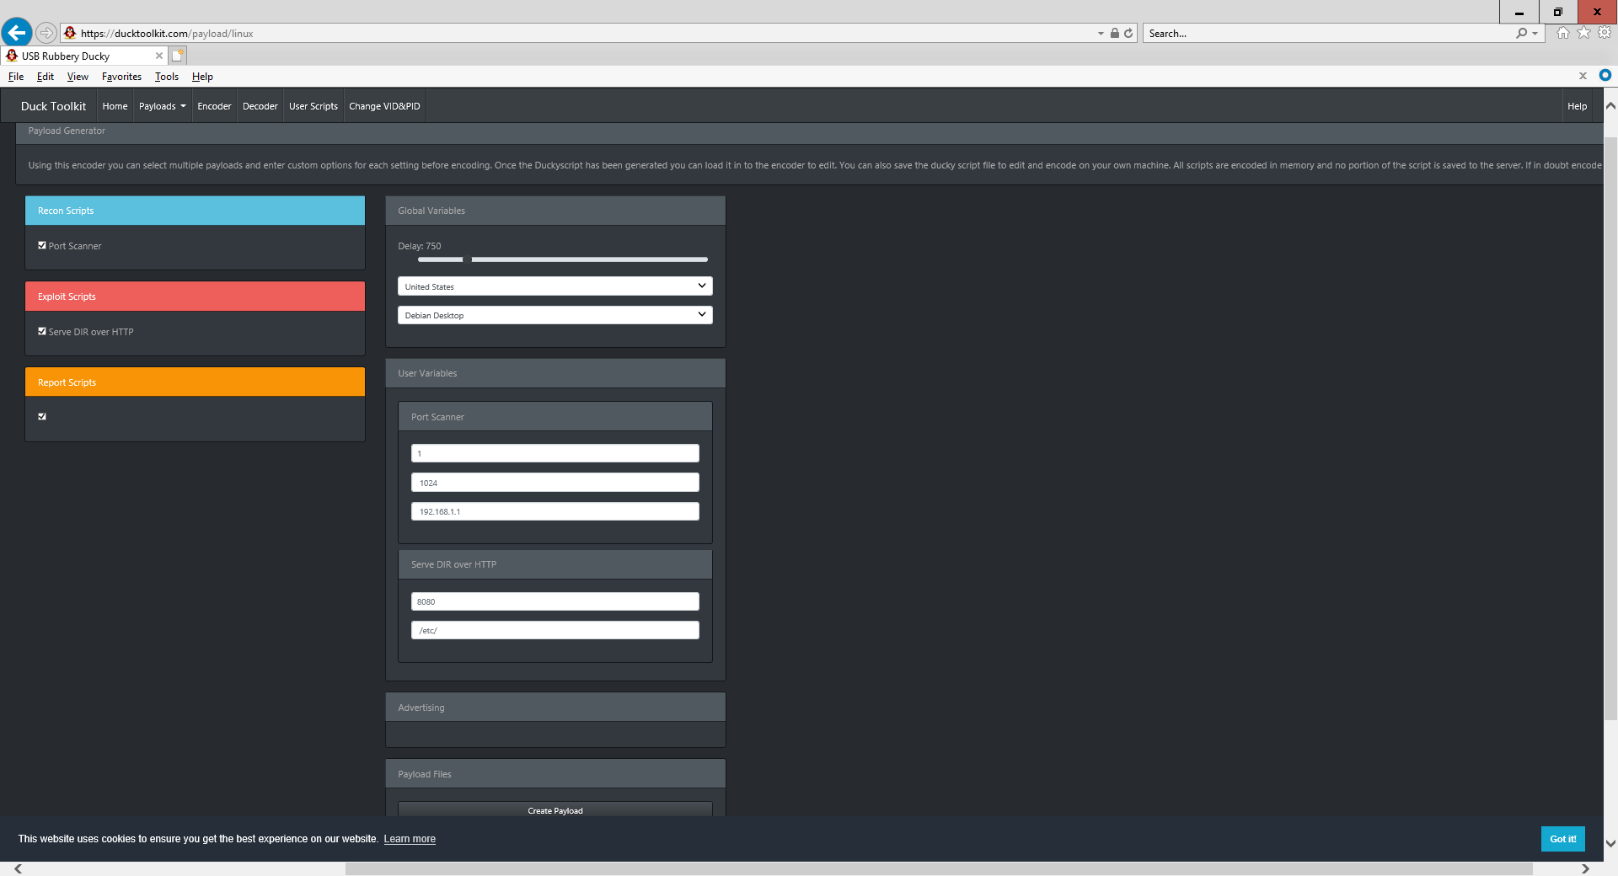

Slide 20
Screen Crab

Slide 21
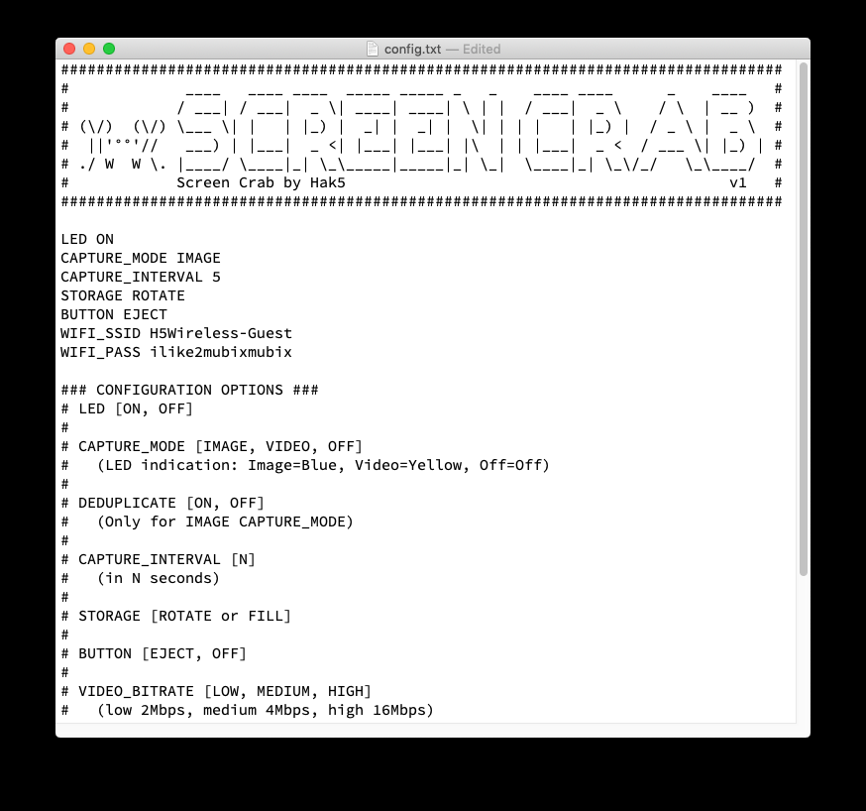
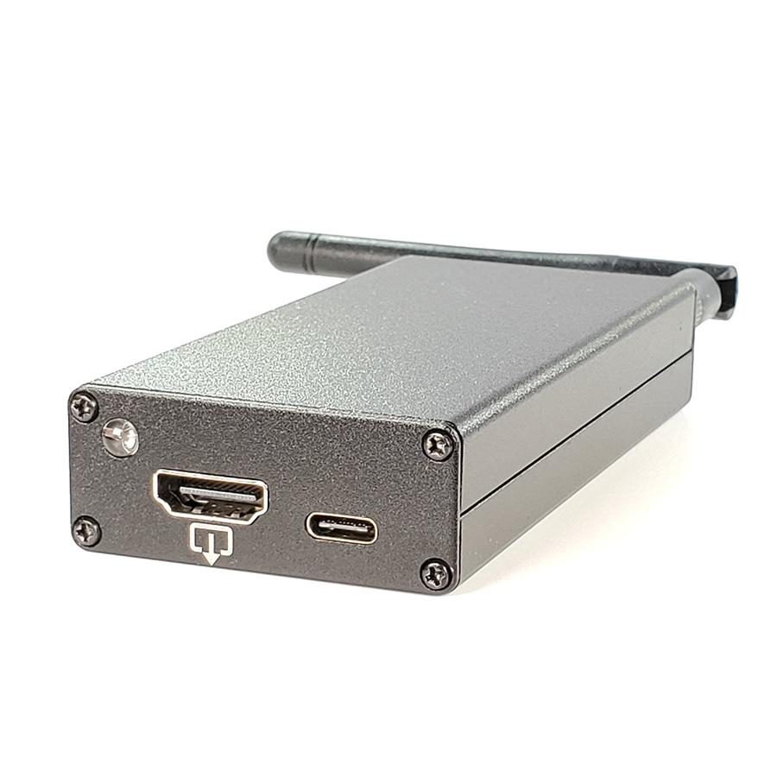
Screen Crab

Slide 22
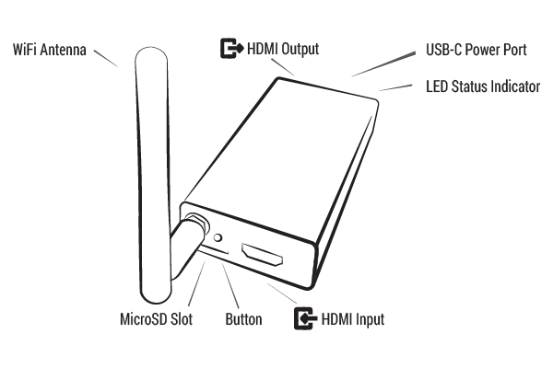
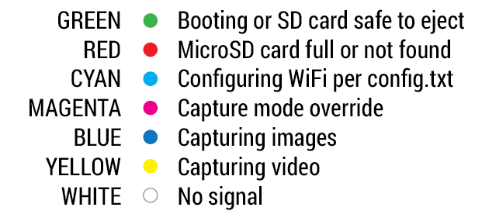
By default the Screen Crab will save screenshots to a MircoSD card at regular intervals. With a blank MicroSD inserted, the Screen Crab will write a config.txt file to the root card.
Default Configuration:
LED ON CAPTURE_MODE IMAGE CAPTURE_INTERVAL 5 STORAGE FILL BUTTON EJECT
Capture Configuration:
LED [ON, OFF]
CAPTURE_MODE [IMAGE, VIDEO, OFF]
(LED indication: Image=Blue, Video=Yellow, Off=Off) DEDUPLICATE [ON, OFF] (Only for IMAGE CAPTURE_MODE) CAPTURE_INTERVAL [N] (in N seconds) STORAGE [ROTATE or FILL] BUTTON [EJECT, OFF] VIDEO_BITRATE [LOW, MEDIUM, HIGH] (low 2Mbps, medium 4Mbps, high 16Mbps)
https://docs.hak5.org/hc/en-us/categories/360002117873-Screen-Crab

Slide 23
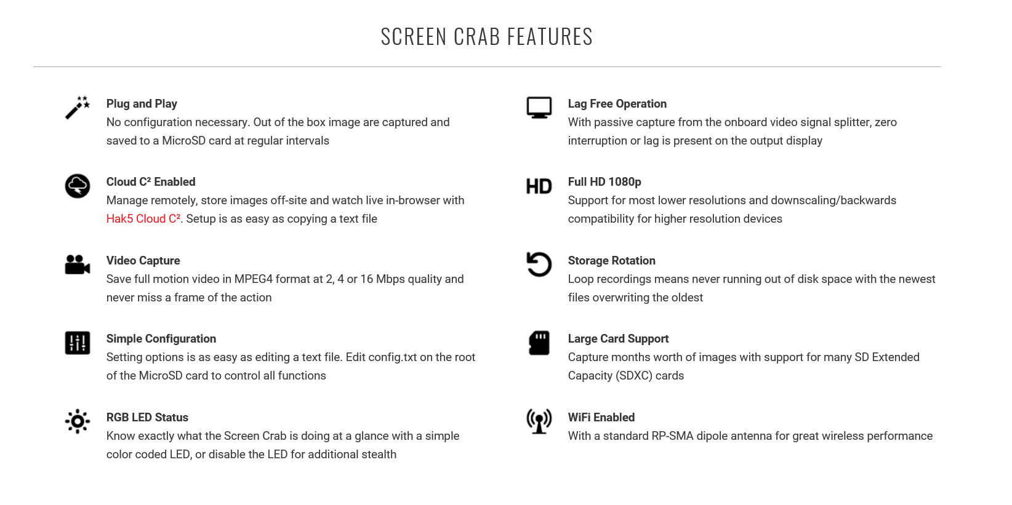

Slide 24
Signal Owl

Slide 25
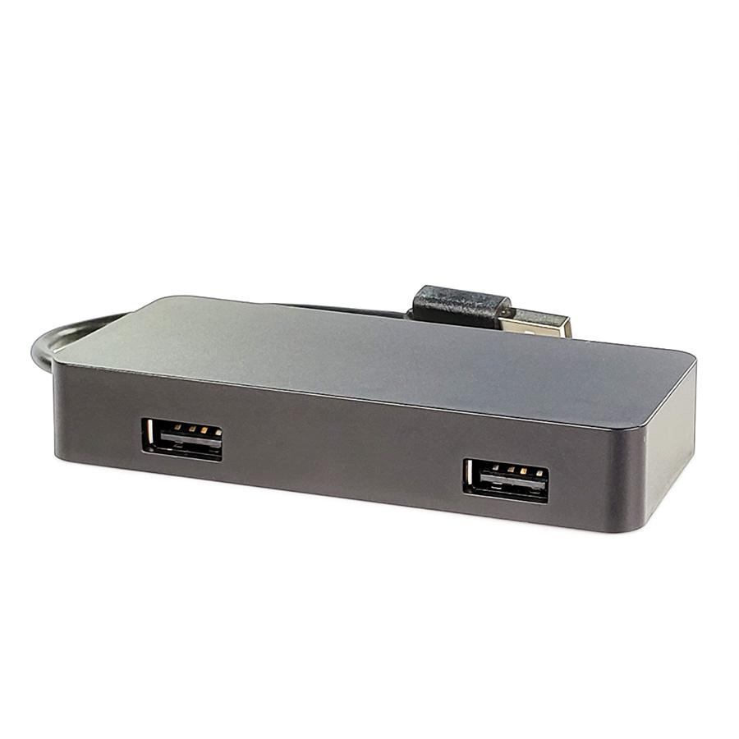
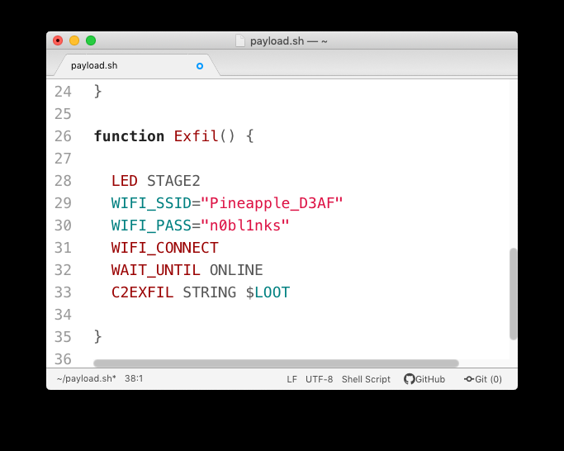
Simple and Powerful
Coupled with custom utilities and popular wireless tools – like the Aircrack-ng Suite, MDK4, and Kismet – writing payloads couldn't be easier. With a simple and flexible framework, and an ecosystem of payloads from the Hak5 repository, getting started is easy.
Signal Owl

Slide 26
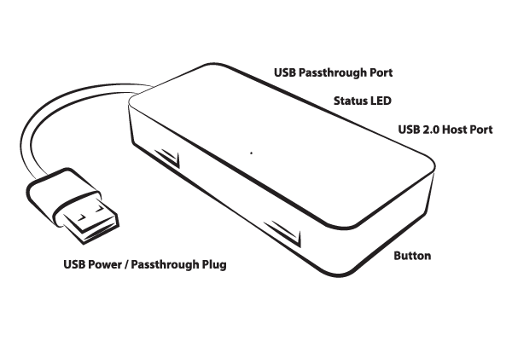
Simple and Powerful
Coupled with custom utilities and popular wireless tools – like the Aircrack-ng Suite, MDK4, and Kismet – writing payloads couldn't be easier. With a simple and flexible framework, and an ecosystem of payloads from the Hak5 repository, getting started is easy.

Slide 27
Modes of Operation It has two basic modes of operation:
Arming Mode and Attack Mode. By default when powered on the Signal Owl will boot into Attack Mode. To access Arming Mode, momentarily press the button on the bottom of the unit using a paperclip or similar instrument during the 3 second mode selection phase at bootup as indicated by the rapidly blinking LED.
Arming Mode
In Arming Mode, the Signal Owl will present the user with an open access point named Owl_xxxx (where xxxx is the last two octets of the devices MAC address) and will be accessible via SSH.
The open access point may be configured with WPA security by editing the /etc/config/wireless file and adding the following options to the config 'wifi-iface' section:
option 'encryption' 'psk2' option 'key' 'secret passphrase'
Attack Mode
In Attack Mode, the Signal Owl will execute the following operations:
If a payload is present on the root of a connected USB flash disk, it will be copied to the Signal Owl's internal storage at /root/payload
Similarly if an extension folder is present on the root of a USB flash disk, the contents of this folder will be copied to the Signal Owl's internal storage at /root/payload/extensions
The extensions will be sourced, and the payload on the Signal Owl's internal storage will execute
If no payload is found (on internal or external storage) the LED will indicate the FAIL status
While in attack mode, if the button is momentarily pressed (for under 1 second), the payload will stop and any loot captured to /root/loot will be copied to a connected USB flash disk. After the loot is copied, the payload run will start again.
https://docs.hak5.org/hc/en-us/categories/360002117953-Signal-Owl

