Slide 1
Kali PoE
Kali Linux on Raspberry Pi using Power over Ethernet
Dr. John W. Carls, CISSP, C|EH

Slide 2
Raspberry Pi
Kali Linux
Power over Ethernet
Demo

Slide 3

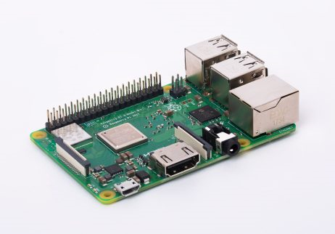
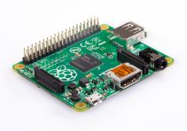
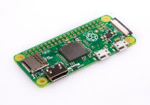
Raspberry Pi - Raspberry Pi Foundation (https://www.raspberrypi.org/)
Raspberry Pi 3 Model B+
Broadcom BCM2837B0 64-bit SoC
Quad-core ARM Cortex-A53 1.4 GHz processor
Dual Core VideoCore IV GPU (1 Gpixels/s ~ 2001 Xbox)
1 GB LPDDR2 + microSD
10/100/1000 Mbps Ethernet
4 USB Ports
Wireless ac/n + Bluetooth LE
HDMI
Raspberry Pi 3 Model B
Broadcom BCM2837 64-bit SoC
Quad-core ARM Cortex-A53 1.2 GHz processor
1 GB LPDDR2 + microSD
10/100 Mbps Ethernet
4 USB Ports
Wireless n + Bluetooth LE
HDMI
Raspberry Pi 2 Model B
Broadcom BCM2836 32-bit SoC
Quad-core ARM Cortex-A7 900 MHz processor
1 GB + microSD
10/100 Mbps Ethernet
4 USB Ports
Wireless
HDMI
Raspberry Pi 1 Model B+
Raspberry Pi 1 Model A+
Raspberry Pi Zero W
Wireless & Bluetooth
Raspberry Pi Zero

Slide 4
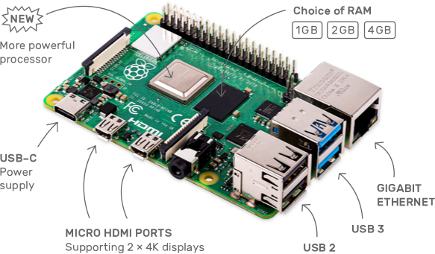
Raspberry Pi - Raspberry Pi Foundation (https://www.raspberrypi.org/)
Raspberry Pi 4 Model B+
Broadcom BCM2711 64-bit SoC
Quad-core ARM Cortex-A72 1.5 GHz processor
Dual Core VideoCore IV GPU (1 Gpixels/s ~ 2001 Xbox)
1 / 2 / 4 GB LPDDR4-3200 SDRAM + microSD
10/100/1000 Mbps Ethernet
4 USB Ports (2 USB 3.0 / 2 USB 2.0)
Wireless n / ac (2.4GHz / 5 GHz) + Bluetooth 5.0 LE
Dual Micro-HDMI
Power over Ethernet (PoE) enabled (requires PoE HAT)

Slide 5



What is Kali Pi?
Combining Kali and Raspberry Pi
Kali Pi
Kali Linux 2019.3
Penetration Testing
MetaPackages
Raspberry Pi
Linux OS – Raspbian Linux (variant of Debian)

Slide 6
Power over Ethernet (PoE)
Power over Ethernet or PoE describes any of several standard or ad-hoc systems which pass electric power along with data on twisted pair Ethernet cabling. This allows a single cable to provide both data connection and electric power to devices such as wireless access points, IP cameras, and VoIP phones.
There are several common techniques for transmitting power over Ethernet cabling. Three of them have been standardized by IEEE 802.3 since 2003. These standards are known as Alternative A, Alternative B, and 4PPoE. For 10BASE-T and 100BASE-TX, only two of the four signal pairs in typical Cat 5 cable are used.
Alternative B separates the data and the power conductors, making troubleshooting easier. It also makes full use of all four twisted pairs in a typical Cat 5 cable. The positive voltage runs along pins 4 and 5, and the negative along pins 7 and 8.
https://en.wikipedia.org/wiki/Power_over_Ethernet

Slide 7
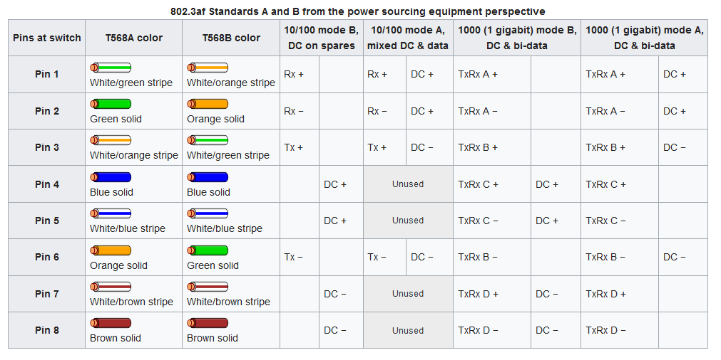
Power over Ethernet

