Slide 1

WiFi-enabled Data Sharing
with LibraryBox and PirateBox
13 Feb 2020 OISF Meeting
Multiple projects are using small, portable WiFi routers to share files for educational and other purposes. This talk will focus on Jason Griffey's LibraryBox, which is a custom repackaging of Dr. David Darts' Piratebox. Security aspects including use of open WiFi, FTP, mesh networking, and use for dead drops and data exfiltration will be discussed.
John Roberts
jwr39@aol.com
john.roberts@mtsi-va.com

Slide 2
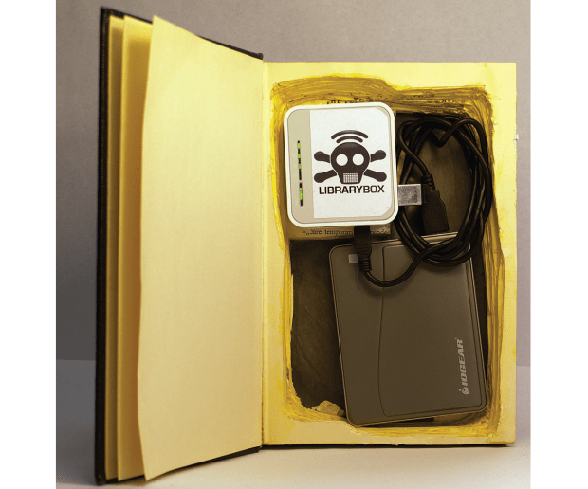

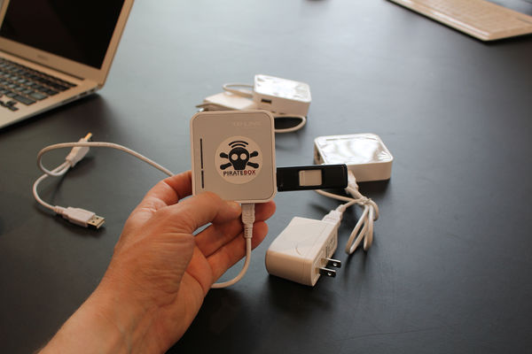
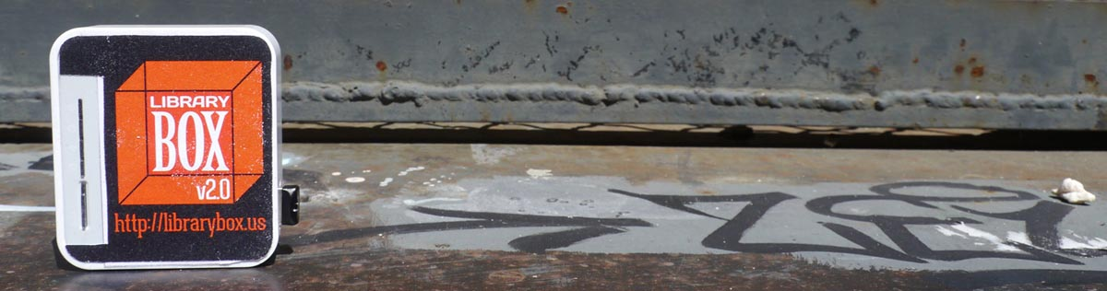
Key Websites
http://librarybox.us/
  v2.0 at http://librarybox.us/building.php
  v2.1 at http://librarybox.us/buildingv2.1.php
  Discussion http://librarybox.us/group.php
https://piratebox.cc/
  Forum https://forum.piratebox.cc/
https://openwrt.org/

Slide 3
LibraryBox
http://librarybox.us/
LibraryBox is an open source, portable digital file distribution tool based on inexpensive hardware that enables delivery of educational, healthcare, and other vital information to individuals off the grid.
LibraryBox is a digital distribution tool for education, libraries, healthcare, and emergency response. Anywhere there is a lack of open internet access, LibraryBox can bridge the gap of information delivery.
LibraryBox is a fork of PirateBox for the TP-Link MR 3020, customized for educational, library, and other needs. LibraryBox was conceived and created by Jason Griffey.

Slide 4
LibraryBox Project
LibraryBox created by Jason Griffey
  v1.0 at Computers in Libraries conference, 2012
  v1.5 in late 2012
  LibraryBox Kickstarter July 2013
  v2.0 with Matthias Strubel, May 2014
  v2.1 (current), December 2015
LibraryBox inspired by PirateBox art project by Dr. David Darts, Chair of the Department of Art at New York University [in 2013 timeframe].
http://librarybox.us/about.php
https://makezine.com/projects/make-37/librarybox/

Slide 5
What is LibraryBox?
http://librarybox.us/whatis.php
LibraryBox is a combination of a router (a variety of hardware will work), USB drive, and software that, when combined, give you a small, low powered webserver. The webserver acts like a captive portal, and delivers files that are stored on the USB drive.
To use LibraryBox, you simply connect to the wifi SSID "LibraryBox" and launch a browser. Attempting to visit any webpage will push you to the LibraryBox homepage on the device, which has information about the project, and links on the menu for downloads. You can browse the contents of the Shared folder, and download any files you'd like. The device you are using does have to be able to understand the download (for instance, downloading an EPUB ebook to a Kindle won't really work).

Slide 6
PirateBox Project
https://piratebox.cc/faq
PirateBox was created by Dr. David Darts, the lead developer is Matthias Strubel. Aaron Williamson from the Software Freedom Law Center provided advice on the project and Christiane Ruetten originally ported PirateBox to OpenWrt. The project is actively supported by developers and testers all over the world.
Created in late 2010? First articles January 2011. Likely inspired by Aram Bartholl's “Dead Drops”.
https://piratebox.cc/press
https://arstechnica.com/tech-policy/2011/01/piratebox-an-artistic-provocation-in-lunchbox-form/

Slide 7
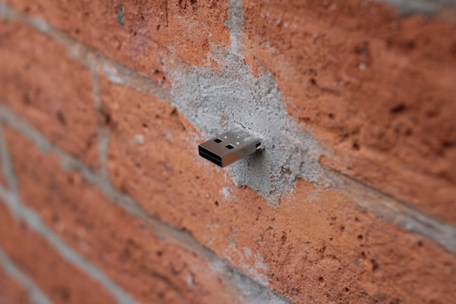
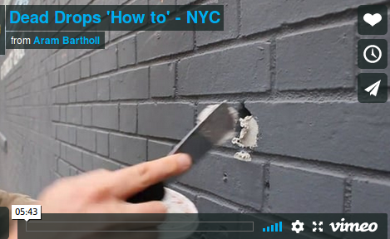
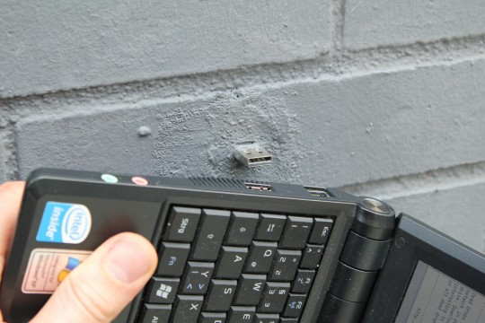
Dead Drops
http://deaddrops.com/
Aram Bartholl, a Berlin based media artist, started the ‘Dead Drops’ project during his stay in NYC at EYEBEAM as artist in residence, October 2010.
‘Dead Drops’ is an anonymous, offline, peer to peer file-sharing network in public space. USB flash drives are embedded into walls, buildings and curbs accessible to anybody in public space. Everyone is invited to drop or find files on a dead drop. Plug your laptop to a wall, house or pole to share your favorite files and data. Each dead drop is installed empty except a readme.txt file explaining the project.

Slide 8
What is PirateBox?
https://piratebox.cc/
https://piratebox.cc/faq
PirateBox is a DIY anonymous offline file-sharing and communications system built with free software and inexpensive off-the-shelf hardware.
PirateBox creates offline wireless networks designed for anonymous file sharing, chatting, message boarding, and media streaming. You can think of it as your very own portable offline Internet in a box! PirateBox project is following a view[sic] simple goals.
When users join the PirateBox wireless network and open a web browser, they are automatically redirected to the PirateBox welcome page. Users can anonymously chat, post images or comments on the bulletin board, watch or listen to streaming media, or upload and download files inside their web browser.

Slide 9
PirateBox “Goals”
https://piratebox.cc/goals
PirateBox provides easy file sharing and messaging over a local area network.
PirateBox is designed to educate the public and make them aware about online censorship, surveillance and freedom of speech.
PirateBox truly respects privacy and thus does not collect any access or connection logs from its users.
PirateBox has an educational purpose and aims to teach about computer programming and computer networks.
PirateBox network (AP) should be open, and use open networking standards to allow communication with other users.

Slide 10
PirateBox Hardware
https://piratebox.cc/mods
Three groups:
  OpenWRT-based
  Raspberry Pi(rate)Box
  Laptop-based (regular OS)
LibraryBox forked OpenWRT branch
LibraryBox port to Raspberry Pi not complete
http://librarybox.us/group.php
Any progress on LB on Raspberry Pi's? (11/19/19)

Slide 11
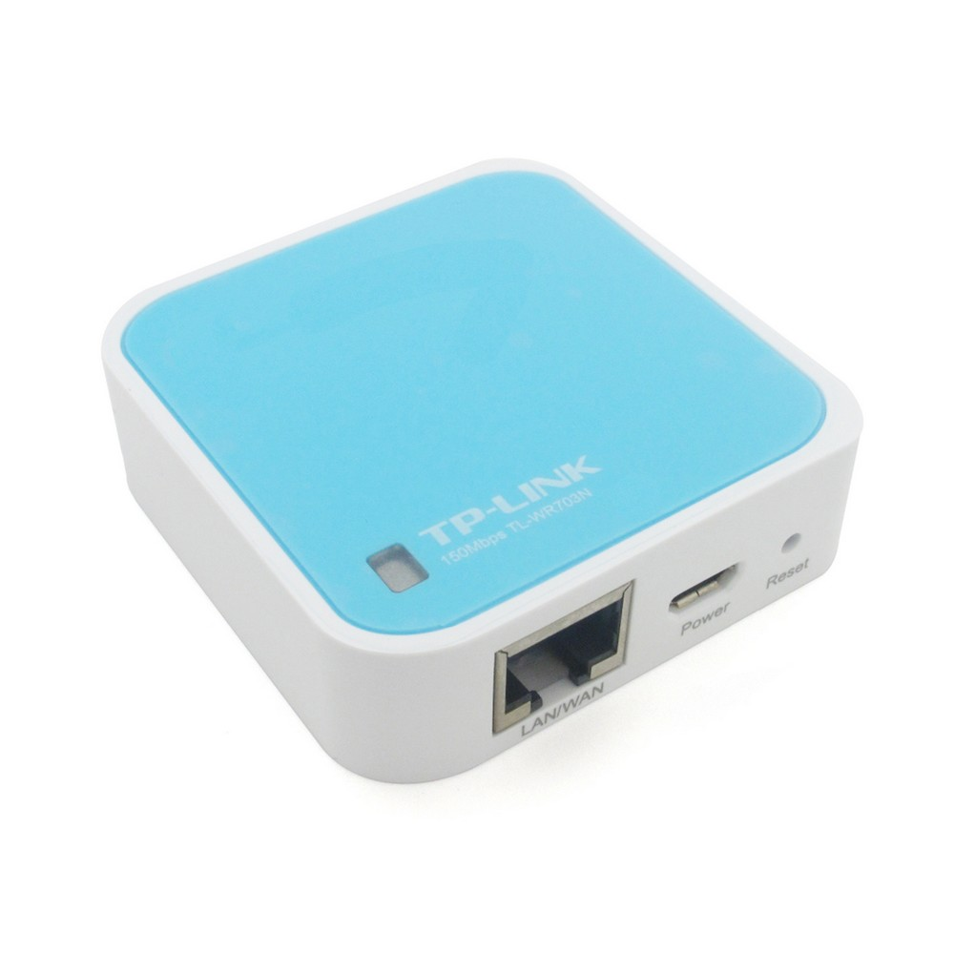
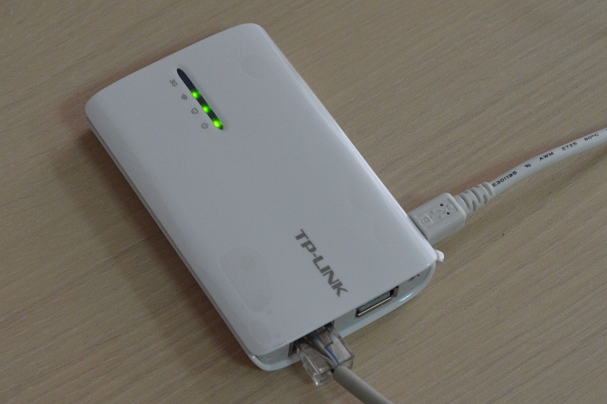
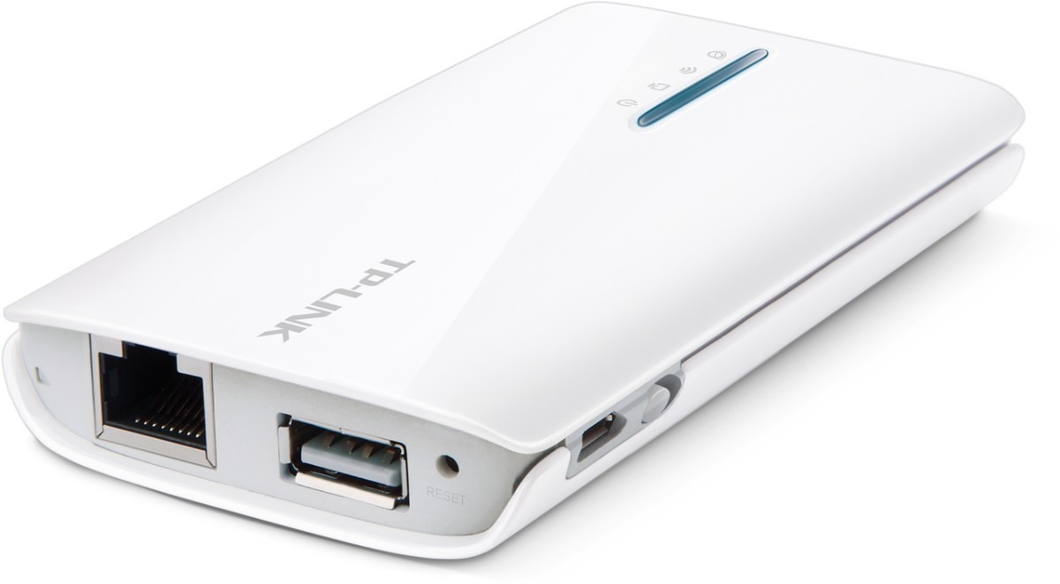
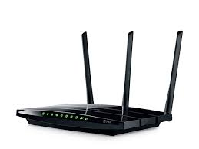
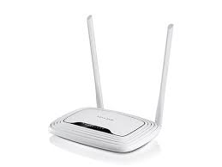
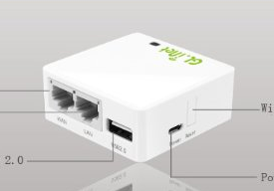
LibraryBox Hardware
http://librarybox.us/upgrading2.1.php
MR3020 - Version 1 firmware
MR3040 - Version 1 firmware
MR3040 - Version 2 firmware
MR3420 - Version 1 firmware
MR3420 - Version 2 firmware
WR703N - Version 1 firmware
WR842N - Version 1 firmware
WR842N - Version 2 firmware
WR1043ND - Version 1 firmware
WR1043ND - Version 2 firmware
WR2543 - Version 1 firmware
WDR4300 - Version 1 firmware
MR10U - Version 1 firmware
MR11U - Version 1 firmware
MR11U - Version 2 firmware
MR13U - Version 1 firmware
GL-iNet - Version 1 firmware

Slide 12
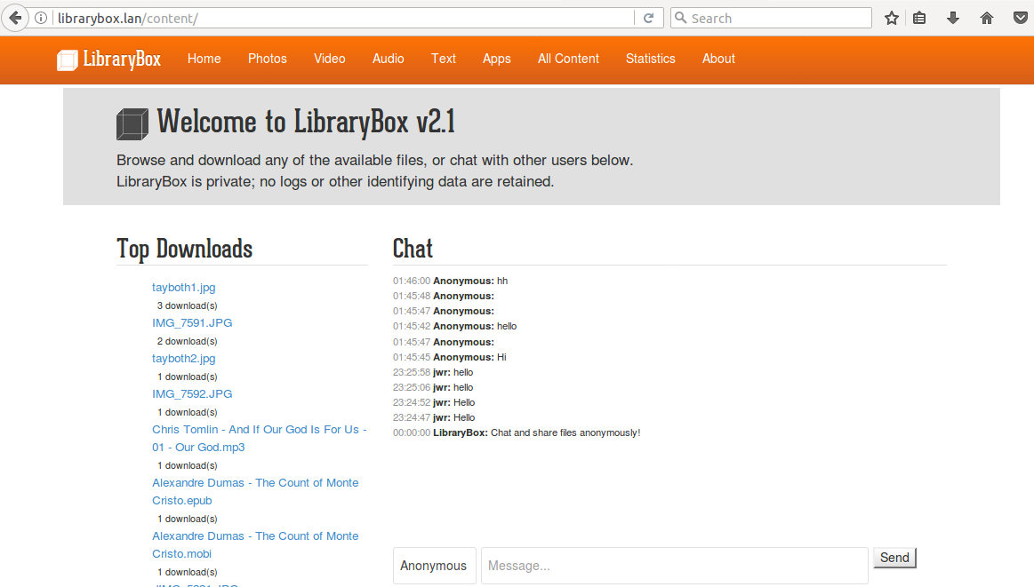
Home Screen

Slide 13
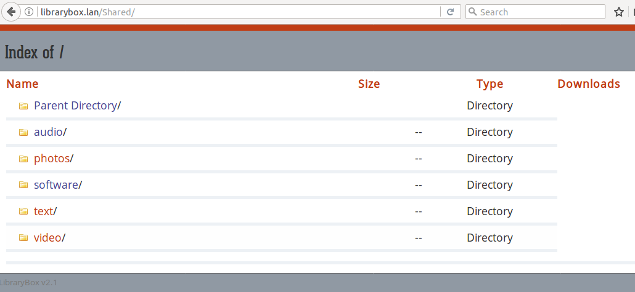
Shared Files

Slide 14
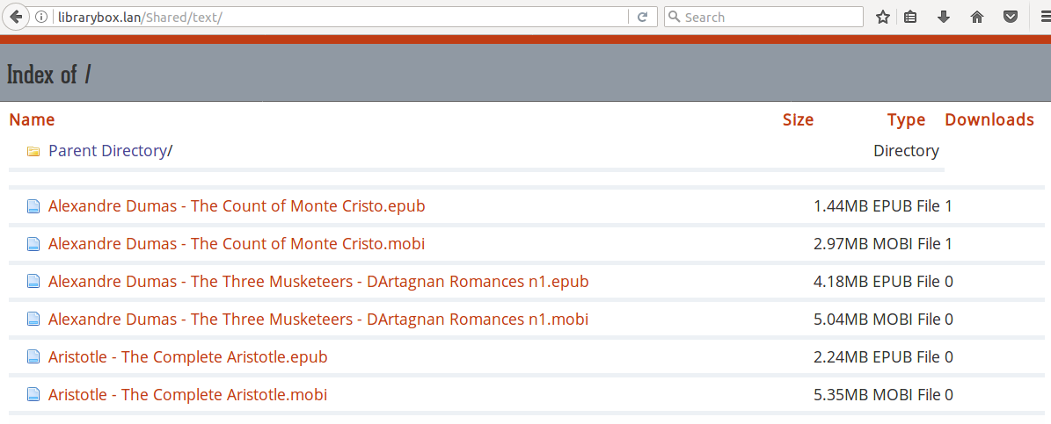
Directory Listings

Slide 15
LibraryBox Elements
OpenWRT (wifi, web server, ...)
Open WiFi (no password)
FTP (file transfer), SSH (admin access)
Kareha (Chat/Shoutbox)
Mini-DLNA (media sharing)
Mesh networking (master/slave config)

Slide 16
Security Concerns
Open WiFi – no password & no encryption
  Could simply add a password
Use of FTP vs sFTP – to enable anonymous use
No antivirus (OpenWRT has clamav)
Mesh networking
  Password for inter-box transfers
  Master/slave config keeps under control
Minimal logging / chat moderation capability
If FTP upload enabled, very limited controls

Slide 17
Applications
Benign – as designed
  Offline respository of educational files
  Collaboration tool (chat, file exchange) at seminar, conference, or class
  Easily transportable media sharing (photos, videos)
  Computer->Usb Flash->WiFi->Tablet file transfer
Potentially Malicious
  Library poisoned with malware
  Use as real Dead Drop for espionage
  Data Infil/Exfil for PenTesting or espionage

Slide 18
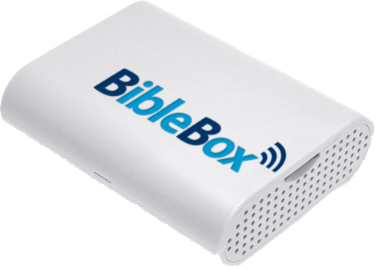
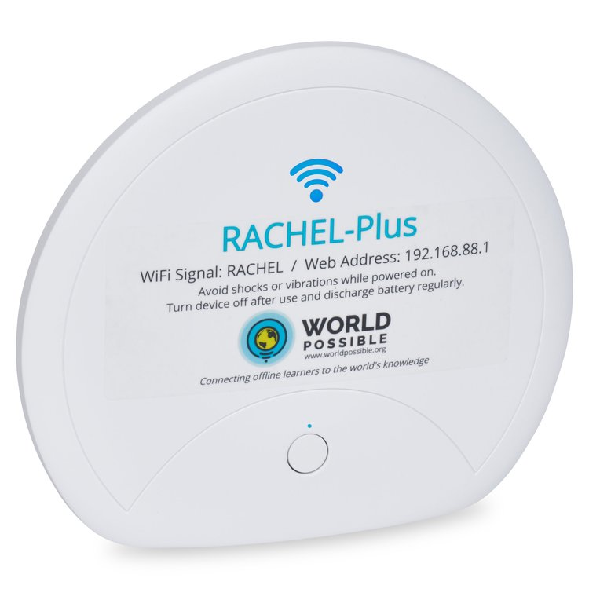
Other Projects
https://biblebox.org/ (R-Pi based)
https://biblebox.org/alternatives/
  ConnectBox, DoveStream, KingdomIT Box, Lightstream Pocket, PastorBox, Sheepstation, WiFi Bible
https://worldpossible.org/
  RACHEL https://store.worldpossible.org Remote Area Community Hotspot for Education and Learning
  OER2Go http://oer2go.org Open Educational Resources “The Web Unplugged”

