Slide 1
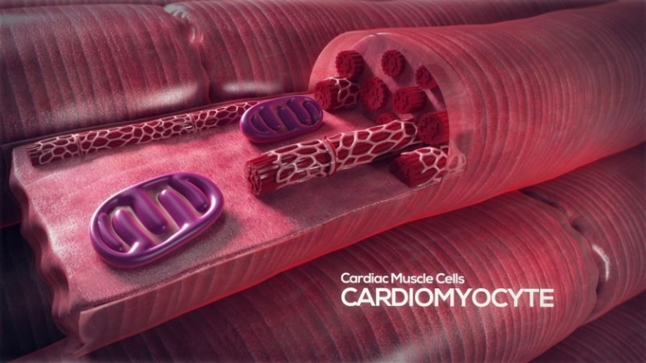
Cardiomyocyte
Cardiomyocytes
Cardiomyocytes are muscle cells that form the cardiac muscle, which is the heart muscle.
Because cardiomyocytes make up the heart muscle, they can be found in the heart.
These cells are not just important, but our life depends on them because they are the cells that make our heart beat. They make up the atria and the ventricles of the heart; atria is where the heart enters and ventricles is where the blood is released or stored.
Another reason why our heart beats depend on these cells is because their fibers have to be able to shorten and lengthen, which aids in the muscle to contract and relax; therefore, pumping blood.¹
1. Cardiac Muscle Cell, Wikipedia.

Slide 2
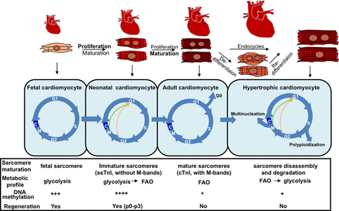
Cell Cycle and Tumorigenesis of Cardiomyocytes
According to a cardiovascular research done by Dr. Walsh et al., “DNA synthesis in neonatal life was attributable to bi-nucleation, therefore suggesting that cardiomyocytes withdraw from the cell cycle shortly after birth.”¹
Cardiac primary tumors are very rare. “In published autopsy series, the high-end incidence of such tumors is about one quarter of one percent.” ²
Cardiovascular Research, Oxford Academy.
National Cancer Institute.

Slide 3
Pathogens and Infectious Disease
Virus infections of the heart or heart diseases can severely damage cardiomyocytes, which will lead them to fight off the infection or disease.
Role of Cytokines Signaling within the Cardiomyocyte
According to the National Library of Medicine, many cytokines are known to activate the JAK–STAT signaling pathway, that are interactions between proteins in a cell, which subsequently activates the transcription of cytokine-responsive genes. The induced SOCS proteins inhibit JAK-mediated phosphorylation of the cytokine receptor by binding to JAK or the receptor, thus leading to the shutoff of STAT molecules, which are protein molecules. This negative-feedback regulation via SOCS tightly regulates the duration and intensity of cytokine-induced JAK–STAT signaling.¹ This is a small part of the cellular mechanism when a cell is invaded by a pathogen.
1. Infection of Cardiomyocytes.

Slide 4
Onela Hirmez
Work Cited:
“Matters of the Heart: Why Are Cardiac Tumors So Rare?” National Cancer Institute, 10 Feb. 2009, www.cancer.gov/types/metastatic-cancer/research/cardiac-tumors.
Yuan, Xuejun, and Thomas Braun. “Multimodal Regulation of Cardiac Myocyte Proliferation.” Circulation Research, American Heart Association, Inc., 21 July 2017, circres.ahajournals.org/content/121/3/293/tab-figures-data.
Walsh, et al. “Cardiomyocyte Cell Cycle Control and Growth Estimation in Vivo -an Analysis Based on Cardiomyocyte Nuclei | Cardiovascular Research | Oxford Academic.” OUP Academic, Oxford University Press, 13 Jan. 2010, academic.oup.com/cardiovascres/article/86/3/365/316788.
Francis2, Joseph, et al. “Mohammed Khaleduzzaman.” Journal of Virology, 1 Nov. 2007, jvi.asm.org/content/81/22/12307.full.

