Slide 1
Basic matrix algebra (random vector)
Woojoo Lee

Slide 2
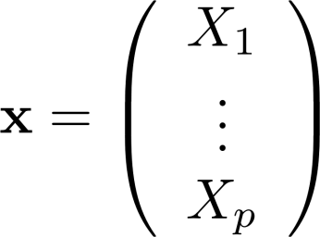
Random vector : elements are random !

Slide 3
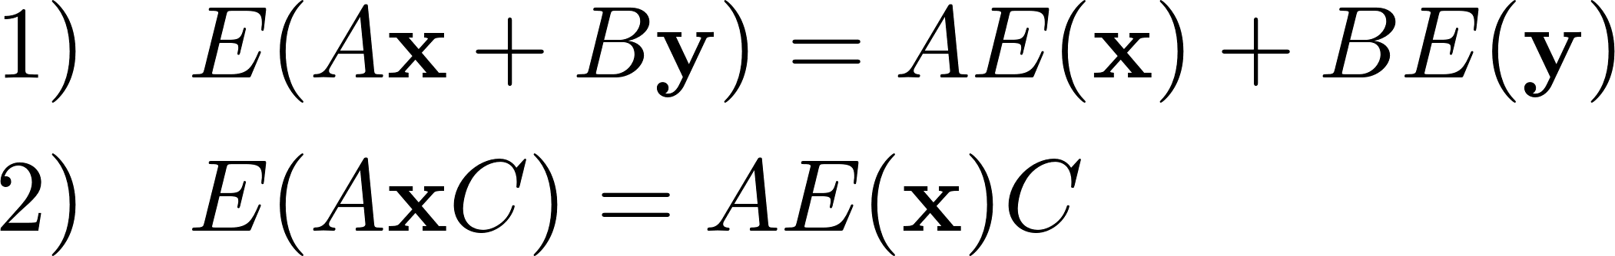
Remark) The key property of “expectation” is linearity !.

Slide 4
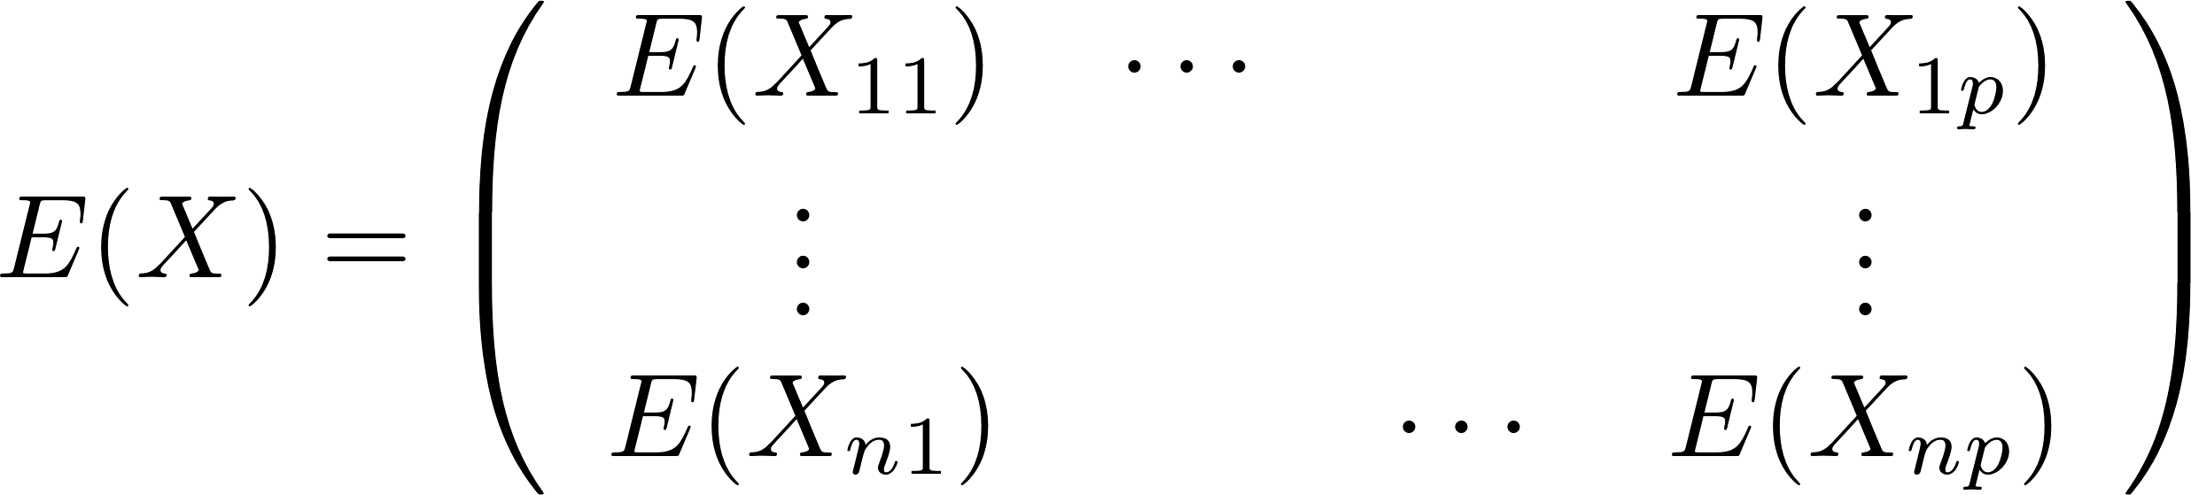
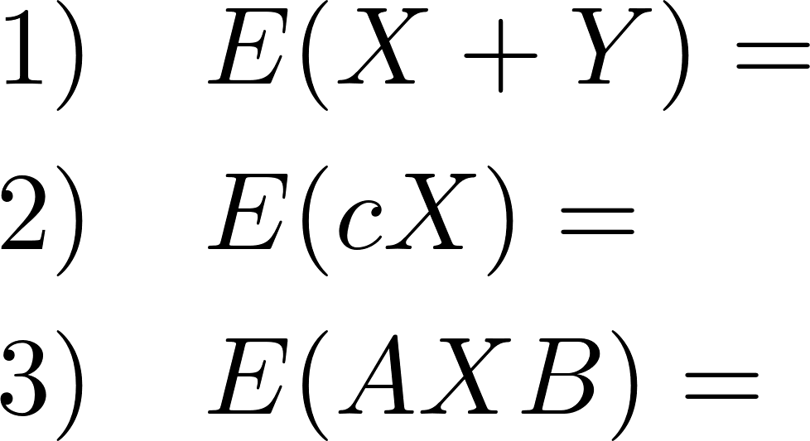

Slide 5
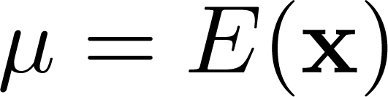
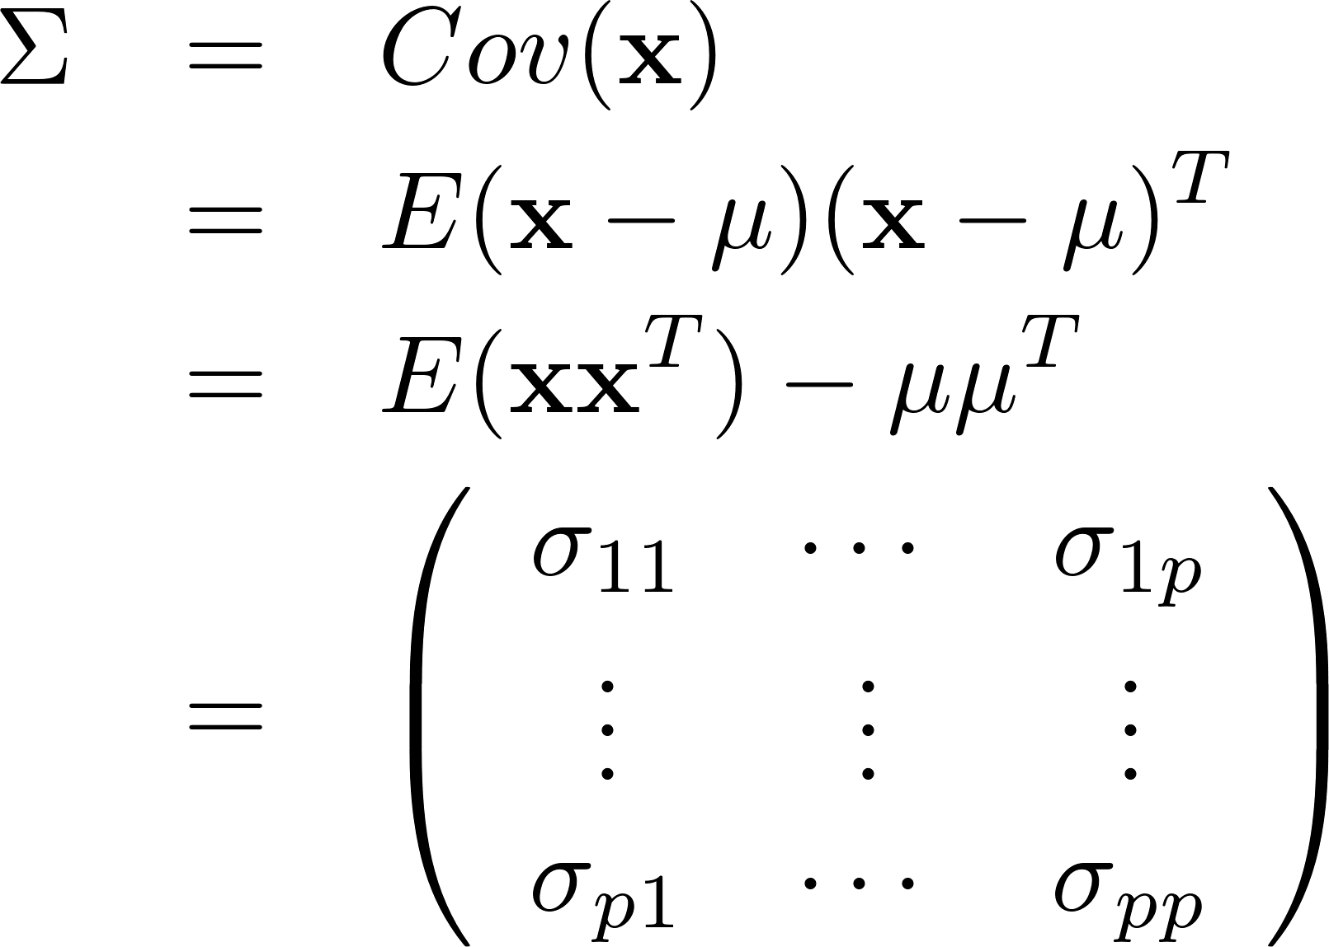
Mean vector
Covariance matrix

Slide 6
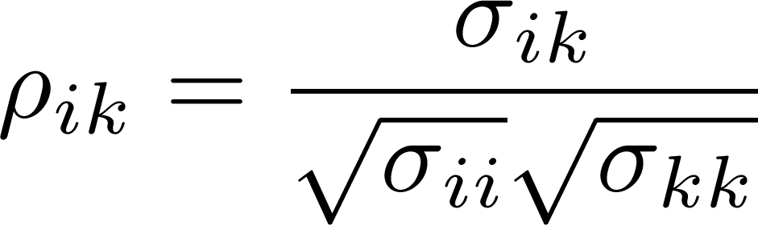
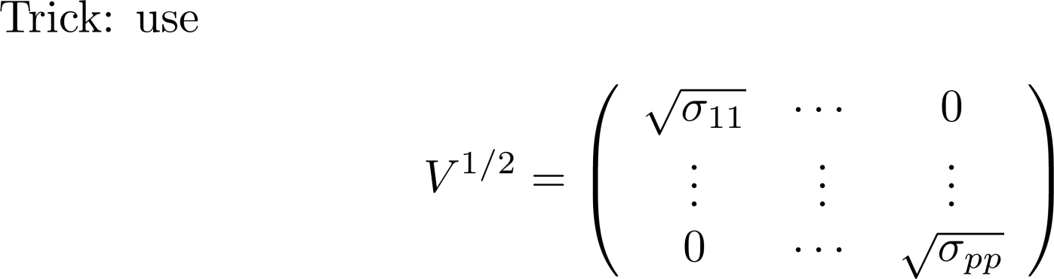
Correlation matrix

Slide 7
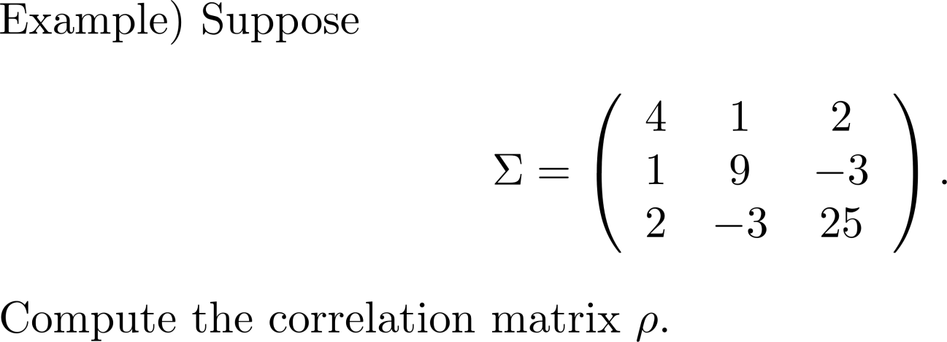

Slide 8
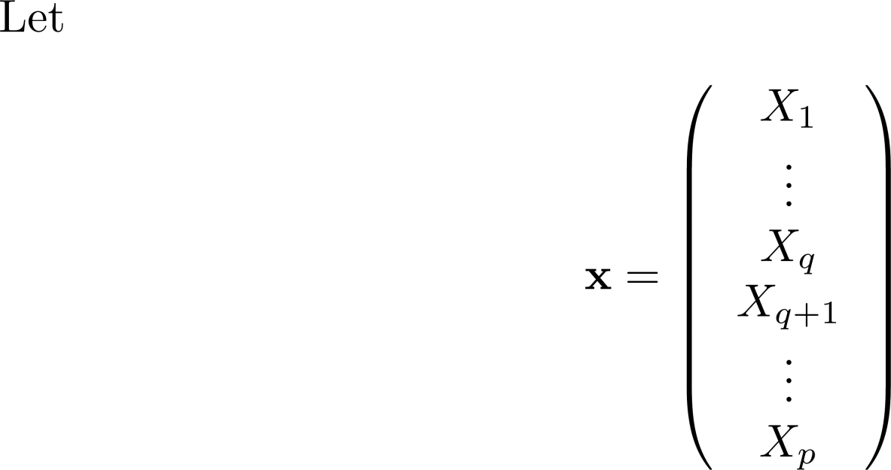
Remark ) Partitioning the covariance matrix and its interpretation

Slide 9
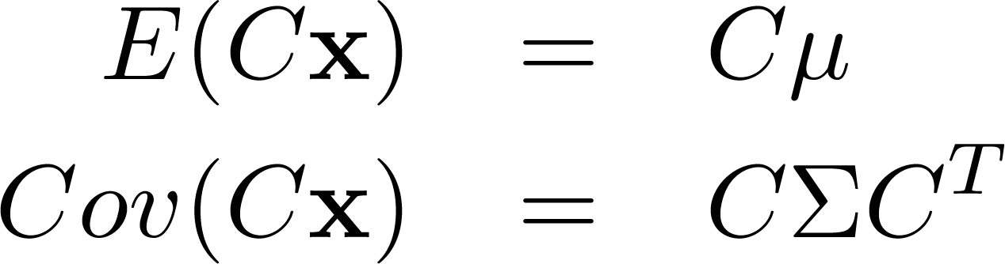
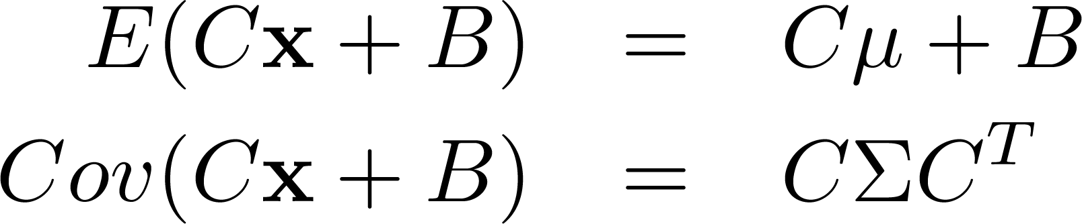
The mean vector and covariance matrix for linear combinations of random variables.

Slide 10
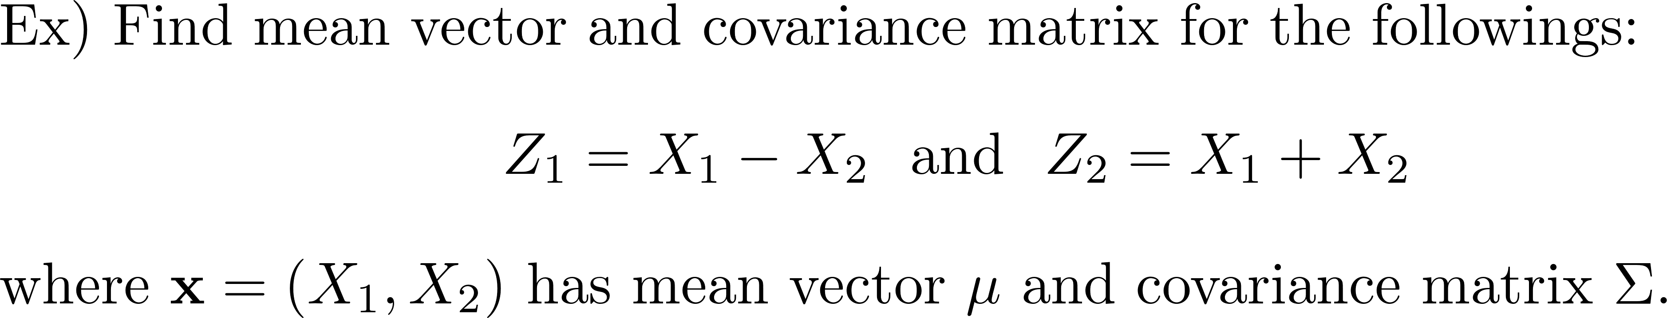

Slide 11
The relationship between a covariance matrix and PD

