Slide 1
USING THE BLOCKCHAIN TO IMPROVE INTEROPERABILITY AND PRIVACY IN ELECTRONIC HEALTH RECORDS
Leslie Zhou
Dr. Abeer Aljarrah, Dr. Arno Puder
A Thesis Oral Defense, 6/23/2023

Slide 2
AGENDA
Introduction
Background and Technologies
Design and Architecture
Implementation
Evaluation
Conclusion and Future Work

Slide 3
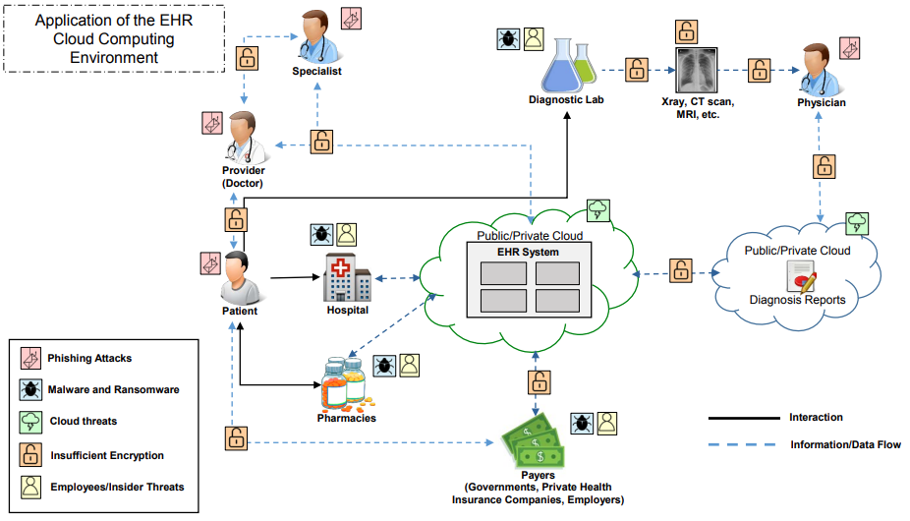
Introduction
Cloud Based Electronic Health Record System [1]
[1] “Electronic Health Record Systems,” HSS.gov, Feb. 13, 2020.
Notes:
1. Patients do not have an integrated view
Stored in centralized database. vulnerable to cloud threats, ransomware that makes data not accessible
Different healthcare providers use different systems
Healthcare provider do not always share data
2. Patients do not have a sense of ownership to their data
Under HIPAA, only data in covered entities are protected, legally
Other entities get a copy of your data and they don’t have the same protection, open to insider threats and vulnerabilities in third-party system
Overall, patient data are handled in a closed source environment, so patients don’t have a good sense of what happens to their data

Slide 4
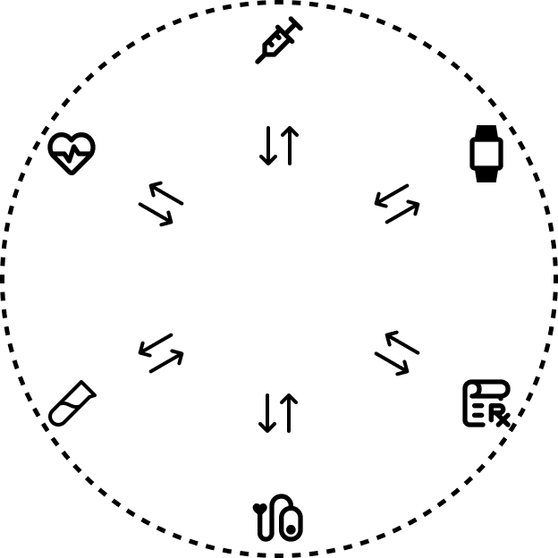
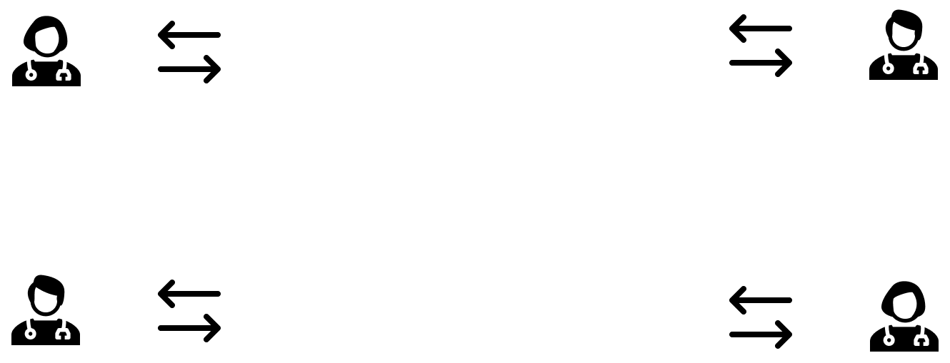
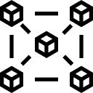
Our Implementation
Notes:
Decentralized platform, data integrity and availability
Consistent and up-to-date records that are always available
Confidentiality - We build the EHR system in smart contract with access control
Have a UI for managing the records
And a medication reminder application that interact with the EHR

Slide 5
Security Frameworks
Transport Layer Security
Access Control
  #1 issue in OWASP Top 10 [1]
  Ownable [2]
    Token
    NFT
    Factory that belong to an application
  Role-based Access Control [2]
    Multiple entities need access to different resources
https://owasp.org/Top10/A01_2021-Broken_Access_Control/
https://docs.openzeppelin.com/contracts/4.x/access-control

Slide 6
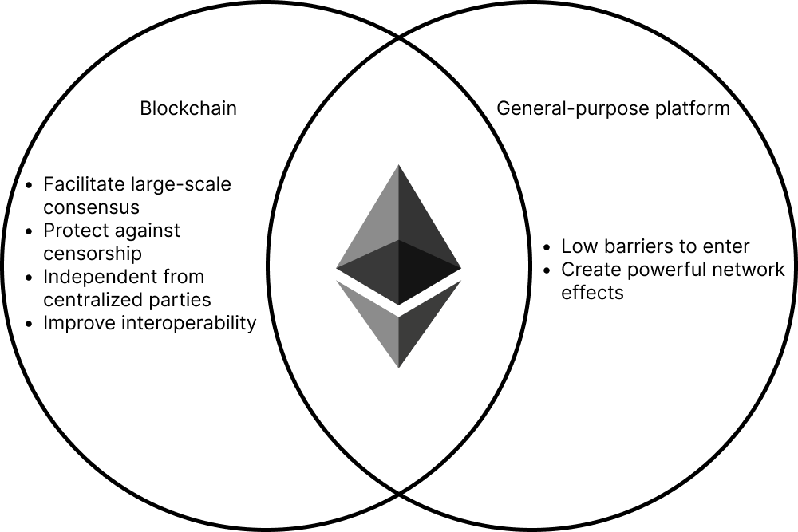


Ethereum
Notes:
Up to date, consistent records
Availability
More participation in expanding the ecosystem
Smart contracts self executing code
And there’s a ethereum virtual machine

Slide 7
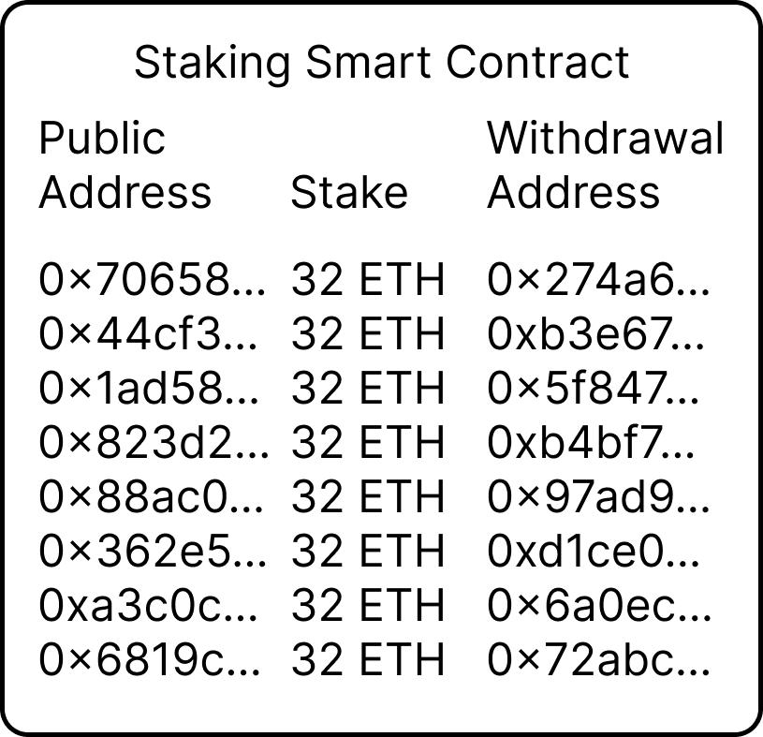
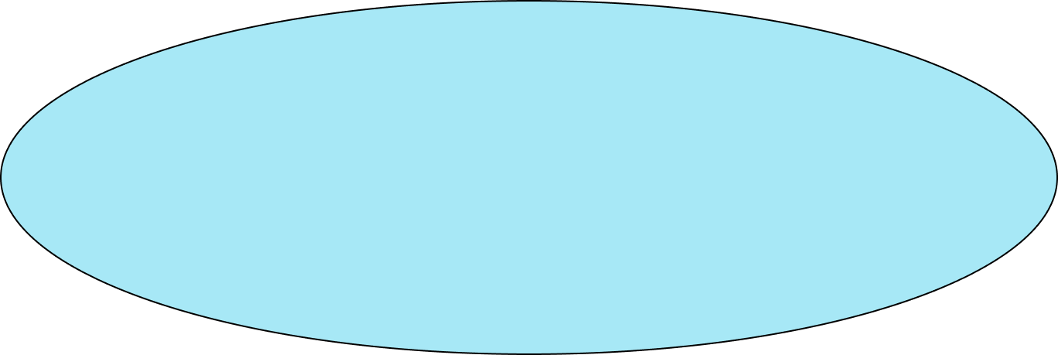
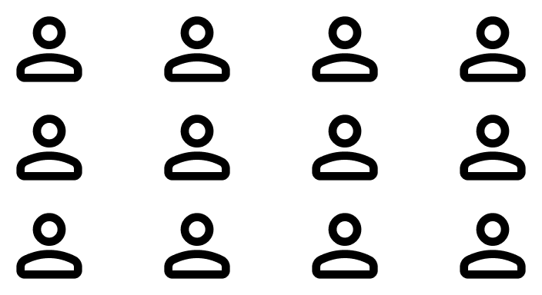

Proof of Stake
1 epoch = 32 slot
1 slot = 12 second
Notes:
Deposit into the staking contract to become a validator
All validator randomly split into 32 committees
Each committee is responsible for one block
More decentralized
More secure
More sustainable

Slide 8
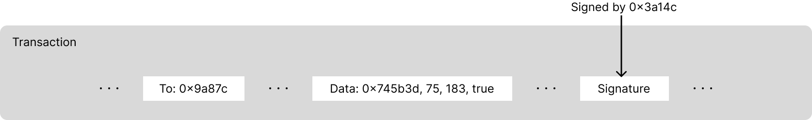
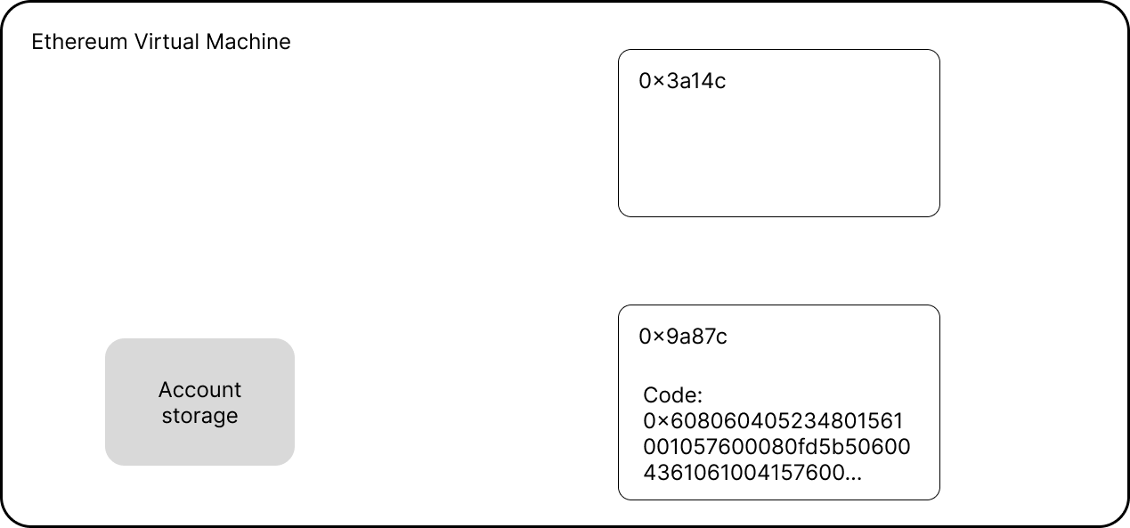

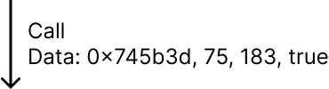

Transaction

Slide 9
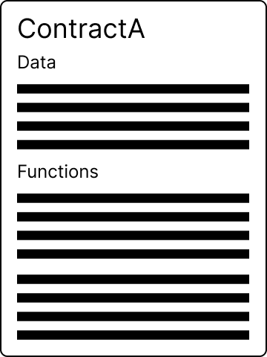


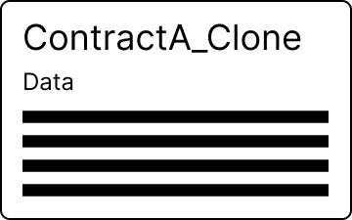
Minimal Proxy Contract
deploy
clone
Factory

Slide 10
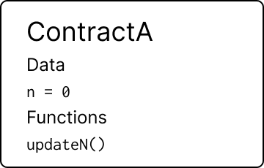
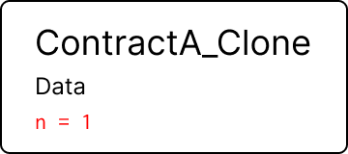
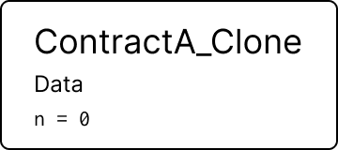
Minimal Proxy Contract
updateN()
delegatecall

Slide 11
Minimal Proxy Contract Cost Comparison
Cost comparison between direct deployment and using clone [1]
[1] H. Croubois, "Cheap Contract Deployment Through Clones," presented at the OpenZeppelin Contracts Workshop, Mar. 2, 2021. [Online]. Available: https://youtu.be/3Mw-pMmJ7TA

Slide 12
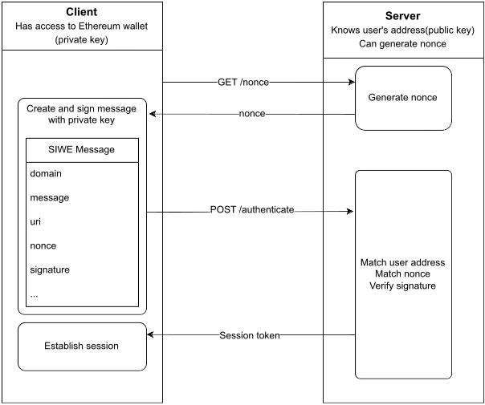
Sign-in with Ethereum
Provide a universal identity for off-chain services
Improve interoperability

Slide 13






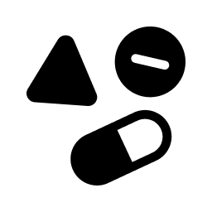
User Stories
Patients share health records to authorized personnel and application
Doctor prescribe medication to patients

Slide 14
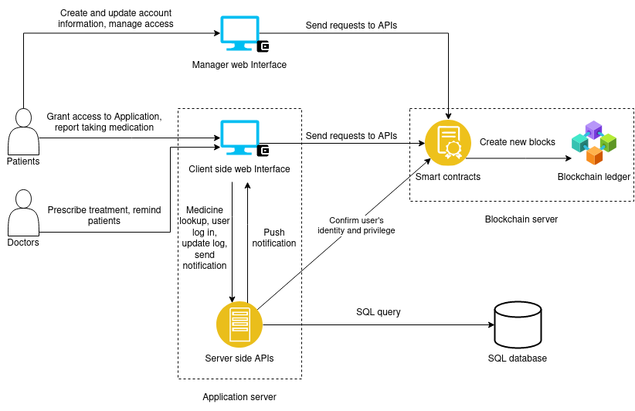
Architecture
Notes:
We focused more on the patient experience here in this project
First we look at the top of this graph
Patients can create their account, update their info, and manage access through the manager interface
Then we have the application in the bottom part where doctor can prescribe medication to patients
The application in our case uses both the smart contract and a traditional server
When patients take their medication, they can log it in the application, and that goes to the SQL database
Why SQL? We use SQL in this specific application for medicine lookup, and logging treatment progress. These are large amount insensitive data that would be inefficient to store on blockchain

Slide 15
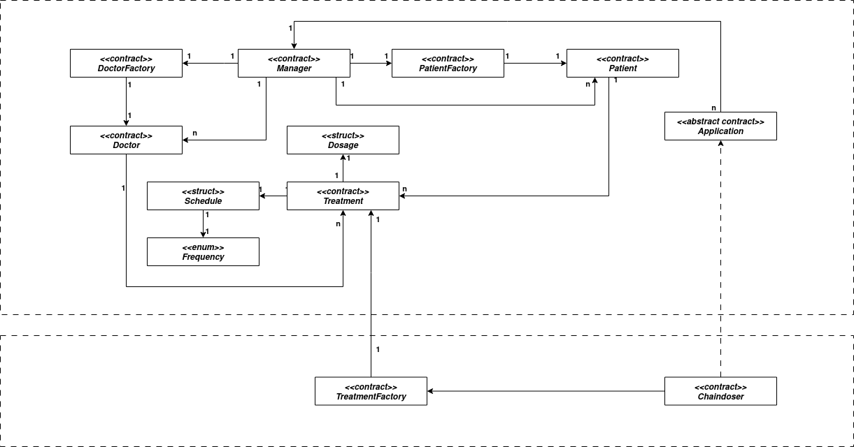
Architecture
EHR System
Application
Notes:
Ownable
Role-based

Slide 16
Roles
Patient contract
Every role has an admin role [1]
grandRole(role, account) onlyAdmin(role)
revokeRole(role, account) onlyAdmin(role)
PATIENT_ROLE
APPLICATION_ROLE
DOCTOR_ROLE
[1] https://docs.openzeppelin.com/contracts/4.x/access-control

Slide 17
Roles
Patient
Chaindoser
...
Treatment[]
...
prescribe()
PATIENT_ROLE
addTreatment()
removeTreatment()
APPLICATION_ROLE
DOCTOR_ROLE
Notes:
We want the users to manage treatments through an application to streamline the process
So we have addTreatment and removeTreatment functions that require the application role
Then in the application, there is a prescribe function that requires the function caller to have the doctor role
The patient need to grant the application the application role, then grant the doctor the doctor role, so the doctor can manage the treatments through the application

Slide 18
Implementation

Slide 19
Evaluation
Access Control
  EHR System
  Application
Cost for users
  Patient
  Doctor

Slide 20
Setup
Patient | Requests from | Accepted
0 | 1,2,3,4,5,6,7,8,9 | 1,2,3,4,5,6,7,8,9
1 | 0,2,3,4,5,6,7,8,9 | 0,2,3,4,5,6,7,8,9
2 | 0,1,3,4,5,6,7,8,9 | 0,1
3 | 0,1,4,5,6,7,9 | 0,1,4,5,6,7,9
4 | 0,2,3,6,7,8 | 0,2,3,6,7,8
5 | 0,1,2,3,4,6,7,8,9 | 0,1,2,4,6,7,9
6 | 0,1,2,3,4,5,7,8,9 | 0,1,2,3,5,7,8,9
7 | 0,1,2,3,4,5,6,8,9 | 0,1,2,3,4,6,8,9
8 | 0,1,3,4,5,6,7,9 | 0,1,4,5,7,9
9 | 0,1,2,3,4,5,6,7,8 | 0,1,2,3,4,5,6,8
10 patients and 10 doctors
Request DOCTOR_ROLE
Accepting requests
Spoof accepting requests
Spoof granting roles

Slide 21
Read/Write Access
Patient | Requests from | Accepted
0 | 1,2,3,4,5,6,7,8,9 | 1,2,3,4,5,6,7,8,9
1 | 0,2,3,4,5,6,7,8,9 | 0,2,3,4,5,6,7,8,9
2 | 0,1,3,4,5,6,7,8,9 | 0,1
3 | 0,1,4,5,6,7,9 | 0,1,4,5,6,7,8,9
4 | 0,2,3,6,7,8 | 0,2,3,6,7,8
5 | 0,1,2,3,4,6,7,8,9 | 0,1,2,4,6,7,9
6 | 0,1,2,3,4,5,7,8,9 | 0,1,2,3,5,7,8,9
7 | 0,1,2,3,4,5,6,8,9 | 0,1,2,3,4,6,8,9
8 | 0,1,3,4,5,6,7,9 | 0,1,4,5,7,9
9 | 0,1,2,3,4,5,6,7,8 | 0,1,2,3,4,5,6,8
 | D0 |  | D1 |  | D2 |  | D3 |  | D4 |  | D5 |  | D6 |  | D7 |  | D8 |  | D9
P0
P1
P2
P3
P4
P5
P6
P7
P8
P9

Slide 22
Prescription Access
 | D0 | D1 | D2 | D3 | D4 | D5 | D6 | D7 | D8 | D9
P0
P1
P2
P3
P4
P5
P6
P7
P8
P9
Patient | Requests from | Accepted
0 | 1,2,3,4,5,6,7,8,9 | 1,2,3,4,5,6,7,8,9
1 | 0,2,3,4,5,6,7,8,9 | 0,2,3,4,5,6,7,8,9
2 | 0,1,3,4,5,6,7,8,9 | 0,1
3 | 0,1,4,5,6,7,9 | 0,1,4,5,6,7,8,9
4 | 0,2,3,6,7,8 | 0,2,3,6,7,8
5 | 0,1,2,3,4,6,7,8,9 | 0,1,2,4,6,7,9
6 | 0,1,2,3,4,5,7,8,9 | 0,1,2,3,5,7,8,9
7 | 0,1,2,3,4,5,6,8,9 | 0,1,2,3,4,6,8,9
8 | 0,1,3,4,5,6,7,9 | 0,1,4,5,7,9
9 | 0,1,2,3,4,5,6,7,8 | 0,1,2,3,4,5,6,8
 | D0 | D1 | D2 | D3 | D4 | D5 | D6 | D7 | D8 | D9
P0
P1
P2
P3
P4
P5
P6
P7
P8
P9

Slide 23
Cost Evaluation Setup
Simulated on Sepolia testnet [1]
Added 10 patients and 10 doctors
Requested and accepted access requests
Prescribed 1000 treatments
[1] https://ethereum.org/en/developers/docs/networks/

Slide 24
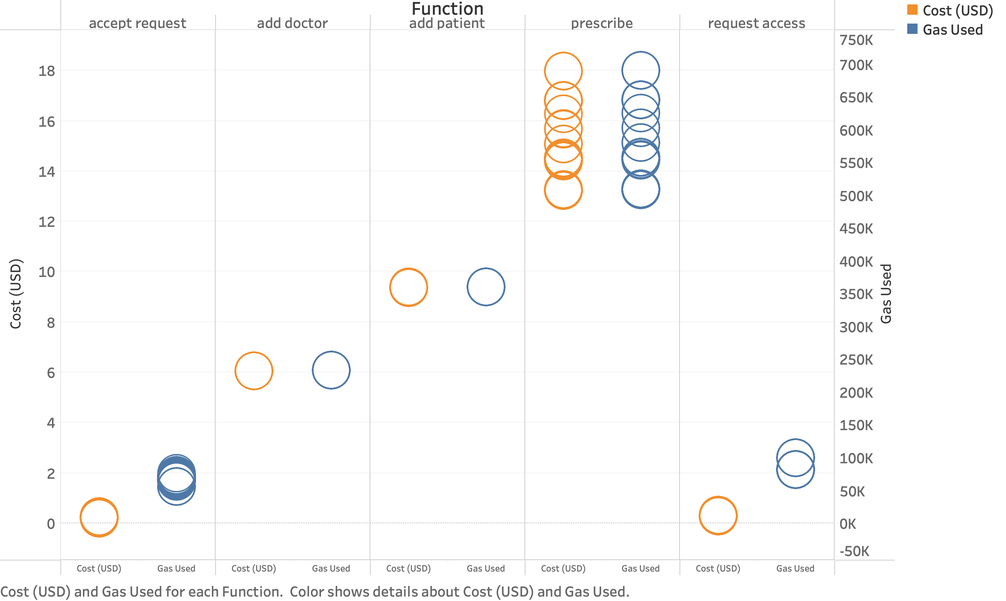
Cost Results(1ETH = $1300)

Slide 25
Conclusion
Give patients control on the data governance
Tamper-proof data that is always available
  Improved interoperability
Protect against unauthorized access
  Improved security and privacy
Relatively cheap to use

Slide 26
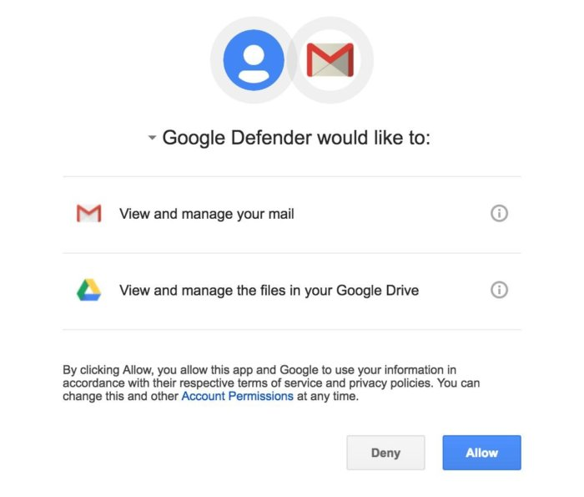
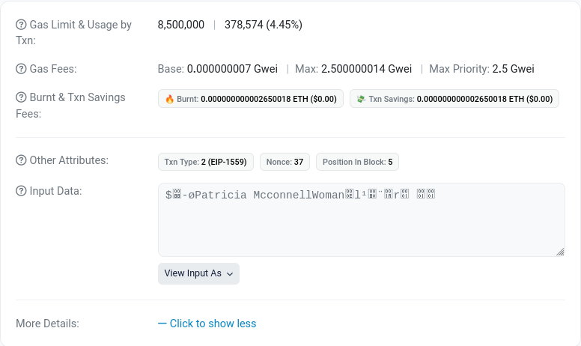
Limitation
Slower to propagate information
Transparency
  Homomorphic encryption
Prone to phishing

Slide 27
Future Work
More features
  Emergency contacts
  Tests results
  Histories
Fine tune access control
  Relationship-based access control?
  More entities
Encryption
Legislation

Slide 28
Thank you
Any questions?

