Slide 1
Spacer M3 L15 => 4
Spacer M3 L16 => 4
Spacer M3 L32 => 5
M3 nut => 13
Wood screws 3,5 x 16=> 4
Screw M3 x 8 => 13
Screw M3 x 16 => 8
Spacer M3 L5 => 8
Spacer M3 L25 => 12
Spacer distribution for ohmpi lite
M3 x 8mm
DPH 5005
Measurement board
M3 x 16mm
M3 x 32mm
Raspberry pi
M3 nut
M3 x 15mm
Plexiglass
M3 nut
M3 x 8mm
M3,5 x 16mm
M3 nut
M3 x 25mm
Mux board
M3 x 25mm
Mux board
M3 x 5mm
Plexiglass
M3 x 16mm

Slide 2
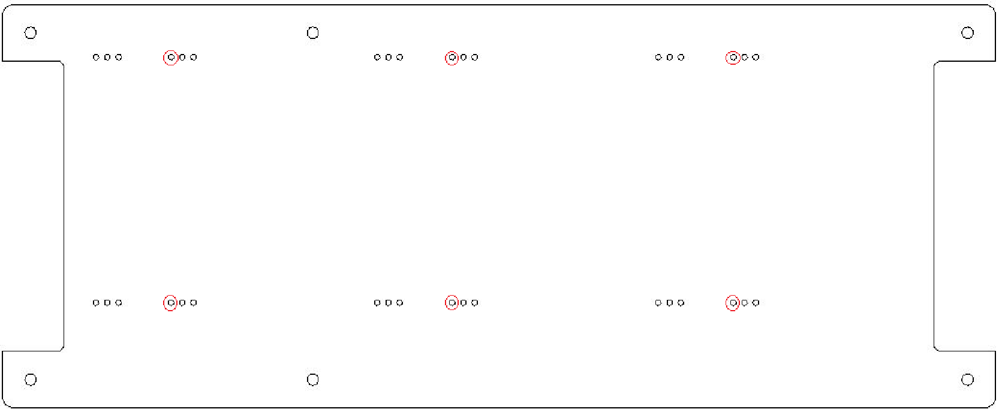
Spacer distribution for ohmpi lite
1
Screw M3 x 16 => 8
Spacer M3 L5 => 8
2
2
2
2
M3 x 5mm
Plexiglass
1
M3 x 16mm
1
1

Slide 3
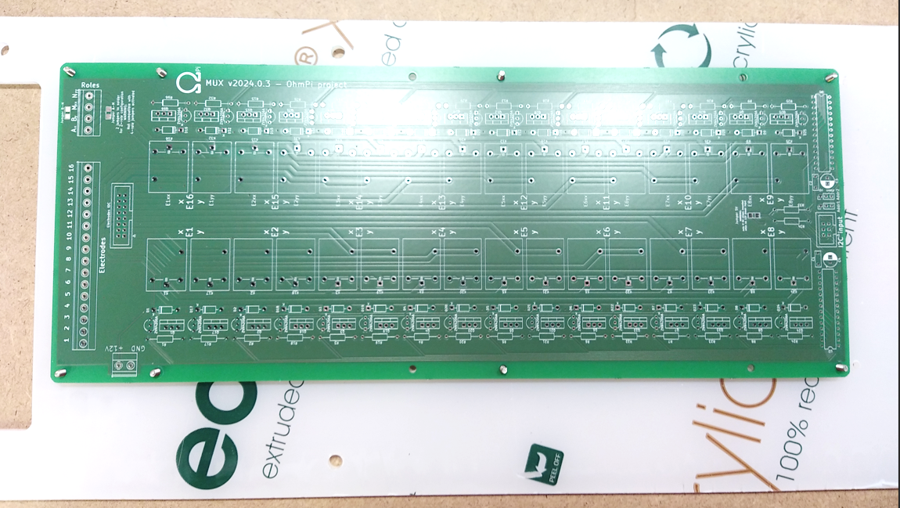
Spacer distribution for ohmpi lite
3
Spacer M3 L25 => 8
3
M3 x 25mm
3
3
Mux board

Slide 4
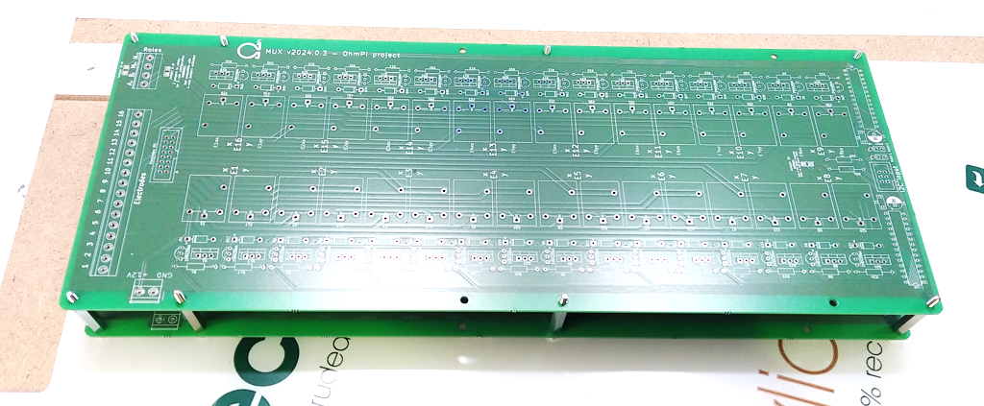
Spacer distribution for ohmpi lite
3
Spacer M3 L25 => 6
M3 nut => 4
9
9
3
3
M3 x 25mm
Mux board
Mux board

Slide 5
Spacer distribution for ohmpi lite
4
4
4
4
M3 x 8mm
Measurement board
7
6
Raspberry pi
5
7
M3 x 16 => 4
5
M3 x 15 => 4
6
M3 x 32 => 5
4
Screw M3 x 8 => 9

Slide 6
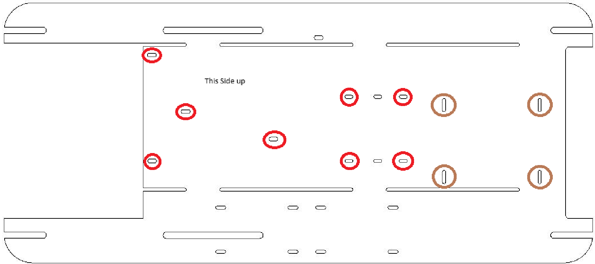
Spacer distribution for ohmpi lite
Measurement board
DPH 5005
Raspberry pi
Plexiglass
9
M3 nut
M3 nut
M3 x 8mm
M3 x 8mm
4
10
4
Screw M3 x 8 => 4
M3 nut => 5
Wood Screws M3,5 x 16 => 4
9
10

Slide 7
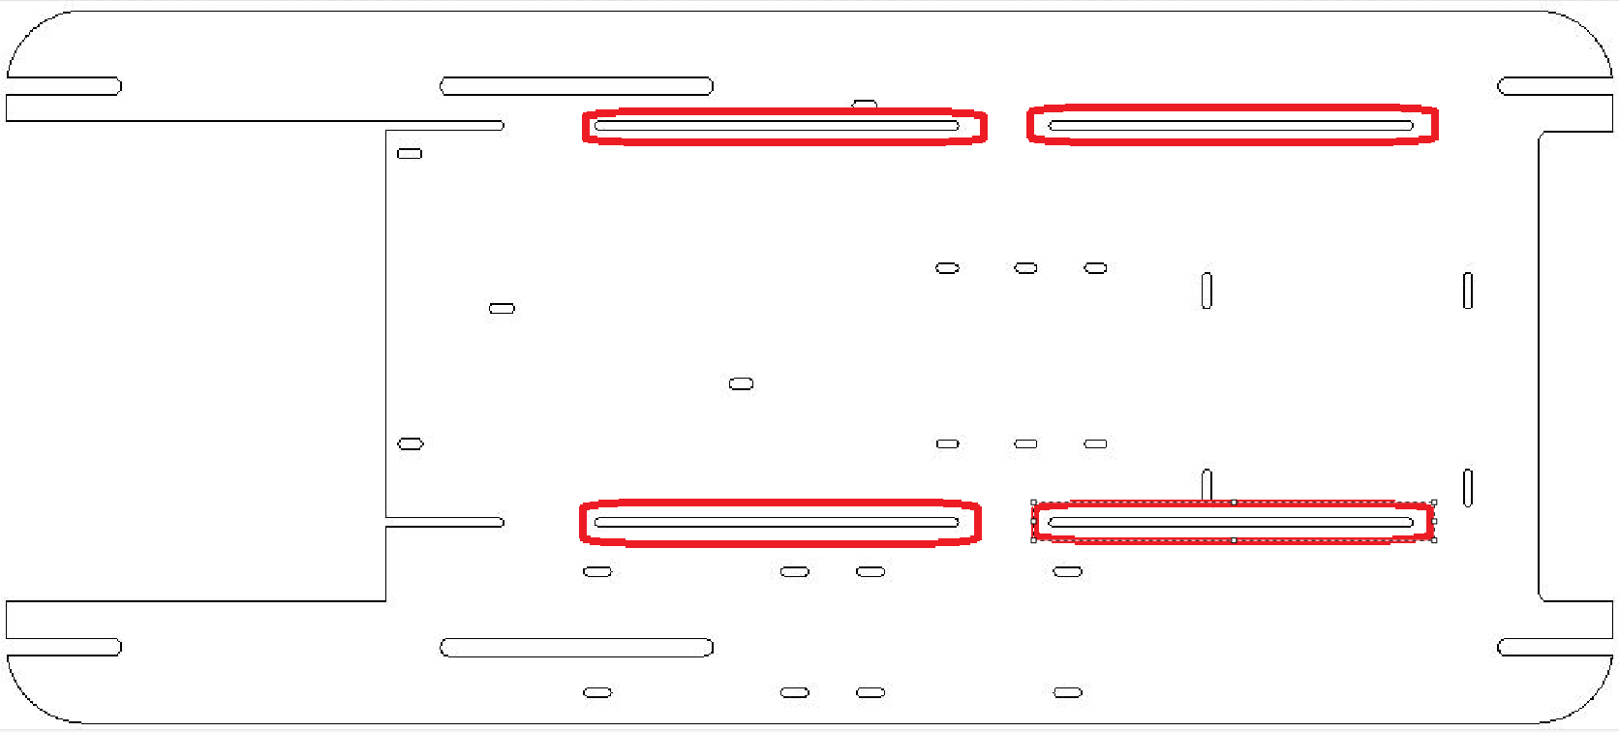
Spacer distribution for ohmpi lite
DPH 5005
Measurement board
9
Raspberry pi
Plexiglass
9
M3 nut => 4

