Slide 1
instructions
Please make a lightning-fast, mobile-first webapp that allows people to quickly stage H&N malignancies with newest AJCC guidelines. The goal is for students to go through quick radio buttons/menu selects in as few actions as possible to arrive at staging.
There is a powerpoint in the project directory. Use images in these slides as the basis for TNM staging and prognostic staging (e.g. Stage I/II/III/IV).
Double check everything. Citations are necessary. Students need to be able to trust this. I included URLs for the image sources, but please double-check it with a 2nd peer-reviewed or reputable source—preferably the AJCC staging itself. Make sure everything is up-to-date.
Every staged cancer should show an image of the survival curve for that prognostic stage at the final stage, with a reference to the paper for that staging.
Make sure that cTNM staging and pTNM staging align with prognostic staging if they are different for anything.
If you have questions about the plan or something I’ve provided seems wrong/inconsistent, please ask.
This is for educational purposes only—not for clinical practice.
Please suggest a plan for hosting this app online. Minimize cost. Assume 20 users/day.

Slide 2
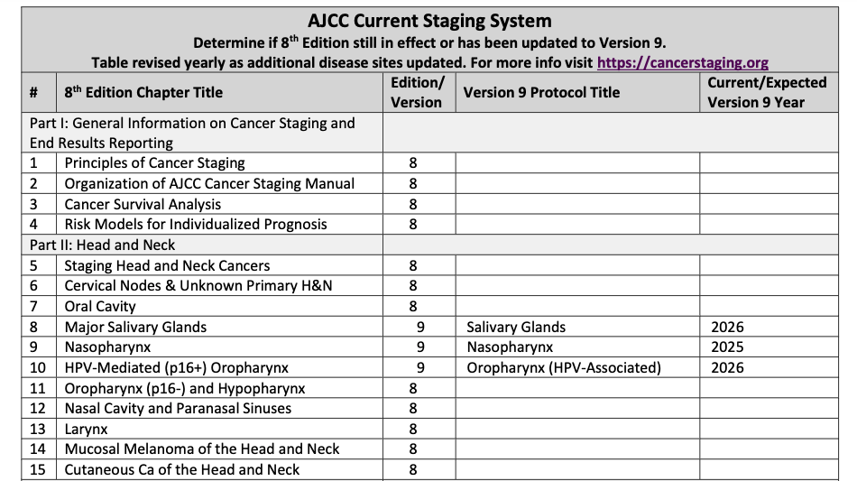
https://www.facs.org/media/c5ik5tkr/ajcc-current-staging-system-2026.pdf

Slide 3
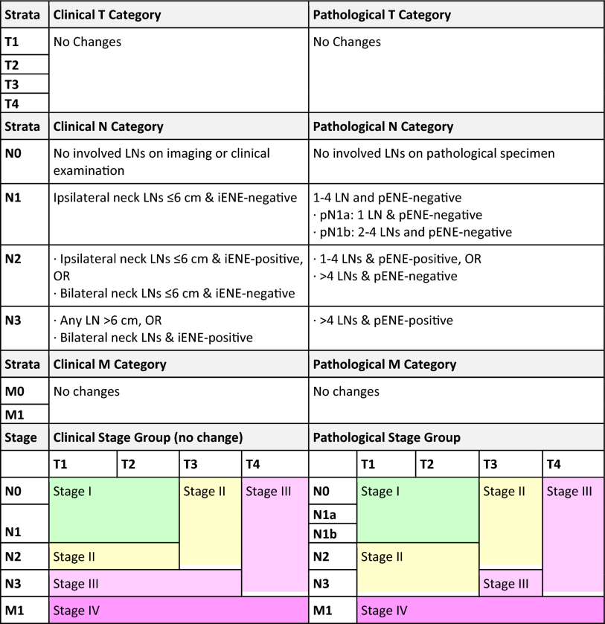
Oropharyngeal p16 POSITIVE
https://link.springer.com/article/10.1245/s10434-026-19496-2

Slide 4
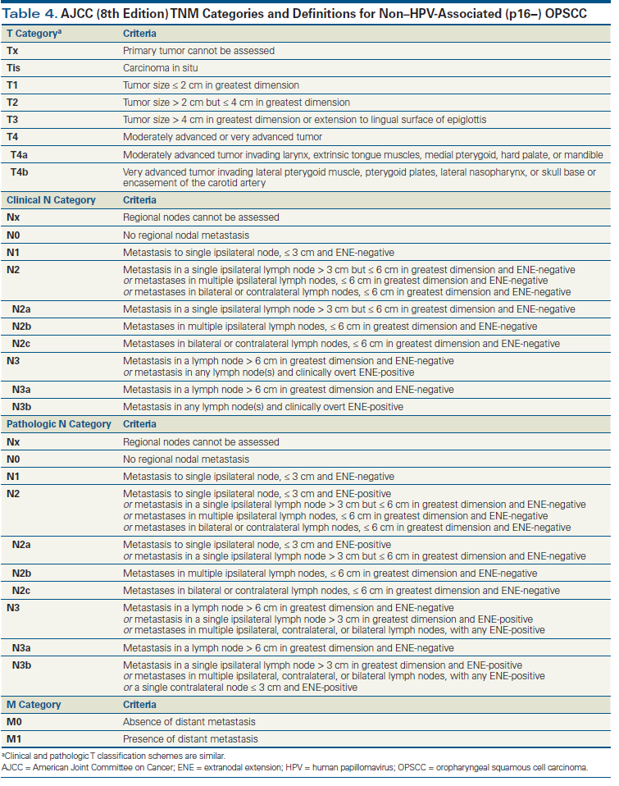
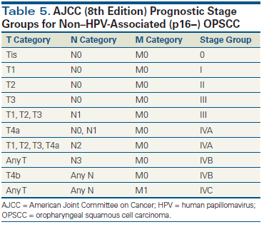
Oropharyngeal p16 NEGATIVE
https://www.cancernetwork.com/view/emergence-novel-staging-system-oropharyngeal-squamous-cell-carcinoma-based-hpv-status

Slide 5
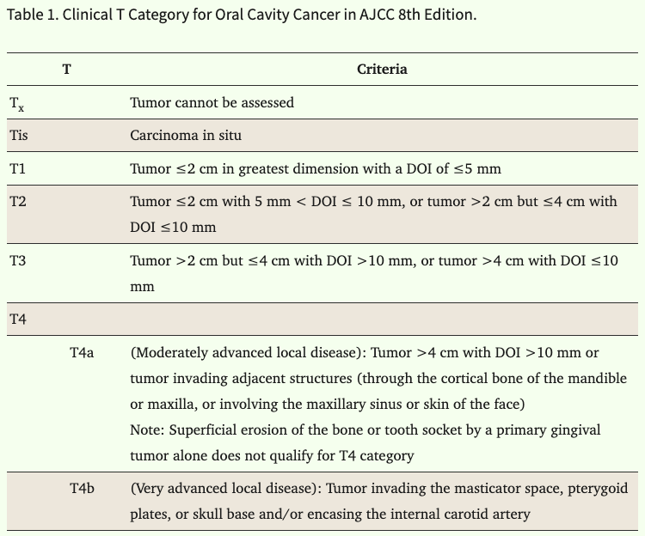
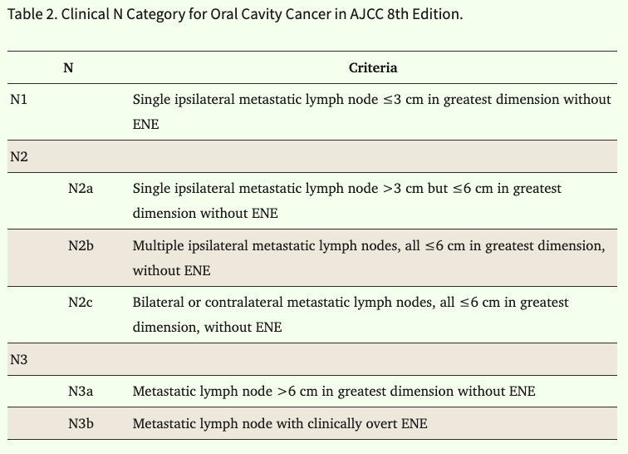
Oral cavity
M0: no mets
M1: mets
https://pmc.ncbi.nlm.nih.gov/articles/PMC12883927

Slide 6
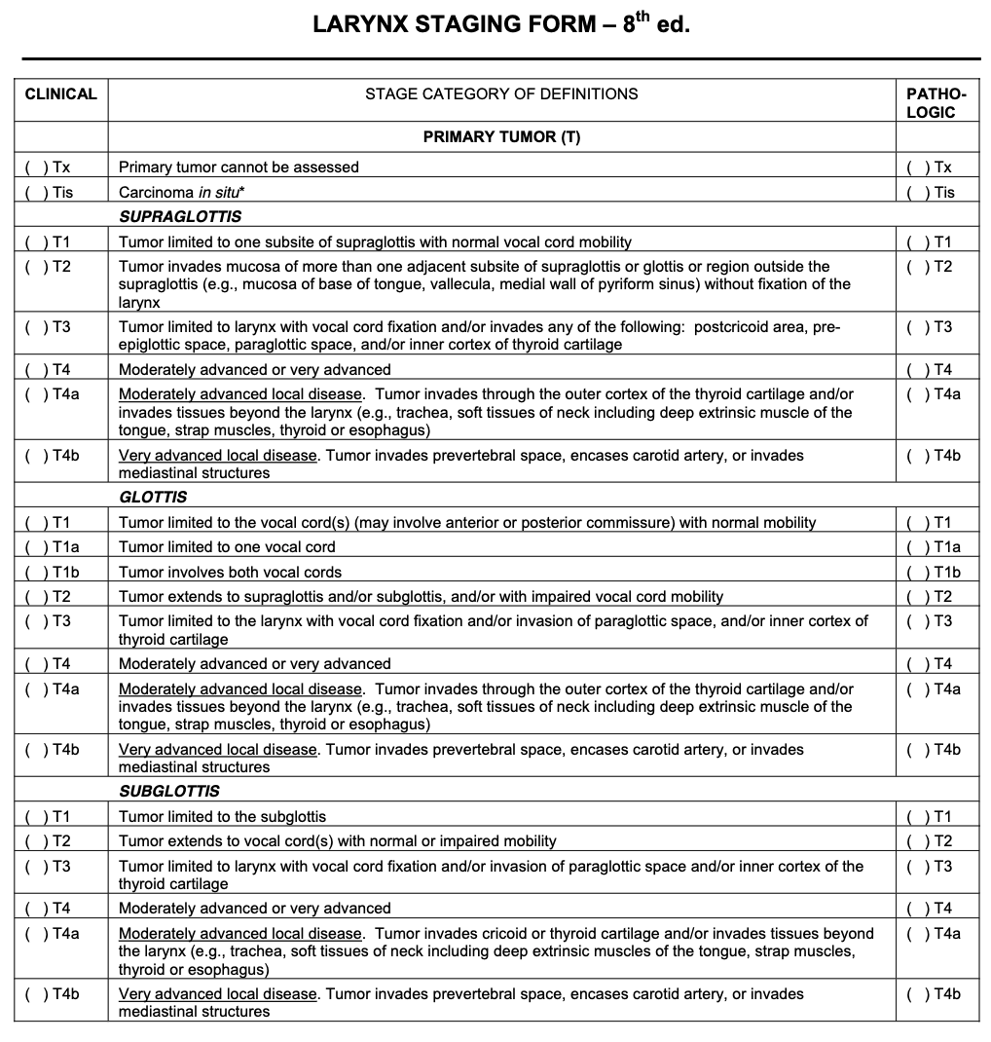
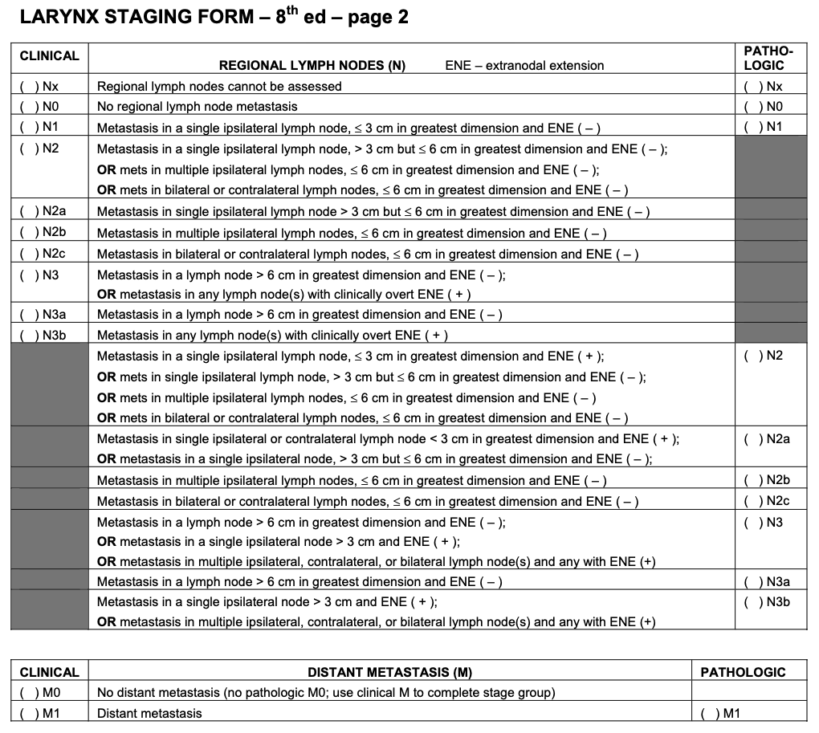
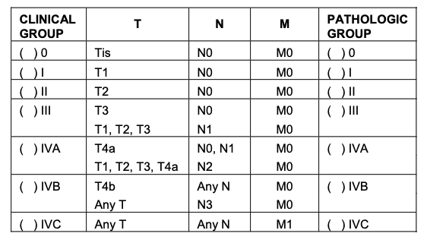
Larynx
https://dl.icdst.org/pdfs/files3/c9ae57945f9300e9866af6cbbdc0ef86.pdf

Slide 7
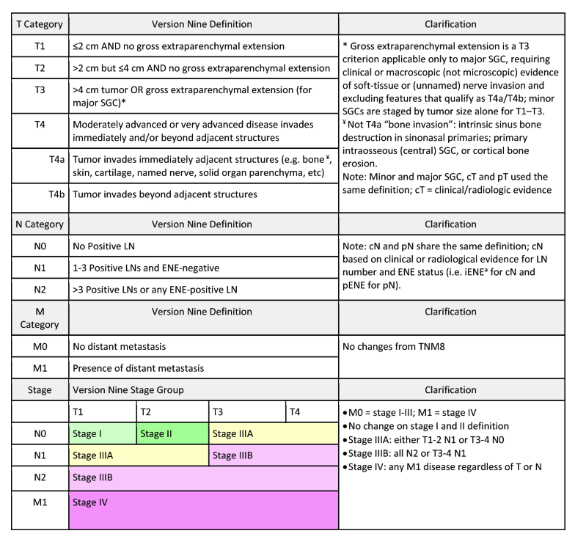
Salivary gland
https://link.springer.com/article/10.1245/s10434-026-19350-5/tables/1

Slide 8
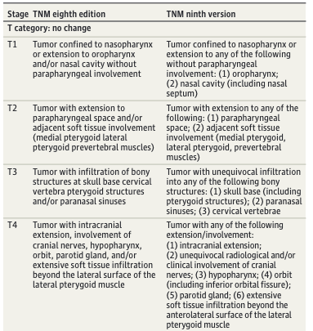
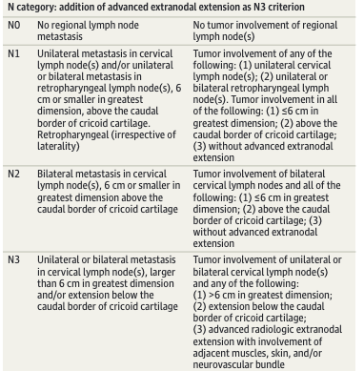

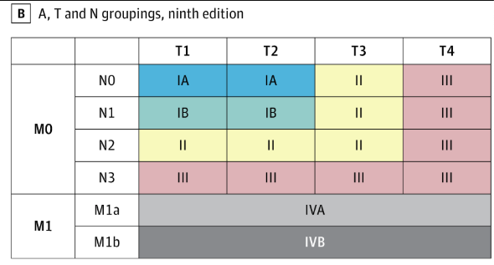
Nasopharynx
https://jamanetwork.com/journals/jamaoncology/fullarticle/2824837

Slide 9
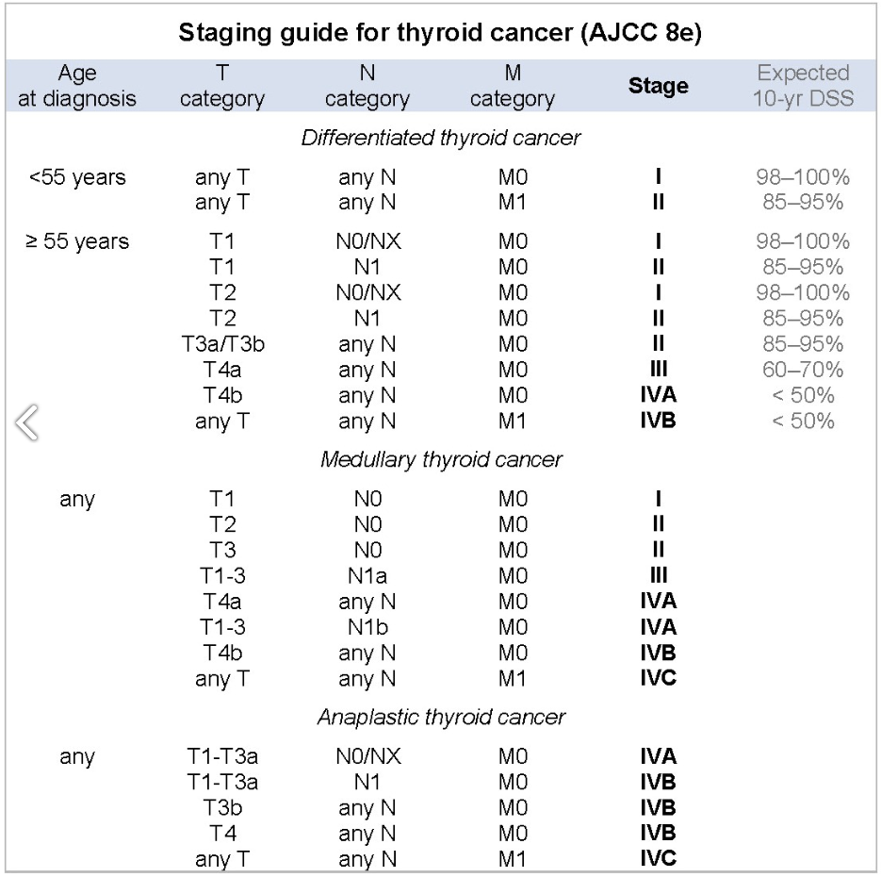
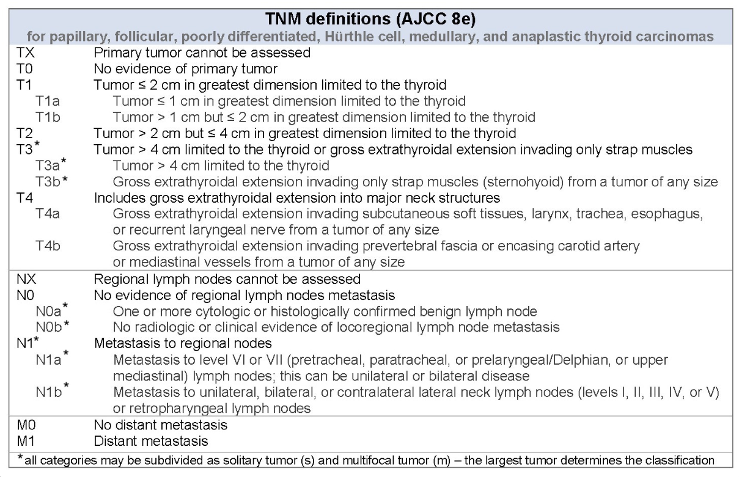
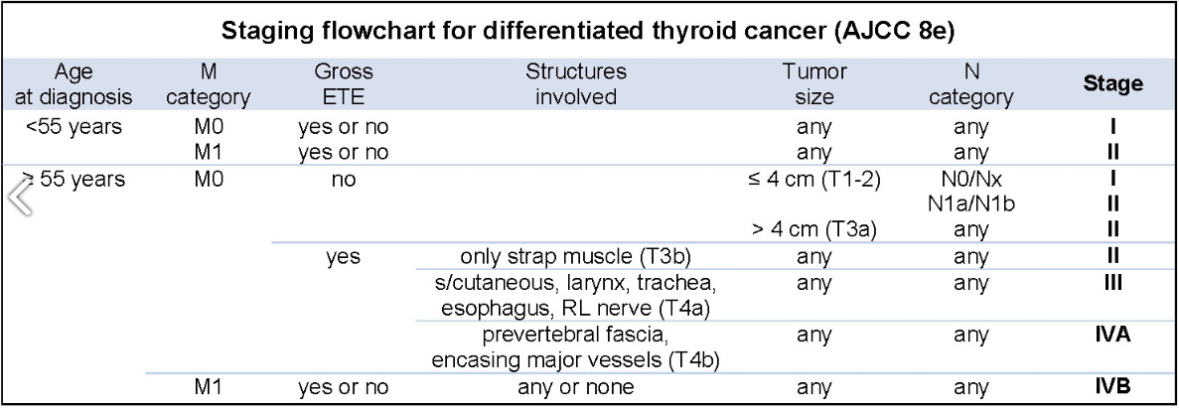
Thyroid (AJCC)
https://www.pathologyoutlines.com/topic/thyroidstaging.html
https://pmc.ncbi.nlm.nih.gov/articles/PMC5467103/

Slide 10
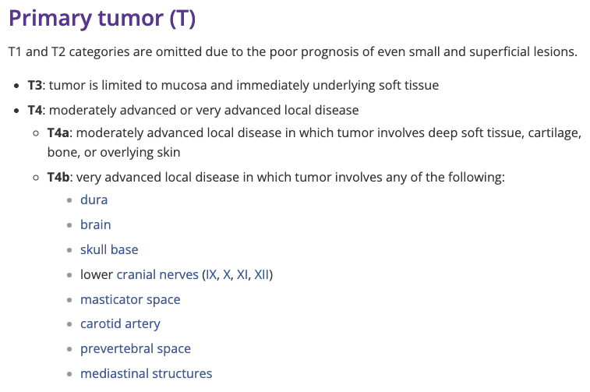
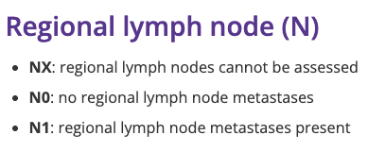
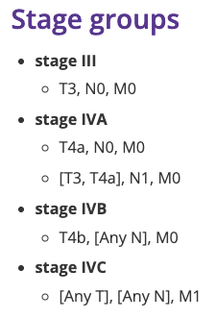
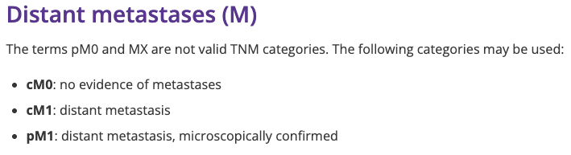
Mucosal melanoma H&N
https://radiopaedia.org/articles/mucosal-melanoma-of-the-head-and-neck-staging?lang=us
https://www.pathologyoutlines.com/topic/oralcavitystagingmucosalmelanoma.html

Slide 11
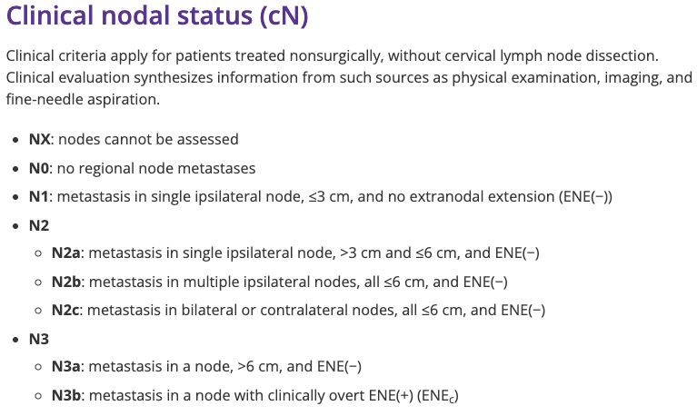
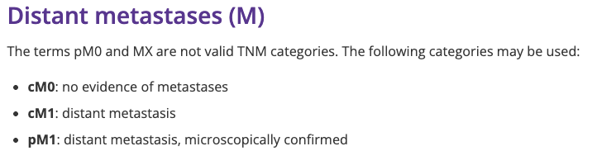
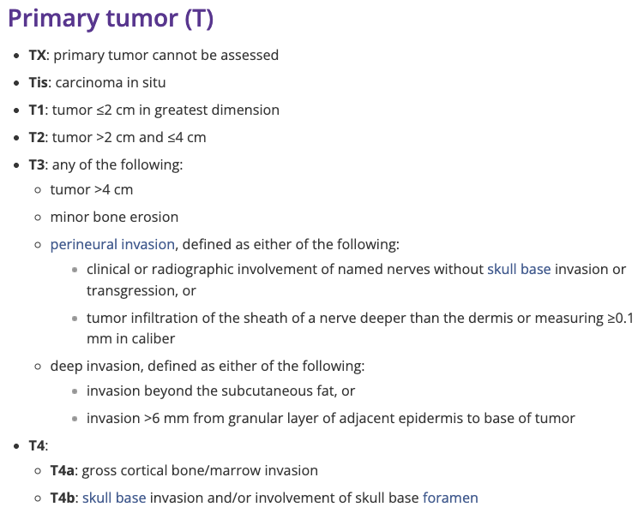
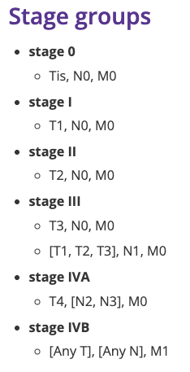
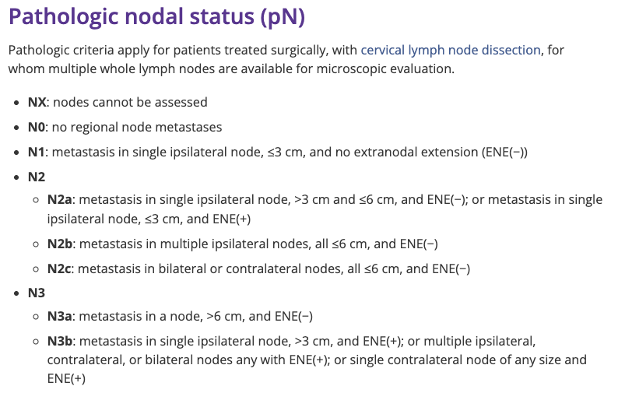
Cutaneous carcinoma H&N
https://radiopaedia.org/articles/cutaneous-carcinoma-of-the-head-and-neck-staging?lang=us
https://www.pathologyoutlines.com/topic/skintumornonmelanocyticstagingskincarcinoma.html

Slide 12
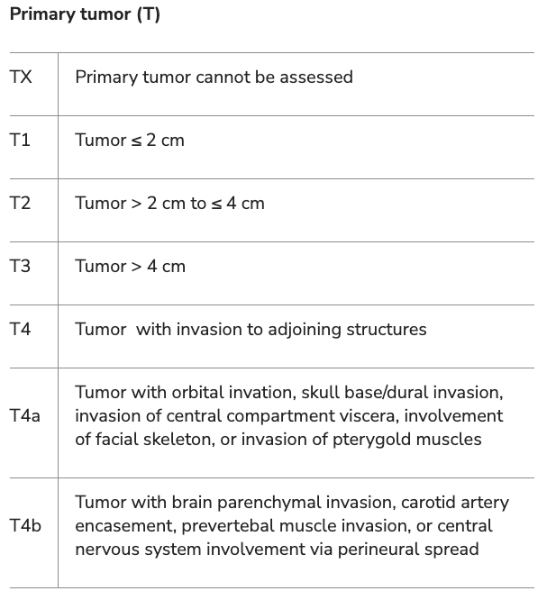
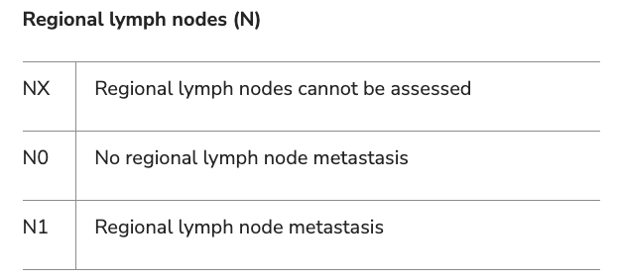
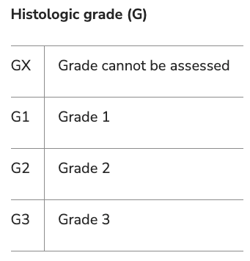
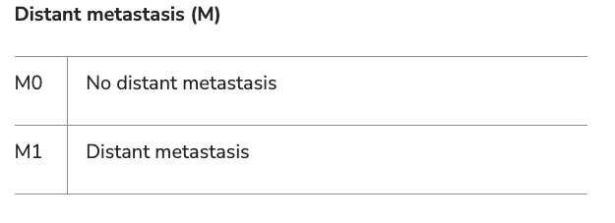
Sarcoma of H&N
Cates (2019) and Salunkhe et al. (2023) have proposed prognostic staging groups, but none have been endorsed by the AJCC. Please disclose this to users and do not attempt to produce prognostic stage.
https://emedicine.medscape.com/article/2006584-overview
https://onlinelibrary.wiley.com/doi/10.1002/hed.25701
https://www.redjournal.org/article/S0360-3016(23)05001-0/fulltext

