Slide 1
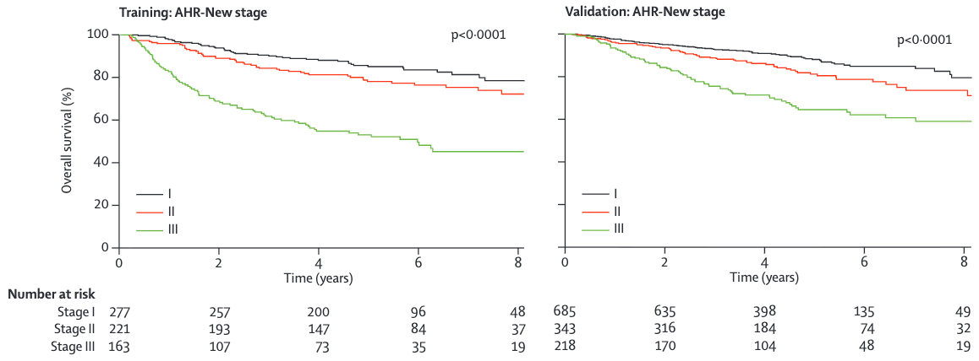
oropharynx-hpv-clinical

Slide 2
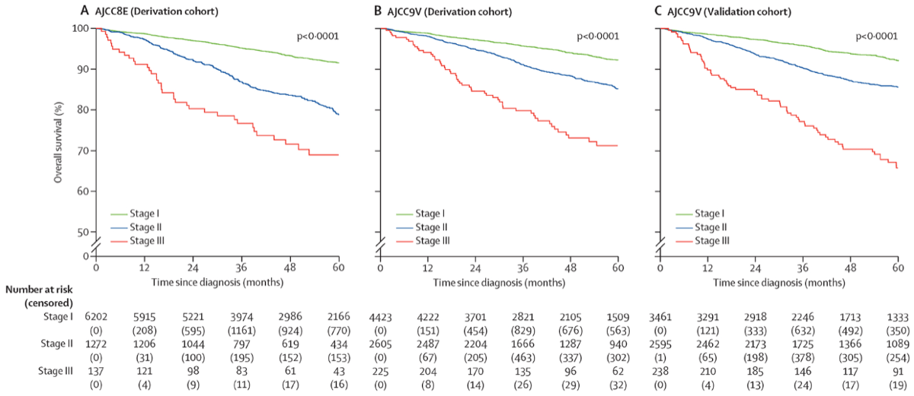
oropharynx-hpv-pathological

