Slide 1
CHAPTER 12: Networks and Data Communications
The Architecture of Computer Hardware, Systems Software & Networking:
An Information Technology Approach
5th Edition, Irv Englander
John Wiley and Sons ©2013
PowerPoint slides authored by Angela Clark, University of South Alabama
PowerPoint slides for the 4th edition were authored by Wilson Wong, Bentley University
Note: This set of slides is well-suited for two lectures.

Slide 2
Data Communications
A simple view
Data – messages to be shared between sender and receiver
Communications channel that can capably and reliably transport messages
Protocols establish accurate and appropriate meaning to the messages that are understood by both senders and receivers
Physical connection that is independent of the messaging
  Message sharing “connection” between applications at the sender and the receiver
  Physical connection with signaling that represents the messages being transported
Examples
  POTS – Plain Old Telephone Service
  Web servers and Web browsers
Copyright 2013 John Wiley & Sons, Inc.
12-<number>

Slide 3
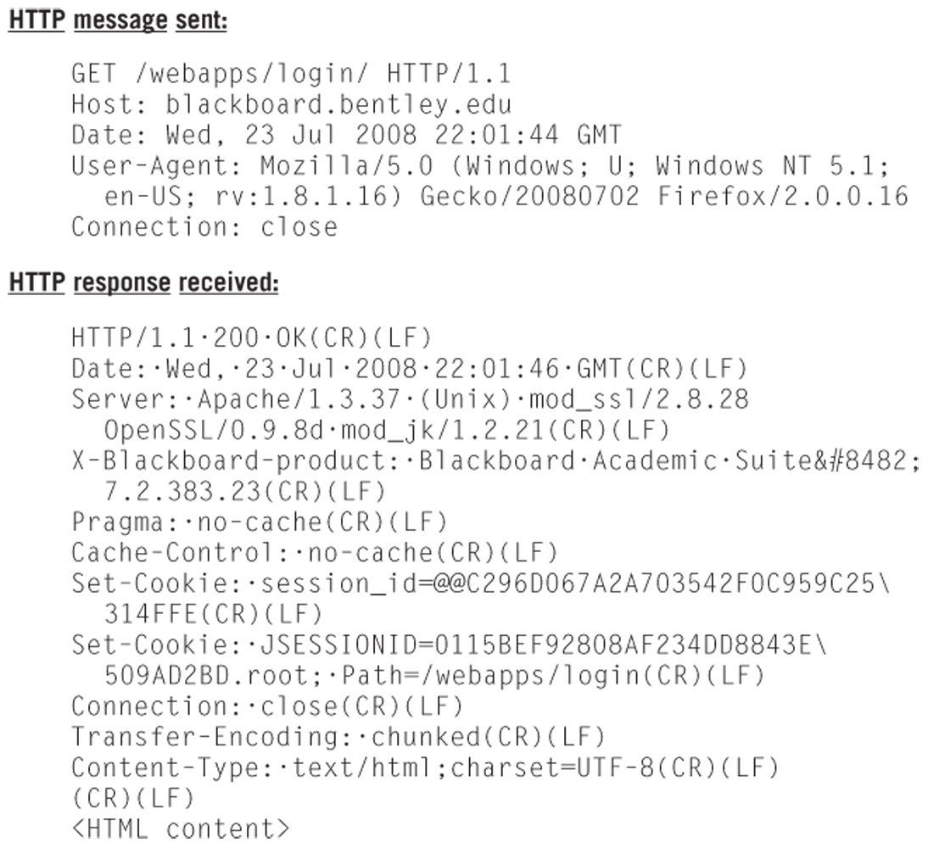
HTTP Request and Response
Copyright 2013 John Wiley & Sons, Inc.
12-<number>

Slide 4
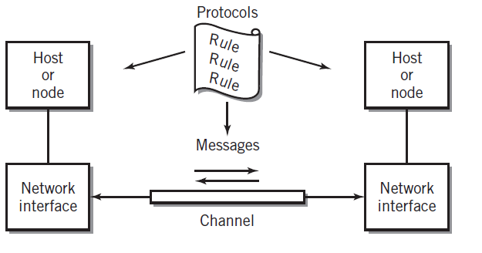
Model of a Communication Channel
Copyright 2013 John Wiley & Sons, Inc.
12-<number>

Slide 5
Messages
Communication between cooperating applications at each end node
Can take many forms such as data, a program, a file, or multimedia
Represented digitally
Data is described as a byte stream because communications are predominantly serial
Limitation as a communication tool is the varying message length
  Long messages could tie up a communication channel indefinitely, creating problems for other messages that share that channel
Copyright 2013 John Wiley & Sons, Inc.
12-<number>

Slide 6
Packets
A group of related packets make up a single message
Consist of data encapsulated by the packet header, which contains information about the packet
Used to solve problems of channel availability and maximum utilization
Equivalent to an envelope that contains pages of data
Sometimes referred to as a frame or datagram, which identifies their purpose
Copyright 2013 John Wiley & Sons, Inc.
12-<number>

Slide 7
Packet Header
Also known as the preamble
Contains
  Description of the packet
  Destination address of receiver
  Source address of sender
  Information about the data being sent
Copyright 2013 John Wiley & Sons, Inc.
12-<number>

Slide 8
Advantages of Packets
Simplifies operations and increases communications efficiency
Reasonable unit for routing of data
Alternative to dedicating a channel for the entire length of the message
Packets from several sources can share a single channel
Each sender/receiver pair appears to have a channel to itself
Receiving computer can process an entire block of data instead of a character or byte at a time
Simplifies synchronization of the sending and receiving systems by providing clear start and stop points
Copyright 2013 John Wiley & Sons, Inc.
12-<number>

Slide 9
Channel Characteristics (1)
Communication channel
  Path for the message between two communicating nodes
  May include intermediate nodes that forward packets to the next node
  Interfaces at each end of the connection may be different
Links
  Segment of a communication channel
Bandwidth
  Bit rate of overall channel
Medium
  Guided – communications limited to a specific path
  Unguided – communications not limited to a specific path
Copyright 2013 John Wiley & Sons, Inc.
12-<number>

Slide 10
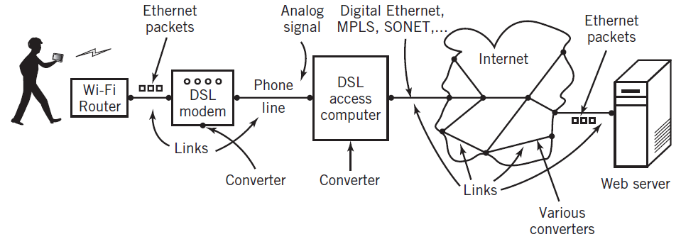
A Multi-Link Channel
Copyright 2013 John Wiley & Sons, Inc.
12-<number>

Slide 11
Channel Characteristics (2)
Data transmission directionality
  Simplex – messages are carried only in one direction
  Half-duplex – messages are carried in both directions but only one direction at a time
  Full duplex – messages are simultaneously carried in both directions
Number of connections
  Point-to-point or Multipoint
End node interfaces
  Wired or wireless Ethernet
  Bluetooth, WiMax, DSL, cable, satellite link, telephone modem, etc.
Protocols allow interconnection for data communications capability
Copyright 2013 John Wiley & Sons, Inc.
12-<number>

Slide 12
Network Topology
Fundamental layout of a network
Describes the path or paths between any two points in the network
Affects availability, speed and traffic congestion of the network
Logical topology – operational relationship between the various network components
Physical topology – actual layout of the network wiring
Copyright 2013 John Wiley & Sons, Inc.
12-<number>

Slide 13
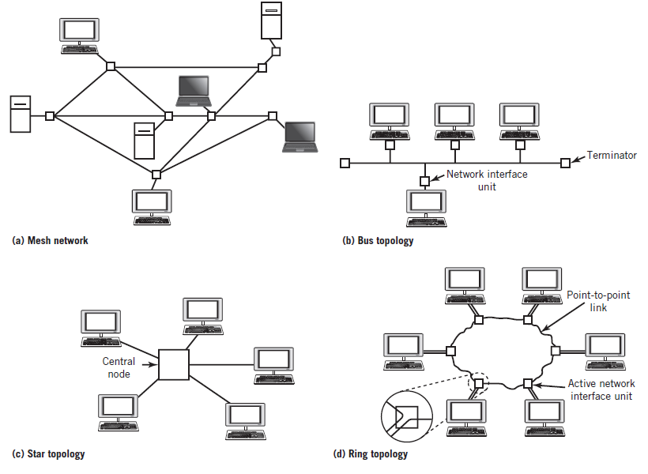
Network Topologies
Copyright 2013 John Wiley & Sons, Inc.
12-<number>

Slide 14
Mesh Topology
Multiple paths between end nodes
Failure of an individual intermediate node will slow but not stop the network as long as an alternative path is available
Large networks that use switches and routers are typically partial mesh networks
Full mesh network
  Direct point-to-point channel connecting every pair of nodes
  Impractical due to the large number of connections needed
  Number of connections = nodes x (nodes – 1) / 2
  500 computer nodes would require 125,000 interconnecting cables!
Copyright 2013 John Wiley & Sons, Inc.
12-<number>

Slide 15
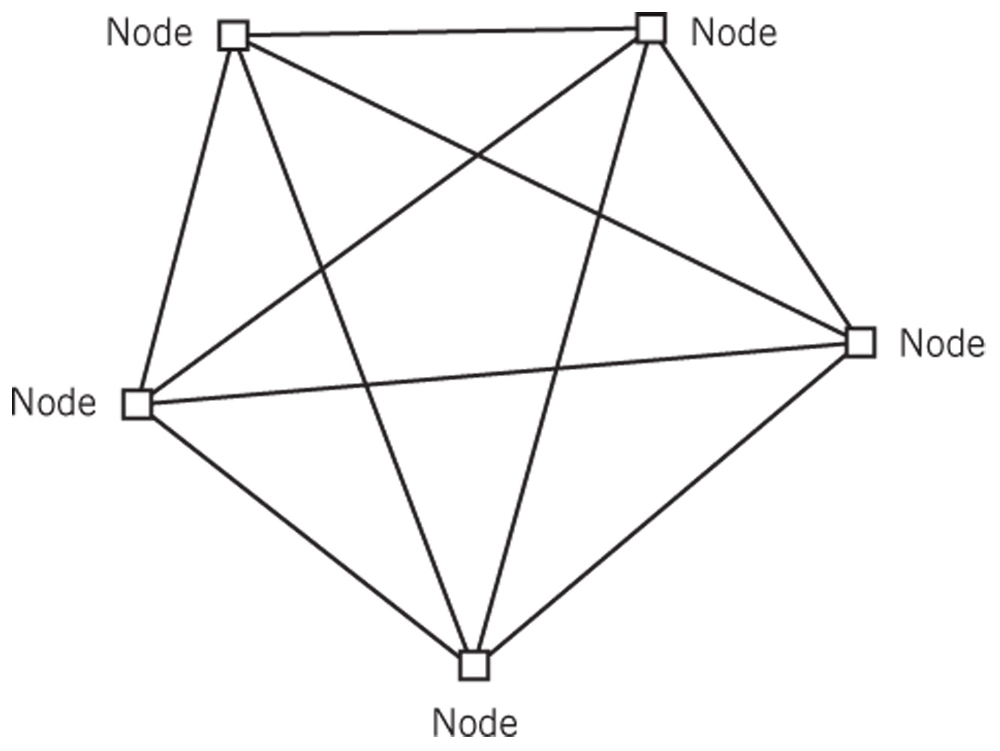
Five-Node Full Mesh Network
Copyright 2013 John Wiley & Sons, Inc.
12-<number>

Slide 16
Bus Topology
Similar to multipoint buses in Chapter 7
Each node is tapped into the bus along the bus
To communicate, each node “broadcasts” a message that travels along the bus
Every node on the bus receives the message but it is ignored by all nodes except the one whose node matches the delivery address in the message
Transmission from any stations travels entire medium (both directions)
Termination required at ends of bus to prevent the signal from echoing
Branches can be added to a bus, expanding it into a tree but messages are still broadcast throughout the entire tree
Copyright 2013 John Wiley & Sons, Inc.
12-<number>

Slide 17
Bus Network Implementation
Only requires a single pair of wires from one end of the network space to the other
  Easiest to wire of the network topologies
  Low cost
Traffic congestion is a major issue
Rarely used in designs of new networks except for wireless networks
Because of the unguided nature of radio waves, wireless networks require some form of bus topology
Copyright 2013 John Wiley & Sons, Inc.
12-<number>

Slide 18
Star Topology
Primarily used for local area networks and sometimes used to connect satellite offices to a central office
All nodes are connected point-to-point to a central device
Nodes communicate through the central device
Switching in the central device connects pairs of nodes together to allow them to communicate directly
Central device can steer data from one node to another as required
Most modern switches allow multiple pairs to communicate simultaneously
Failure of central device causes entire network to go down
Copyright 2013 John Wiley & Sons, Inc.
12-<number>

Slide 19
Ring Topology
Point-to-point connection from each node to the next
Last node is connected back to the first to form a closed ring
Each node retransmits the signal that it receives from the previous node in the ring
Packets are placed on the loop at a node, and travel from node to node until the desired node is reached
Although the ring is inherently unidirectional, it is possible to build a bidirectional ring network
Popular in the past because they provided a controlled way in which to guarantee network performance
  Legacy token-ring local area networks
Used in some FDDI fiber optic backbone and metropolitan area networks
Copyright 2013 John Wiley & Sons, Inc.
12-<number>

Slide 20
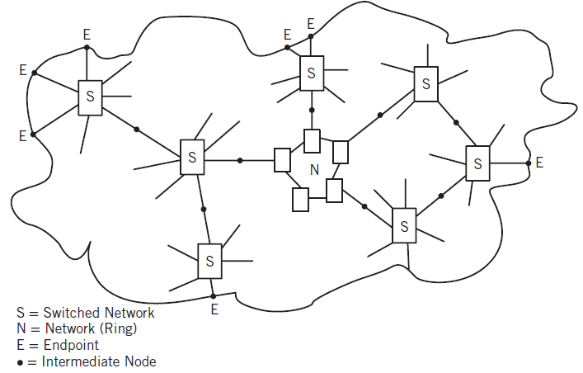
Connecting End Points Through Links and Networks
Copyright 2013 John Wiley & Sons, Inc.
12-<number>

Slide 21
Local Area Networks (LAN)
A network that connects computers and other supporting devices over a relatively small localized area
Typically ranging in size from a single room to multiple buildings in close range of each other
Most of the computers are personal computers or workstations
Routers and perhaps gateways are used to connect the LAN to other networks
Creating separate LANs for different departments or for different business functions is done to minimize extraneous traffic on the network
Most modern LANs are based on one of the Ethernet protocol standards
Copyright 2013 John Wiley & Sons, Inc.
12-<number>

Slide 22
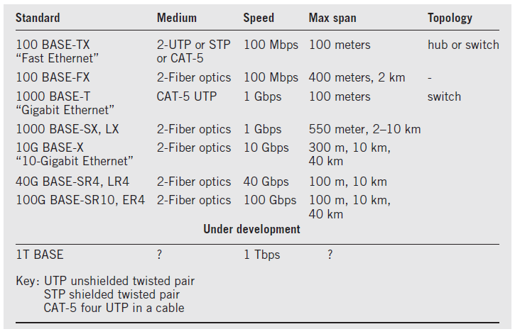
Common Wired Ethernet Standards
Copyright 2013 John Wiley & Sons, Inc.
12-<number>

Slide 23
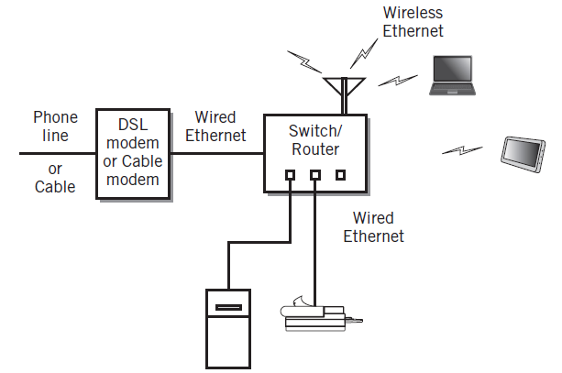
Typical Home Network
Copyright 2013 John Wiley & Sons, Inc.
12-<number>

Slide 24
Ethernet Hubs
Based on bus topology
A passive central connection device used to simplify wiring and maintenance
Physical layer device where all of the connections are tied together inside the hub
Signals are broadcast to every device connected to the hub
Use of hubs is declining because switches often provide better performance
Copyright 2013 John Wiley & Sons, Inc.
12-<number>

Slide 25
Ethernet Switches
Logically a star topology, not a bus topology
Able to set up a direction connection between any two nodes
Multiple pairs of nodes can communicate at the full bandwidth
Prevalent method for wired local area networks
Copyright 2013 John Wiley & Sons, Inc.
12-<number>

Slide 26
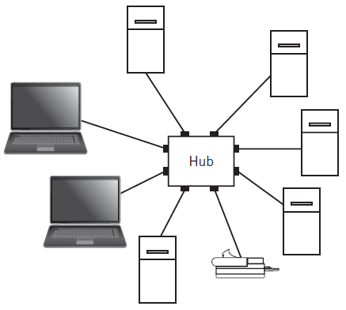
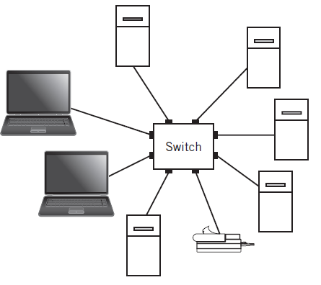
Hub- vs. Switch-Based Ethernet
Logically a bus and can be viewed as a zero-length bus
Logically and physically a star topology
Copyright 2013 John Wiley & Sons, Inc.
12-<number>

Slide 27
Wireless Ethernet (WiFi)
Radio-based compatible extension to the Ethernet standard
Central access point is similar to a hub but is an active node
Central access point transmits and receives radio waves to communicate with the nodes
Radio space must be shared between the nodes
Possible for stations to be out of range or blocked by buildings or other obstacles
  Hidden Node and Out-of-Range conditions
Some NICs support multiple radio frequencies
Copyright 2013 John Wiley & Sons, Inc.
12-<number>

Slide 28
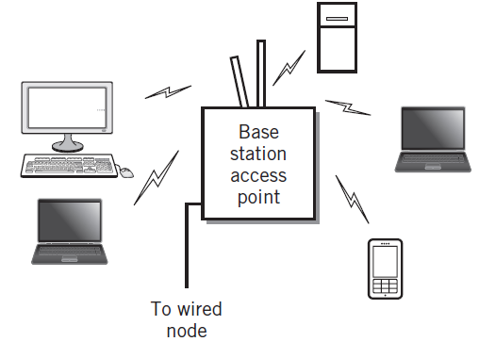
Basic Wi-Fi Local Area Network
Copyright 2013 John Wiley & Sons, Inc.
12-<number>

Slide 29
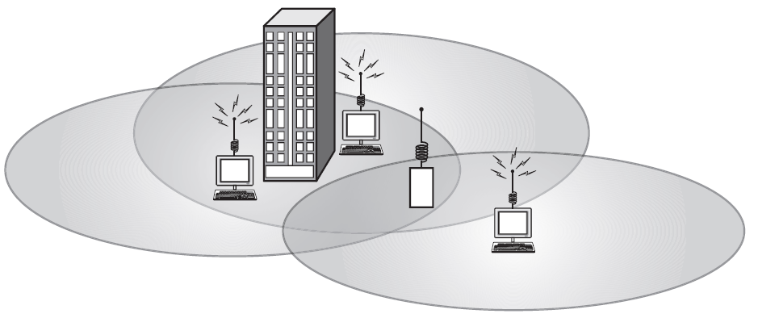
Hidden Node and Out-of-Range Conditions
Copyright 2013 John Wiley & Sons, Inc.
12-<number>

Slide 30
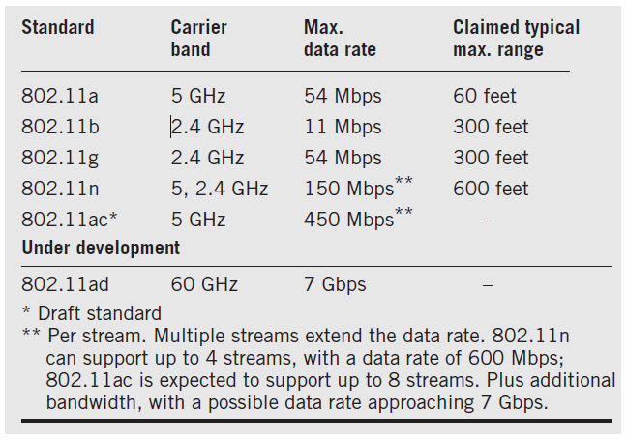
Wireless Ethernet Characteristics
Copyright 2013 John Wiley & Sons, Inc.
12-<number>

Slide 31
Backbone Networks
Ties together LANs and provides access to external networks like the Internet
Chief motivation is to improve overall performance of a larger network by creating separate networks for groups of users who primarily communicate with one another
Communication between LANs is enabled only when necessary
Overall range of the network can be extended beyond the limits of a single LAN
Often used to extend availability of wireless Ethernet access beyond access point range limits through a mesh network
Intranets – an organizational network where user interfaces and applications are primarily based on Web services
Copyright 2013 John Wiley & Sons, Inc.
12-<number>

Slide 32
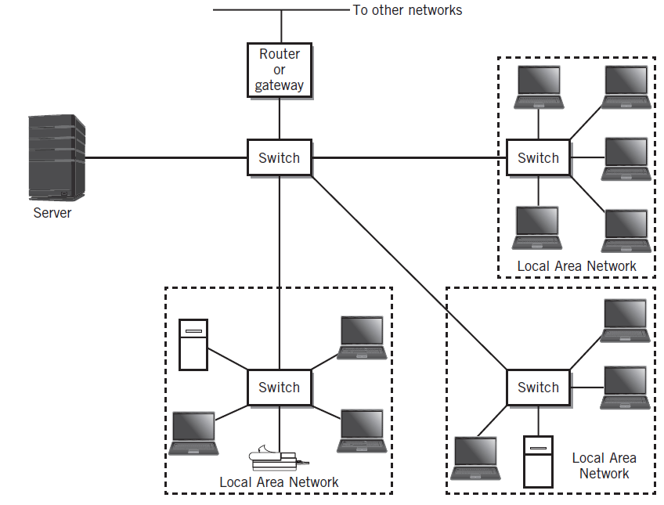
Backbone Network
Copyright 2013 John Wiley & Sons, Inc.
12-<number>

Slide 33
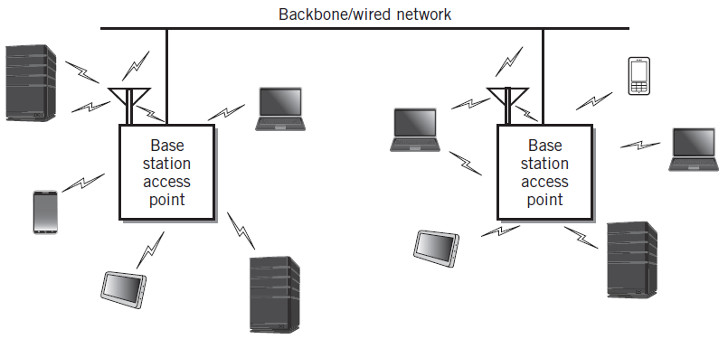
Configuration of a Wi-Fi Network
Copyright 2013 John Wiley & Sons, Inc.
12-<number>

Slide 34
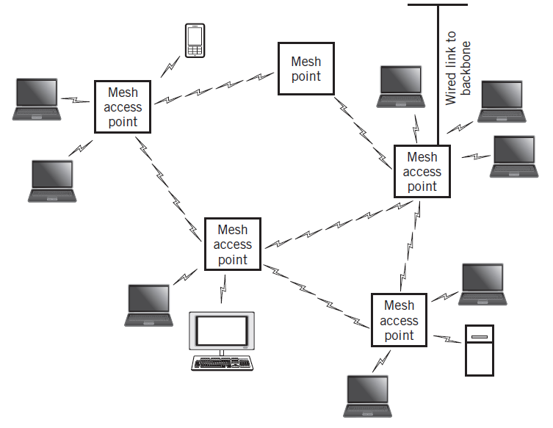
Wireless Mesh Network
Copyright 2013 John Wiley & Sons, Inc.
12-<number>

Slide 35
Metropolitan Area Networks
A network larger in geographical scope than a LAN but within a range of less than 30 miles or 50 km
Often there is a desire to create network links to connect locations that would require running wires through someone else’s property.
  Requires services from a service provider or public carrier
  Begins to resemble a WAN
  Edge connection – a connection at an access point on the customer’s premises that connects to a provider
Campus area network (CAN)
  Network type between a LAN and a MAN
  Number of interconnected buildings clustered together
Copyright 2013 John Wiley & Sons, Inc.
12-<number>

Slide 36
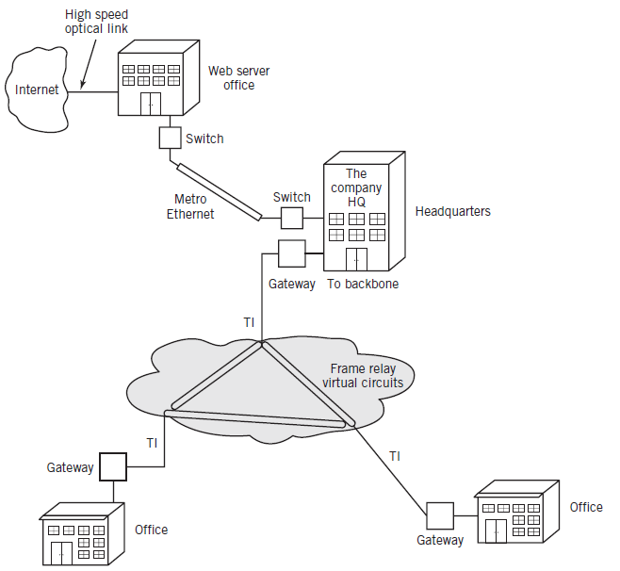
A Metropolitan Area Network
Copyright 2013 John Wiley & Sons, Inc.
12-<number>

Slide 37
Wide Area Networks (WAN)
Facilitate communications between users and applications over large geographical distances
Distinguishing feature is the extensive reliance on service providers to provide the required connectivity between nodes
The carrier network is sometimes represented as a collection of private virtual networks
Primary reasons for WANs
  Organization requires data communication links between widely spread facilities and between an organization and its external contacts
  Organization requires fast access to the Internet, either as a consumer or as a provider of Internet services, or both
Extranet
  A connection between a business and its business partners that usually uses the Internet as a medium for its activities
Copyright 2013 John Wiley & Sons, Inc.
12-<number>

Slide 38
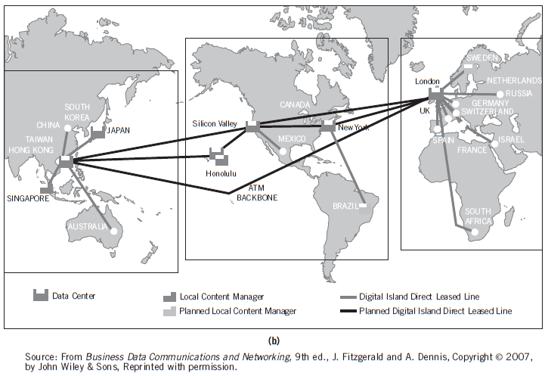

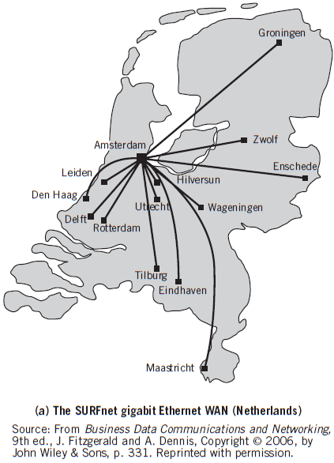
Two Real-World WANs
Copyright 2013 John Wiley & Sons, Inc.
12-<number>

Slide 39
Internet Backbones and the Internet
Internet Service Providers (ISPs)
Internet backbone
  High speed fiber optic networks that carry traffic between major cities throughout the world
  Created to speed network traffic that would otherwise require many slow hops to the final destination
Network access points
  Interchanges between the backbones
Local ISPs receive their service from regional ISPs who, in turn, receive their service from national ISPs
Most regional ISPs also interconnect among themselves
Copyright 2013 John Wiley & Sons, Inc.
12-<number>

Slide 40
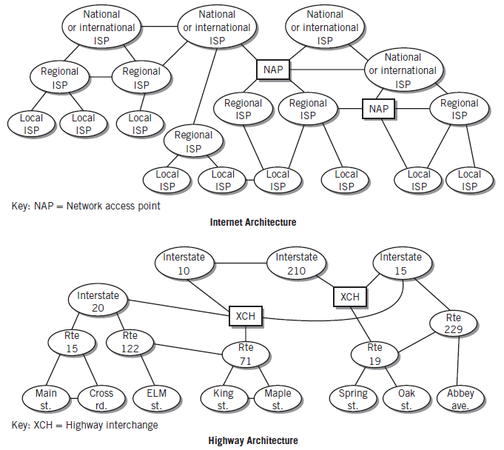
Comparison of Internet and Highway Architecture
Copyright 2013 John Wiley & Sons, Inc.
12-<number>

Slide 41
Piconets
Also known as personal area networks (PAN)
Created for the personal use of an individual
Generally have ranges of 30 feet or less, which is sufficient to permit an individual to interconnect personal computing devices
Connections between different cooperating users are possible but rare
Bluetooth is the primary medium for PANs
Example: interconnection between a cell phone, hands-free speaker and car radio
Copyright 2013 John Wiley & Sons, Inc.
12-<number>

Slide 42
Packet Routing
Circuit switching
  Dedicated channel between source and destination for duration of connection
Virtual circuit
  Multi-link channel path used to send packets between two end nodes
  Intermediate nodes may be shared with other channel paths
Packet switching (datagram switching)
  Each packet is routed from node to node independently based on various criteria
Copyright 2013 John Wiley & Sons, Inc.
12-<number>

Slide 43
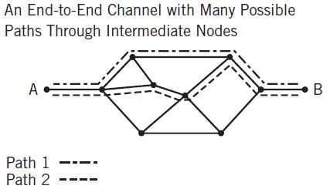
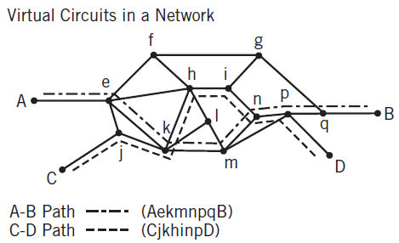
Packet Routing
Copyright 2013 John Wiley & Sons, Inc.
12-<number>

Slide 44
Routers and Gateways
Routers
  Specialized devices used to interconnect networks and pass packets from one network to another
  Operation (see following slide)
    When a packet arrives at an input port, the processor decides where the packet is to be directed
    A switch is set to direct the packet to the correct output port
Gateways
  Same as routers but connect dissimilar networks together
  Convert packet headers for the dissimilar networks
Copyright 2013 John Wiley & Sons, Inc.
12-<number>

Slide 45
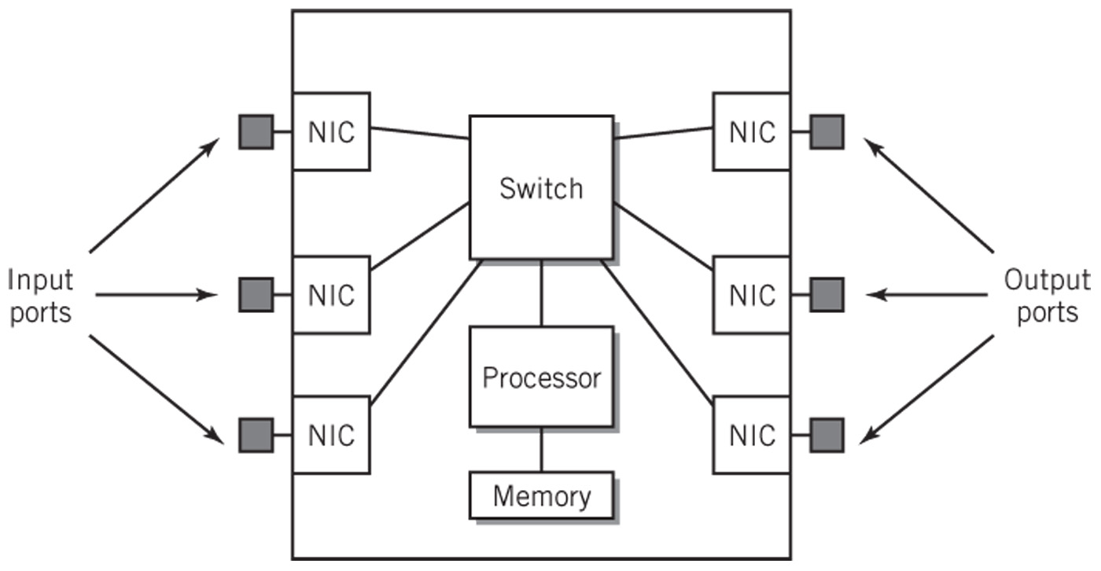
Router Block Diagram
Copyright 2013 John Wiley & Sons, Inc.
12-<number>

Slide 46
Standards Organizations
ISO (International Organization for Standardization)
  > 17,000 standards including the OSI Reference Model
IEEE (Institute for Electrical and Electronics Engineers
  Ethernet standards – Ethernet (802.3), Wi-Fi (802.11), Bluetooth (802.15) and WiMax (802.16)
IETF (Internet Engineering Task Force)
  Internet standards based on RFCs (request for comments)
ICANN
  Internet Corporation for Assigned Names and Numbers
  IP address allocation, domain name registration, protocol parameter assignment
  Management of domain name and root server systems
IANA (Internet Assigned Numbers Authority)
  Registers application layer port numbers and specific parameter values used in Internet protocol headers
Copyright 2013 John Wiley & Sons, Inc.
12-<number>

Slide 47
Copyright 2013 John Wiley & Sons
All rights reserved. Reproduction or translation of this work beyond that permitted in section 117 of the 1976 United States Copyright Act without express permission of the copyright owner is unlawful. Request for further information should be addressed to the Permissions Department, John Wiley & Sons, Inc. The purchaser may make back-up copies for his/her own use only and not for distribution or resale. The Publisher assumes no responsibility for errors, omissions, or damages caused by the use of these programs or from the use of the information contained herein.
Copyright 2013 John Wiley & Sons, Inc.
12-<number>

