Slide 1
CHAPTER 13:
Ethernet and TCP/IP Networking
The Architecture of Computer Hardware, Systems Software & Networking:
An Information Technology Approach
5th Edition, Irv Englander
John Wiley and Sons ©2013
PowerPoint slides authored by Angela Clark, University of South Alabama
PowerPoint slides for the 4th edition were authored by Wilson Wong, Bentley University
Note: This set of slides is well-suited for two lectures.

Slide 2
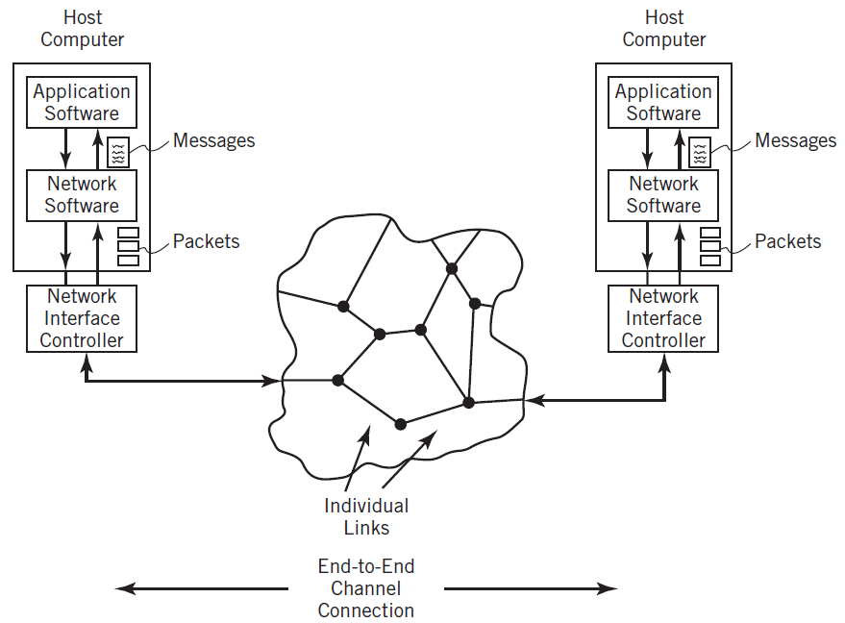
End-to-End Channel Connection
Copyright 2013 John Wiley & Sons, Inc.
13-<number>

Slide 3
Communication Model
Implemented as a hierarchical protocol stack
Each layer of the stack at the sender node contributes information that is used by the corresponding peer layer at the receiver node
Different protocols for the different aspects of communication
Separating tasks and including well defined interfaces between the tasks
  Adds flexibility
  Simplifies design of protocols
  Permits modification or substitution of protocols without affecting unrelated tasks
  Permits a system to select only the protocols needed for a particular application
Copyright 2013 John Wiley & Sons, Inc.
12-<number>

Slide 4
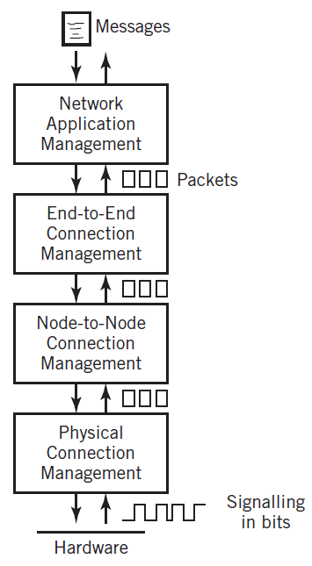
Simplified Model of Layered Communication
Copyright 2013 John Wiley & Sons, Inc.
13-<number>

Slide 5
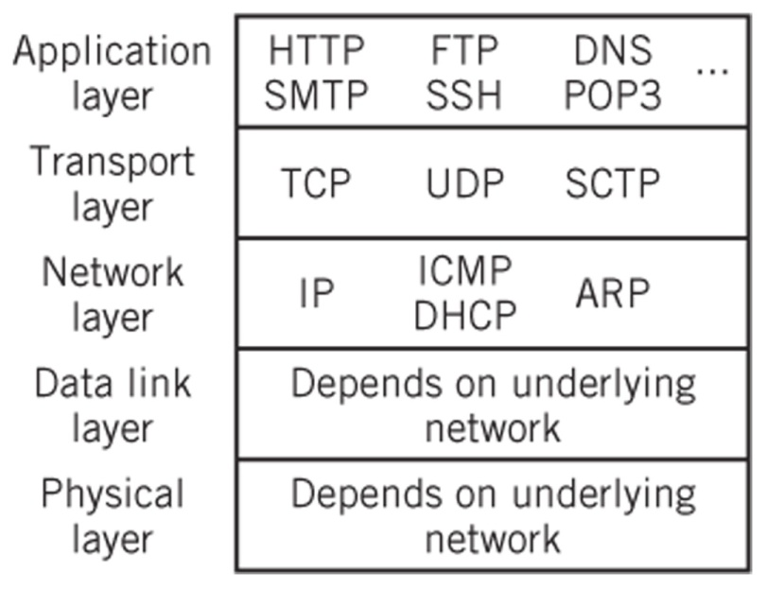
TCP/IP
Transmission Control Protocol/Internet Protocol
Based on five protocol layers, although layers 1 and 2 are not actually specified in the standard. However, the TCP/IP model recognizes the existence of these layers as a necessity.
The TCP/IP protocol suite encompasses an integrated suite of numerous protocols that work together and guide all aspects of communication
Layer 5
Layer 4
Layer 3
Layer 2
Layer 1
Copyright 2013 John Wiley & Sons, Inc.
12-<number>

Slide 6
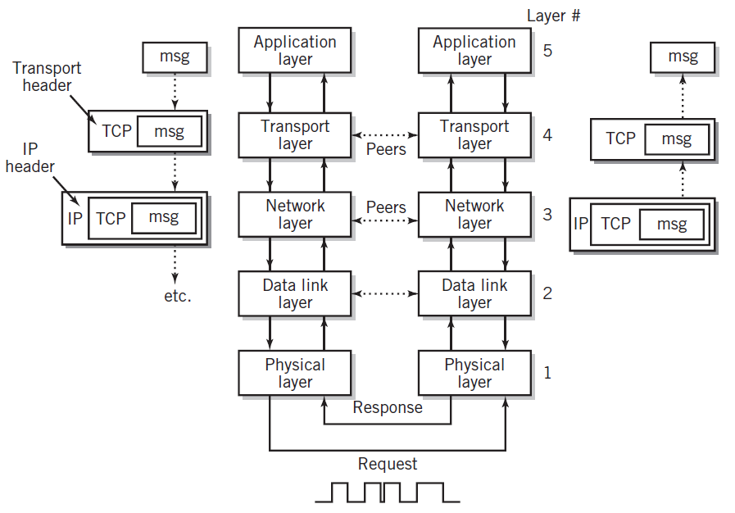
Operation of TCP/IP Model
Copyright 2013 John Wiley & Sons, Inc.
12-<number>

Slide 7
Physical Layer (Layer 1)
Layer at which communication actually takes place consisting of a bare stream of bits
Primarily implemented in hardware by a network interface controller (NIC)
Physical access protocol includes
  Definition of the medium
  Signaling method, signal parameters, carrier frequencies, lengths of pulses, synchronization and timing issues
  Method used to physically connect the computer to the medium
Copyright 2013 John Wiley & Sons, Inc.
12-<number>

Slide 8
Data Link Layer (Layer 2)
Responsible for the reliable transmission and delivery of packets between two adjacent nodes
Packets at this layer are called frames
Often divided into two sublayers:
  Software logical link control (LLC) sublayer
    Error correction, flow control, retransmission, packet reconstruction and IP datagram/frame conversions
    Numbers frames and reorders received frames to recreate the original message
    Rarely used
  Hardware medium-access control (MAC) sublayer
    Defines procedures for accessing the channel and detecting errors
    Responsible for services such as data encoding, collision handling, synchronization, and multiplexing
Copyright 2013 John Wiley & Sons, Inc.
12-<number>

Slide 9
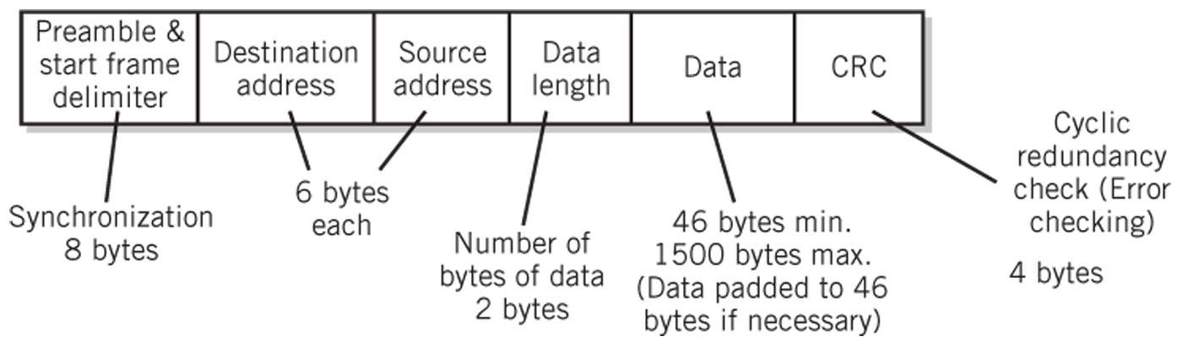
Ethernet Frame Format
Copyright 2013 John Wiley & Sons, Inc.
13-<number>

Slide 10
Hub-Based Ethernet
Simple means of wiring a bussed Ethernet together
Logically still a bus network
CSMA-CD
Collision
  Occurs when multiple nodes access the network in such a way that their messages become mixed and garbled
Network propagation delay
  Amount of time that it takes for one packet to get from one end of the network to the other
Adequate for networks with light traffic
Copyright 2013 John Wiley & Sons, Inc.
13-<number>

Slide 11
Switched Ethernet
Permits point-to-point connection of any pair of nodes
Multiple pairs can be connected simultaneously
Possible to connect nodes in full-duplex mode
Each pair of connections operates at the maximum bit rate of the network
Why can’t there be any collisions in a switched Ethernet network?
Copyright 2013 John Wiley & Sons, Inc.
13-<number>

Slide 12
Wireless Ethernet (Wi-Fi)
Ad hoc mode
  Assumes direct connections between nodes
  Based on partial mesh network topology
  Rarely used
Infrastructure mode
  Based on shared access point
  CSMA/CA – collision avoidance MAC protocol
    Station waits until channel is clear plus a short random amount of time before transmitting
    May use ‘request to send’ and ‘clear to send’ options to improve collision avoidance
Copyright 2013 John Wiley & Sons, Inc.
13-<number>

Slide 13
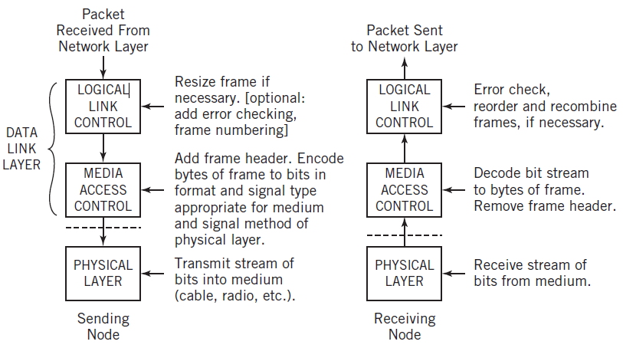
Data Link and Physical Layer Operation
Copyright 2013 John Wiley & Sons, Inc.
13-<number>

Slide 14
Network Layer (Layer 3)
Also called the internetworking layer or IP layer
IP protocol
  Responsible for routing packets from the source end node to the destination end node through intermediate nodes
  Performed using datagram packet switching and logical IP addresses
  Unreliable, best-effort delivery service
  Size of datagram ranges from 20 to 65,536 bytes
  Header size between 20 and 60 bytes
Copyright 2013 John Wiley & Sons, Inc.
13-<number>

Slide 15
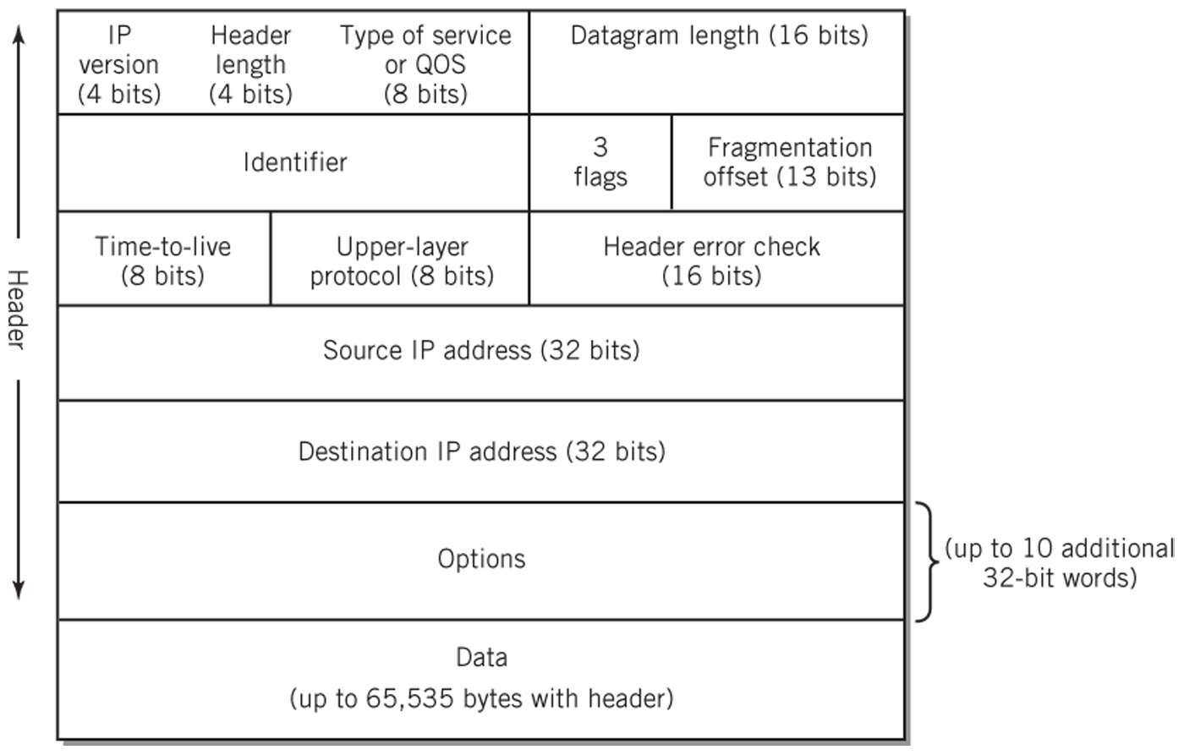
IPv4 Datagram Format
Copyright 2013 John Wiley & Sons, Inc.
13-<number>

Slide 16
Network Layer (cont.)
Communications within a local network:
  No routing is required because nodes are directly addressable
  Physical addresses for corresponding IP addresses are looked up in a table
  IP appends a header with the physical address and passes the datagram to the data link layer (layer 2)
Communications sent outside of the local network
  At each intermediate node, the network layer removes the current node address and determines the next node address
  The new address is added to the packet and passed to the data link layer (layer 2)
Copyright 2013 John Wiley & Sons, Inc.
12-<number>

Slide 17
Operation of IP
Two major functions
  Routes datagrams from node to node until they reach their destination node
  Translates IP addresses to physical addresses before it passes the packets to the data link later for delivery
Address Resolution Protocol (ARP)
  Implemented at the network layer
  Translation of IP address to physical address at each intermediate node until destination is reached
  A broadcast of the IP address is sent to every node on the network. The matching node responds with a physical address
  Physical address (MAC address in the case of Ethernet) is sent in frame to the data link layer
  At final destination, the packet is passed up to the transport layer for deployment to the application layer
Copyright 2013 John Wiley & Sons, Inc.
13-<number>

Slide 18
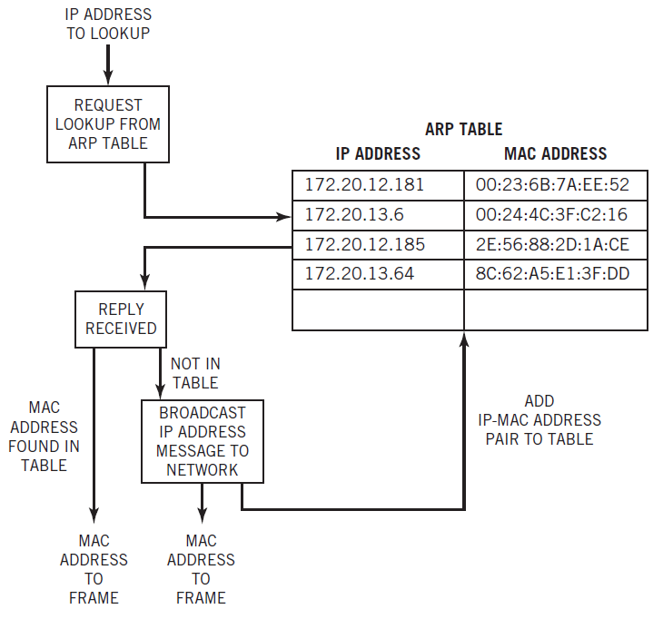
Address Resolution Protocol
Copyright 2013 John Wiley & Sons, Inc.
13-<number>

Slide 19
Internet Control Message Protocol
ICMP
  Auxiliary protocol that creates error messages for failures at the network layer
  Error code is encapsulated in an IP datagram and sent to source
  Typical messages: ‘Destination Host Unknown’, ‘Time to Live Exceeded’
  Used for queries by network tools such as ping and traceroute
Copyright 2013 John Wiley & Sons, Inc.
13-<number>

Slide 20
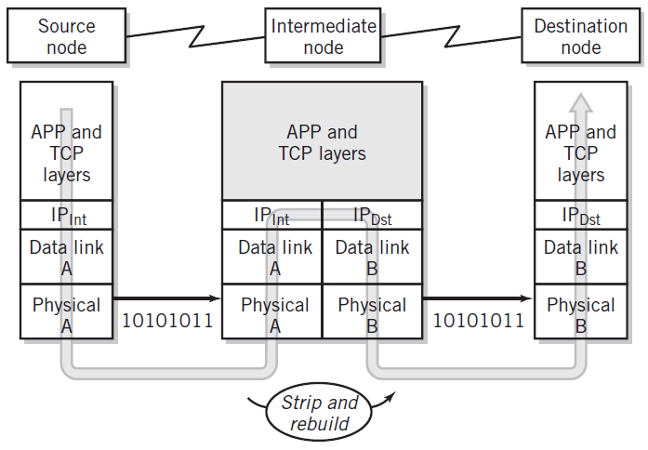
Passing a Message Through an Intermediate Node
Copyright 2013 John Wiley & Sons, Inc.
12-<number>

Slide 21
Transport Layer (Layer 4)
Provides services that support reliable end-to-end communications
Generates the final address of the destination
Responsible for all end-to-end communication facilities
Establishes connection with the destination, provides flow control, data assurance, reordering of packets, error recovery, and connection termination
Packetization of the message, breaking up of the message into packets of reasonable size, takes place at this level
Copyright 2013 John Wiley & Sons, Inc.
12-<number>

Slide 22
TCP/IP Addressing
Port Addresses (port numbers)
  Transport layer uses to identify the application that is to receive the message
  16 bits in length
  Example: port 80 is commonly used for Web services
  First 1024 numbers are called well-known ports because they are standard addresses specified for most common applications
  User defined port numbers are also available to applications
  For example, the following Web service uses the user-defined port of 8080:
  http://www.somewhere.org:8080/hiddenServer
Copyright 2013 John Wiley & Sons, Inc.
12-<number>

Slide 23
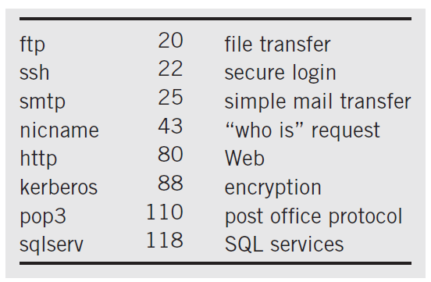
Well-Known Port Numbers
Copyright 2013 John Wiley & Sons, Inc.
12-<number>

Slide 24
Sockets
Originated with BSD UNIX
Provide an interface between the application layer and the transport layer to initiate connections and send messages through the network
Defined by source port number and IP address and the destination port number and IP address
Allows for multiple simultaneous open connections
Copyright 2013 John Wiley & Sons, Inc.
13-<number>

Slide 25
Transport Layer Protocols
TCP (Transmission Control Protocol)
  Connection-oriented, reliable delivery service
  Control packets are used to create a full duplex logical connection through handshaking
  Numbering of packets allows packets to be reassembled in order
UDP (User Datagram Protocol)
  Unreliable, connectionless service
  No acknowledgment of receipt by receiving node
  Example: streaming video
SCTP (Stream Control Transmission Protocol)
  Similar to TCP but with improved fault tolerance and ability to transport multiple messages through the same connection
Copyright 2013 John Wiley & Sons, Inc.
12-<number>

Slide 26
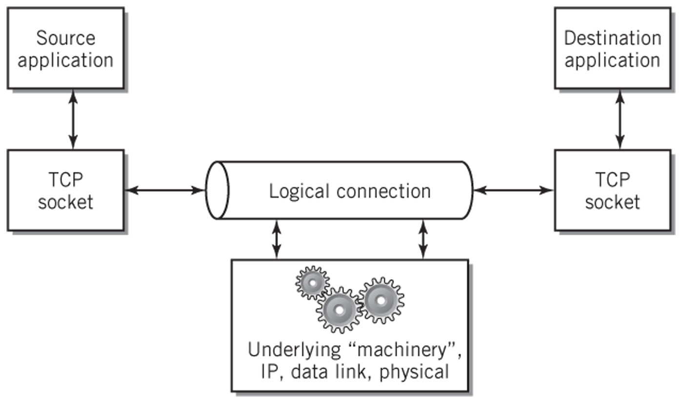
Logical Connection View of TCP
Copyright 2013 John Wiley & Sons, Inc.
12-<number>

Slide 27
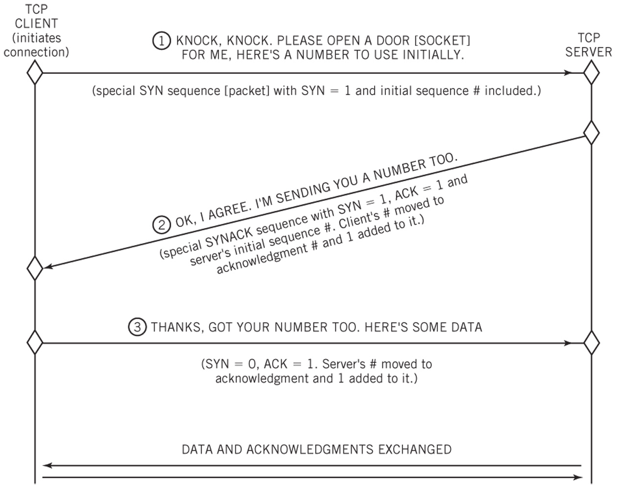
Three-Way TCP Connection Handshake
Copyright 2013 John Wiley & Sons, Inc.
13-<number>

Slide 28
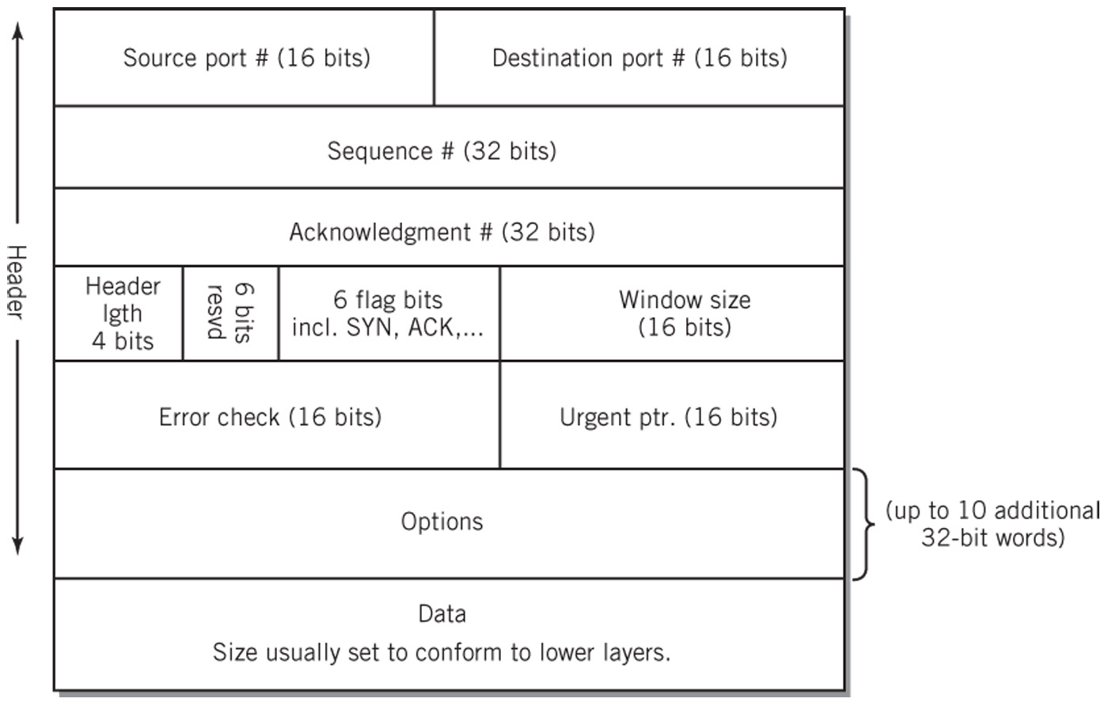
TCP Segment Format
Copyright 2013 John Wiley & Sons, Inc.
13-<number>

Slide 29
IPv4 Addresses
Registered and allocated by ICANN
32 bits long divided into 4 octets
Assigned in blocks of contiguous addresses
  Number of addresses is a power of two
  Example: 208.80.152.2 (Wikipedia’s IP address)
Divided into three levels
  Network address
  Subnetworks (subnets)
  Hosts (nodes)
Masks
  Used to separate the different parts of the address
Copyright 2013 John Wiley & Sons, Inc.
12-<number>

Slide 30
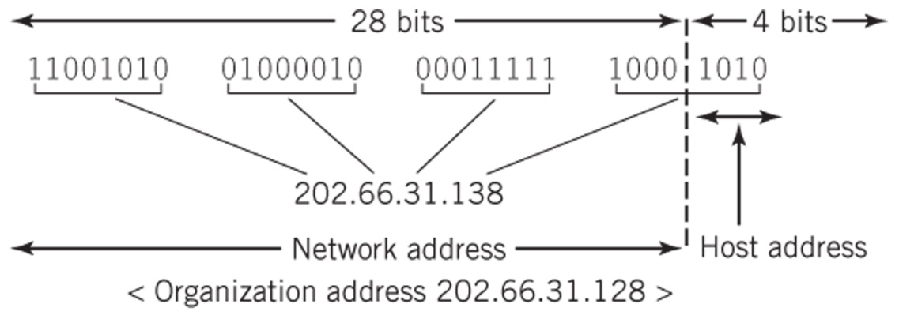
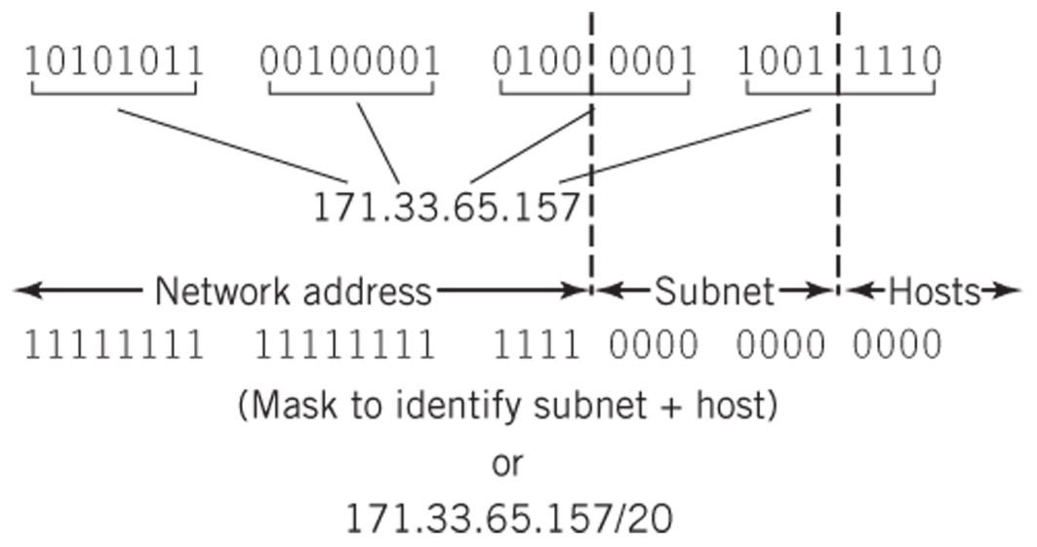
IP Addresses
IP Block Addresses
IP Hierarchy and Subnet Mask
Copyright 2013 John Wiley & Sons, Inc.
13-<number>

Slide 31
NAT and DHCP
  Two methods to distribute IP addresses more efficiently:
  Network Address Translation (NAT)
    Use of private network IP addresses behind a router
    The router must readdress traffic passing between the Internet and the local network
    Difficult with large networks
Dynamic Host Configuration Protocol (DHCP)
  Maintain a bank of available IP addresses and assign them dynamically to computers for use when the computers are attached to the network
  Method often used by large organizations, DSL, and cable providers
  DHCP client on computer or network device broadcasts a query to locate the DHCP server
  DHCP server responds with a lease that includes an IP address, domain name of network, IP address of DNS server, subnet mask, IP address of gateway, and other configuration parameters
Copyright 2013 John Wiley & Sons, Inc.
13-<number>

Slide 32
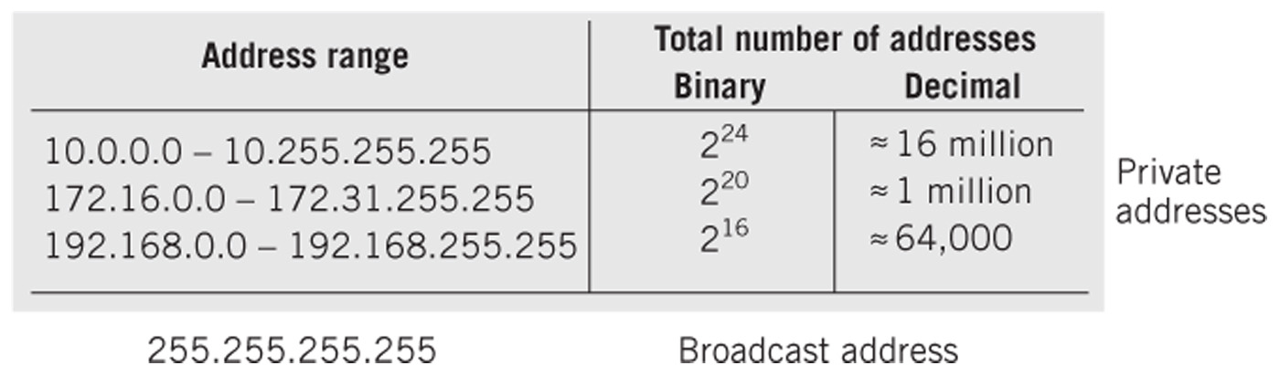
Reserved IP Addresses
Copyright 2013 John Wiley & Sons, Inc.
13-<number>

Slide 33
IPv6
Intended to eventually replace IPv4 to provide additional IP addresses
128-bit addresses arranged as eight groups of four-digit hexadecimal numbers separated by colons
Leading zeroes and zero values in one or more consecutive groups may be eliminated
Example: 2CAA:30::370:0:12AB is the same as
2CAA:0030:0000:0000:0000:0370:0000:12AB
Copyright 2013 John Wiley & Sons, Inc.
13-<number>

Slide 34
Domain Names and DNS Services
Domain Names
  Hierarchical system of network address identifiers used throughout the Internet and on local area networks, intranets and extranets
  Created so users would not have to memorize IP addresses
Domain Name System (DNS)
  Domain name resolution – translates domain names into IP addresses
  Uses a massive distributed database containing a directory system of servers
  Each entry contains a domain name and an associated IP address
Copyright 2013 John Wiley & Sons, Inc.
13-<number>

Slide 35
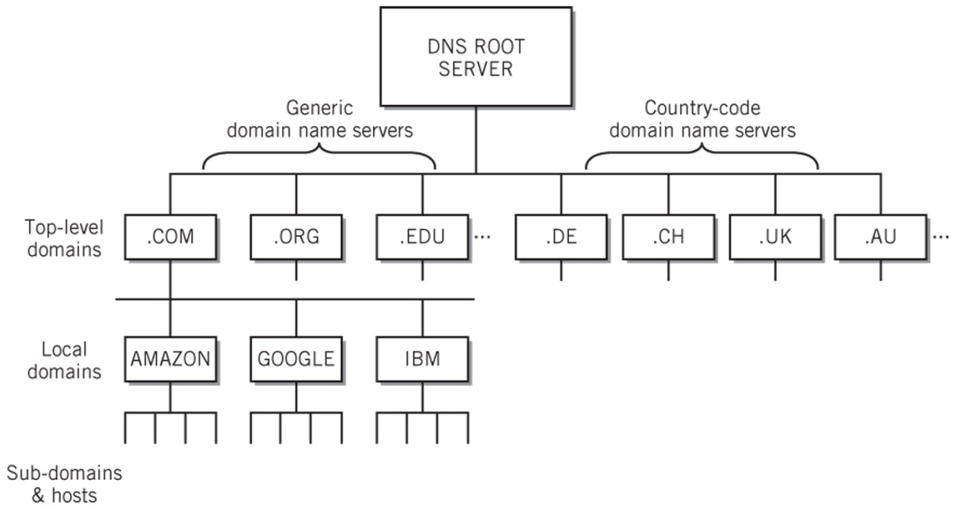
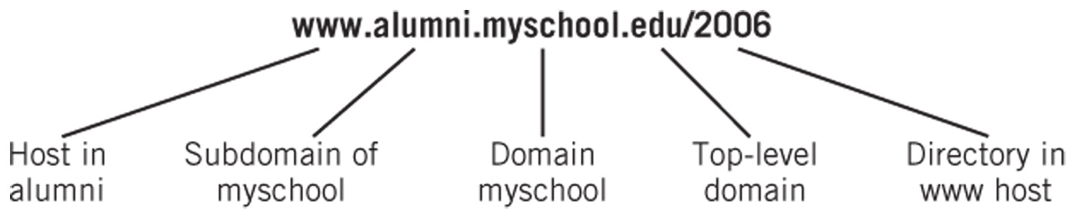
Domain Name System (DNS)
DNS Server Hierarchy
The Elements of a Domain Name
Copyright 2013 John Wiley & Sons, Inc.
13-<number>

Slide 36

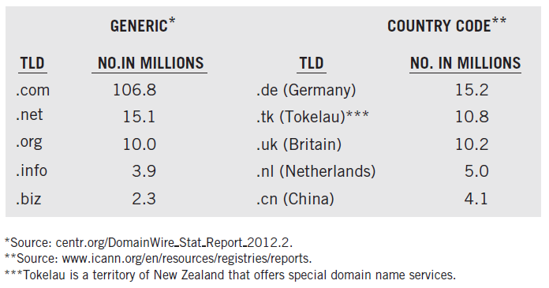
Top Domain Name Registrations
Copyright 2013 John Wiley & Sons, Inc.
13-<number>

Slide 37
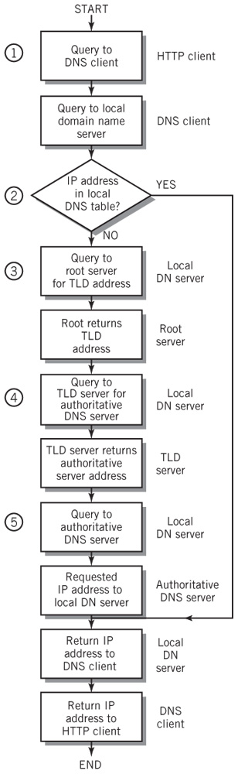
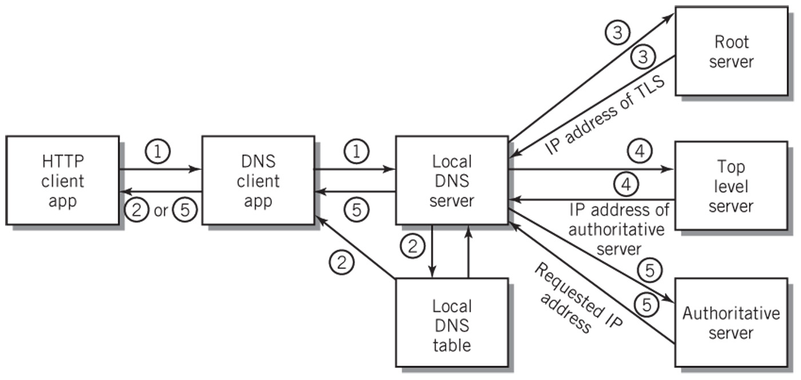
Domain Name Resolution
Copyright 2013 John Wiley & Sons, Inc.
13-<number>

Slide 38
Quality of Service (QoS)
Methods to reserve and prioritize channel capacity to favor packets that require special treatment
Service guarantees from contract carrier services that specify particular levels of throughput, delay and jitter
  Jitter – variation in delay from packet to packet
Differentiated service (DiffServ)
  8-bit (DS) field in IP header
  Set by the application at the sender or by the first node
  DiffServ capable nodes such as routers can then prioritize and route packets based on the packet class
Copyright 2013 John Wiley & Sons, Inc.
13-<number>

Slide 39
Network Security Categories
Intrusion
  Keeping network and system resources free from intruders
Confidentiality
  Keeping the content of data private
Authentication
  Verifying the identity of a source of data being received
Data integrity and non-repudiation
  Protecting the content of data communication against changes and verifying the source of the message
Assuring network availability and access control
  Keep network resources operational and restricting access to those permitted to use them
Copyright 2013 John Wiley & Sons, Inc.
13-<number>

Slide 40
Network Security
Network intrusions
  Packet sniffers read data in a packet as it passes through a network
  Probing attacks to uncover IP address / port numbers that accept data packets
Physical and Logical Access Restriction
  Limit access to wiring and network equipment
  Firewall
  Private networks
Encryption
  Symmetric key cryptography
    Both keys used for encryption and decryption
    Both sender and receiver use the same key, which makes security difficult
  Public key-private key cryptography
    Two different keys are used for encryption and decryption
Copyright 2013 John Wiley & Sons, Inc.
13-<number>

Slide 41
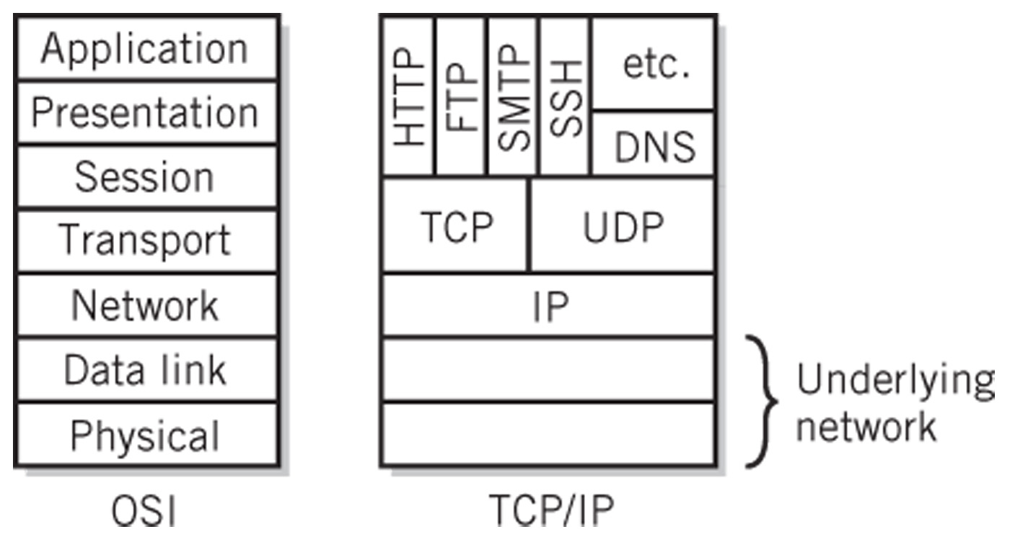
Comparison of OSI and TCP/IP
Copyright 2013 John Wiley & Sons, Inc.
12-<number>

Slide 42
OSI Session Layer
Establishes a dialogue between two cooperating applications or processes at the ends of the communication link
Responsible for
  Establishing the session between the applications
  Controlling the dialogue
  Terminating the session
Examples
  Remote login
  Print spooling to remote printer
Copyright 2013 John Wiley & Sons, Inc.
12-<number>

Slide 43
OSI Presentation Layer
Responsible for presenting data at the destination with the same meaning and appearance as it would have at the source
Provides common data conversions and transformations that allow systems with different standards to communicate
Includes services such as data compression and restoration, encryption and decryption, data reformatting, ASCII-Unicode conversion, etc.
Copyright 2013 John Wiley & Sons, Inc.
12-<number>

Slide 44
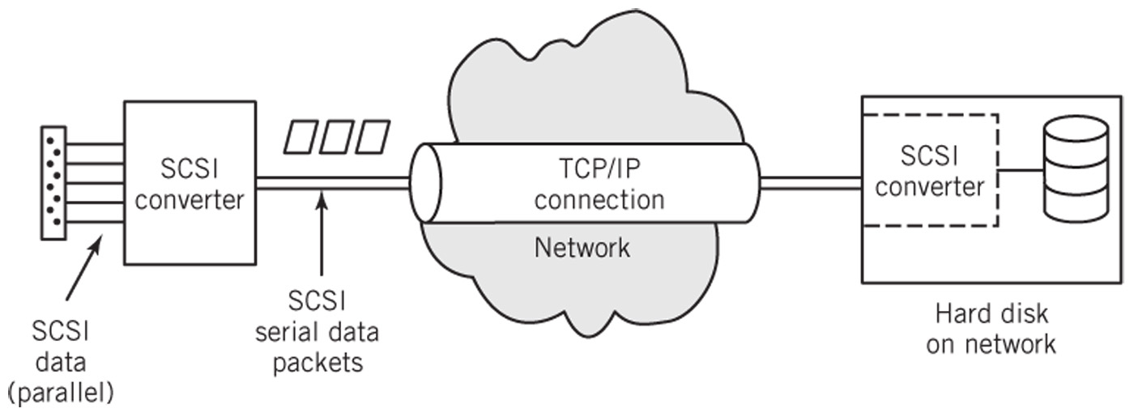
SCSI over IP
Copyright 2013 John Wiley & Sons, Inc.
12-<number>

Slide 45
Cellular Technology
May serve as Wi-Fi access points for computing devices
Provide standard TCP/IP protocol services at application, transport, and network layers
Converging to a global mobile communication standard called Long Term Evolution (4G LTE)
Requires additional protocols between data link and network layers to address handoff, movement from cell to cell
Copyright 2013 John Wiley & Sons, Inc.
13-<number>

Slide 46
Alternative Protocols
MPLS (Multi-Protocol Label Switching)
  Creates a virtual circuit over packet switched networks to improve forwarding speed of datagrams
SONET (Synchronous Optical Network) and
SDH (Synchronous Digital Hierarchy)
  Protocols that use fiber optic technology to create wide area networks with very high bit rates over long distances
Frame Relay
  Slow, wide area network standard
Copyright 2013 John Wiley & Sons, Inc.
13-<number>

Slide 47
Copyright 2013 John Wiley & Sons
All rights reserved. Reproduction or translation of this work beyond that permitted in section 117 of the 1976 United States Copyright Act without express permission of the copyright owner is unlawful. Request for further information should be addressed to the Permissions Department, John Wiley & Sons, Inc. The purchaser may make back-up copies for his/her own use only and not for distribution or resale. The Publisher assumes no responsibility for errors, omissions, or damages caused by the use of these programs or from the use of the information contained herein.
Copyright 2013 John Wiley & Sons, Inc.
13-<number>

