Slide 1
CHAPTER 15:
Operating Systems: An Overview
The Architecture of Computer Hardware, Systems Software & Networking:
An Information Technology Approach
5th Edition, Irv Englander
John Wiley and Sons ©2013
PowerPoint slides authored by Angela Clark, University of South Alabama
PowerPoint slides for the 4th edition were authored by Wilson Wong, Bentley University

Slide 2
Without an Operating System…
Program instructions must be loaded into memory by hand
No user interface except for I/O routines provided with executing program
System is idle when waiting for user input
No facility to store, retrieve, or manipulate files
No ability to control peripheral devices
Can run only one program at a time; computer halts at end of each program
Copyright 2013 John Wiley & Sons, Inc.
15-<number>

Slide 3
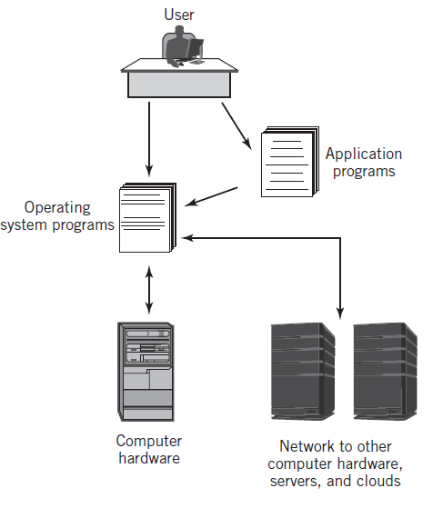
Integrated Computer Environment
Copyright 2013 John Wiley & Sons, Inc.
15-<number>

Slide 4
Definition of an Operating System
“A collection of computer programs that integrate the hardware resources of the computer and make those resources available to a user and the user’s programs, in a way that allows the user access to the computer in a productive, timely, and efficient manner.”
Copyright 2013 John Wiley & Sons, Inc.
15-<number>

Slide 5
Operating System – Basic Services
Accepts commands and requests from users and users’ programs and responds with appropriate output results
Manages, loads, and executes programs
Manages hardware resources of the computer including interfaces to networks and other external parts of the system
Note: The operating system itself consists of hundreds or thousands of programs, each specialized for particular OS tasks
Copyright 2013 John Wiley & Sons, Inc.
15-<number>

Slide 6
Concurrent Operations
Multitasking (multiprogramming)
  Use of concurrent processing to simulate simultaneous execution of multiple programs even when using only a single CPU
  Supports multiuser systems
Multiprocessing
  Actual simultaneous processing of multiple programs using either multiple CPUs or multiple CPU cores
Copyright 2013 John Wiley & Sons, Inc.
15-<number>

Slide 7
Operating System – Additional Services
Provides interfaces for the user and the user’s programs
File management and support services
I/O support services
Means of starting the computer
  Bootstrapping or booting the computer or Initial Program Load (IPL)
Handles all interrupt processing
Network services
Services to allocate resources such as memory, CPU time, and I/O devices
Security and protection services
Systems administration
Copyright 2013 John Wiley & Sons, Inc.
15-<number>

Slide 8
Operating System Components
Memory Resident
  Always loaded in memory
  Commonly called the kernel
  Contains essential services required by other parts of the operating system and applications.
  Typically responsible for managing memory, processes and tasks, and secondary storage
Memory Non-resident
  Infrequently used programs
  Software tools
  Commands
Bootstrap program
Copyright 2013 John Wiley & Sons, Inc.
15-<number>

Slide 9
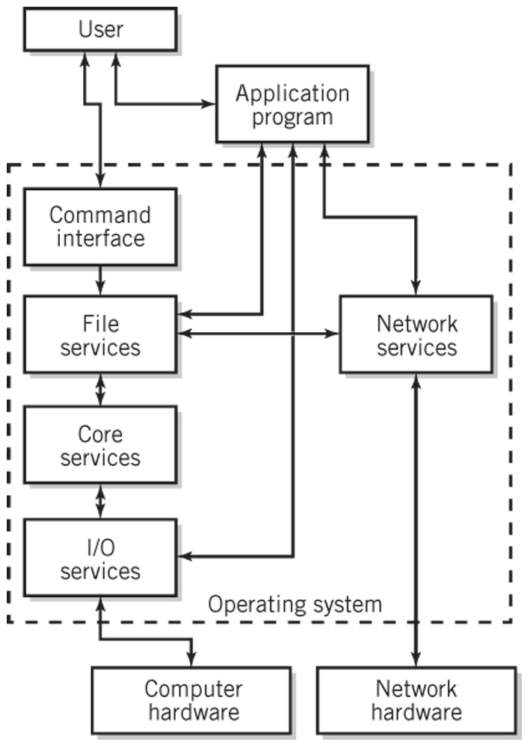
Simplified Diagram of Operating System Services
Copyright 2013 John Wiley & Sons, Inc.
15-<number>

Slide 10
General Purpose Computing Systems Categories
Single-user, single-tasking (essentially obsolete)
Single-user, multitasking
Mainframes
Operating systems for mobile devices
Distributed systems
Network servers
Embedded systems
Real-time systems
Copyright 2013 John Wiley & Sons, Inc.
15-<number>

Slide 11
OS Degree of Activity
Interactive
  Also known as conversational systems
Batch processing
  User submits programs or jobs for processing
  Little to no user interaction
Event driven
  Interrupts or service requests
Copyright 2013 John Wiley & Sons, Inc.
15-<number>

Slide 12
Hardware and the OS
A hardware platform may support a variety of operating systems
An operating system may work on a variety of platforms
A standard operating system that works on different hardware
  Provides program and file portability
  Enables user efficiency through a recognizable interface
  Is implemented through a systems programming language like C++ or Java as opposed to assembly language
Copyright 2013 John Wiley & Sons, Inc.
15-<number>

Slide 13
Services and Facilities
Command processor
File management system
I/O control system
Process control management and interprocess communication
Memory management
Scheduling system
Secondary storage management
Network management, communication support, and communication interfaces
System protection management and security
System administration
Copyright 2013 John Wiley & Sons, Inc.
15-<number>

Slide 14
User Interface and
Command Execution Services
Types of user interfaces
  CLI – Command Line Interface
  GUI – Graphical User Interface
Shell
  User interface and command processor that interacts with the kernel
  UNIX/Linux: C, Bourne, bash and Korn shells
Command Languages
  IBM Mainframes – JCL
  MS Windows – .BAT files, Windows Powershell
  UNIX/Linux – shell scripts
Copyright 2013 John Wiley & Sons, Inc.
15-<number>

Slide 15
File Management
File – logical unit of storage
Basic file management system provides
  Directory structures for each I/O device
  Tools to copy, move, store, retrieve, and manipulate files
  Information about each file in the system and the tools to access that information
  Security mechanisms to protect files and control access
Additional file management features
  Backup, emergency retrieval, and recovery
  File compression
  Journaling
  Transparent network file access
  Auditing
Copyright 2013 John Wiley & Sons, Inc.
15-<number>

Slide 16
I/O Services
Startup configuration
  IBM-type PCs use BIOS (basic input/output system)
Device drivers that implement interrupts and provide other techniques for handling I/O
Plug-and-play
Copyright 2013 John Wiley & Sons, Inc.
15-<number>

Slide 17
Process Control Management
A process is an executing program
Interprocess messaging services
  Example: a pipe in UNIX or Windows that is a temporary software connection between two programs or commands
Thread
  An individually executable part of a process
  Shares memory and other resources with other threads of the same process
Copyright 2013 John Wiley & Sons, Inc.
15-<number>

Slide 18
Memory Management
Keeps track of memory
  Identifies programs loaded into memory
  Amount of space each program uses
  Available remaining space
  Prevents programs from reading and writing memory outside of their allocated space
Maintains queues of waiting programs
Allocates memory to programs to be loaded
Deallocates a program’s memory space upon program completion
Usually implemented with virtual storage
Copyright 2013 John Wiley & Sons, Inc.
15-<number>

Slide 19
Scheduling
High-level scheduling
  Placed in queue based on level of priority and eventually executed
Dispatching
  Actual selection of process(es) that will be executed at any given time
  Nonpreemptive: program voluntarily gives up control
  Preemptive: uses clock interrupt for multitasking
Context switching
  Transfer control to the process that is being dispatched
Processing requirements: CPU vs. I/O bound
Copyright 2013 John Wiley & Sons, Inc.
15-<number>

Slide 20
Achieving Multitasking
While one program is waiting for I/O to take place, another program is using the CPU to execute instructions
Time-slicing
  The CPU may be switched rapidly back and forth between different programs
Dispatcher
  is activated by I/O operation or real time clock interrupt
  selects next process to run
Copyright 2013 John Wiley & Sons, Inc.
15-<number>

Slide 21
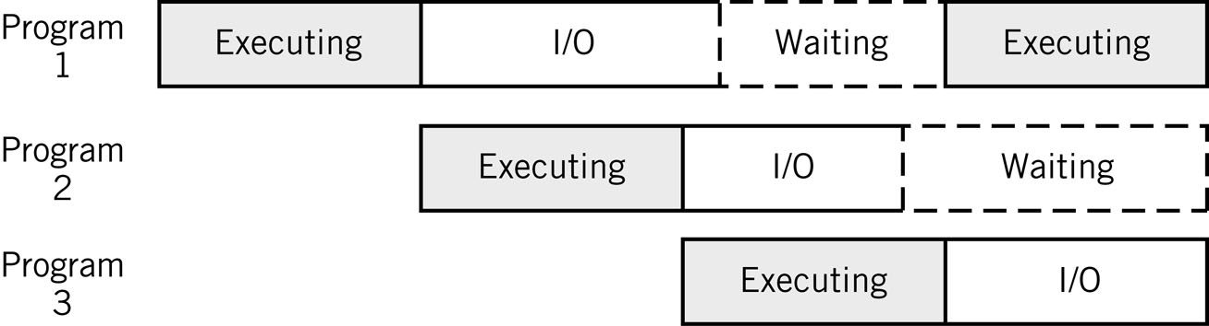
Sharing the CPU during I/O Breaks
I/O represents a large percentage of a typical program’s execution
Copyright 2013 John Wiley & Sons, Inc.
15-<number>

Slide 22
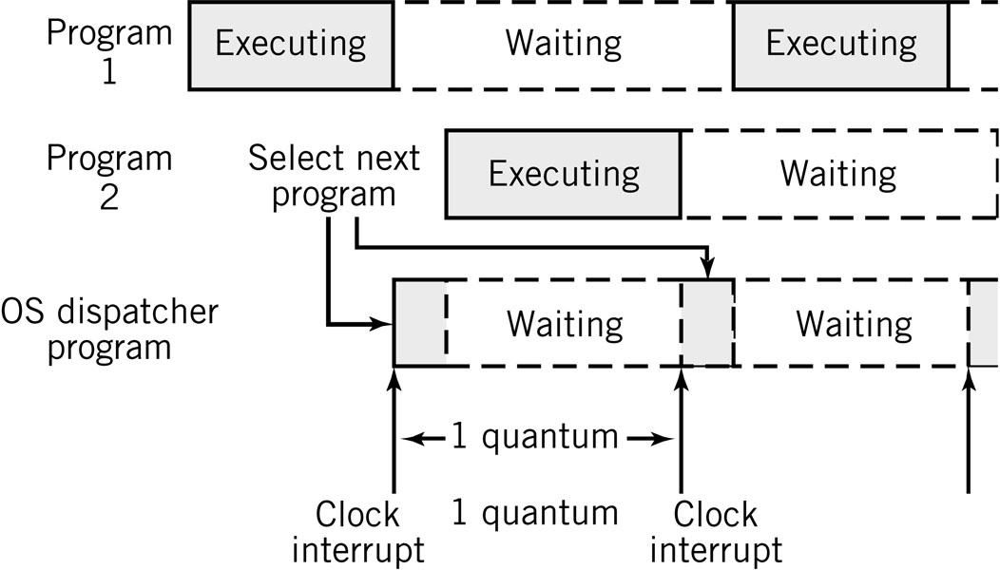
Time-sharing the CPU
Time slicing
Copyright 2013 John Wiley & Sons, Inc.
15-<number>

Slide 23
Secondary Storage Management
Keeps track of free secondary storage space
Maintains file system and directories
Optimizes completion of I/O tasks for efficient disk usage
Combination of hardware and software
Copyright 2013 John Wiley & Sons, Inc.
15-<number>

Slide 24
Network and Communication Services
TCP/IP protocol suite
  Locate and connect to other computers
  Pass application data in packets to other systems
  Access files, I/O devices, and programs from remote systems
  Support distributed processing
Network Applications
  Email, remote login, Web services, streaming multimedia, voice over IP telephony, VPN
Communication services
  Interface between communication software and OS I/O control system that provides network access
Copyright 2013 John Wiley & Sons, Inc.
15-<number>

Slide 25
Security and Protection Services
Protect OS from user processes
Protect processes from each other
Protect processes from outside world
Prevent unauthorized entry to system
Prevent unauthorized system use by authorized users
Copyright 2013 John Wiley & Sons, Inc.
15-<number>

Slide 26
System Administration Support
System configuration and setting group configuration policies
Adding and deleting users
Controlling and modifying user privileges
System security
Files systems management
Network administration
Backups
Software installations and upgrades
OS installations (system generation), patches, and upgrades
System tuning and optimization
Monitoring performance
Recovering lost data
Copyright 2013 John Wiley & Sons, Inc.
15-<number>

Slide 27
Systems Tools Examples
IBM z/OS
  sysgen: reconfiguration to incorporate new equipment
  Workload Manager: optimize system resources automatically
Unix/Linux
  superuser: system administrator account with privileges to override all restrictions and security built into the system
  adduser: administer user accounts
  mount/umount: mount and unmount a file system
  fsck: check and repair a file system
  ufsdump/ufsrestore: create and restore backups
Windows
  Control panel
  Task manager (Ctrl-Alt-Del menu)
Copyright 2013 John Wiley & Sons, Inc.
15-<number>

Slide 28
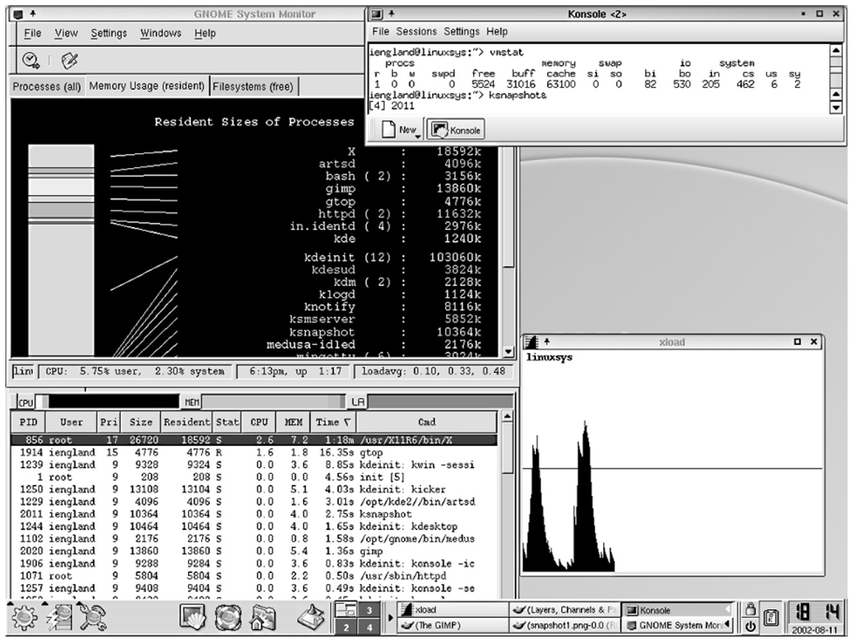
Typical System Status Report
Copyright 2013 John Wiley & Sons, Inc.
15-<number>

Slide 29
OS Configurations
Three main configurations for the organization of an operating system
  Monolithic configuration
    Unix/Linux
  Hierarchical (layered) configuration
    Multics
    Windows 2000 and later versions (approximately hierarchical)
  Microkernel
    Macintosh OS X
Copyright 2013 John Wiley & Sons, Inc.
15-<number>

Slide 30
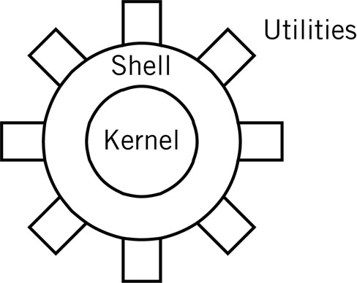
Monolithic Kernel
Drawback: stability and integrity must be managed carefully
Examples: UNIX, Linux
Copyright 2013 John Wiley & Sons, Inc.
15-<number>

Slide 31
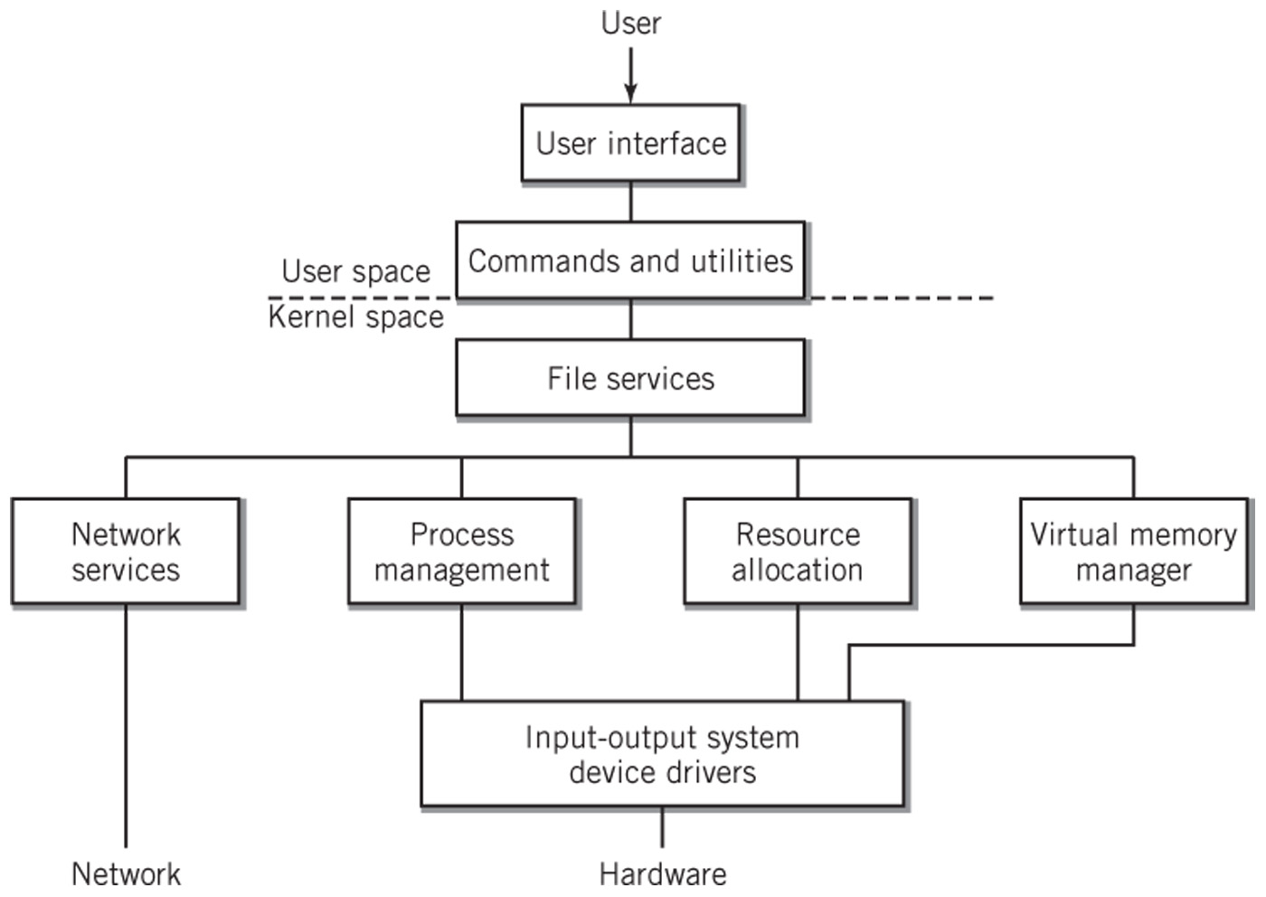
Hierarchical Model of an OS
Each layer is independent of the other layers
Requests are passed down to the layer immediately below it
Copyright 2013 John Wiley & Sons, Inc.
15-<number>

Slide 32
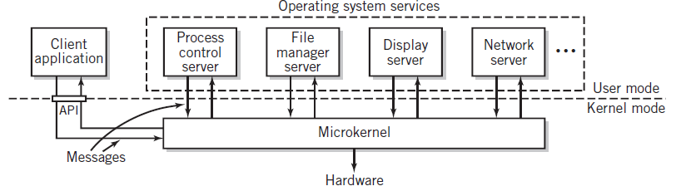
Microkernel
Minimum essential functionality
Client-server system on same system
  Clients request services from microkernel, which passes message onto appropriate server
Copyright 2013 John Wiley & Sons, Inc.
15-<number>

Slide 33
Seven Types of Operating Systems
Single-user systems and workstations
  Predominant systems in use
  Laptop and desktop computers and workstations
  Macintosh OSX, versions of Windows, Linux, and Sun Solaris
Mobile operating systems
  Designed for small hand-held devices such as smartphones
  Features of single-user multitasking systems but with constraints on memory, storage, CPU execution speed, and electrical power
  Touch screen capability, special keyboard handling, GPS, handwriting ,and voice recognition
  IOS, Android, E-readers, tablets
Copyright 2013 John Wiley & Sons, Inc.
15-<number>

Slide 34
Seven Types of Operating Systems
Mainframe systems
  Designed to manage large scale computing resources
  Extensive I/O capability to handle large numbers of transactions
  Support batch data processing operations, cloud computing and large Web services and database processing
  Consists of clusters made up of multiprocessor units
Network servers
  Focused on supporting clients connected to the server
  We services, file services, print services, application services, and/or database services to clients
  Improved security, high reliability, backup facilities
Copyright 2013 John Wiley & Sons, Inc.
15-<number>

Slide 35
Seven Types of Operating Systems
Real-time systems
  One or more processes must be able to access the operating system immediately
  Multitasking system where the real-time program’s interrupts have very high priority
  Examples
    Air controller systems, rocket propulsion control systems, car brakes
Embedded control systems
  Specialized systems designed to control a single piece of equipment such as an automobile or a microwave oven
  Software is usually provided in ROM
  Real-time system dedicated to the particular application
  Example: General Motors Delphi system
Copyright 2013 John Wiley & Sons, Inc.
15-<number>

Slide 36
Seven Types of Operating Systems
Distributed systems
  Growing in prominence and importance
  Processing power distributed among computers in a cluster or network
  Program components may be stored on different systems and executed upon request using .NET and CORBA standards
  Example: Distributed Computing Environment (DCE)
Copyright 2013 John Wiley & Sons, Inc.
15-<number>

Slide 37
Copyright 2013 John Wiley & Sons
All rights reserved. Reproduction or translation of this work beyond that permitted in section 117 of the 1976 United States Copyright Act without express permission of the copyright owner is unlawful. Request for further information should be addressed to the Permissions Department, John Wiley & Sons, Inc. The purchaser may make back-up copies for his/her own use only and not for distribution or resale. The Publisher assumes no responsibility for errors, omissions, or damages caused by the use of these programs or from the use of the information contained herein.
Copyright 2013 John Wiley & Sons, Inc.
15-<number>

