Slide 1
CHAPTER 8: CPU and Memory
Design, Enhancement, and Implementation
The Architecture of Computer Hardware, Systems Software & Networking:
An Information Technology Approach
5th Edition, Irv Englander
John Wiley and Sons ©2013
PowerPoint slides authored by Angela Clark, University of South Alabama
PowerPoint slides for the 4th edition were authored by Wilson Wong, Bentley University

Slide 2
Current CPU Architectures
Current CPU Architecture Designs
  Traditional modern architectures
  Complex Instruction Set Computers (CISC)
  Reduced Instruction Set Computers (RISC)
Current CPU Architectures
  IBM Mainframe series
  Intel x86 family
  IBM POWER/PowerPC family
  ARM architecture
  Oracle SPARC family
Copyright 2013 John Wiley & Sons, Inc.
8-<number>

Slide 3
Traditional Modern Architectures
Problems with early CPU Architectures and solutions:
Large number of specialized instructions were rarely used but added hardware complexity and slowed down other instructions
Slow data memory accesses could be reduced by increasing the number of general purpose registers
Using general registers to hold addresses could reduce the number of addressing modes and simplify architecture design
Fixed-length, fixed-format instruction words would allow instructions to be fetched and decoded independently and in parallel
Copyright 2013 John Wiley & Sons, Inc.
8-<number>

Slide 4
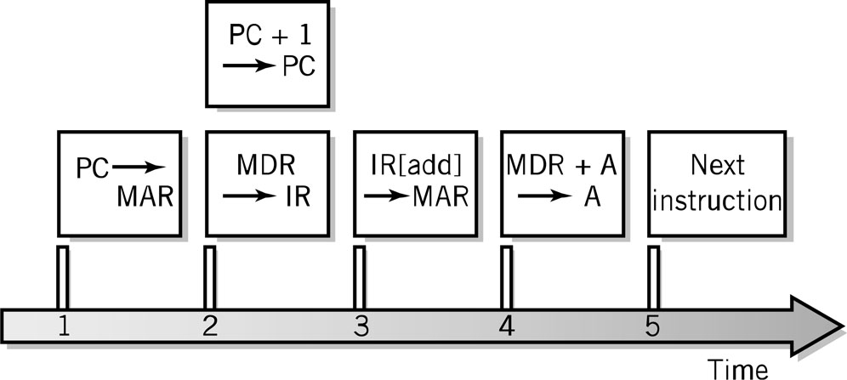
Fetch-Execute Cycle Timing Issues
Computer clock is used for timing purposes for each step of the instruction cycle
GHz (gighertz) – billion steps per second
Instructions can (and often) take more than one step
Data word width can require multiple steps
Fetch-execute timing diagram
Copyright 2013 John Wiley & Sons, Inc.
8-<number>

Slide 5
CPU Features and Enhancements
Separate Fetch/Execute Units
Pipelining
Multiple, Parallel Execution Units
Scalar Processing
Superscalar Processing
Branch Instruction Processing
Copyright 2013 John Wiley & Sons, Inc.
8-<number>

Slide 6
Separate Fetch-Execute Units
Fetch Unit
  Instruction fetch unit
  Instruction decode unit
    Determine opcode
    Identify type of instruction and operands
  Several instructions are fetched in parallel and held in a buffer until decoded and executed
  Instruction Pointer (IP) register holds instruction location of current instruction being processed
Execution Unit
  Receives instructions from the decoder unit
  Appropriate execution unit services the instruction
Copyright 2013 John Wiley & Sons, Inc.
8-<number>

Slide 7
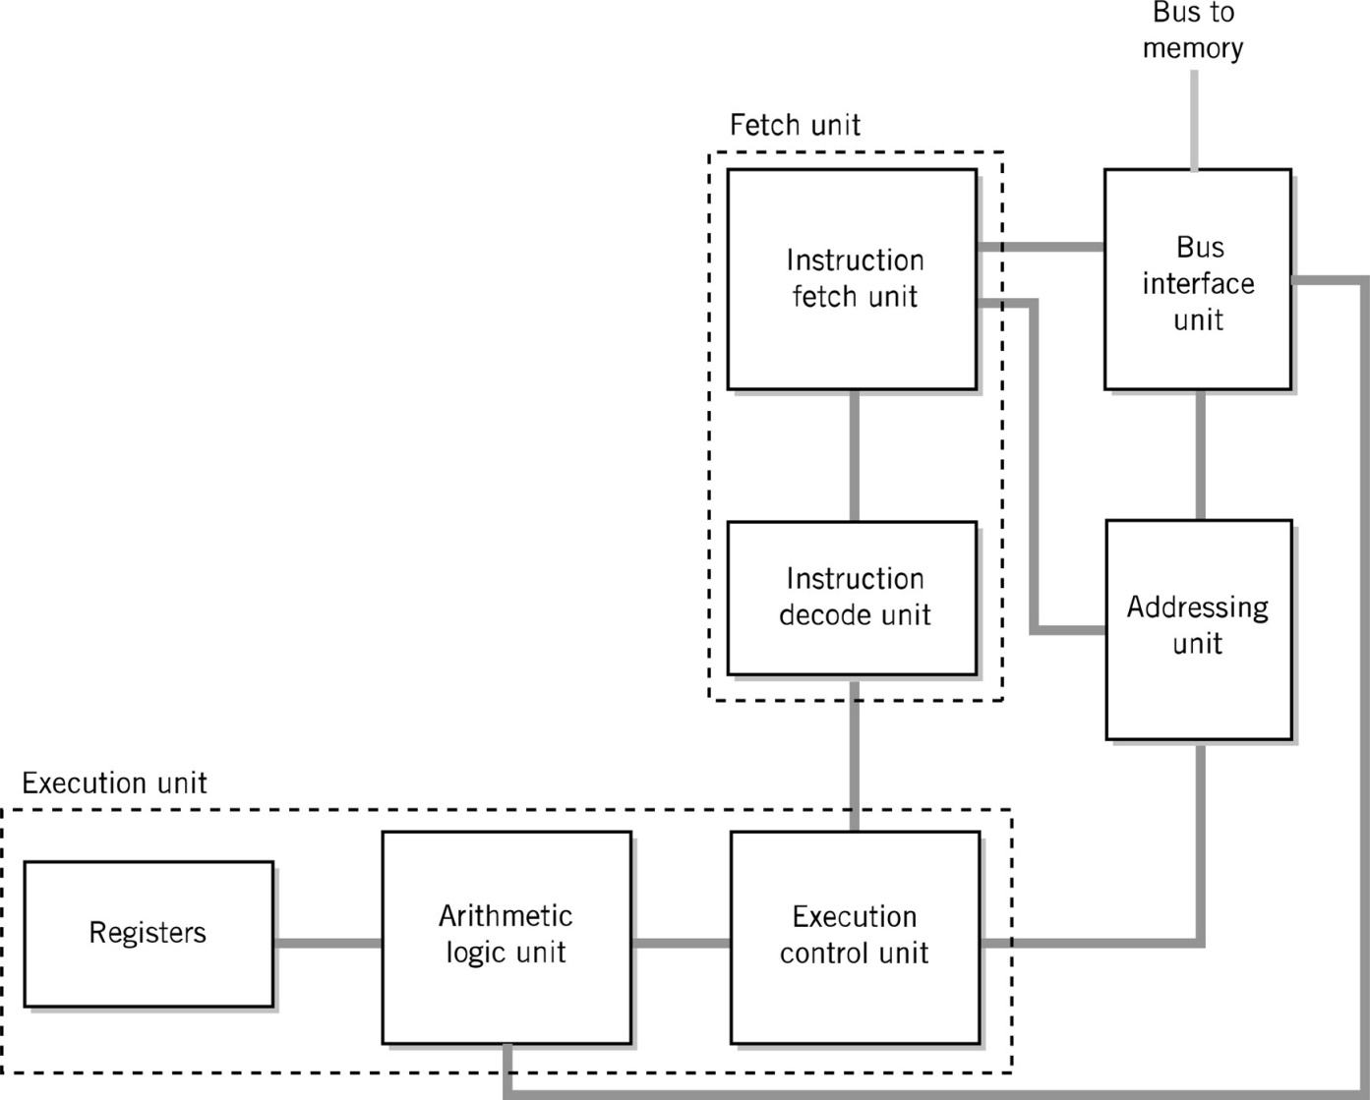
Alternative CPU Organization
Copyright 2013 John Wiley & Sons, Inc.
8-<number>

Slide 8
Instruction Pipelining
Assembly line technique to allow overlapping between fetch-execute cycles of sequences of instructions
Scalar processing
  Average instruction execution is approximately equal to the clock speed of the CPU
Problems from stalling
  Instructions have different numbers of steps
Problems from branching
Copyright 2013 John Wiley & Sons, Inc.
8-<number>

Slide 9
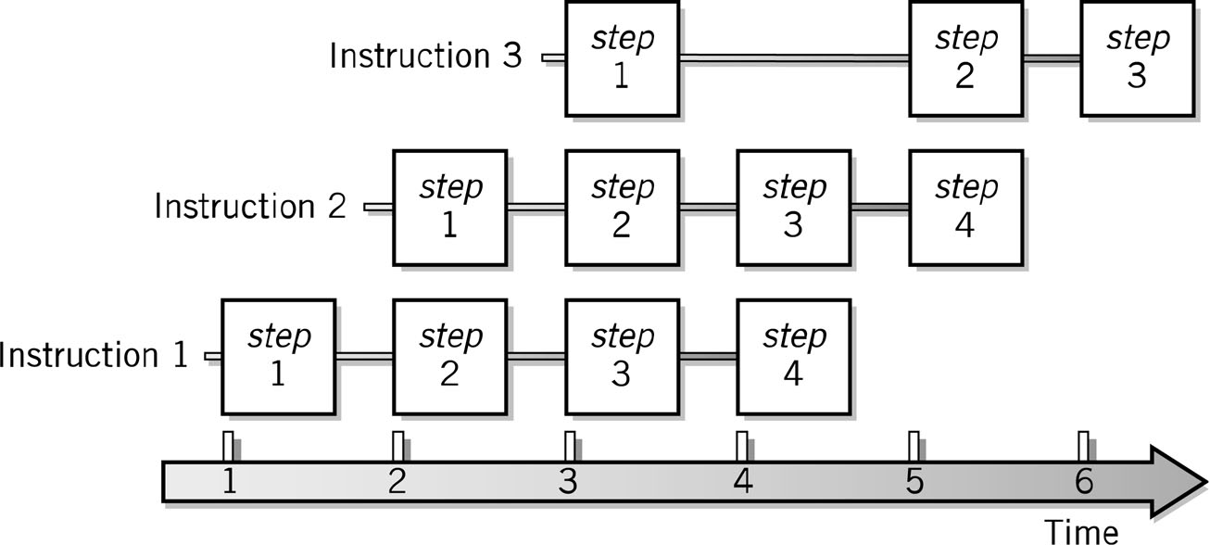
Pipelining Example
Copyright 2013 John Wiley & Sons, Inc.
8-<number>

Slide 10
Branch Problem Solutions
Separate pipelines for both possibilities
Probabilistic approach
Requiring the following instruction to not be dependent on the branch
Instruction reordering (superscalar processing)
Copyright 2013 John Wiley & Sons, Inc.
8-<number>

Slide 11
Multiple, Parallel Execution Units
Different instructions have different numbers of steps in their cycle
Differences in each step
Each execution unit is optimized for one general type of instruction
Multiple execution units permit simultaneous execution of several instructions
Copyright 2013 John Wiley & Sons, Inc.
8-<number>

Slide 12
Superscalar Processing
Process more than one instruction per clock cycle
Separate fetch and execute cycles as much as possible
Buffers for fetch and decode phases
Parallel execution units
Copyright 2013 John Wiley & Sons, Inc.
8-<number>

Slide 13
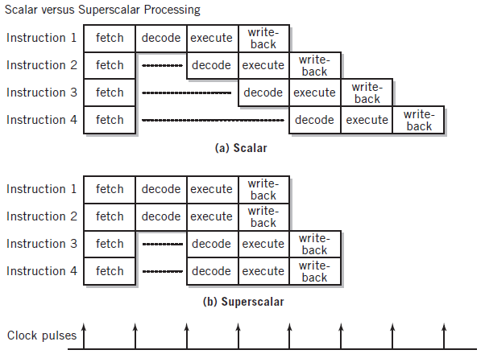
Scalar vs. Superscalar Processing
Copyright 2013 John Wiley & Sons, Inc.
8-<number>

Slide 14
Superscalar Issues
Out-of-order processing – dependencies (hazards)
Data dependencies
Control dependencies – flow or branch dependencies
Parallel speculative execution or branch prediction
  Branch History Table to aid in branch prediction
Register access conflicts
  Rename or logical registers, register alias tables
Copyright 2013 John Wiley & Sons, Inc.
8-<number>

Slide 15
Memory Enhancements
Memory is slow compared to CPU processing speeds
  2Ghz CPU = 1 cycle in ½ of a billionth of a second
  70ns DRAM = 1 access in 70 millionth of a second
Methods to improvement memory accesses
  Wide Path Memory Access
    Retrieve multiple bytes instead of 1 byte at a time
  Memory Interleaving
    Partition memory into subsections, each with its own address register and data register
  Cache Memory
Copyright 2013 John Wiley & Sons, Inc.
8-<number>

Slide 16
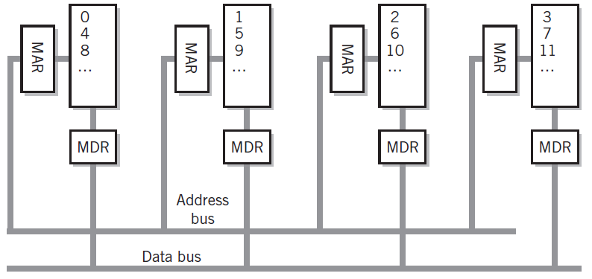
Memory Interleaving
Copyright 2013 John Wiley & Sons, Inc.
8-<number>

Slide 17
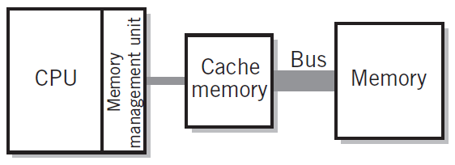
Cache Memory
Blocks: between 8 and 64 bytes
Cache Line
  Unit of transfer between storage and cache memory
Tags: pointer to location in main memory
Cache controller
  Hardware that checks tags to determine if in cache
Hit Ratio: ratio of hits out of total requests
Synchronizing cache and memory
  Write through
  Write back
Copyright 2013 John Wiley & Sons, Inc.
8-<number>

Slide 18
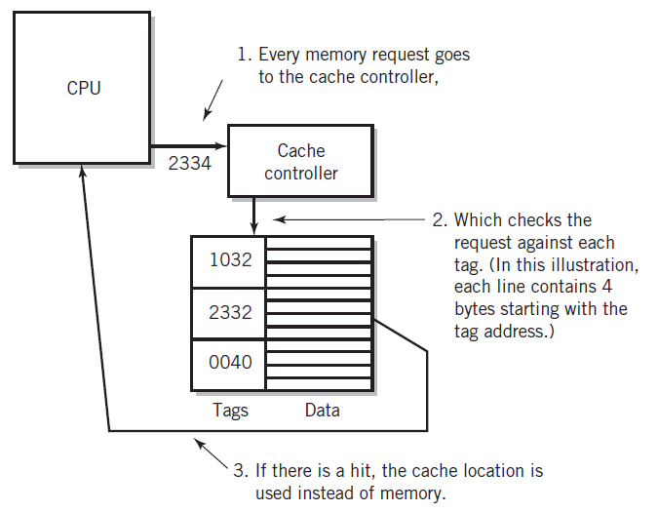
Step-by-Step Use of Cache
Copyright 2013 John Wiley & Sons, Inc.
8-<number>

Slide 19
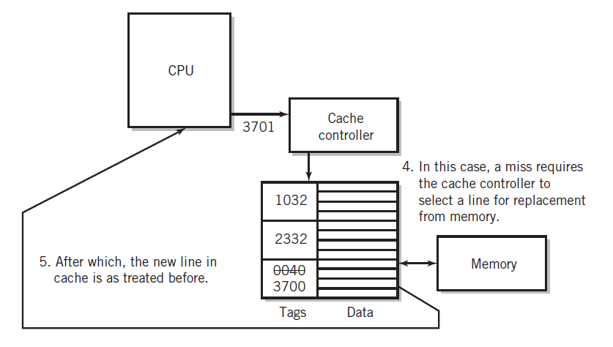
Step-by-Step Use of Cache
Copyright 2013 John Wiley & Sons, Inc.
8-<number>

Slide 20
Performance Advantages
Hit ratios of 90% and above are common
50%+ improved execution speed
Locality of reference is why caching works
  Most memory references confined to small region of memory at any given time
  Well-written program in small loop, procedure, or function
  Data likely in array
  Variables stored together
Copyright 2013 John Wiley & Sons, Inc.
8-<number>

Slide 21
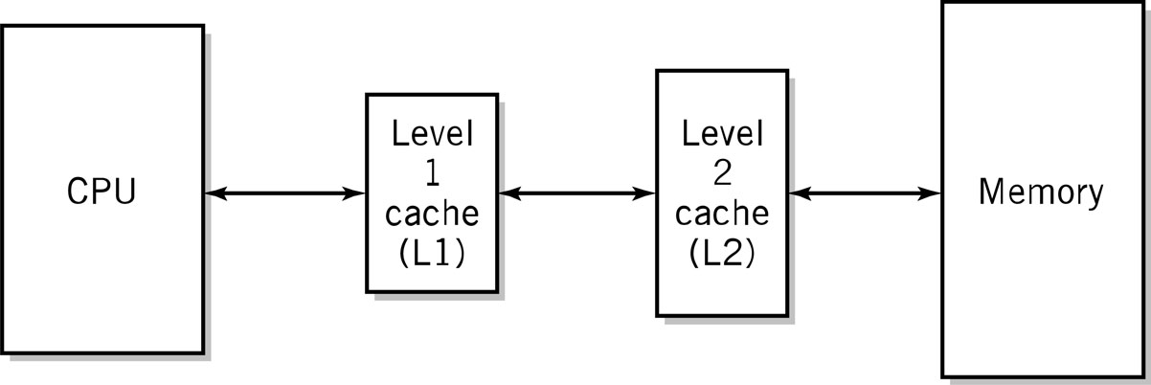
Two-Level Caches
Why do the sizes of the caches have to be different?
Copyright 2013 John Wiley & Sons, Inc.
8-<number>

Slide 22
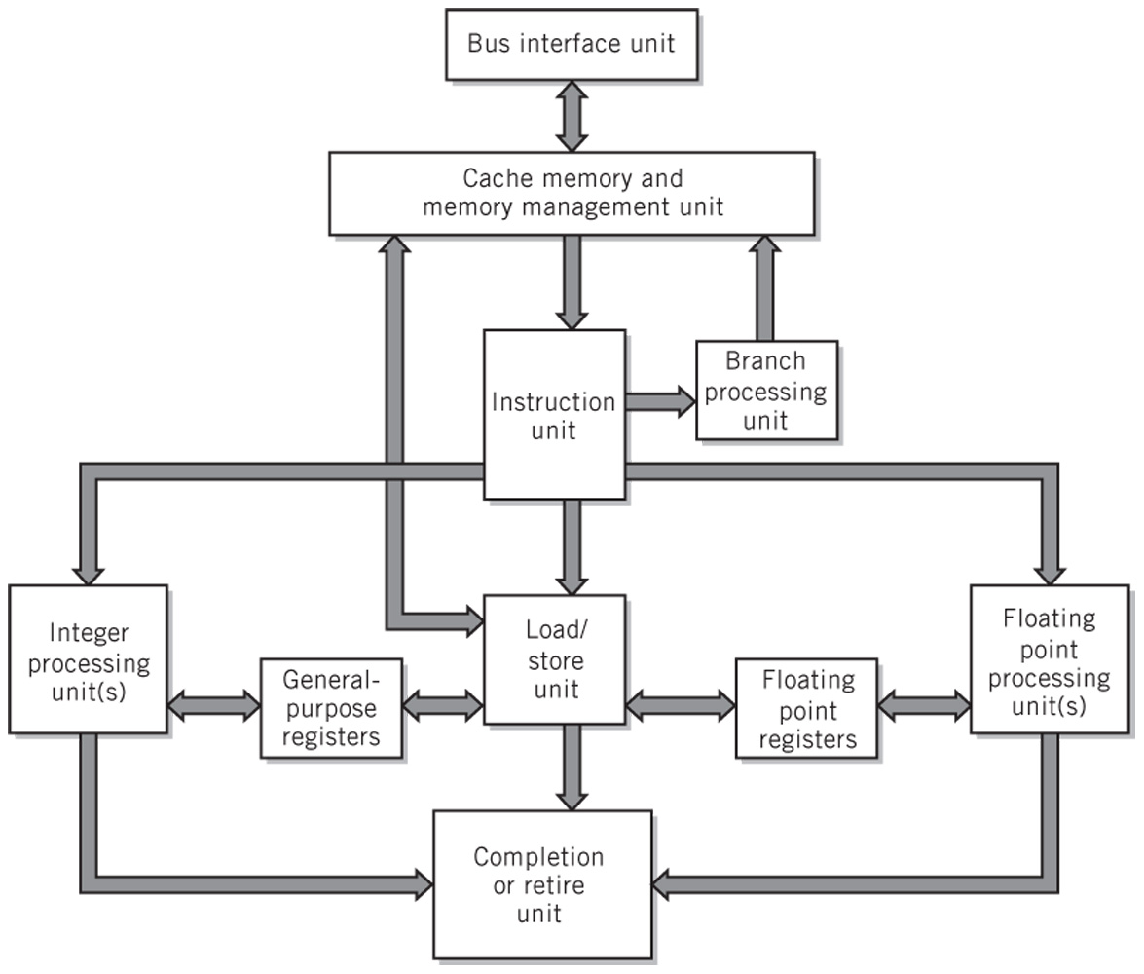
Modern CPU Block Diagram
Copyright 2013 John Wiley & Sons, Inc.
8-<number>

Slide 23
Multiprocessing
Reasons
  Increase the processing power of a system
  Parallel processing through threads: independent segments of a program that can be executed concurrently
Multiprocessor system
  Tightly coupled
  Multicore processors—when CPUs are on a single integrated circuit
Copyright 2013 John Wiley & Sons, Inc.
8-<number>

Slide 24
Multiprocessor Systems
Identical access to programs, data, shared memory, I/O, etc.
Easily extends multi-tasking and redundant program execution
Two ways to configure
  Master-slave multiprocessing
  Symmetrical multiprocessing (SMP)
Copyright 2013 John Wiley & Sons, Inc.
8-<number>

Slide 25
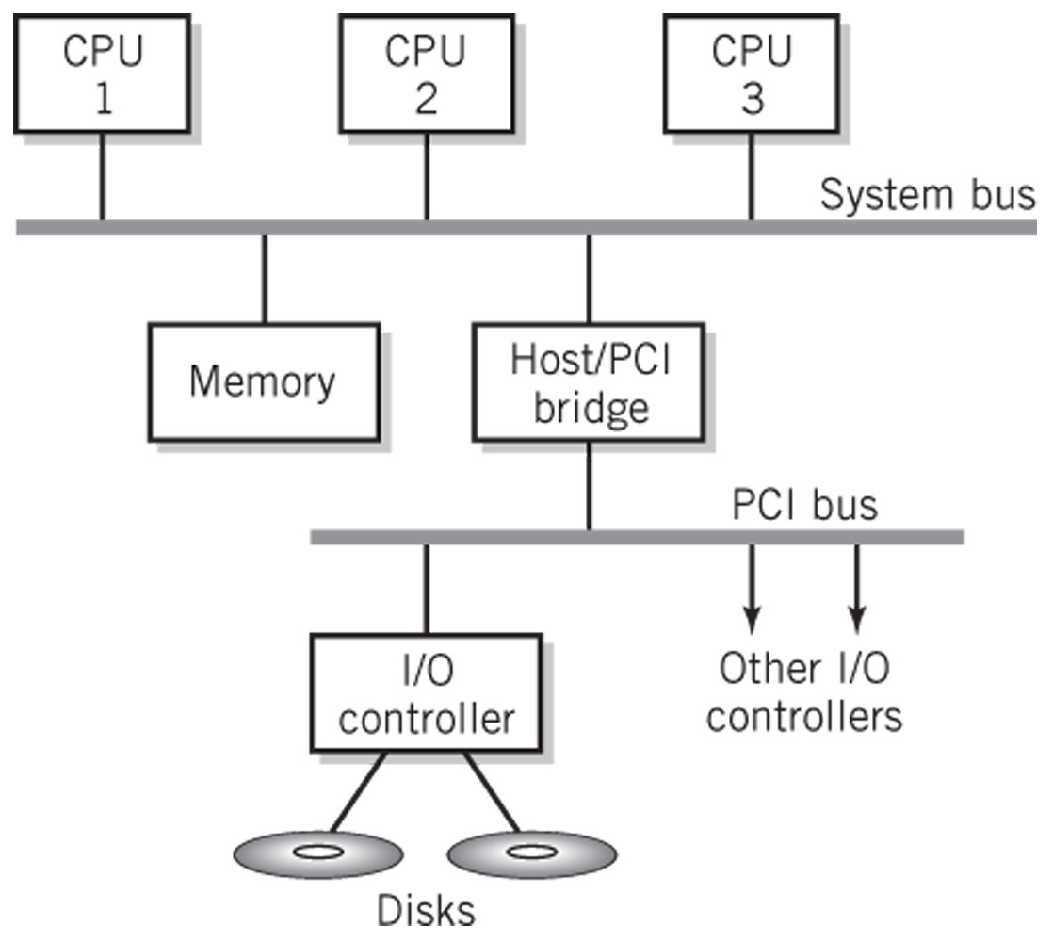
Typical Multiprocessing System Configuration
Copyright 2013 John Wiley & Sons, Inc.
8-<number>

Slide 26
Master-Slave Multiprocessing
Master CPU
  Manages the system
  Controls all resources and scheduling
  Assigns tasks to slave CPUs
Advantages
  Simplicity
  Protection of system and data
Disadvantages
  Master CPU becomes a bottleneck
  Reliability issues—if master CPU fails entire system fails
Copyright 2013 John Wiley & Sons, Inc.
8-<number>

Slide 27
Symmetrical Multiprocessing
Each CPU has equal access to resources
Each CPU determines what to run using a standard algorithm
Disadvantages
  Resource conflicts: memory, I/O, etc.
  Complex implementation
Advantages
  High reliability
  Fault tolerant support is straightforward
  Balanced workload
Copyright 2013 John Wiley & Sons, Inc.
8-<number>

Slide 28
Copyright 2013 John Wiley & Sons
All rights reserved. Reproduction or translation of this work beyond that permitted in section 117 of the 1976 United States Copyright Act without express permission of the copyright owner is unlawful. Request for further information should be addressed to the Permissions Department, John Wiley & Sons, Inc. The purchaser may make back-up copies for his/her own use only and not for distribution or resale. The Publisher assumes no responsibility for errors, omissions, or damages caused by the use of these programs or from the use of the information contained herein.
Copyright 2013 John Wiley & Sons, Inc.
8-<number>

