Slide 1

Sentiment Analysis of Bank Customer Reviews using Bidirectional Encoder Representations from Transformer
Thanapoom Phatthanaphan
Deep Learning, Computer Science Department
Stevens Institute of Technology

Slide 2

Project Member
Thanapoom Phatthanphan
CWID 20011296
Degree Master’s Degree in Computer Science
Sentiment Analysis of Bank Customer Reviews using Bidirectional Encoder Representations from Transformer

Slide 3
Overview
Dataset & Tools
Implementation
Results
Conclusion
Overview of the project
Problem: Manually read and classify good or bad reviews take a lot of time
(Impossible to review a large dataset)
Build a Sentiment analysis system using Bidirectional Encoder Representations from Transformer (BERT) to analyze bank customer reviews to accurately and efficiently classify more than 10,000 recent customer reviews from 48 US banks as either positive or negative.
Steps of implementation
Raw data
Training data
Import data
Preprocessing
Text encodings
Models training
(BERT)
Evaluation
Classification
Validation
Test data
Validation data
Sentiment Analysis of Bank Customer Reviews using Bidirectional Encoder Representations from Transformer

Slide 4
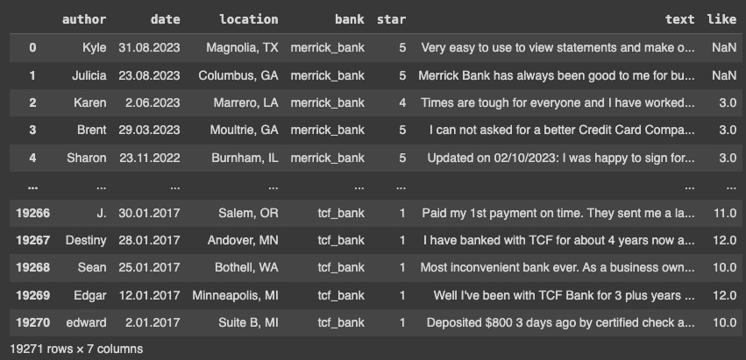
Overview
Dataset & Tools
Implementation
Results
Conclusion
Dataset
More than 10,000 recent customer reviews from 48 US Banks
(Data from 2017-2023)
Public dataset
https://www.kaggle.com/datasets/trainingdatapro/20000-customers-reviews-on-banks/data
19271 Reviews
Sentiment Analysis of Bank Customer Reviews using Bidirectional Encoder Representations from Transformer

Slide 5







Overview
Dataset & Tools
Implementation
Results
Conclusion
Data handling
Plotting
Statistical modelling
Deep Learning implementation (BERT for this project)
Sentiment Analysis of Bank Customer Reviews using Bidirectional Encoder Representations from Transformer

Slide 6
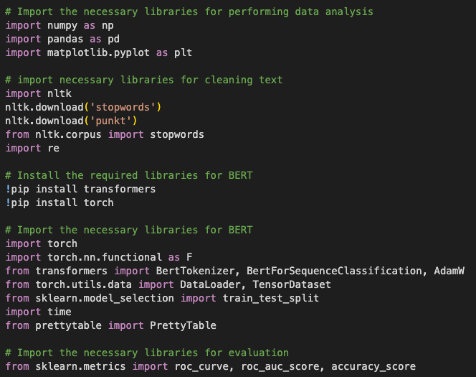
Overview
Dataset & Tools
Implementation
Results
Conclusion
1. Importing the libraries
Data handling & plotting the graph
Text cleaning for
data preprocessing
Implementation the BERT model
Evaluation
Sentiment Analysis of Bank Customer Reviews using Bidirectional Encoder Representations from Transformer

Slide 7
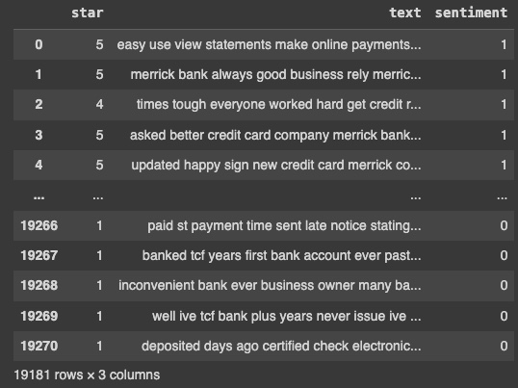
Overview
Dataset & Tools
Implementation
Results
Conclusion
2. Data preprocessing
- Define 4-5 stars as 1 (positive reviews), and 1-3 stars as 0 (Negative reviews) in ”Sentiment” column
- Remove punctuation, numbers, and stopwords
- Convert into lowercase
19181 Reviews (After cleaning)
Sentiment Analysis of Bank Customer Reviews using Bidirectional Encoder Representations from Transformer

Slide 8

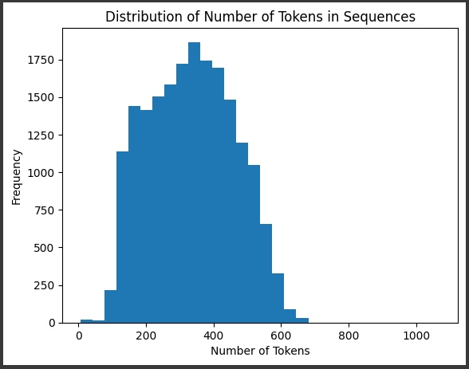
Overview
Dataset & Tools
Implementation
Results
Conclusion
2. Data preprocessing
Data statistics
Most of the reviews have 200-400 tokens
Avg. for positive: 212
Avg. for negative: 349
I will define the maximum sequence length for BERT implementation at 256
(Not too short and too long)
Sentiment Analysis of Bank Customer Reviews using Bidirectional Encoder Representations from Transformer

Slide 9
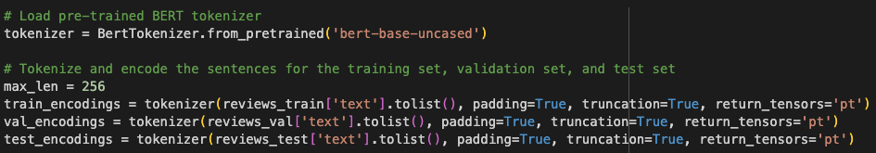
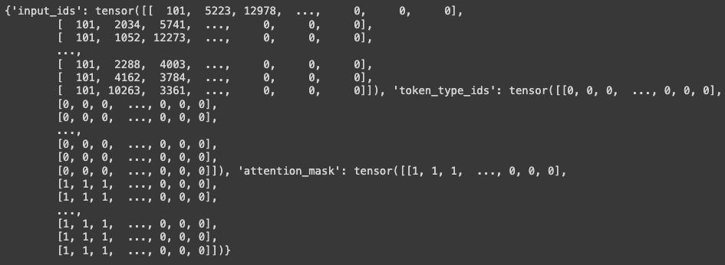
Overview
Dataset & Tools
Implementation
Results
Conclusion
3. Splitting dataset & Encoding the text
Inputs
Labels
80%: Training dataset
10%: Validation dataset
10%: Test dataset
Encodings using pre-trained BERT tokenizer (Padding & Truncation with the maximum length at 256)
Sentiment Analysis of Bank Customer Reviews using Bidirectional Encoder Representations from Transformer

Slide 10
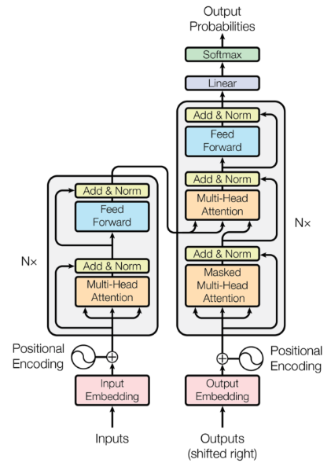
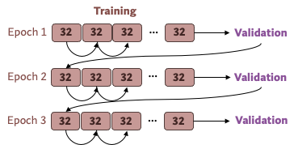
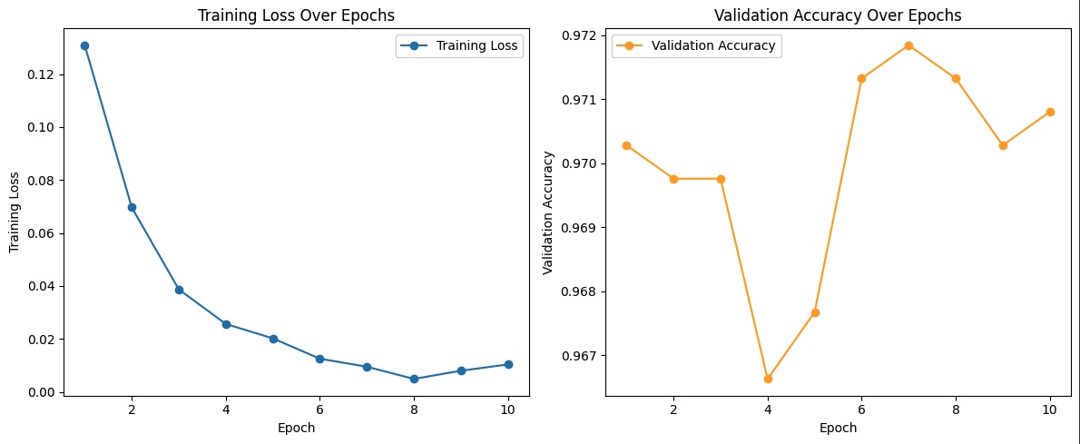
Overview
Dataset & Tools
Implementation
Results
Conclusion
Training
Epoch 1
32
32
32
…
32
Validation
4. Model training
…
Epoch 2
32
32
32
32
Validation
Epoch 3
32
32
32
…
32
Validation
12 transformer layer
12 attention heads/layer
768 hidden units/layer
110 million params
Initial settings
- Batch size: 32
- Number of epochs: 10
- Learning rate: 2e-5
Training
Validation
Epoch 1
32
32
32
…
32
32
32
32
…
32
Epoch 2
32
32
32
…
32
32
32
32
…
32
Epoch 3
32
32
32
…
32
32
32
32
…
32
No significant changes after 3 epochs
Sentiment Analysis of Bank Customer Reviews using Bidirectional Encoder Representations from Transformer

Slide 11
Batch size | Learning Rate | Training loss |  |  | Validation accuracy |  |  | Training time (seconds) | Avg. memory usage/epoch (MB)
 |  | Epoch 1 | Epoch 2 | Epoch 3 | Epoch 1 | Epoch 2 | Epoch 3
16 | 2e-5 | 0.120 | 0.063 | 0.038 | 0.969 | 0.962 | 0.969 | 424.46 | 4341.47
64 | 2e-5 | 0.138 | 0.072 | 0.045 | 0.963 | 0.970 | 0.968 | 369.48 | 11770.82
128 | 2e-5 | Error (Too much memory usage)
32 | 2e-5 | 0.131 | 0.066 | 0.035 | 0.969 | 0.970 | 0.969 | 389.66 | 12086.17
32 | 5e-5 | 0.136 | 0.071 | 0.043 | 0.970 | 0.968 | 0.969 | 388.85 | 6555.75
32 | 1e-5 | 0.145 | 0.073 | 0.046 | 0.970 | 0.966 | 0.973 | 389 .27 | 7645.11
32 | 0.01 | 0.497 | 0.454 | 0.453 | 0.904 | 0.904 | 0.904 | 388.24
Overview
Dataset & Tools
Implementation
Results
Conclusion
Training
Epoch 1
32
32
32
…
32
Validation
4. Model training
…
Epoch 2
32
32
32
32
Validation
Setting | Training loss |  |  | Validation accuracy |  |  | Training time (seconds)
 | Epoch 1 | Epoch 2 | Epoch 3 | Epoch 1 | Epoch 2 | Epoch 3
Batch size: 16 Learning Rate: 2e-5 | 0.120 | 0.063 | 0.038 | 0.969 | 0.962 | 0.969 | 424.46
Batch size: 64 Learning Rate: 2e-5 | 0.138 | 0.072 | 0.045 | 0.963 | 0.970 | 0.968 | 369.48
Batch size: 128 Learning Rate: 2e-5 | Error (Too much memory usage)
Batch size: 32 Learning Rate: 2e-5 | 0.156 | 0.077 | 0.045 | 0.972 | 0.972 | 0.971 | 388.22
Batch size: 32 Learning Rate: 5e-5 | 0.136 | 0.071 | 0.043 | 0.970 | 0.968 | 0.969 | 388.85
Batch size: 32 Learning Rate: 1e-2 | 0.497 | 0.454 | 0.453 | 0.904 | 0.904 | 0.904 | 388.24
Batch size: 32 Learning Rate: 1e-3 | 0.336 | 0.321 | 0.320 | 0.904 | 0.904 | 0.904 | 388.79
Batch size: 32 Learning Rate: 1e-4 | 0.184 | 0.105 | 0.108 | 0.944 | 0.970 | 0.942 | 389.06
Batch size: 32 Learning Rate: 1e-5 | 0.145 | 0.073 | 0.046 | 0.970 | 0.966 | 0.973 | 389.27
Batch size: 32 Learning Rate: 1e-6 | 0.263 | 0.145 | 0.108 | 0.917 | 0.964 | 0.963 | 389.59
Epoch 3
32
32
32
…
32
Validation
Setting | Training loss |  |  | Validation accuracy |  |  | Training time (seconds)
 | Epoch 1 | Epoch 2 | Epoch 3 | Epoch 1 | Epoch 2 | Epoch 3
Batch size: 16 Learning Rate: 2e-5 | 0.120 | 0.063 | 0.038 | 0.969 | 0.962 | 0.969 | 424.46
Batch size: 64 Learning Rate: 2e-5 | 0.138 | 0.072 | 0.045 | 0.963 | 0.970 | 0.968 | 369.48
Batch size: 128 Learning Rate: 2e-5 | Error (Too much memory usage)
Batch size: 32 Learning Rate: 2e-5 | 0.156 | 0.077 | 0.045 | 0.972 | 0.972 | 0.971 | 388.22
Batch size: 32 Learning Rate: 5e-5 | 0.136 | 0.071 | 0.043 | 0.970 | 0.968 | 0.969 | 388.85
Batch size: 32 Learning Rate: 1e-2 | 0.497 | 0.454 | 0.453 | 0.904 | 0.904 | 0.904 | 388.24
Batch size: 32 Learning Rate: 1e-3 | 0.336 | 0.321 | 0.320 | 0.904 | 0.904 | 0.904 | 388.79
Batch size: 32 Learning Rate: 1e-4 | 0.184 | 0.105 | 0.108 | 0.944 | 0.970 | 0.942 | 389.06
Batch size: 32 Learning Rate: 1e-5 | 0.145 | 0.073 | 0.046 | 0.970 | 0.966 | 0.973 | 389.27
Batch size: 32 Learning Rate: 1e-6 | 0.263 | 0.145 | 0.108 | 0.917 | 0.964 | 0.963 | 389.59
Training
Validation
Epoch 1
32
32
32
…
32
32
32
32
…
32
Epoch 2
32
32
32
…
32
32
32
32
…
32
Epoch 3
32
32
32
…
32
32
32
32
…
32
Sentiment Analysis of Bank Customer Reviews using Bidirectional Encoder Representations from Transformer

Slide 12
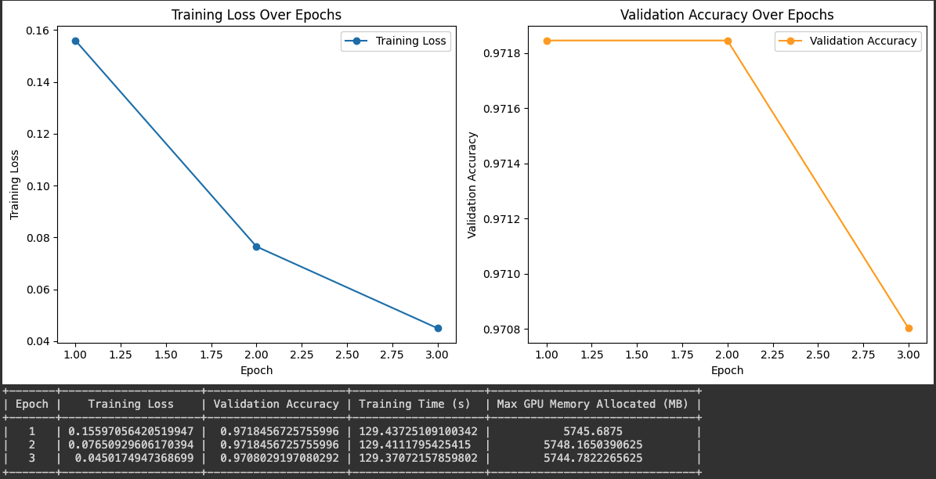
Overview
Dataset & Tools
Implementation
Results
Conclusion
4. Model training
Batch size: 32, Learning rate: 2e-5
0.156
0.972
0.972
0.077
0.045
0.971
Sentiment Analysis of Bank Customer Reviews using Bidirectional Encoder Representations from Transformer

Slide 13
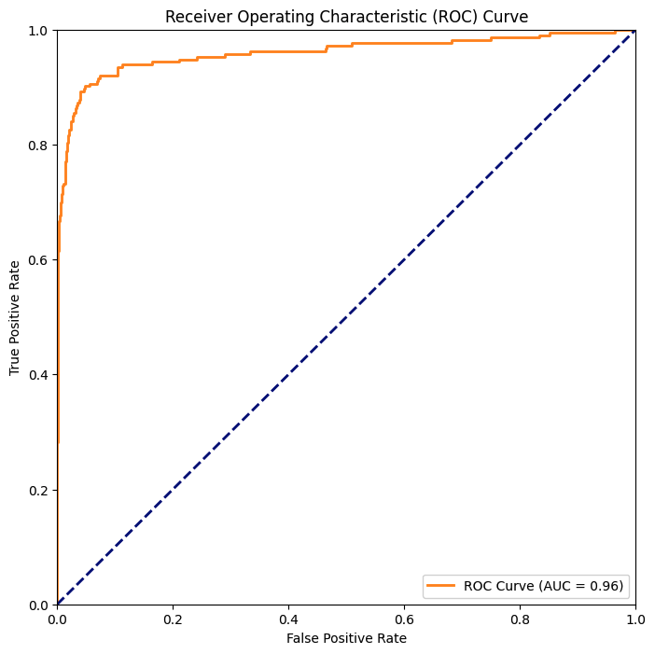
Overview
Dataset & Tools
Implementation
Results
Conclusion
5. Evaluation result
Evaluate the model performance to classify the reviews between positive and negative reviews on Test dataset
ROC Score: 0.9601
The model is excellent at telling the difference between positive and negative reviews
Accuracy: 0.9620
The overall correctness of the model’s predictions is excellent
Sentiment Analysis of Bank Customer Reviews using Bidirectional Encoder Representations from Transformer

Slide 14
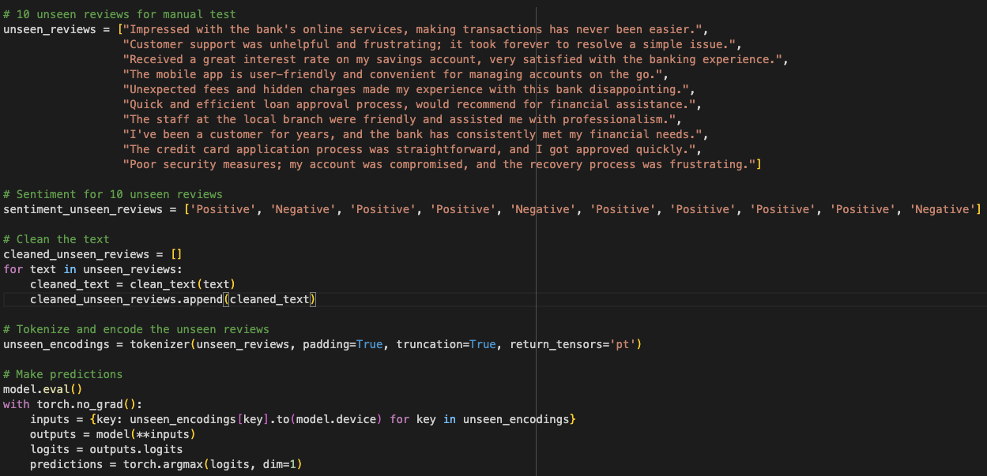
Overview
Dataset & Tools
Implementation
Results
Conclusion
5. Evaluation result
Evaluate the model performance to classify the reviews between positive and negative reviews on Test dataset
Manually check with 10 unseen reviews
Sentiment Analysis of Bank Customer Reviews using Bidirectional Encoder Representations from Transformer

Slide 15
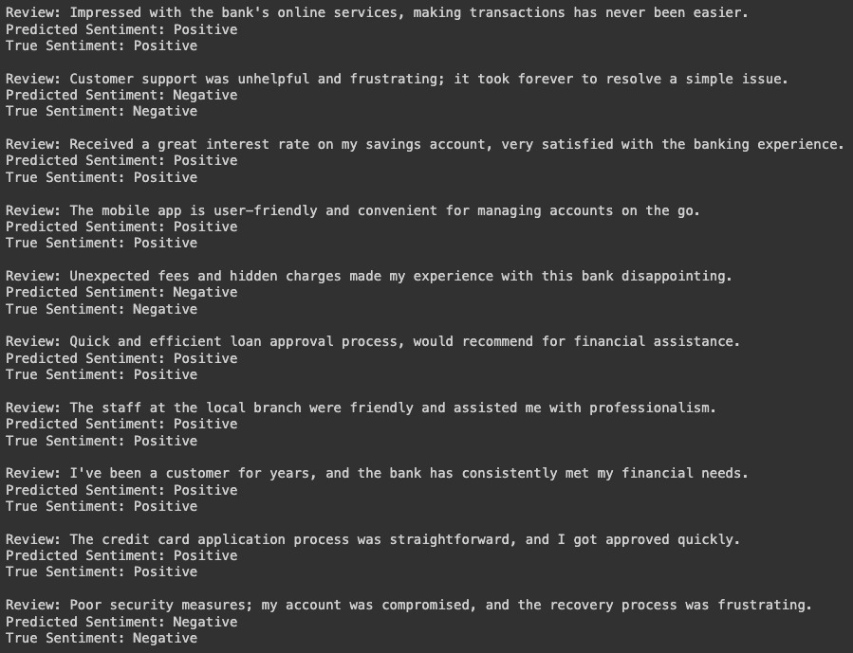
Overview
Dataset & Tools
Implementation
Results
Conclusion
5. Evaluation result
Positive
Negative
Positive
Positive
All correct classification
Negative
Positive
Positive
Positive
Positive
Negative
Sentiment Analysis of Bank Customer Reviews using Bidirectional Encoder Representations from Transformer

Slide 16
Overview
Dataset & Tools
Implementation
Results
Conclusion
Conclusion
In this sentiment analysis of bank customer reviews using BERT, the model achieved a high ROC score of 0.9601, indicating excellent ability to distinguish between positive and negative sentiments. The accuracy of 96.20% reflects the model’s overall correctness in predicting sentiment, showcasing its strong performance in classifying customer reviews.
With the training time at around 388 seconds and 5,745 MB memory usage for each epoch for a dataset with more than 15,000 rows seem reasonable this BERT model.
Sentiment Analysis of Bank Customer Reviews using Bidirectional Encoder Representations from Transformer

Slide 17

Thank you
for your attention
Sentiment Analysis of Bank Customer Reviews using Bidirectional Encoder Representations from Transformer

