Slide 1

Symptom Extraction and Linking from Vaccine Adverse Event Reports
Thanapoom Phatthanaphan
Natural Language Processing, Computer Science Department
Stevens Institute of Technology

Slide 2

Project Member
Thanapoom Phatthanphan
CWID 20011296
Degree Master’s Degree in Computer Science
Symptom Extraction and Linking from Vaccine Adverse Event Reports

Slide 3
Overview
Dataset & Tools
Implementation
Results
Project’s Goal
Develop named entity recognition packages to identify symptom related terms from narrative text reports
Develop named entity linking methods to link the identified terms to standard terms in a dictionary
Steps of implementation
Import data
Preprocessing
Extracting Symptom-related Entities
Linking Entities to Standard Symptoms
Evaluation
Download and inport the VAERS dataset
Select significant vaccine type
Statistical analysis
Find the standard and the most common symptoms
Download Stanza
Extract the symptom-related entities in each symptom text
Link the extracted symptoms to the standard and most common symptoms
Evaluate the performance of the model to extract symptom (Precision, Recall, Recall)
Symptom Extraction and Linking from Vaccine Adverse Event Reports

Slide 4
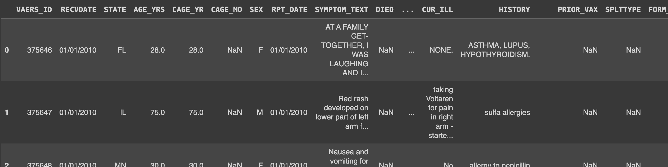
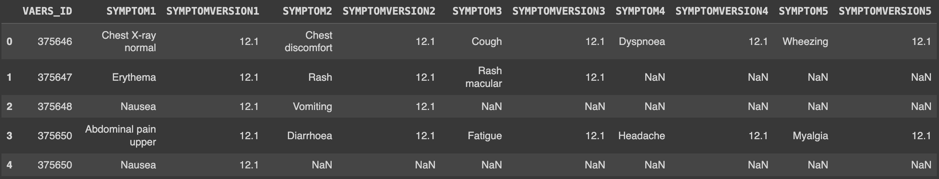
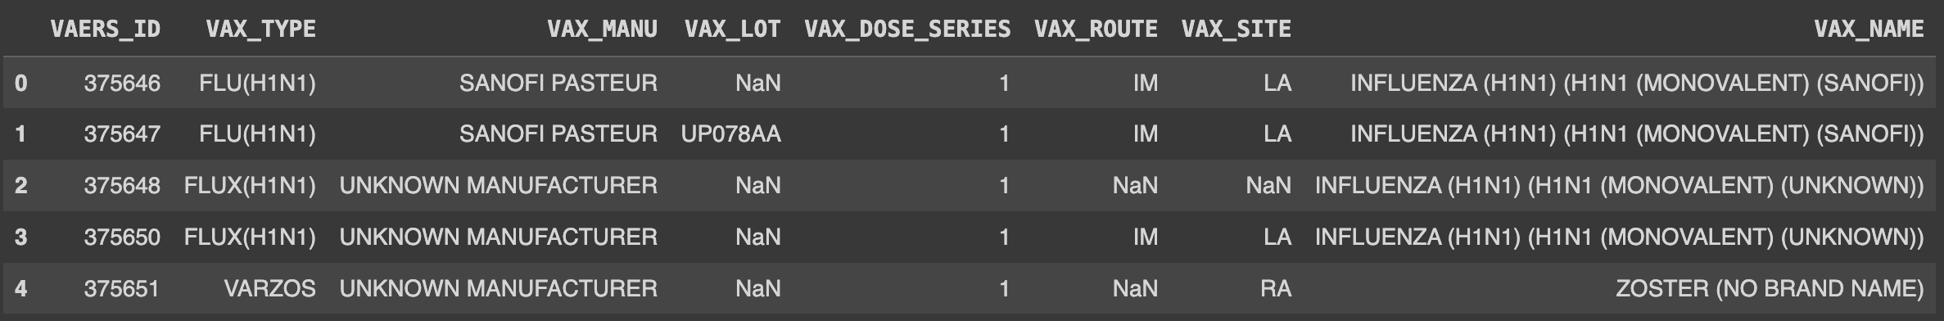
Overview
Dataset & Tools
Implementation
Results
Dataset
The reports of adverse events after a person has received a vaccination from the Vaccine Adverse Event Reporting System (VAERS).
Public dataset: https://vaers.hhs.gov/data/datasets.html
Report
detail
dataset
Symptom
dataset
Vaccine
dataset
Symptom Extraction and Linking from Vaccine Adverse Event Reports

Slide 5







Overview
Dataset & Tools
Implementation
Results
Data handling
Plotting
Extracting method
Linking methods
Symptom Extraction and Linking from Vaccine Adverse Event Reports

Slide 6
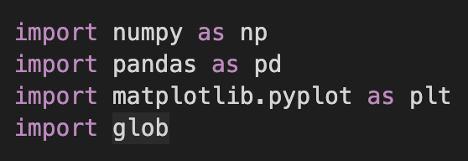
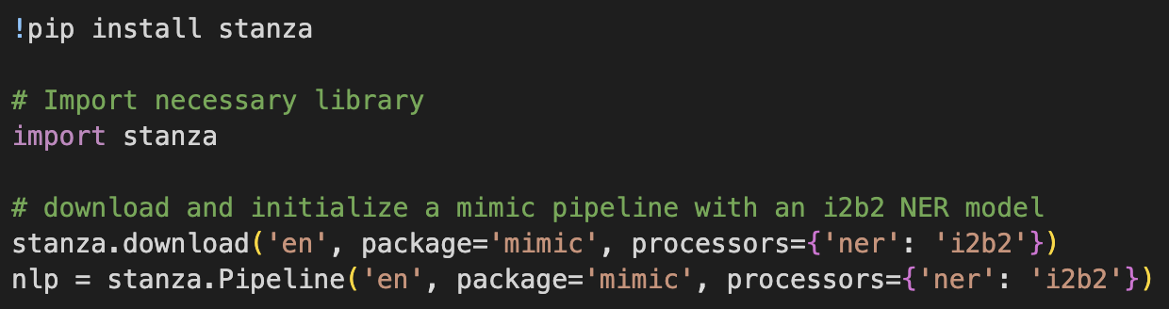

Overview
Dataset & Tools
Implementation
Results
1. Importing the libraries
Data handling and plotting
Extracting method
Linking method
Symptom Extraction and Linking from Vaccine Adverse Event Reports

Slide 7
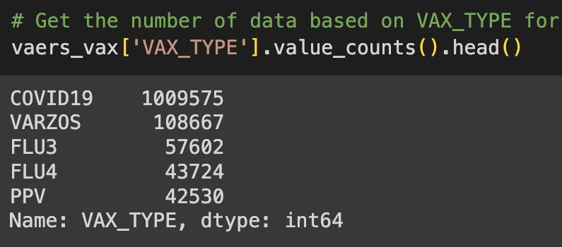
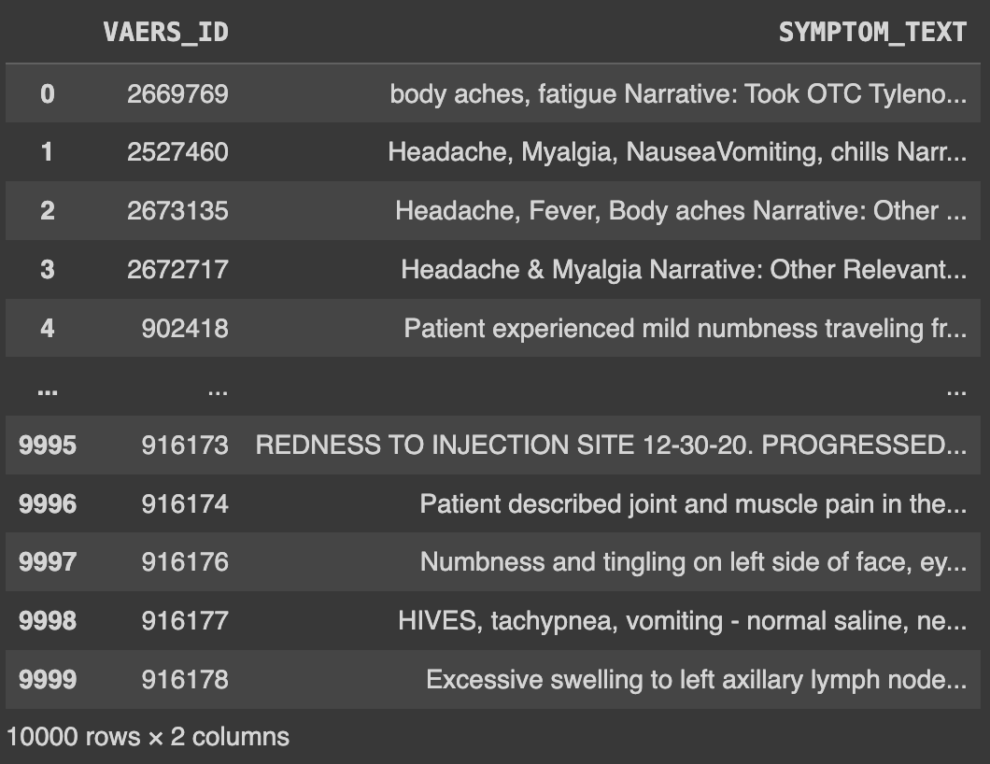
Overview
Dataset & Tools
Implementation
Results
2. Data preprocessing
Find the largest number of data based on Vaccine type
Select 10,000 reports about COVID-19
The largest one is COVID-19
(Select this one for the model)
Symptom Extraction and Linking from Vaccine Adverse Event Reports

Slide 8
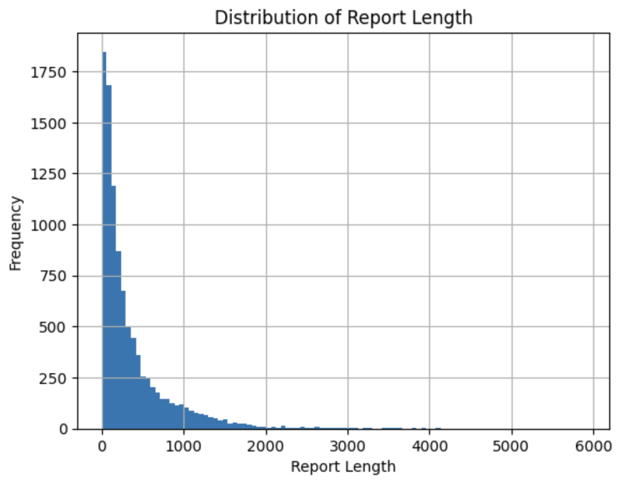
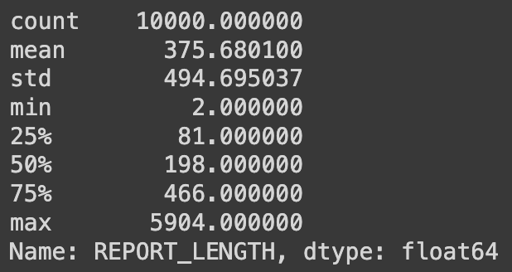
Overview
Dataset & Tools
Implementation
Results
2. Data preprocessing (Data statistics)
Plotting the distribution charts to see the length of the symptom text of these 10,000 selected covid-19 reports
Average: 376 characters
Minimum: 2 characters
Maximum: 5904 characters
Symptom Extraction and Linking from Vaccine Adverse Event Reports

Slide 9
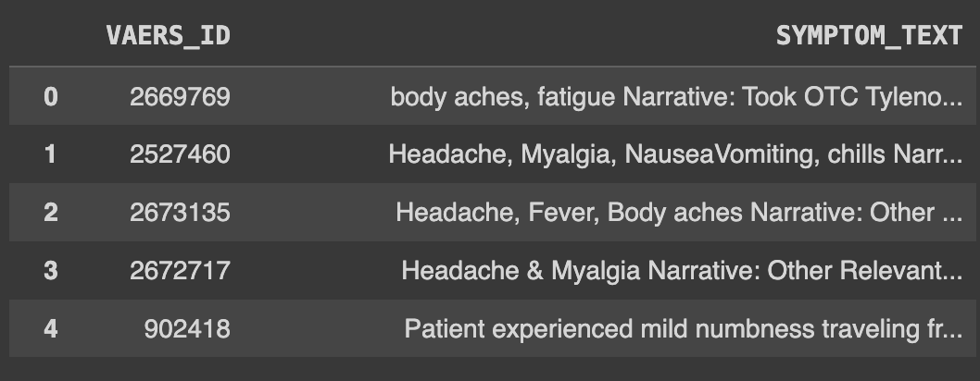
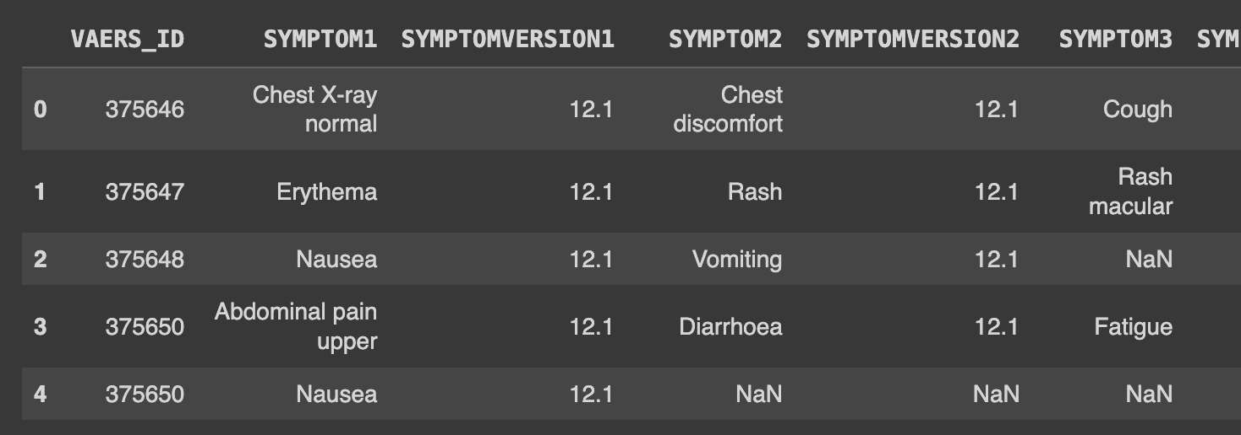
Overview
Dataset & Tools
Implementation
Results
2. Data preprocessing
Get the lists of standard symptom and the top 100 common symptoms
Link between 2 dataset using VAERS_ID
10,000 selected covid-19 reports
Symptom dataset
[ ‘Fatigue’, ‘Pain’, ‘Chills’, ‘Headache’, ‘Myalgia’, … ]
All standard symptoms
Got 2 lists
[ ‘Headache’, ‘Fatigue’, ‘’, ‘Chills’, ‘Dizziness’, … ]
Top 100 common symptoms
Symptom Extraction and Linking from Vaccine Adverse Event Reports

Slide 10
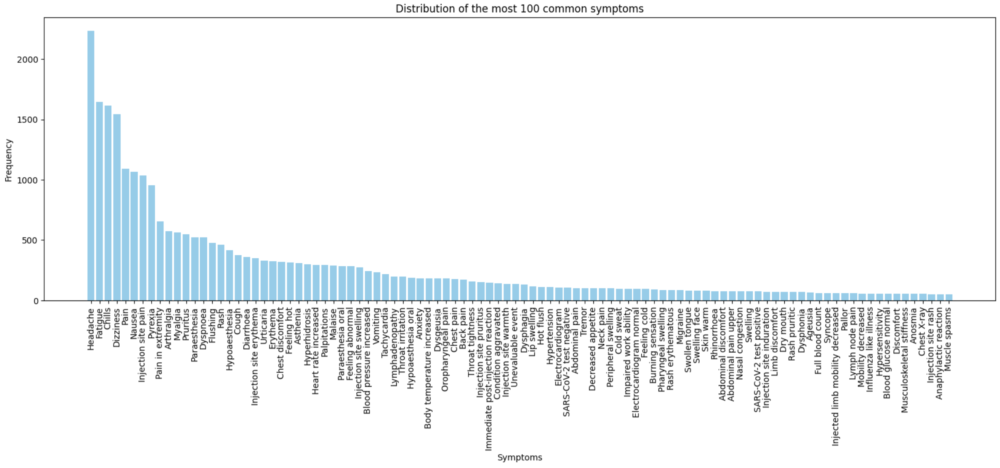
Overview
Dataset & Tools
Implementation
Results
2. Data preprocessing (Data statistics)
Plotting the distribution charts to see the number of each symptom
[ ‘Headache’, ‘Fatigue’, ‘’, ‘Chills’, ‘Dizziness’, … ]
Symptom Extraction and Linking from Vaccine Adverse Event Reports

Slide 11
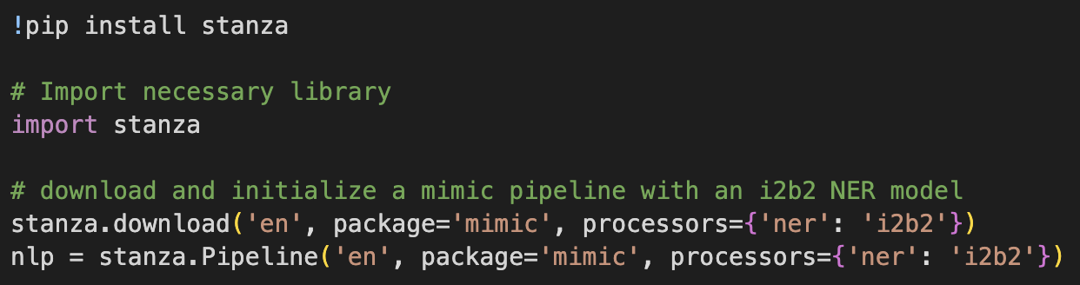
Overview
Dataset & Tools
Implementation
Results
3. Extracting Symptom-related entities
Import stanza and download the English language model with a named entity recognition processor called i2b2 from mimic package.
Initialize a Stanza pipeline
Download the model
Initialize a pipeline
Mimic package provides pre-trained models for clinical text processing
Symptom Extraction and Linking from Vaccine Adverse Event Reports

Slide 12
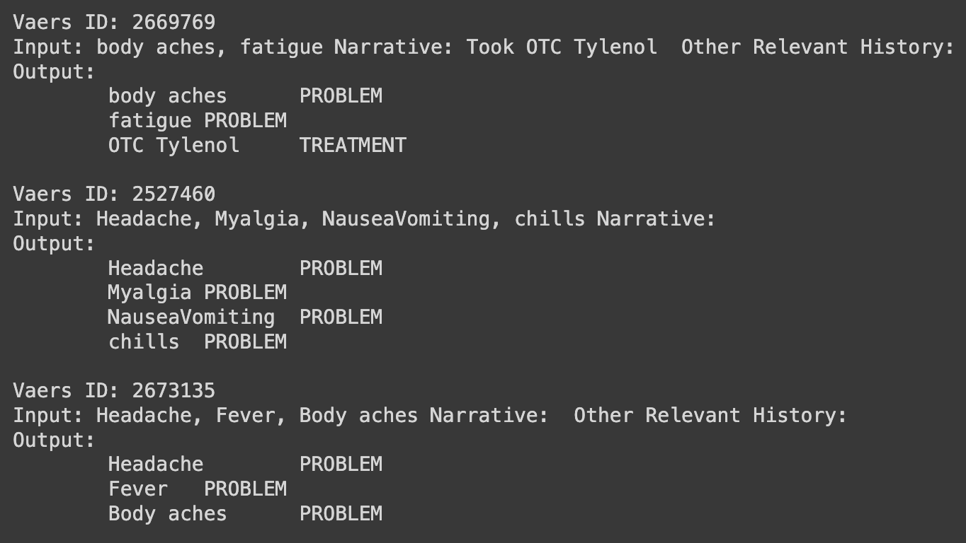
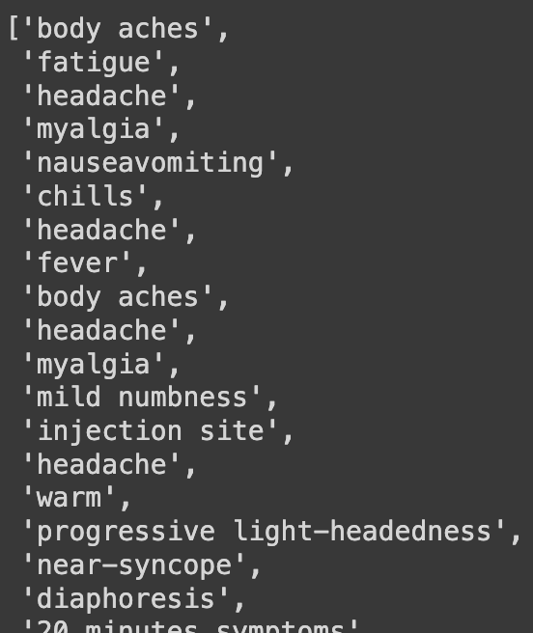
Overview
Dataset & Tools
Implementation
Results
3. Extracting Symptom-related entities
Extract the symptoms from the symptom text of covid-19 reports, then store those symptoms in a list
Store these problems (symptoms) in a list
Symptom Extraction and Linking from Vaccine Adverse Event Reports

Slide 13
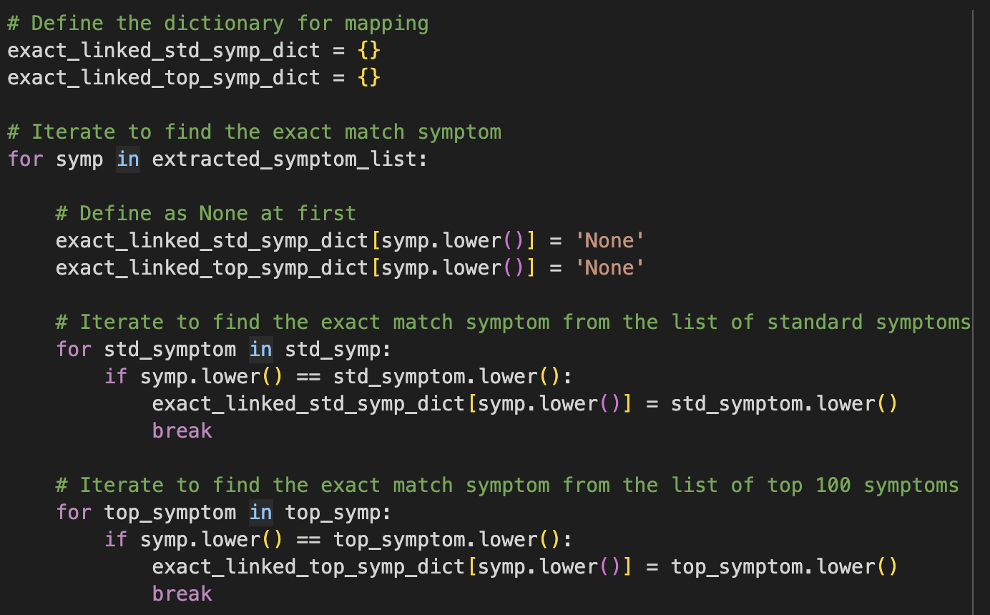
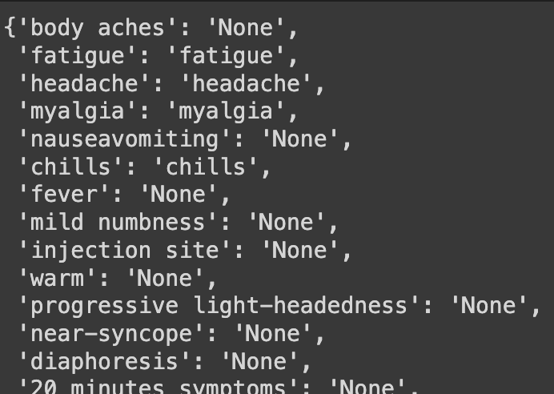
Overview
Dataset & Tools
Implementation
Results
4. Linking Entities to the standard symptoms
Link the extracted symptoms to the standard symptoms and the top 100 common symptoms, using Rule-based (Exact matching and Fuzzy matching), and Similarity-based matching.
(Note: Testing only 50 reports for not too long running time)
Method 1: Exact matching
Link the extracted symptom to the standard symptom that is exactly matching.
Symptom Extraction and Linking from Vaccine Adverse Event Reports

Slide 14
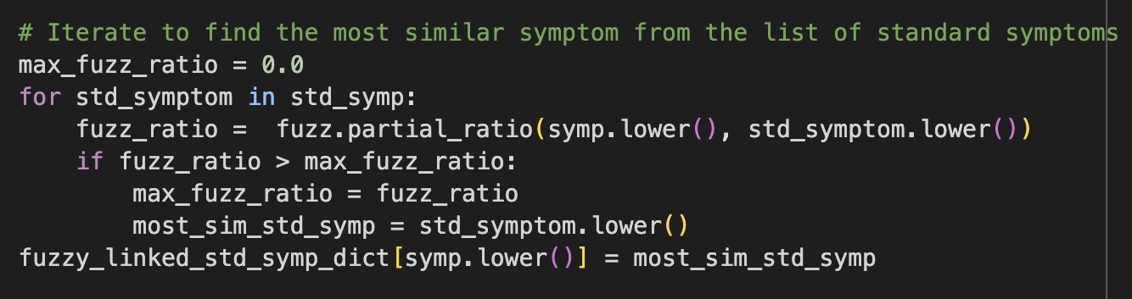
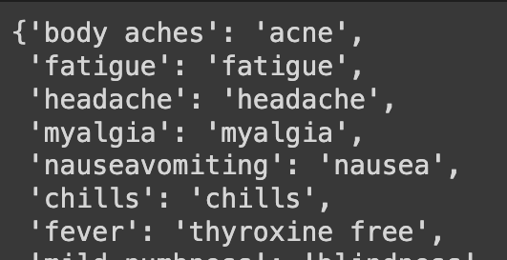
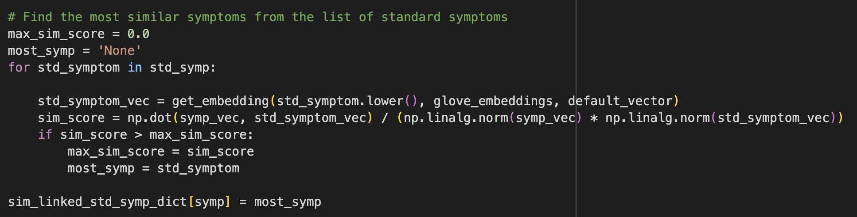
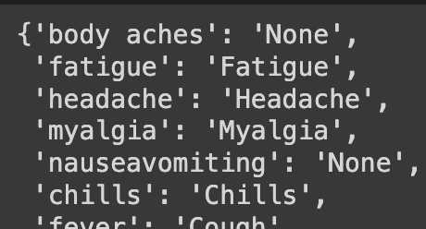
Overview
Dataset & Tools
Implementation
Results
4. Linking Entities to the standard symptoms
Method 2: Fuzzy matching
Link the extracted symptom to the standard symptom with the most similar sequence of characters
Method 3: Similarity-based matching
Get the vector of each symptom using GloVe, then find the most similar standard symptom using Cosine-similarity
Symptom Extraction and Linking from Vaccine Adverse Event Reports

Slide 15
Overview
Dataset & Tools
Implementation
Results
5. Evaluation (Automatic)
Evaluate the model by computing cosine similarity score between the extracted symptoms and the standard symptoms.
Criteria
Similarity score >= 0.8 : True positive
Similarity score < 0.8 : False positive
Not found : False negative
(#Standard symptoms - #Extracted symptoms)
Linking methods | Comparison | Precision | Recall | F1 score
Exact matching | Standard | 0.179 | 0.394 | 0.246
 | Top 100 common | 0.174 | 0.387 | 0.240
Fuzzy matching | Standard | 0.179 | 0.394 | 0.246
 | Top 100 common | 0.174 | 0.387 | 0.240
Cosine-similarity matching | Standard | 0.237 | 0.462 | 0.313
 | Top 100 common | 0.217 | 0.441 | 0.291
Best
results
(Note: Testing only 50 reports for not too long running time)
Symptom Extraction and Linking from Vaccine Adverse Event Reports

Slide 16
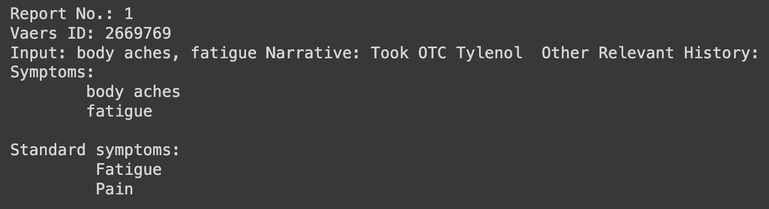
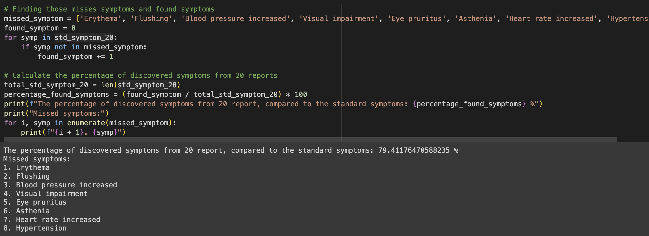
Overview
Dataset & Tools
Implementation
Results
5. Evaluation (Manual)
Manually check each report for 20 reports
#Reports: 20 reports
#Extracted all symptoms: 13 reports
The model can completely extract symptoms for 13 reports (65%)
#Standard symptoms: 68 symptoms
#Extracted symptoms: 60 symptoms
The model can extract the symptoms from 20 reports for 79.41%
Missing symptoms that the model could not extract
(Found from manually checking)
Symptom Extraction and Linking from Vaccine Adverse Event Reports

Slide 17

Thank you
for your attention
Symptom Extraction and Linking from Vaccine Adverse Event Reports

