Slide 1



Telco Customer Churn Predictions
CS 513-A
Knowledge Discovery & Data Mining
Master of Science in Computer Science
Stevens Institute of Technology
Project Group No. 19
Thanapoom
Phatthanaphan
20011296
tphattha@stevens.edu
Shiva Rama Krishna Mandadapu
Hantao Guo

Slide 2
OVERVIEW
Problem Statement
Develop a churn prediction model for a telecommunication company using historical customer data to identify customers who might leave their services.
Source of Dataset: https://www.kaggle.com/datasets/blastchar/telco-customer-churn
The dataset contains 7043 customer service data of a telecommunication company
Presentation Flow
SUMMARY
Data
Understanding
Data
Preparation
Modeling
Evaluation
Summary
Stevens Institute of Technology

Slide 3
DATA
UNDERSTANDING
DATA
PREPARATION
MODELING
EVALUATION
SUMMARY
Input features (19 variables)
No. | Features
1 | Gender | Male / Female
2 | Senior Citizen | 1 (Yes) / 0 (No)
3 | Partner | Yes / No
4 | Dependents | Yes / No
5 | Tenure | #months in service
6 | Phone Service | Yes / No
7 | Multiple Lines Service | Yes / No / No phone service
8 | Internet Service | DSL / Fiber optic / No
9 | Online Security | Yes / No / No internet service
10 | Online Backup | Yes / No / No internet service
No. | Features
11 | Device Protection | Yes / No / No internet service
12 | Tech SUpport | Yes / No / No internet service
13 | Streaming TV | Yes / No / No internet service
14 | Streaming Movies | Yes / No / No internet service
15 | Contract | Month-to-month / One-year / Two-year
16 | Paperless Billing | Yes / No
17 | Payment Method | Electronic check / Mailed check / Bank transfer (automatic) / Credit card (automatic)
18 | Monthly Charges | Amount charges by monthly
19 | Total Charges | Total amount charges
Target variable
Yes – A customer churns a telecommunications company’s service
Churn
No – A customer do not churn a telecommunications company’s service
Stevens Institute of Technology

Slide 4
DATA
UNDERSTANDING
DATA
PREPARATION
MODELING
EVALUATION
SUMMARY
Concerned features review
Analyze concerned features
7043
Customers
Phone service
Monthly charges
Tenure
Partner
Multiple lines service
Internet service
Gender
Senior Citizen
Tech support
Streaming Movies
Dependents
Contract
Device protection
Streaming TV
Paperless billing
Online security
Online backup
Total charges
Payment method

Slide 5
DATA
UNDERSTANDING
DATA
PREPARATION
MODELING
EVALUATION
SUMMARY
Concerned features review
Churn
Not churn
47% who use 0-1 year
Churned
34% who use
paperless bill
Churned
45% who use
Electronic check
Churned
35% who paid
monthly 60-100$
Churned
Stevens Institute of Technology

Slide 6
DATA
UNDERSTANDING
DATA
PREPARATION
MODELING
EVALUATION
SUMMARY
Concerned features review
Churn
Not churn
42% who use
Fiber optic Churned
42% senior citizen
Churned
30% who use
Streaming Movies
Churned
30% who use Streaming TV
Churned
Stevens Institute of Technology

Slide 7
DATA
UNDERSTANDING
DATA
PREPARATION
MODELING
EVALUATION
SUMMARY
Target customers who might churn
Customers who … % Churn
are new customer (received service < 1 year) 47%
use paperless billing 34%
pay by electronic check 45%
have monthly charges around 60-100$ 35%
are senior citizens 42%
use Fiber optic (Internet Service) 42%
subscript Streaming TV 30%
subscribt Streaming Movies 30%
Stevens Institute of Technology

Slide 8
DATA
UNDERSTANDING
DATA
PREPARATION
MODELING
EVALUATION
SUMMARY
Categorize concerned group that might be useful for implementing predictive models
No. | Category | Detail
1 | Tenure group (Every 1 year) | Categorize by tenure range: 0-1 year, 1-2 years, 2-3 years, 3-4 years, 4-5 years, and >5 years
2 | Total services | The number of services that customer receives
3 | Security concerns | Customers who receive Online security & Device Protection services
4 | Entertainment concerns | Customers who receive both Streaming TV and Movies services
5 | Technical support | Senior citizens who select to receive Technical support service
6 | Billing and payment comfortable concerns | Customers who select Paperless billing and Electronic check as their services
7 | Price range group | Categorize by monthly paid range: 0-20$, 20-40$, 40-60$, 60-80$, 80-100$, and 100-120$
After categorized, converted all concerned data into numerical term
to prepare for implementing predictive models
Stevens Institute of Technology

Slide 9
DATA
UNDERSTANDING
DATA
PREPARATION
MODELING
EVALUATION
SUMMARY
Implementing predictive models
Implemented in 9 selected models including
Data understanding
Decision Trees
Naive Bayes Classifier
AdaBoost Classifier
Multilayer Perceptron
Bagging along with Random Forest
K-nearest neighbor with Grid Search CV
Logistic Regression with Grid Search CV
Random Forest with Randomized Search CV
Support Vector Machine with Grid Search CV
Data preparation
Modeling
Evaluation
Stevens Institute of Technology

Slide 10
DATA
UNDERSTANDING
DATA
PREPARATION
MODELING
EVALUATION
SUMMARY
Performance result
We want to focus on the performance to correctly identify most of churn customers (positive cases), then we focus on ”Precision” result
No | Models | Accuracy | AUC-ROC | Precision | Recall | F1-Score
1 | Support Vector Machine with Grid Search CV | 79.56% | 70.00% | 63.89% | 50.00% | 56.10%
2 | Bagging along with Random Forest | 79.56% | 70.27% | 63.60% | 50.82% | 56.50%
3 | Logistic Regression with Grid Search CV | 79.77% | 71.47% | 63.17% | 54.08% | 58.27%
4 | Random Forest with Randomized Search CV | 79.28% | 70.25% | 62.58% | 51.36% | 56.42%
5 | AdaBoost Classifier | 79.28% | 71.04% | 61.88% | 53.80% | 57.56%
6 | K-Nearest Neighbor with Grid Search CV | 79.56% | 72.20% | 61.83% | 56.80% | 59.21%
7 | Multilayer Perceptron | 79.20% | 71.52% | 61.26% | 55.43% | 58.20%
8 | Decision Tree | 72.46% | 64.76% | 47.35% | 48.64% | 47.99%
9 | Naïve Bayes Classifier | 66.86% | 73.09% | 43.25% | 86.14% | 57.58%
Stevens Institute of Technology

Slide 11
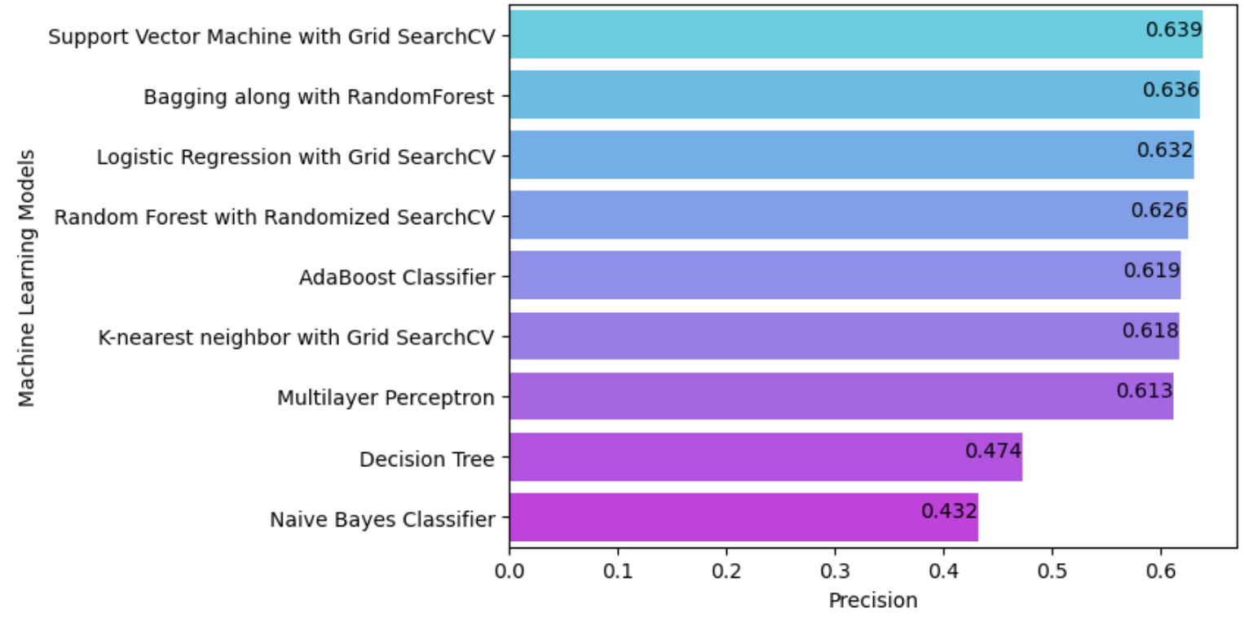
DATA
UNDERSTANDING
DATA
PREPARATION
MODELING
EVALUATION
SUMMARY
Conclusion
We have identified the optimal model based on precision evaluations is Support Vector Machine with Grid Search CV produced the highest precision of 63.89% for this specific problem. The Decision Tree and Naive Bayes Classifier models exhibited the poorest performance are 47.35% and 43.25%
Stevens Institute of Technology

Slide 12
APPENDIX
Stevens Institute of Technology

Slide 13
APPENDIX
Paste the code from this slide towards the end
**Not for presentation**
Stevens Institute of Technology

