Slide 1
Optimasation toolbox

Slide 2
Terms defined
optimtool
optimoptions
optimset

Slide 3
Description
Provides functions for finding parameters that minimizes or maximizes the objectives without compromising constraints.
Key features
  Nonlinear and multiobjective optimization
  Solvers for nonlinear least squares, data fitting, and nonlinear equatiosn
  Quadratic and linear programming
  Mixed-integer linear programming
  Optimization app
  Parallel Computing toolbox support

Slide 4
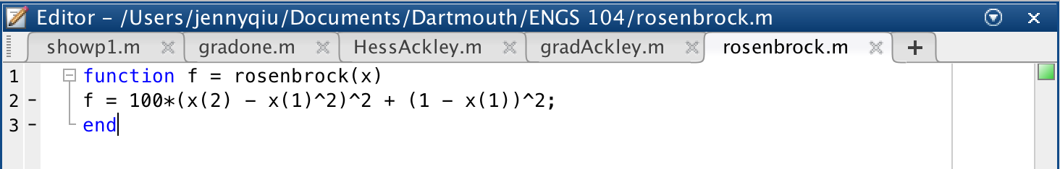
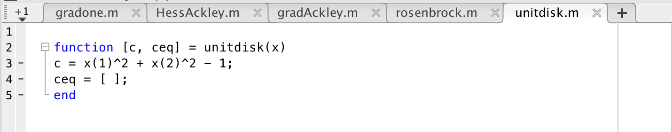
Recipe for disaster
Objective function: f(x) – the function you want to minimize
Constraints: limiting a set of x which you can search for a minimum. Equations or inequalities

Slide 5
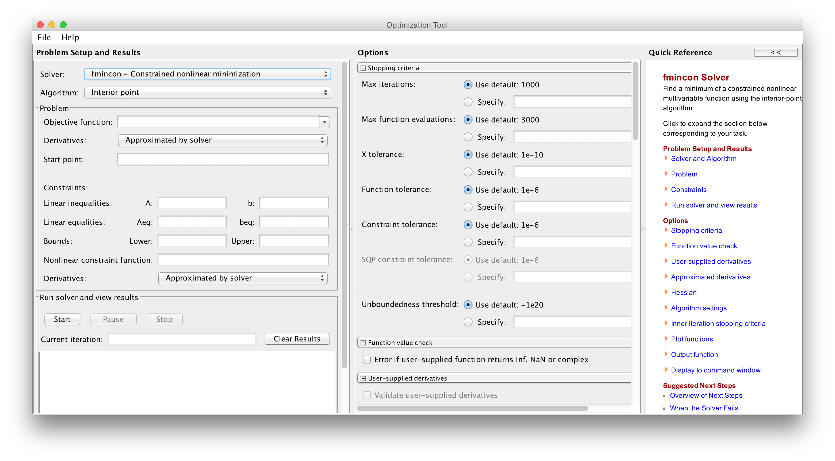
optimtool
Opens up optimization toolbox

Slide 6
features
Solver: chooses a solver that is appropriate for the problem. Can be set via optimoptions
Algorithm chooses a method
Objective function: setting the objective that is called via @ handle.
Start point: initial point where fmincon will begin it’s search

Slide 7
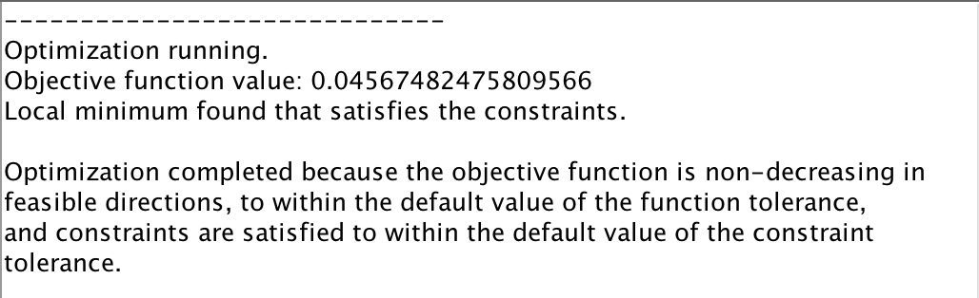
Running from the interface

Slide 8
optimoptions
Sets optimtool options via command line

Slide 9
Optimset
Set options from the command line.

Slide 10
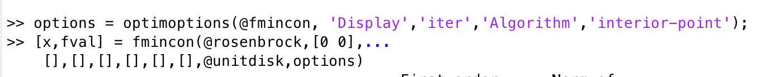
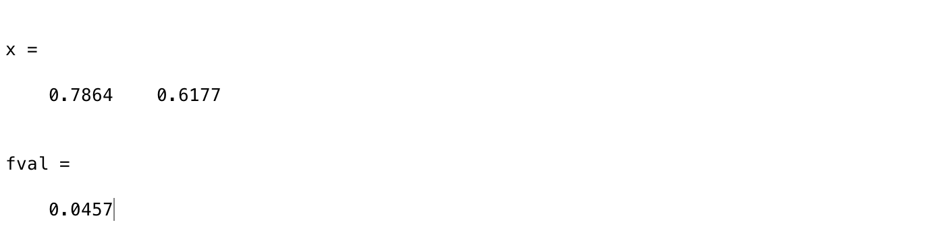
Running from cmd
Notes:
optimset

