Slide 1

SATUUU99 / BRAND IDENTITY
01
Notes:
Brand source: user-provided SATUUU99 identity boards, 0406AABD-1B31-4585-A3C9-0834773E0AB6.PNG and 1EA5F5B3-5B3A-4519-9F4E-639ABB2B8651.PNG. Artwork and mockups extracted from supplied reference images. Existing spa mood images from the project are generated concept imagery, not documentary photographs. Layout, typography and body copy recreated as editable elements. Brand guidance beyond the reference is proposed implementation guidance.

Slide 2
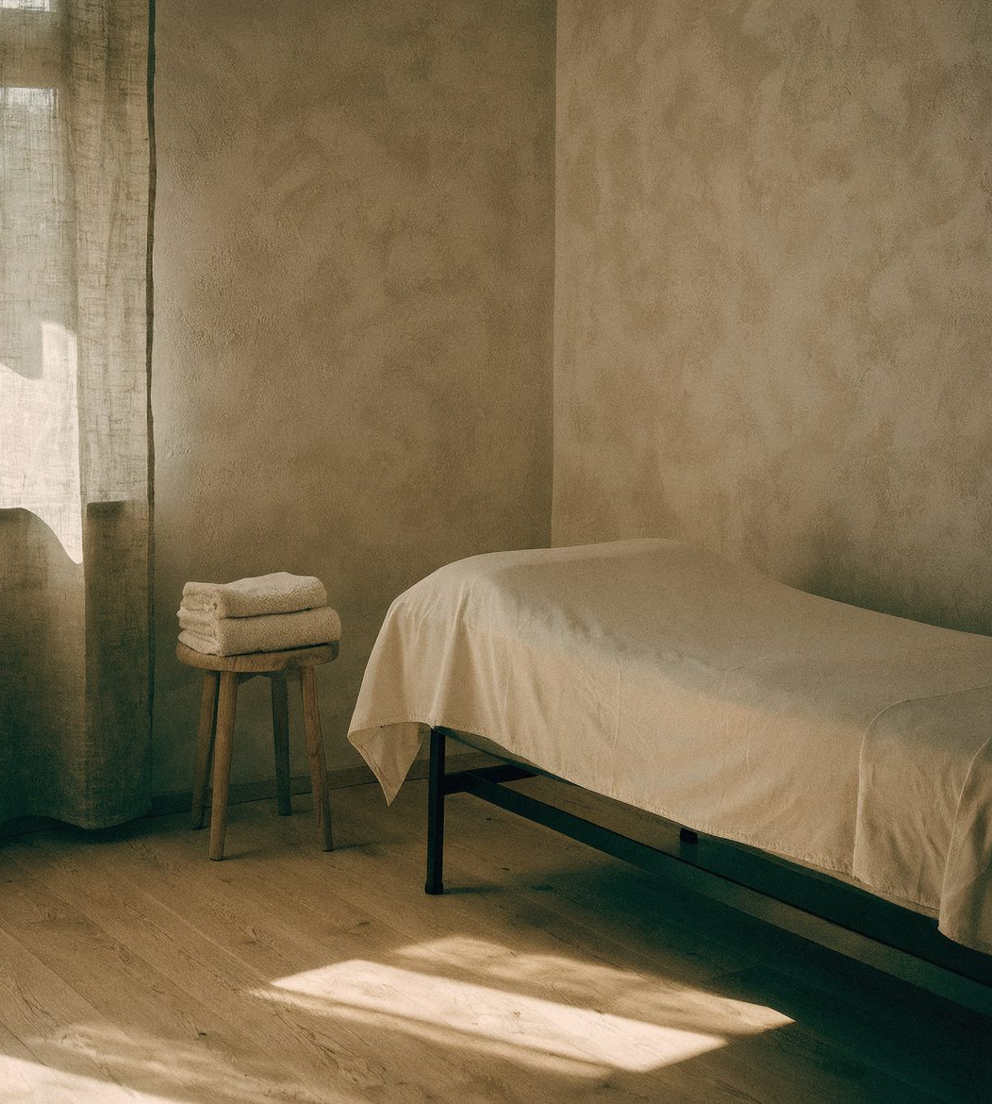
OUR WORLD
More than
a place.
Culture. People. Nature.
A slower tomorrow.
02
Notes:
Brand source: user-provided SATUUU99 identity boards, 0406AABD-1B31-4585-A3C9-0834773E0AB6.PNG and 1EA5F5B3-5B3A-4519-9F4E-639ABB2B8651.PNG. Artwork and mockups extracted from supplied reference images. Existing spa mood images from the project are generated concept imagery, not documentary photographs. Layout, typography and body copy recreated as editable elements. Brand guidance beyond the reference is proposed implementation guidance.

Slide 3
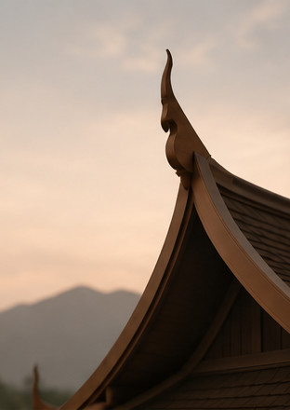
THE IDEA
Rooted in today,
inspired by
tomorrow.
The same values, with a new perspective.
A calmer world begins with the space
we make for one another.
03
Notes:
Brand source: user-provided SATUUU99 identity boards, 0406AABD-1B31-4585-A3C9-0834773E0AB6.PNG and 1EA5F5B3-5B3A-4519-9F4E-639ABB2B8651.PNG. Artwork and mockups extracted from supplied reference images. Existing spa mood images from the project are generated concept imagery, not documentary photographs. Layout, typography and body copy recreated as editable elements. Brand guidance beyond the reference is proposed implementation guidance.

Slide 4
THE LOGO
A familiar form.
An open gesture.
Inspired by traditional Thai architecture,
the symbol expresses balance, openness
and a brighter tomorrow.
04
Notes:
Brand source: user-provided SATUUU99 identity boards, 0406AABD-1B31-4585-A3C9-0834773E0AB6.PNG and 1EA5F5B3-5B3A-4519-9F4E-639ABB2B8651.PNG. Artwork and mockups extracted from supplied reference images. Existing spa mood images from the project are generated concept imagery, not documentary photographs. Layout, typography and body copy recreated as editable elements. Brand guidance beyond the reference is proposed implementation guidance.

Slide 5

LOGO USE
Room to breathe
Keep the symbol and wordmark in their
original proportions. Leave clear space
around the complete signature.
Use earth on ivory for the primary identity.
Use the symbol alone when the brand
name is already present nearby.
Artwork source: supplied brand board
05
Notes:
Brand source: user-provided SATUUU99 identity boards, 0406AABD-1B31-4585-A3C9-0834773E0AB6.PNG and 1EA5F5B3-5B3A-4519-9F4E-639ABB2B8651.PNG. Artwork and mockups extracted from supplied reference images. Existing spa mood images from the project are generated concept imagery, not documentary photographs. Layout, typography and body copy recreated as editable elements. Brand guidance beyond the reference is proposed implementation guidance.

Slide 6

SUPERGRAPHIC
One gesture.
A larger presence.
Let the curves extend beyond the edge.
Use a generous crop and a quiet contrast.
Give the graphic its own space.
06
Notes:
Brand source: user-provided SATUUU99 identity boards, 0406AABD-1B31-4585-A3C9-0834773E0AB6.PNG and 1EA5F5B3-5B3A-4519-9F4E-639ABB2B8651.PNG. Artwork and mockups extracted from supplied reference images. Existing spa mood images from the project are generated concept imagery, not documentary photographs. Layout, typography and body copy recreated as editable elements. Brand guidance beyond the reference is proposed implementation guidance.

Slide 7

PATTERN SYSTEM
A familiar
rhythm
A repeated gesture connects print,
packaging and the spaces we inhabit.
Keep the pattern tonal. Leave areas
of quiet around words and images.
07
Notes:
Brand source: user-provided SATUUU99 identity boards, 0406AABD-1B31-4585-A3C9-0834773E0AB6.PNG and 1EA5F5B3-5B3A-4519-9F4E-639ABB2B8651.PNG. Artwork and mockups extracted from supplied reference images. Existing spa mood images from the project are generated concept imagery, not documentary photographs. Layout, typography and body copy recreated as editable elements. Brand guidance beyond the reference is proposed implementation guidance.

Slide 8
COLOUR PALETTE
Warmth, in five tones
EARTH
STONE
SAND
IVORY
SHADOW
#3A332B
#A69A8C
#D9CEC2
#F6F3ED
#1B1B1B
Primary text
Secondary surfaces
Dividers and texture
Primary canvas
Deep contrast
08
Notes:
Brand source: user-provided SATUUU99 identity boards, 0406AABD-1B31-4585-A3C9-0834773E0AB6.PNG and 1EA5F5B3-5B3A-4519-9F4E-639ABB2B8651.PNG. Artwork and mockups extracted from supplied reference images. Existing spa mood images from the project are generated concept imagery, not documentary photographs. Layout, typography and body copy recreated as editable elements. Brand guidance beyond the reference is proposed implementation guidance.

Slide 9
TYPOGRAPHY
Words with space
Aa
Aa
Playfair Display
Plus Jakarta Sans
Editorial headlines and quiet, expressive statements.
Regular weight. Generous scale. Natural line breaks.
Navigation, body copy and practical information.
Clear hierarchy. Comfortable reading. Calm rhythm.
09
Notes:
Brand source: user-provided SATUUU99 identity boards, 0406AABD-1B31-4585-A3C9-0834773E0AB6.PNG and 1EA5F5B3-5B3A-4519-9F4E-639ABB2B8651.PNG. Artwork and mockups extracted from supplied reference images. Existing spa mood images from the project are generated concept imagery, not documentary photographs. Layout, typography and body copy recreated as editable elements. Brand guidance beyond the reference is proposed implementation guidance.

Slide 10
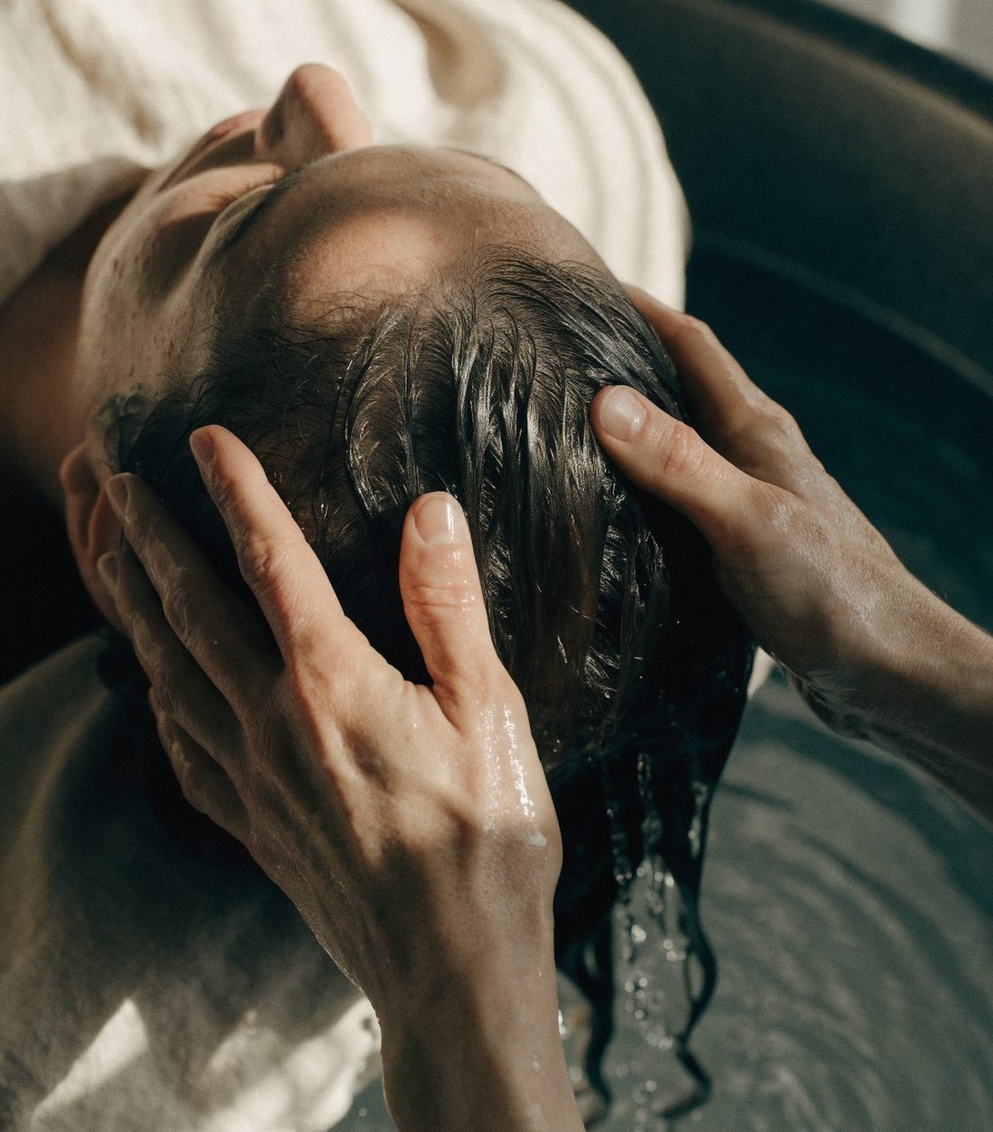
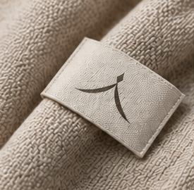

BRAND IMAGERY
Attentive touch
Natural materials
Light and texture
10
Notes:
Brand source: user-provided SATUUU99 identity boards, 0406AABD-1B31-4585-A3C9-0834773E0AB6.PNG and 1EA5F5B3-5B3A-4519-9F4E-639ABB2B8651.PNG. Artwork and mockups extracted from supplied reference images. Existing spa mood images from the project are generated concept imagery, not documentary photographs. Layout, typography and body copy recreated as editable elements. Brand guidance beyond the reference is proposed implementation guidance.

Slide 11
VOICE
A quieter kind
of welcome
GERMAN
Langsamer werden.
Bei dir ankommen.
ENGLISH
Warm and personal. Clear about the details.
Give people room to choose their own pace.
Slower days.
More of you.
11
Notes:
Brand source: user-provided SATUUU99 identity boards, 0406AABD-1B31-4585-A3C9-0834773E0AB6.PNG and 1EA5F5B3-5B3A-4519-9F4E-639ABB2B8651.PNG. Artwork and mockups extracted from supplied reference images. Existing spa mood images from the project are generated concept imagery, not documentary photographs. Layout, typography and body copy recreated as editable elements. Brand guidance beyond the reference is proposed implementation guidance.

Slide 12
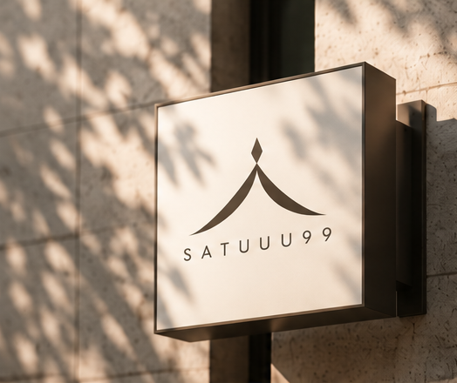
APPLICATIONS
A clear signature at the entrance
A small, considered detail
12
Notes:
Brand source: user-provided SATUUU99 identity boards, 0406AABD-1B31-4585-A3C9-0834773E0AB6.PNG and 1EA5F5B3-5B3A-4519-9F4E-639ABB2B8651.PNG. Artwork and mockups extracted from supplied reference images. Existing spa mood images from the project are generated concept imagery, not documentary photographs. Layout, typography and body copy recreated as editable elements. Brand guidance beyond the reference is proposed implementation guidance.

Slide 13
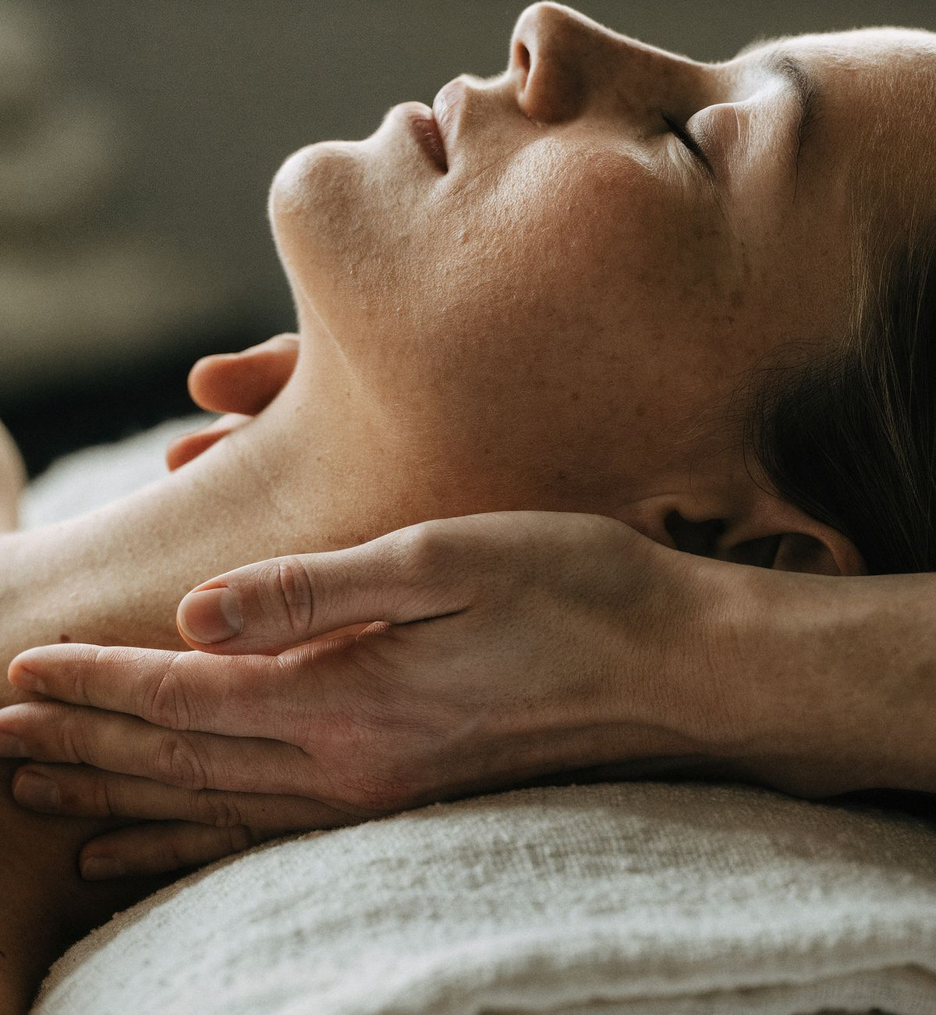
DIGITAL EXPRESSION
The same calm,
on every screen.
An ivory canvas, expressive serif type and
careful movement carry the identity online.
Treatments, the journal and visit information
help each guest find their own way in.
SATUUU99.DE
13
Notes:
Brand source: user-provided SATUUU99 identity boards, 0406AABD-1B31-4585-A3C9-0834773E0AB6.PNG and 1EA5F5B3-5B3A-4519-9F4E-639ABB2B8651.PNG. Artwork and mockups extracted from supplied reference images. Existing spa mood images from the project are generated concept imagery, not documentary photographs. Layout, typography and body copy recreated as editable elements. Brand guidance beyond the reference is proposed implementation guidance.

Slide 14
SATUUU99
Slower days.
Brighter people.
A MORE MEANINGFUL TOMORROW
14
Notes:
Brand source: user-provided SATUUU99 identity boards, 0406AABD-1B31-4585-A3C9-0834773E0AB6.PNG and 1EA5F5B3-5B3A-4519-9F4E-639ABB2B8651.PNG. Artwork and mockups extracted from supplied reference images. Existing spa mood images from the project are generated concept imagery, not documentary photographs. Layout, typography and body copy recreated as editable elements. Brand guidance beyond the reference is proposed implementation guidance.

